Slide 1

Micro Shooters
Inc.
A 2020 Javascript Phaser Multiplayer game

Slide 2
Basic Gameplay
PC based web app (Future mobile responsive)
Players can gain points by killing other enemies
The CarrierShips drop items that players can collect. Possible dropped items:
Weapon: upgrades laser level (max lvl 6)
Shield: player immune to dmg for 4 seconds
Life: player gains an extra life (max 5 lifes)
When they player receives a hit it respawns in the bottom center of the screen in shield mode for 3 seconds
All enemies have a different color/shape and AI functionalities
The player movement is in al 4 directions
The game currently has 8 levels (from which one is a Boss and one is infinite spawn)

Slide 3
Gameflow
User visits the website
He receives a form to add a nickname.
He are redirected to the main menu where receives a greetings message and can click a button turn the sound on/off.
He can click another button to join the battlefield
User kills enemies and collects points or upgrades in order to advance to higher levels.
Current structure:
Level 0: 0-1000 points
Level 1: > 1000 points
Level 2: > 2500 points
Level 3: > 5000 points
Level 4: > 7000 points
Level 5: > 10000 points
Level Boss: > 150000 points
Level Infinite: unlock after killing the Boss

Slide 4
Scenes
Get a form to request a nickname
Boot
Preloader
Main Menu
Game

Slide 5
Extra functions
Your score will automatically be registered when you lose all lives
Left side-bar:
Showing player available lives
Showing current Game level
Showing current Laser level
Right side-bar:
Showing nickname
Showing current user score
Showing the leaderboard with the first 15 highest scores of all time

Slide 6
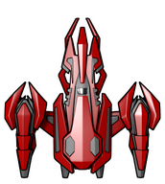
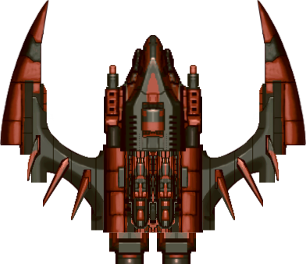


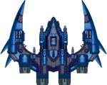

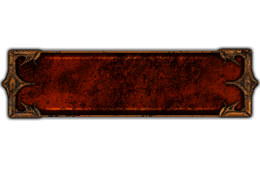
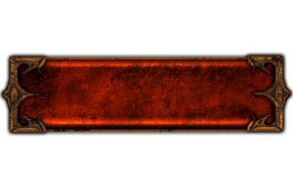
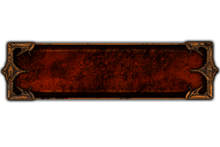
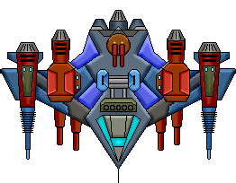

Graphics
Player
Enemies
Lasers (Player/Enemy)
Buttons
Droppings
Explosion
Shield:
Boss:

Slide 7

Sounds
Collect Star
Explosion
Laser
Background music
Item dropped
Button press
Button Hover
Enemy hit
Open the Power Point version of the file (.pptx) if you want to listen the audio files

Slide 8
Future improvements
Make the game playable on mobile devices
Create new worlds with different monsters and weapons
Add grenade functionality

Slide 9
Super improvements
Make the game multiplayer from the same PC and different PC`s (sockets)

Slide 10
Credits
Includes graphics from JS WARS by Jonas Wagner - http://29a.ch/
Thanks kalface@gmail.com blog: http://carlosalface.blogspot.pt/
Some of the sounds in this project were created by David McKee (ViRiX) soundcloud.com/virix
Sound On Off Images: Aaron Burke (itmatters.mobi)

