Slide 1
TEMPORAL EXPONENTIAL-FAMILY RANDOM GRAPH MODELING (TERGMS) WITH STATNET Prof. Steven Goodreau Prof. Martina Morris Prof. Michal Bojanowski Prof. Mark S. Handcock

Slide 2
Source for all things STERGM
Pavel N. Krivitsky and Mark S. Handcock (2014). A Separable Model for Dynamic Networks. Journal of the Royal Statistical Society, Series B, Volume 76, Issue 1, pages 29–46.

Slide 3
Terminology
The phrase “temporal ERGMs,” or TERGMs, refers to all ERGMs that are dynamic
The specific class of TERGMs that have been implemented thus far are called “separable temporal ERGMs,” or STERGMs
In the relevant R package, we left open the possibility that we would develop more in the future
Thus:
 | Cross-sectional | Dynamic
Name of package | ergm | tergm
Name of function in package | ergm | stergm

Slide 4
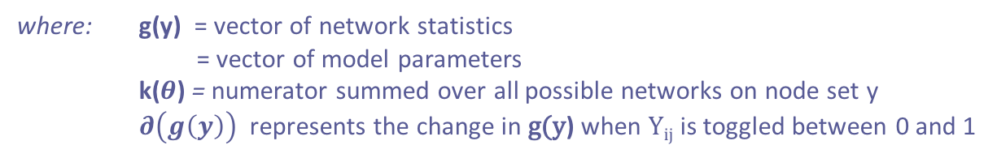
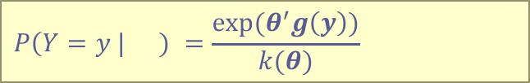
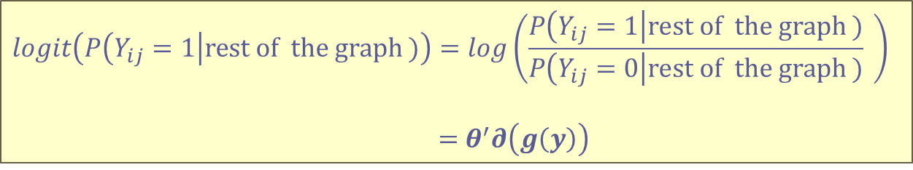
ERGMs: Review
Probability of observing a graph (set of relationships) y on a fixed set of nodes:
$$P\left(Y=y \right|\text{θ} ) =\frac{exp⁡(θ^{′}g\left(y\right))}{k(θ)}$$
Conditional log-odds of a tie
$$logit\left(P\left(Y_{ij}=1\right|\text{rest} \text{of} \text{the} \text{graph} )\right)=log\left(\frac{P\left(Y_{ij}=1\right|\text{rest} \text{of} \text{the} \text{graph} )}{P\left(Y_{ij}=0\right|\text{rest} \text{of} \text{the} \text{graph} )} \right)$$
= $θ^{′}∂\left(g\left(y\right)\right)$
where: g(y) = vector of network statistics
θ = vector of model parameters
k($θ$) = numerator summed over all possible networks on node set y
$∂\left(g\left(y\right)\right)$ represents the change in g(y) when Y_{ij} is toggled between 0 and 1

Slide 5
STERGMs
ERGMs are great for modeling cross-sectional network structure
But they can only predict the presence of a tie; they are unable to separate the processes of tie formation and dissolution
Why separate formation from dissolution?

Slide 6
STERGMs
Intuition: The social forces that facilitate formation of ties are often different from those that facilitate their dissolution.
Interpretation: Because of this, we would want model parameters to be interpreted in terms of ties formed and ties dissolved.
Simulation: We want to be able to control cross-sectional network structure and relational durations separately in our disease simulations, matching both to data

Slide 7
STERGMs
E.g. if a particular type of tie is rare in the cross-section, is that because:
They form infrequently?
They form frequently, but then dissolve frequently as well?
The classic approximation formula from epidemiology helps us see the basic relationship among our concepts:
Prevalence ≈ Incidence x Duration
Formation
Inverse of
dissolution

Slide 8
STERGMs
Core idea:
The y_{ij} values (ties in the network) and Y (the set of all y_{ij} values) are now indexed by time
Represent evolution from Y_{t} to Y_{t+1} as a product of two phases: one in which ties are formed and another in which they are dissolved, with each phase a draw from an ERGM.
Thus, two formulas: a formation formula and a dissolution formula
And, two corresponding sets of statistics

Slide 9
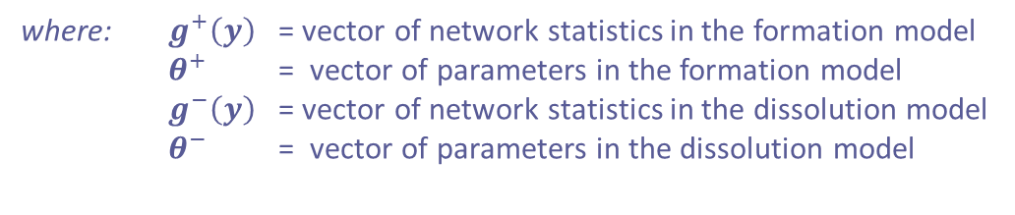
STERGMs
ERGM: Conditional log-odds of a tie existing
$$logit\left(P\left(Y_{ij}=1\right|\text{rest} \text{of} \text{the} \text{graph} )\right)=θ^{′}∂\left(g\left(y\right)\right)$$
STERGM: Conditional log-odds of a tie forming (formation model):
$logit\left(P\left(Y_{ij,t+1}=1 | { Y}_{ij,t}=0\text{, }\text{rest} \text{of} \text{the} \text{graph}\right)\right) \text{= }θ^{+′}∂\left(g^{+}\left(y\right)\right)$
STERGM: Conditional log-odds of a tie persisting (dissolution model):
$logit\left(P\left(Y_{ij,t+1}=1 | { Y}_{ij,t}=1\text{, }\text{rest} \text{of} \text{the} \text{graph}\right)\right)\text{= }θ^{−′}∂\left(g^{−}\left(y\right)\right)$
where: $g^{+}\left(y\right)$ = vector of network statistics in the formation model
$θ^{+}$ = vector of parameters in the formation model
$g^{−}\left(y\right)$ = vector of network statistics in the dissolution model
$θ^{−}$ = vector of parameters in the dissolution model

Slide 10
STERGMs
Dissolution? Or persistence?
$logit\left(P\left(Y_{ij,t+1}=1 | { Y}_{ij,t}=1\text{, }\text{rest} \text{of} \text{the} \text{graph}\right)\right)\text{= }θ^{−′}∂\left(g^{−}\left(y\right)\right)$
The model is expressed as log odds of tie equaling 1 given it equaled 1 at the last time step
This is done to make it consistent with the formation model, so all the math works out nicely
But it implies that the model, and thus the coefficients, should be interpreted in terms of effects on relational persistence
That said, people tend to thing in terms of relational formation and dissolution, since relational dissolution is a more salient event than relational persistence
Thus, we often use the language of dissolution

Slide 11
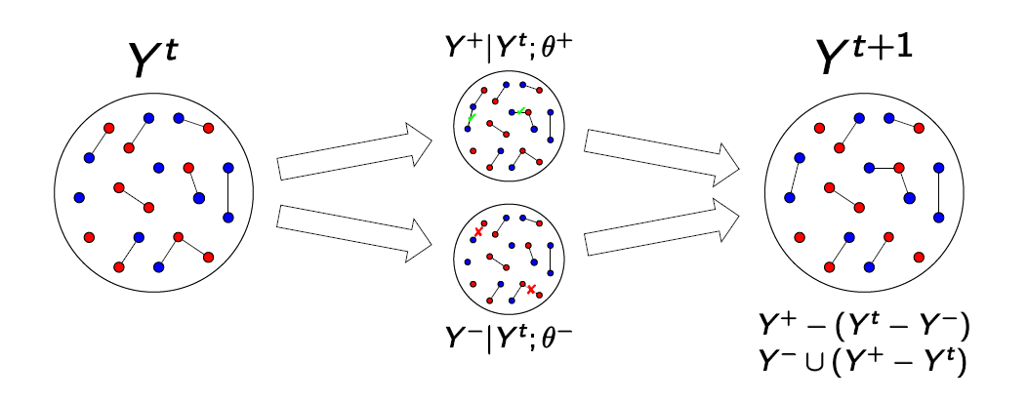
STERGMs
During simulation, two processes occur separately within a time step:
Y⁺ = network in the formation process after evolution
Y⁻ = network in the dissolution process after evolution
This is the origin of the “S” in STERGM

Slide 12
STERGMs
The statistical theory in Krivitsky and Handcock 2014:
demonstrates a given combination of formation and dissolution model will converge to a stable equilibrium, i.e.:
This and other work in press provide the statistical theory for methods for estimating the two models, given certain kinds of data
Prevalence ≈ Incidence x Duration

Slide 13
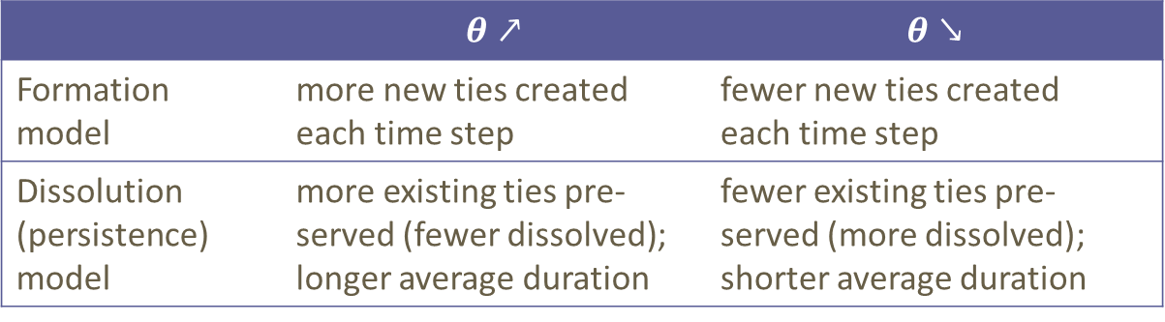
STERGMs: Example of interpretation
Term = ~edges
What combo do you think is most common in empirical networks?
 | $$θ↗$$ | $$θ↘$$
Formation model | more new ties created each time step | fewer new ties created each time step
Dissolution (persistence) model | more existing ties pre- served (fewer dissolved); longer average duration | fewer existing ties pre- served (more dissolved); shorter average duration

Slide 14
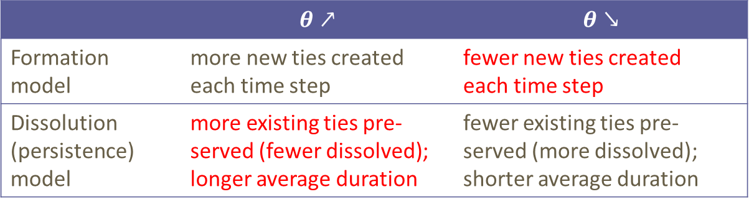
STERGMs: Example of interpretation
Term = ~edges
What combo do you think is most common in empirical networks?
 | $$θ↗$$ | $$θ↘$$
Formation model | more new ties created each time step | fewer new ties created each time step
Dissolution (persistence) model | more existing ties pre- served (fewer dissolved); longer average duration | fewer existing ties pre- served (more dissolved); shorter average duration

Slide 15
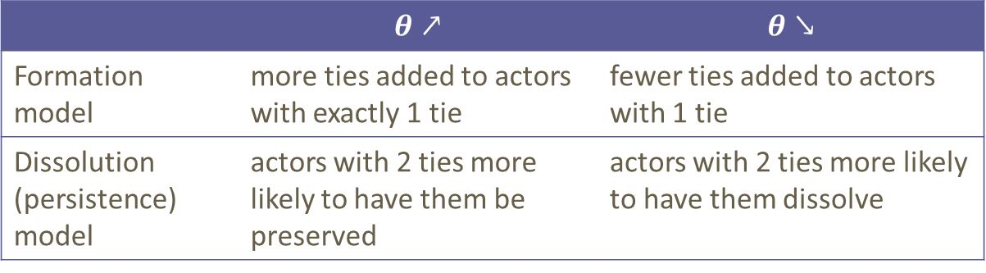
STERGMs: Example of interpretation
Term = ~concurrent (# of nodes with degree 2+)
What combo do you think is most common in empirical sexual networks?
 | $$θ↗$$ | $$θ↘$$
Formation model | more ties added to actors with exactly 1 tie | fewer ties added to actors with 1 tie
Dissolution (persistence) model | actors with 2 ties more likely to have them be preserved | actors with 2 ties more likely to have them dissolve

Slide 16
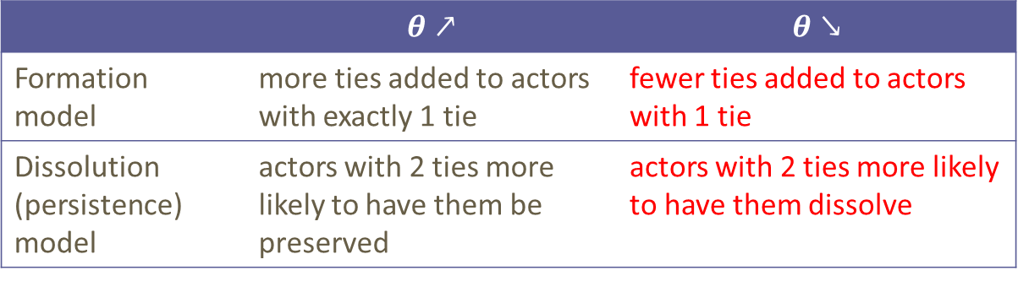
STERGMs: Example of interpretation
Term = ~concurrent (# of nodes with degree 2+)
What combo do you think is most common in empirical sexual networks?
 | $$θ↗$$ | $$θ↘$$
Formation model | more ties added to actors with exactly 1 tie | fewer ties added to actors with 1 tie
Dissolution (persistence) model | actors with 2 ties more likely to have them be preserved | actors with 2 ties more likely to have them dissolve

Slide 17
STERGMs: Data sources
1. Multiple cross-sections of complete network data
easy to work with
but rare-to-non-existent in some fields
2. One snapshot of a cross-sectional network (census, egocentric, or otherwise), plus information on relational durations
more common
but introduces some statistical issues in estimating relation lengths

Slide 18
STERGMs: nodal dynamics
All of the statistical theory presented so far regards networks with
Dynamic relationships, but still
Static actors
I.e. no births and deaths, no changing of nodal attributes
The statistical theory of STERGM can handle nodal dynamics during simulation, with a few added tweaks
Most important is an offset term to deal with changing population size
Without it, density is preserved as population size changes
With it, mean degree is preserved as population size changes

Slide 19
STERGMs: nodal dynamics
For more info, see:
Pavel N. Krivitsky, Mark S. Handcock, and Martina Morris (January 2011). Adjusting for Network Size and Composition Effects in Exponential-Family Random Graph Models. Statistical Methodology, 8(4): 319–339
And for more help with using STERGMs to simulate dynamic networks along with changing nodes and attributes:
Take our intensive summer workshop on network modeling for epidemic diffusion
Explore the online materials for the workshop (on the statnet webpage)
Try the EpiModel package

Slide 20
To the tutorial…..
(reference slides follow)

Slide 21
One cross-section + duration info
In some domains, often takes the form of
asking respondents about individual relationships (either with or without identifiers).
Often this is the n most recent, or all over some time period, or some combination (e.g. up to 3 in the last year)
asking whether the relationship is currently ongoing
if it’s ongoing: asking how long it has been going on (or when it started)
if it’s over: asking how long it lasted (or when it started and when it ended)
From this we want to estimate
the mean duration of relationships
perhaps additional information about the variation in those durations (overall, across categories of respondents, etc.)

Slide 22
One cross-section + duration info
Issues?
1. Ongoing durations are right-censored
can use Kaplan-Meyer or other techniques to deal with

Slide 23
One cross-section + duration info
Issues?
2. Relationships are subject to length bias in their probability of being observed
This can also be adjusted for statistically
However, complex hybrid inclusion rules (e.g. most recent 3, as long as ongoing at some point in the last year) can make this complicated

Slide 24
One cross-section + duration info
In practice (and for examples in this course), we sometimes rely on an elegant approximation:
If relation lengths are approximately exponential/geometric (a big if!), then the effects of length bias and right-censoring cancel out
The mean amount of time that the ongoing relationships have lasted until the day of interview (relationship age) is an unbiased estimator of the mean duration of relationships
Why?!?

Slide 25

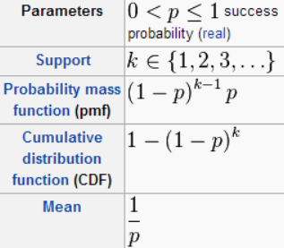
One cross-section + duration info
Exponential/geometric durations suggests a memoryless processes – one in which the future does not depend on the past
Imagine a fair, 6-sided die:
What is the probability I will get a 1 on my next toss?
What is the probability I will get a 1 on my next toss given that my previous 1 was five tosses ago?
On average, how many tosses will I need before I get my first 1?
On average, how many more tosses will I need before I get my next 1, given that my previous 1 was 8 tosses ago?
1/6
1/6
6
6

Slide 26
One cross-section + duration info
Now, let’s imagine this fairly bizarre scenario:
You arrive in a room where there are 100 people who have each been flipping one die; they pause when you arrive.
You don’t know how many sides those dice have, but you know they all have the same number.
You are not allowed to ask any information about what they’ve flipped in the past.
The only information people will give you is: how many flips after your arrival does it take until they get their first 1?
You are allowed to stay until all of the 100 people get their first 1, and they can inform you of the result.
Given the information provided you, how will you estimate the number of sizes on the die?

Slide 27
One cross-section + duration info
Simple: when everyone tells you how many flips it takes from your arrival until their first 1, just take the mean of those numbers. Call it m.
Your best guess for the probability of getting a 1 per flip is 1/m.
And your best guess for the number of sides is the reciprocal of the probability of any one outcome per flip, which is 1/1/m, which just equals m again.
Voila!

Slide 28
One cross-section + duration info
Retrospective relationship surveys are like this, but in reverse:
Dice:
Relationships:

Slide 29
One cross-section + duration info
If you have something approximating a memoryless process for relational duration, then an unbiased estimator for relationship length is to:
ask people about how long their ongoing relationships have lasted up until the present
take the mean of that number across respondents.

Slide 30
One cross-section + duration info
In practice, we find that the geometric distribution doesn’t often capture the distribution of relational durations overall.
But, if you divide the relationships into 2+ types, it can do a reasonable job within type
Especially if you remove any 1-time contacts and model them separately (for populations where they are common)
Remember: DCMs model pretty much everything as a memoryless process, so approximating one aspect of our model that way is well within common practice

