Slide 1
A High Performance Low Power Implementation Scheme for FSM Shuai Li, Ken Choi VLSI Design and Automation Laboratory Department of Electrical and Computer Engineering Illinois Institute of Technology 3301 S Dearborn St., Chicago, IL 60616, USA sli97@hawk.iit.edu, kchoi@ece.iit.edu

Slide 2
1.a high efficient partition algorithm
2.control logic optimization
3.synchronous structure
4. Experimental results

Slide 3
1.a high efficient partition algorithm
A. Probability prediction
For a n-state FSM, the transition probability from state to is
We define each bit of the input signal has the same probability, e.g. , so we can get the FSM states transition probability matrix P.

Slide 4
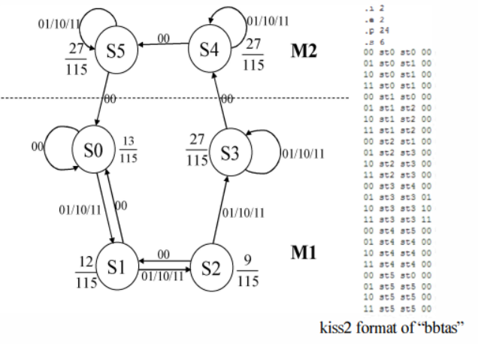
1.a high efficient partition algorithm
A. Probability prediction
transition probability matrix P.
S0 S1 S2 S3 S4 S5
S0
S1
S2
S3
S4
S5
½ ½ 0 0 0 0
½ 0 ½ 0 0 0
0 ½ 0 ½ 0 0
0 0 0 ½ ½ 0
0 0 0 0 ½ ½
½ 0 0 0 0 ½

Slide 5
1.a high efficient partition algorithm
A. Probability prediction
If the Markov chain is irreducible and aperiodic, there is a unique stationary we have:

Slide 6
1.a high efficient partition algorithm
A. Probability prediction
(3)
Theorem 1:The necessary and sufficient condition for irreducible aperiodic Markov chain to be normal return is the existence of stationary distribution, which is the limit distribution
Theorem 2: Irreducible normal recurrent Markov chain with period d.

Slide 7
1.a high efficient partition algorithm
A. Probability prediction
Through (2) to (4), we got the describution of a FSM.
denotes the steady probability of state .
Finally, we got the total transition probability between and as shown in (6):

Slide 8
1.a high efficient partition algorithm
A. Probability prediction

Slide 9
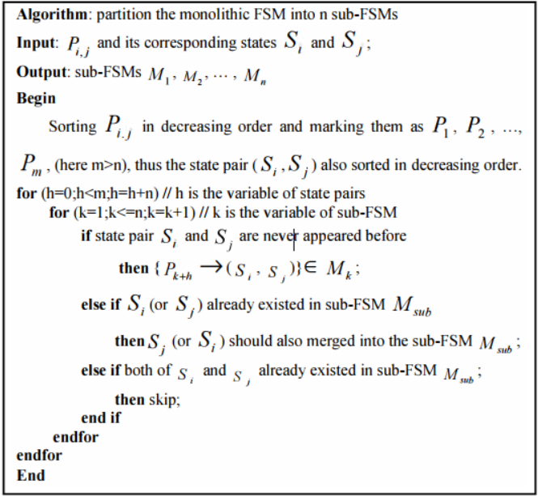
1.a high efficient partition algorithm
B. Partition algorithm
Since we got ,The partition flow is shown in Fig.l.
Figure 1. FSM partition algorithm

Slide 10
2.control logic optimization
We take MCNC [7] benchmark "bbtas" as an example to illustrate our control logic as shown in Fig.2.
Figure 2. State transition graph of “bbtas”

Slide 11
2.control logic optimization
We utilize the algorithm in section II to divide the FSM into two groups:
and .Through transition state table we can get the control logic.
Figure 2. State transition graph of “bbtas”

Slide 12
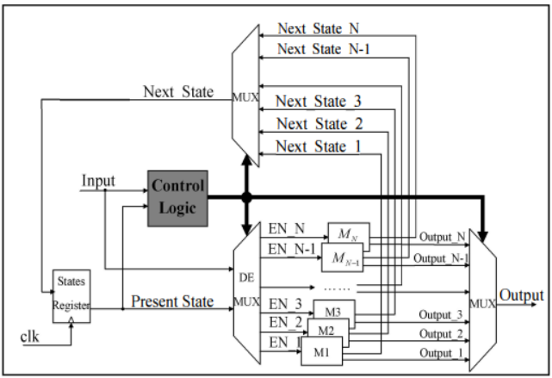
3.synchronous structure
The proposed hardware structure as shown in Fig.3. The implementation model includes: State registers, control logic, sub-FSMs, MUX and DeMUX.
st5
00
00,st4
st4
00,st4
st4
00
Figure 3. Optimized FSM hardware structure
Figure 2. State transition graph of “bbtas”

Slide 13
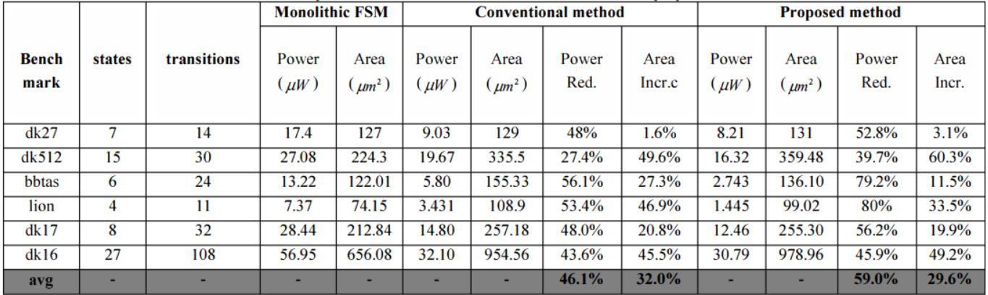
4. Experimental results
As shown in table 1 and FigA, compared with original monolithic FSM and conventional method, the proposed method has three advantages: 1) Power dissipation is around 59% lower than monolithic. 2) The overall area is smaller than the convertional method. 3) The implementation is less complex.
Table 1. Comparison of the results between monolithic FSM and proposed method

Slide 14
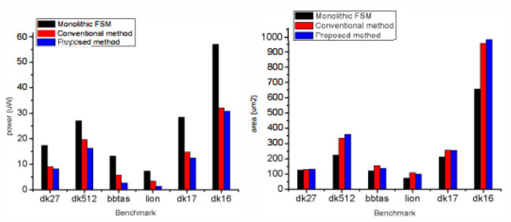
4. Experimental results
Figure 4. Comparison among monolithic FSM, conventional method and proposed method

