Slide 1

Generalization Ideas in Deep Learning
Marcel Bruckner
Technical University of Munich
Computer Vision Group
Department of Informatics
03.12.2019

Slide 2
Generalization Ideas in Deep Learning
Exploring Generalization in Deep Learning
Research based on this paper by:
Behnan Neyshabur, Srinadh Bhojanapalli, David McAllester, Nathan Srebro
Toyota Technological Institute at Chicago

Slide 3
Main ideas
Try to understand what drives generalization in deep learning
Inspection of different approaches
  Norm-based controls
  Sharpness
Empirical study of the approaches

Slide 4
Why do we study generalization behavior
Huge empirical success of deep neural networks
Complex, non-convex optimization problem
Simple stochastic gradient descent (SGD) methods achieve good generalization
Even in this highly over parameterized setting
Many local and global minima

Slide 5
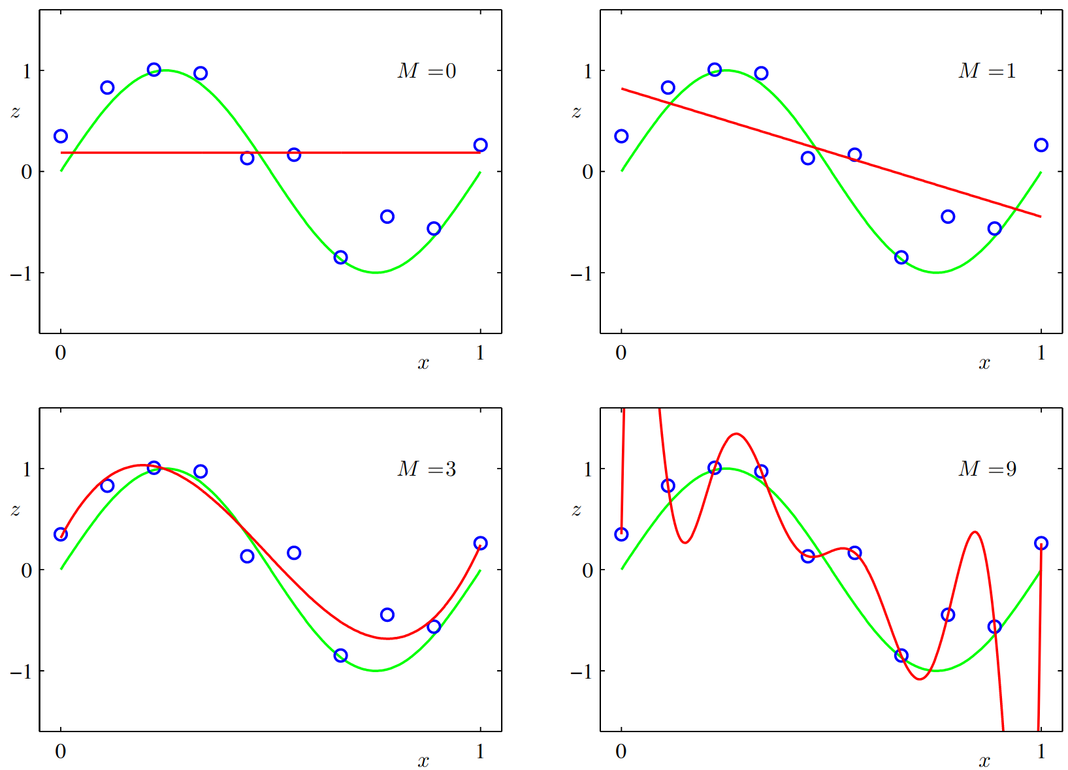
Complexity and capacity
Linear regression:
Fit a polynomial function to data points
Upper row:
  Models are too rigid and cannot explain data
Lower left:
  Model has good capacity and can explain the function described by the data points
Lower right:
  Model has too high capacity and memorizes the data points

Slide 6
Measuring capacity
Desired properties of capacity measures
  Sufficient in ensuring generalization
  Networks learned in practice should be of low complexity under this measure

Slide 7
Norms and margins
Capacity in neural networks can be controlled independent of the number of parameters
Regularization of network weights using different norms
Similarly norm based complexity measures have been established

Slide 8
Norms
L2 norm with capacity proportional to
L1-path norm with capacity proportional to
L2-path norm with capacity proportional to
Spectral norm with capacity proportional to

Slide 9
Margin
Using the cross entropy loss:
When minimizing this loss the network outputs must go to infinity
Norm of weights must also go towards infinity
To be comparable the scaling of the outputs has to be considered
Margin for a single data point is
For a whole training set we use the

Slide 10
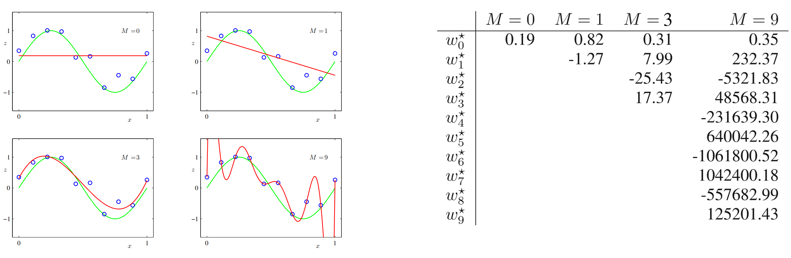
Margin

Slide 11
Norms
L2 norm with capacity proportional to
L1-path norm with capacity proportional to
L2-path norm with capacity proportional to
Spectral norm with capacity proportional to

Slide 12
Empirical investigation
Empirical phenomena that should be explicable
  Zero training error on random labels using same architecture for which real labels generalize well
  Training the same architecture with the same training set using different parameter choices, one method results in better generalization
  Increasing the number of hidden units can lead to decreasing generalization error even when training error does not decrease
Train same model using different approaches and check generalization behavior
  Networks learned using real values should have much lower complexity
  Correlation between complexity measure and generalization ability among zero training error models
  Complexity measure should decrease as number of hidden units increases

Slide 13
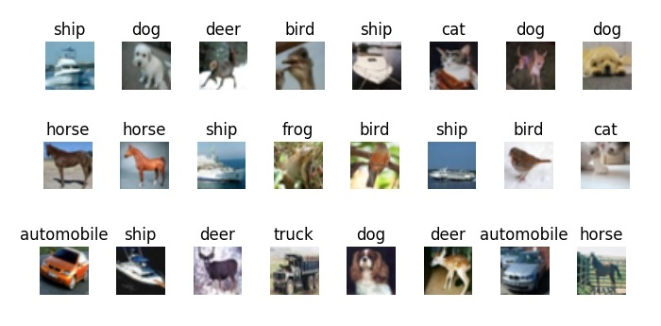
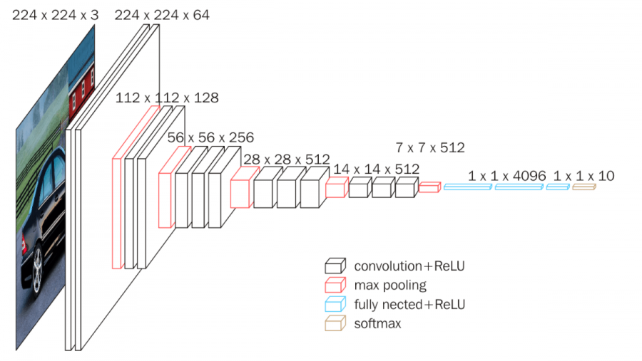
Training approach
General approach used in paper:
  Train VGG on different subsets of CIFAR-10
  Train each model to zero training error
  Calculate norms on resulting model parameters

Slide 14
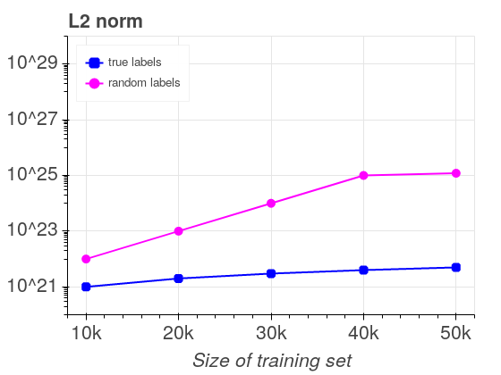
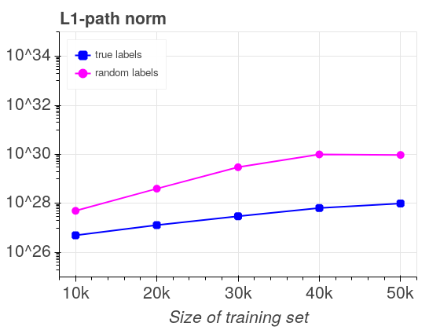
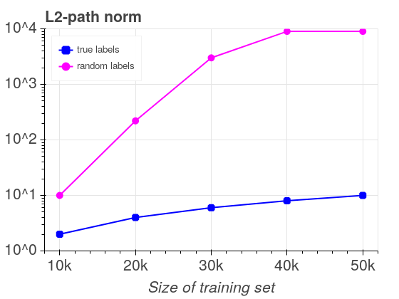
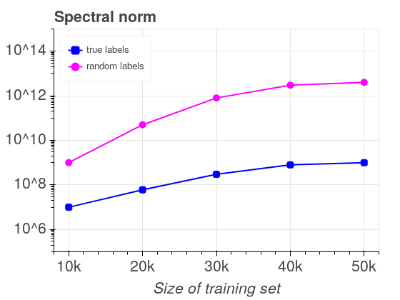
Results of norm-based capacity measures

Slide 15
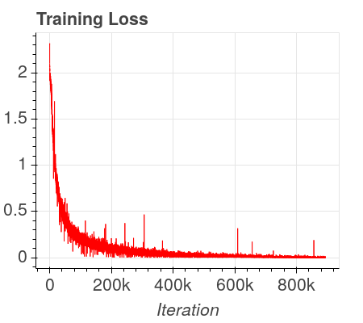
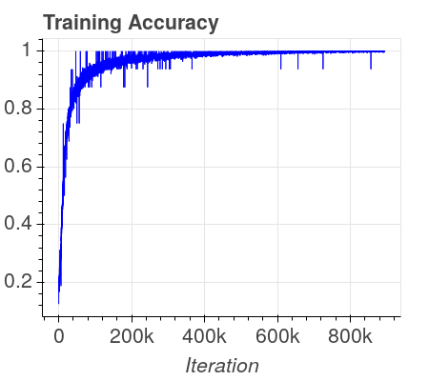
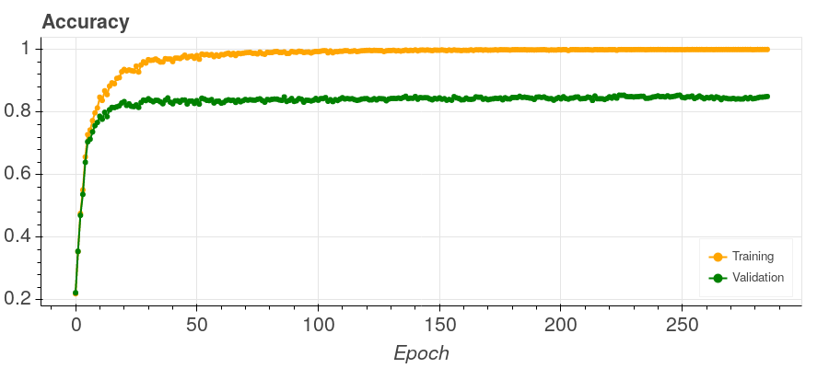
Training of own models
VGG-16
CIFAR-10

Slide 16
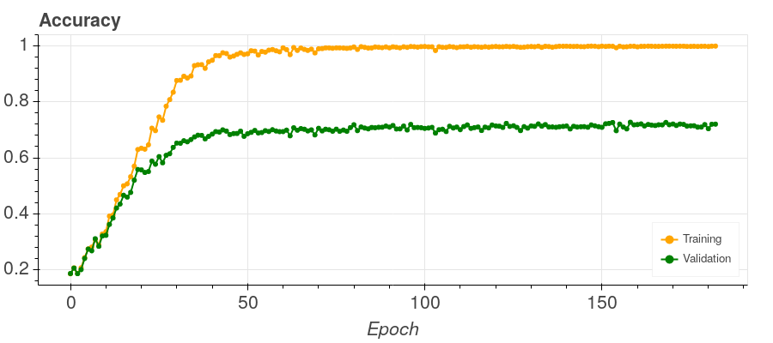
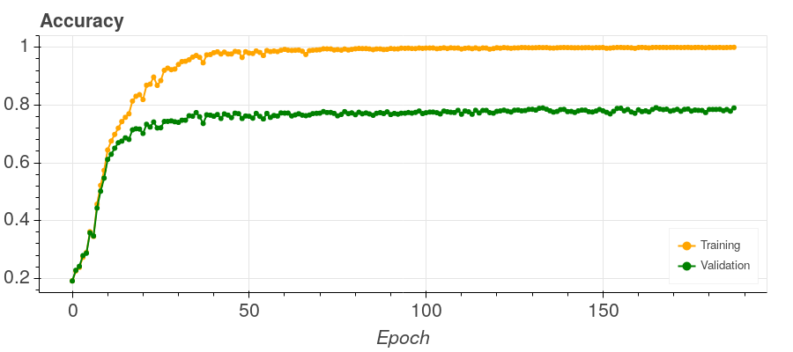
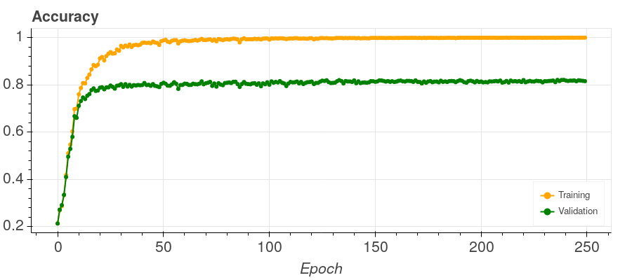
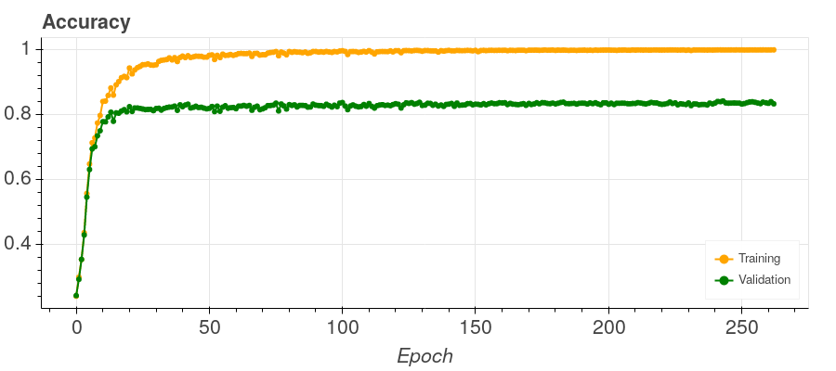
Training of own models
Subset size: 10000
Subset size: 20000
Subset size: 30000
Subset size: 40000
Subset size: 50000
Subset size | Training duration
10000 | 04:57:37
20000 | 08:25:51
30000 | 15:39:29
40000 | 21:28:37
50000 | 1-00:34:02

Slide 17
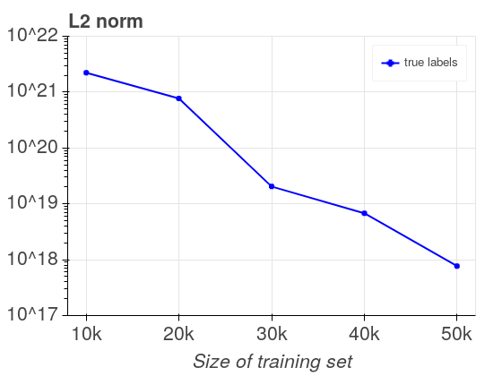
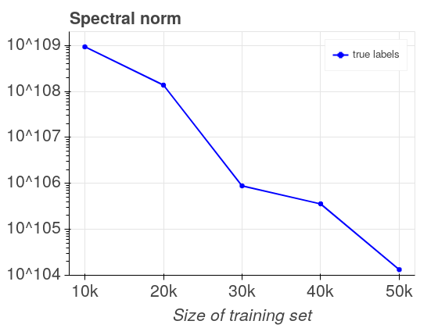
Comparison of results of norm-based capacity measures
Implementation of paper
Own implementation

Slide 18
Problems calculating norm-based capacity measures
Reproduction of training
  No model definition
  No definition of solving strategy
Calculation of norms
  No explanation on how to calculate path norms on convolution layers
  No explanation on how to calculate spectral norm of tensors
Training time
Training on random labels

Slide 19
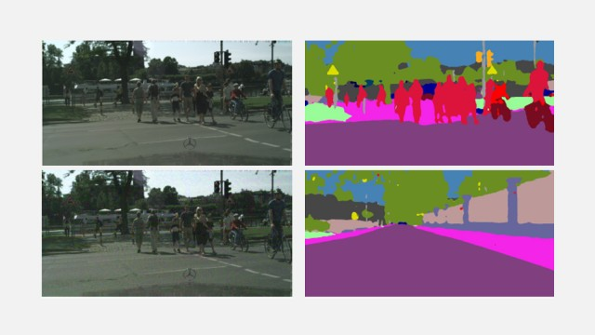
Sharpness
Corresponds to robustness to adversarial perturbations on the parameter space

Slide 20
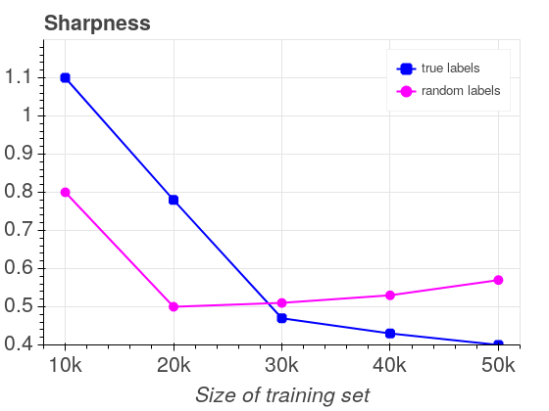
Sharpness
Corresponds to robustness to adversarial perturbations on the parameter space

Slide 21
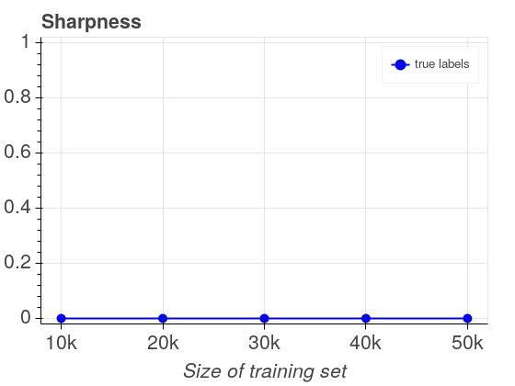
Sharpness
Corresponds to robustness to adversarial perturbations on the parameter space
Paper
Own

Slide 22
Problems calculating sharpness
Constrained optimization problem
  Randomized perturbations
Calculating forward passes over whole training set for every pertubation
  Duration for large subsets
  Parallelization not possible
Subset size | Forward passes in 18 hours
10000 | 2150
20000 | 1100
30000 | 700
40000 | 500
50000 | 400

Slide 23
Empirical Investigation
Empirical phenomena that should be explicable
  Zero training error on random labels using same architecture for which real labels generalize well
  Training the same architecture with the same training set using different parameter choices, one method results in better generalization
  Increasing the number of hidden units can lead to decreasing generalization error even when training error does not decrease
Train same model using different approaches and check generalization behavior
  Networks learned using real values should have much lower complexity
  Correlation between complexity measure and generalization ability among zero training error models
  Complexity measure should decrease as number of hidden units increases

Slide 24
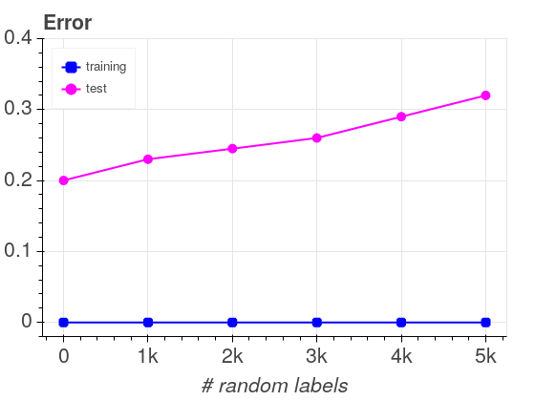
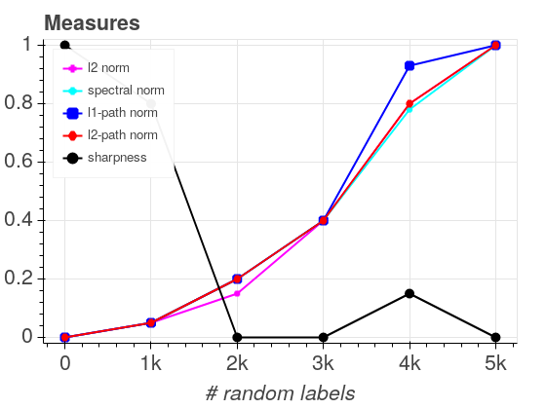
Empirical investigation using confusion sets
Train VGG on CIFAR-10 to different minima
Add confusion sets with varying sizes

Slide 25
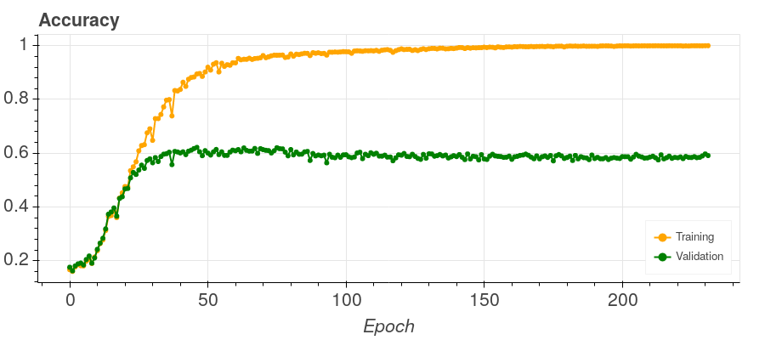
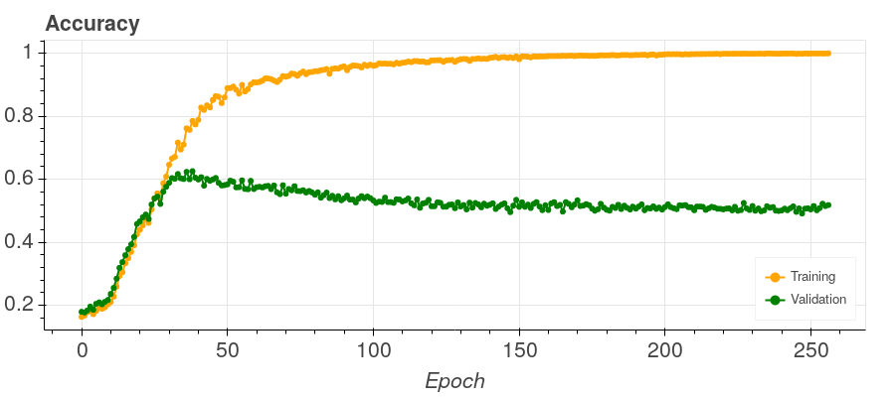
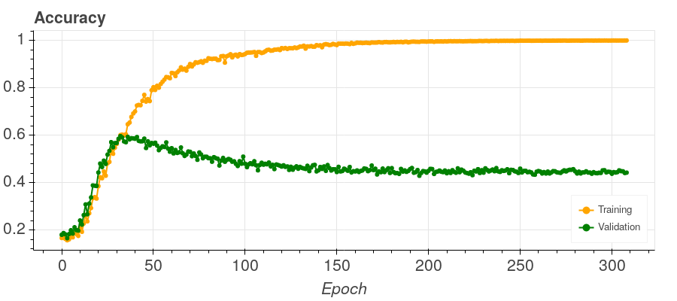
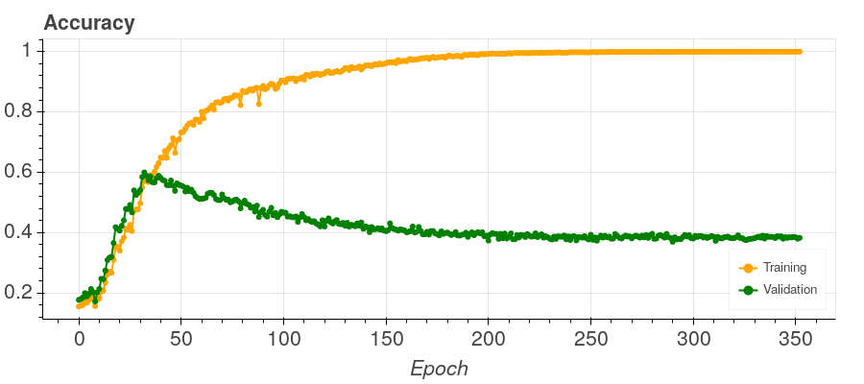
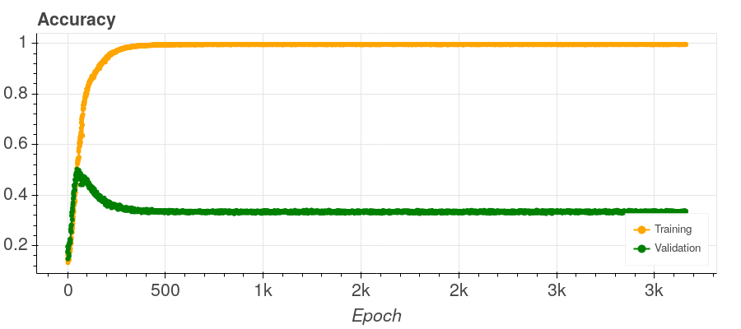
Training of own models using confusion sets
Confusion set size: 0
Confusion set size: 1000
Confusion set size: 2000
Confusion set size: 3000
Confusion set size: 4000
Confusion set size: 5000

Slide 26
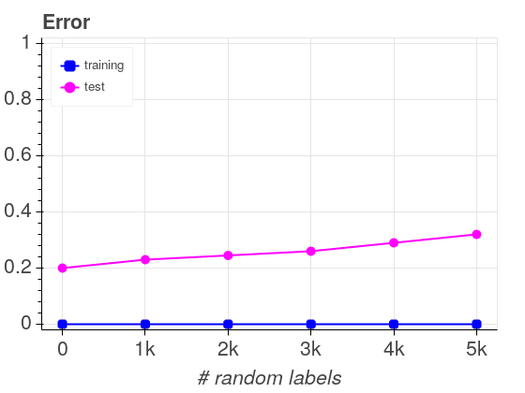
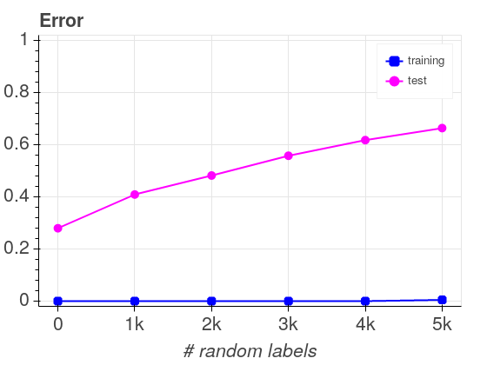
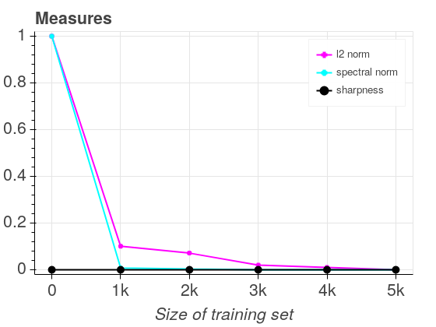
Comparison of results using confusion sets
Implementation of paper
Own implementation

Slide 27
Problems calculating capacity measures using confusion sets
Reproduction of training
  No model definition
  No definition of solving strategy
Calculation of norms
  No explanation on how to calculate path norms on convolution layers
  No explanation on how to calculate spectral norm of tensors
Training to zero training error with 5000 random labeled data points not possible

Slide 28
Empirical investigation
Empirical phenomena that should be explicable
  Zero training error on random labels using same architecture for which real labels generalize well
  Training the same architecture with the same training set using different parameter choices, one method results in better generalization
  Increasing the number of hidden units can lead to decreasing generalization error even when training error does not decrease
Train same model using different approaches and check generalization behavior
  Networks learned using real values should have much lower complexity
  Correlation between complexity measure and generalization ability among zero training error models
  Complexity measure should decrease as number of hidden units increases

Slide 29
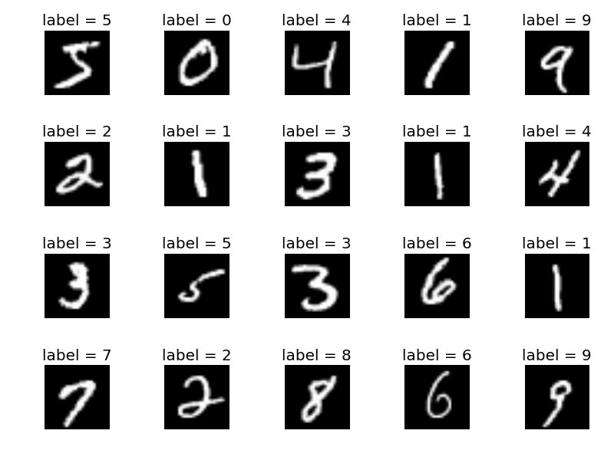
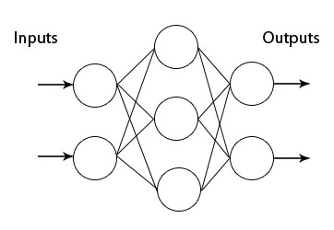
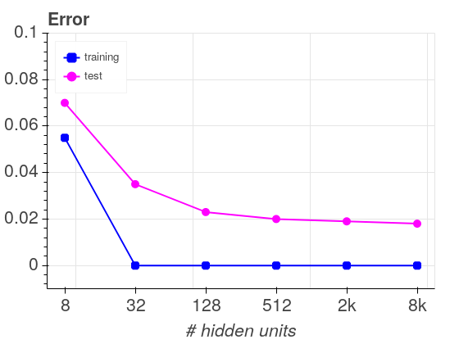
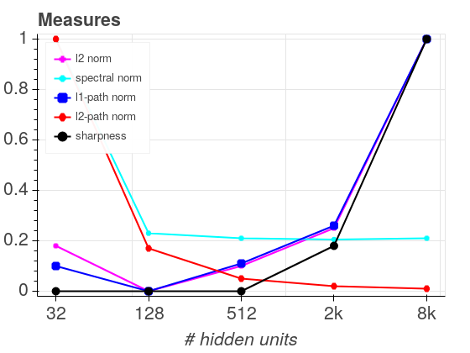
Empirical investigation of different numbers of hidden units
MNIST handwritten digit database
2 layer fully connected network with varying number of hidden units

Slide 30
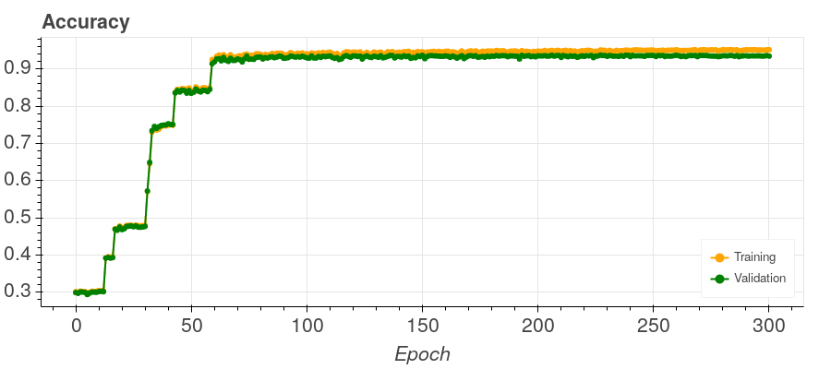
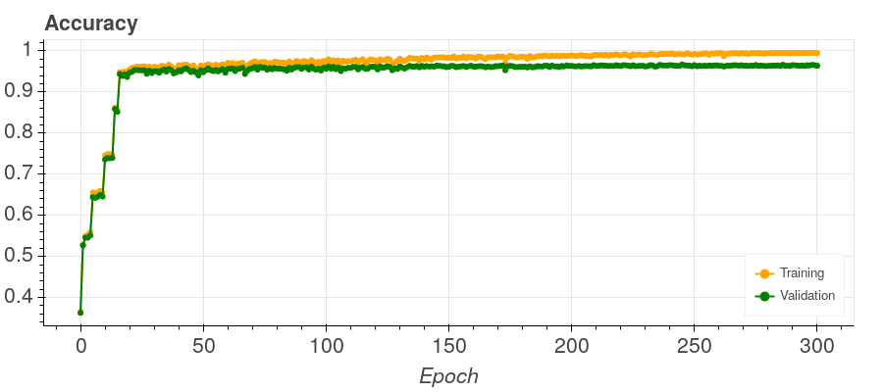
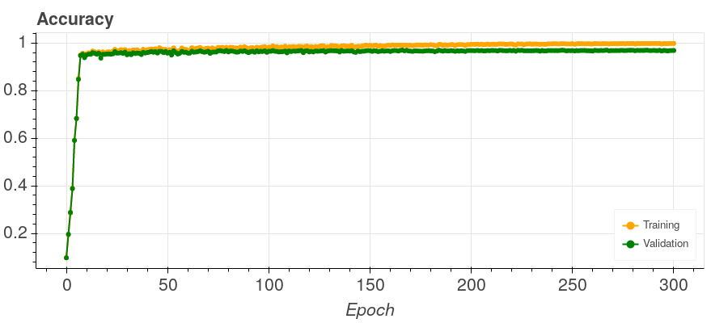
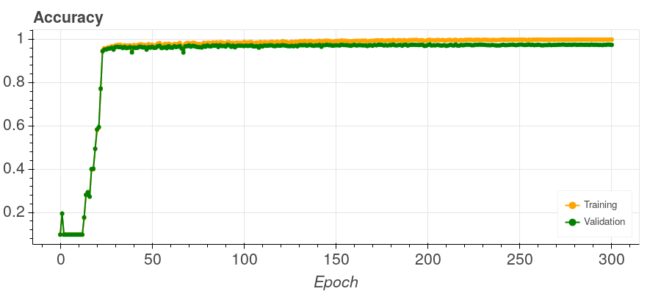
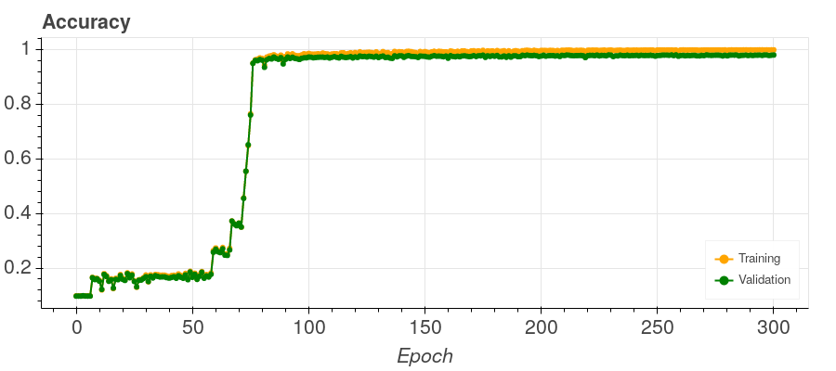
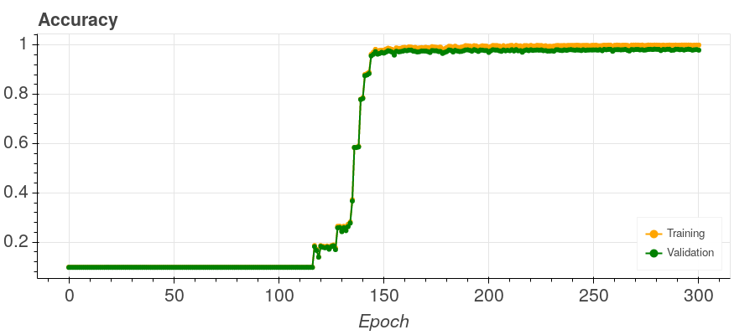
Training of own models using different numbers of hidden units
Hidden units: 8
Hidden units: 32
Hidden units: 128
Hidden units: 512
Hidden units: 2048
Hidden units: 8192

Slide 31
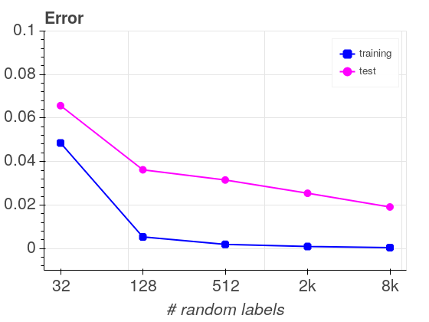
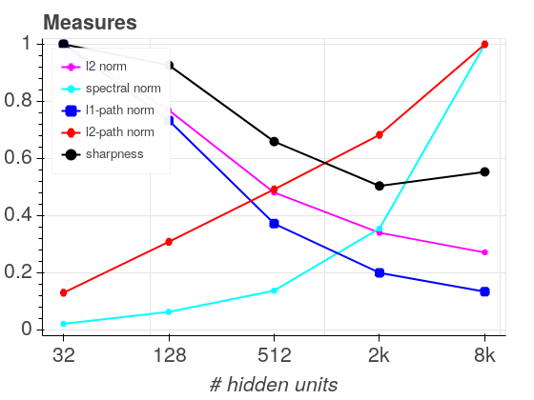
Comparison of results using different numbers of hidden units
Implementation of paper
Own implementation

Slide 32
Problems calculating capacity measures using different numbers of hidden units
Reproduction of training
  No definition of solving strategy
  Training to zero training error not possible
But all measures calculable

Slide 33
Conclusion of the empirical investigation
Empirical phenomena that should be explicable
  Zero training error on random labels using same architecture for which real labels generalize well
  Training the same architecture with the same training set using different parameter choices, one method results in better generalization
  Increasing the number of hidden units can lead to decreasing generalization error even when training error does not decrease
Train same model using different approaches and check generalization behavior
  Networks learned using real values should have much lower complexity
  Correlation between complexity measure and generalization ability among zero training error models
  Complexity measure should decrease as number of hidden units increases

Slide 34
Conclusion of the empirical investigation

Slide 35
Conclusion of the empirical investigation

Slide 36
Conclusion of the empirical investigation
Empirical phenomena that should be explicable
  Zero training error on random labels using same architecture for which real labels generalize well
  Training the same architecture with the same training set using different parameter choices, one method results in better generalization
  Increasing the number of hidden units can lead to decreasing generalization error even when training error does not decrease
Train same model using different approaches and check generalization behavior
  Networks learned using real values should have much lower complexity
  Correlation between complexity measure and generalization ability among zero training error models
  Complexity measure should decrease as number of hidden units increases

Slide 37
Conclusion of the empirical investigation

Slide 38
Conclusion of the empirical investigation
Empirical phenomena that should be explicable
  Zero training error on random labels using same architecture for which real labels generalize well
  Training the same architecture with the same training set using different parameter choices, one method results in better generalization
  Increasing the number of hidden units can lead to decreasing generalization error even when training error does not decrease
Train same model using different approaches and check generalization behavior
  Networks learned using real values should have much lower complexity
  Correlation between complexity measure and generalization ability among zero training error models
  Complexity measure should decrease as number of hidden units increases

Slide 39
Conclusion of the empirical investigation

Slide 40
Conclusion of the empirical investigation
Empirical phenomena that should be explicable
  Zero training error on random labels using same architecture for which real labels generalize well
  Training the same architecture with the same training set using different parameter choices, one method results in better generalization
  Increasing the number of hidden units can lead to decreasing generalization error even when training error does not decrease
Train same model using different approaches and check generalization behavior
  Networks learned using real values should have much lower complexity
  Correlation between complexity measure and generalization ability among zero training error models
  Complexity measure should decrease as number of hidden units increases

Slide 41
Sources
Peter L. Bartlett and Shahar Mendelson. Rademacher and gaussian complexities: Risk bounds and structural results. In David Helmbold and Bob Williamson, editors, Computational Learning Theory, pages 224–240, Berlin, Heidelberg, 2001. Springer Berlin Heidelberg.
Kenji Kawaguchi, Leslie Pack Kaelbling, and Yoshua Bengio. Generalization in deep learning, 2017.
Behnam Neyshabur, Srinadh Bhojanapalli, David McAllester, and Nati Srebro. Exploring generalization in deep learning. In Advances in Neural Information Processing Systems, pages 5947–5956, 2017.
Behnam Neyshabur, Ruslan Salakhutdinov, and Nathan Srebro. Path-sgd: Path-normalized optimization in deep neural networks. CoRR, abs/1506.02617, 2015.
Behnam Neyshabur, Ryota Tomioka, and Nathan Srebro. Norm-based capacity control in neural networks. CoRR, abs/1503.00036, 2015.
Chiyuan Zhang, Samy Bengio, Moritz Hardt, Benjamin Recht, and Oriol Vinyals. Understanding deep learning requires rethinking generalization. CoRR, abs/1611.03530, 2016.

Slide 42
Sources - Images
S. 5, 10: Machine Learning Lecture Script, TUM, http://www.kdd.in.tum.de/lehre/wintersemester-201920/machine-learning/
S. 13: CIFAR-10, https://subscription.packtpub.com/book/big_data_and_business_intelligence/9781789530759/6/ch06lvl1sec40/cifar-10-image-classification-using-tensorflow
S. 13: VGG 16, https://neurohive.io/en/popular-networks/vgg16/
S.19: Universal Adversarial Perturbations Against Semantic Image Segmentation, https://www.bosch-ai.com/research/research-applications/universal-adversarial-perturbations/
S.29: MNIST, https://mc.ai/tutorial-1-mnist-the-hello-world-of-deep-learning/
S.29: Two layer perceptron, http://neuroph.sourceforge.net/tutorials/MultiLayerPerceptron.html

Slide 43
Backup

Slide 44
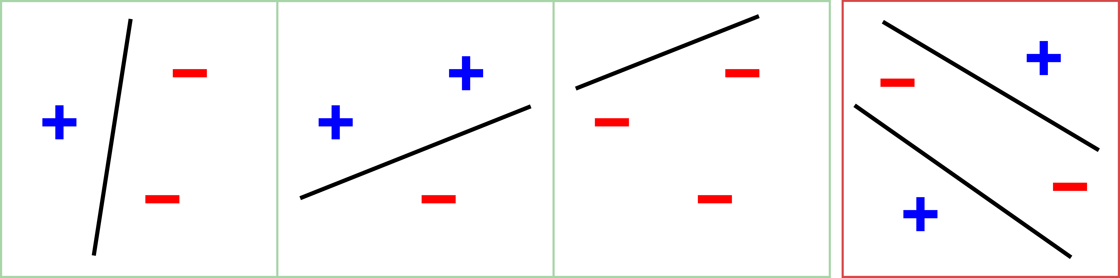
Network Size
For any model the capacity is linear in the total number of parameters
Vapnik-Chervonenkis dimension
  Cardinality of the largest set of points that an algorithm can shatter
But over parameterized setting; # Parameters >> # Samples
Dependence on number of parameters cannot explain generalization
NNs can even fit random labels without generalization
Reduction in generalization error as number of hidden units increase not explicable

