Slide 1
3D Scanning and Spatial Learning Multi-view 4D Volumetric Fusion
Marcel Bruckner, Kevin Bein, Moiz Sajid

Slide 2
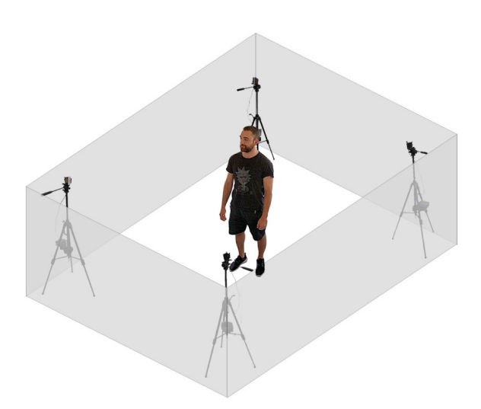
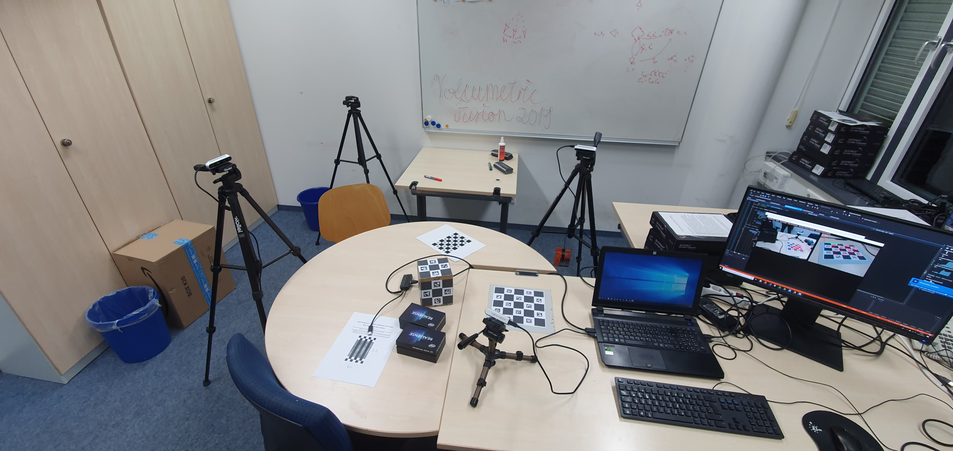
Multi-view 4D Volumetric Capture Setup

Slide 3
Project Milestones
Camera setup
10.2019
Preprocessing
10.2019
Volumetric Fusion and Blending
12.2019
Optimization
01.2020
Non-rigid Tracking
01.2020
Camera calibration
Most of 11.2019

Slide 4
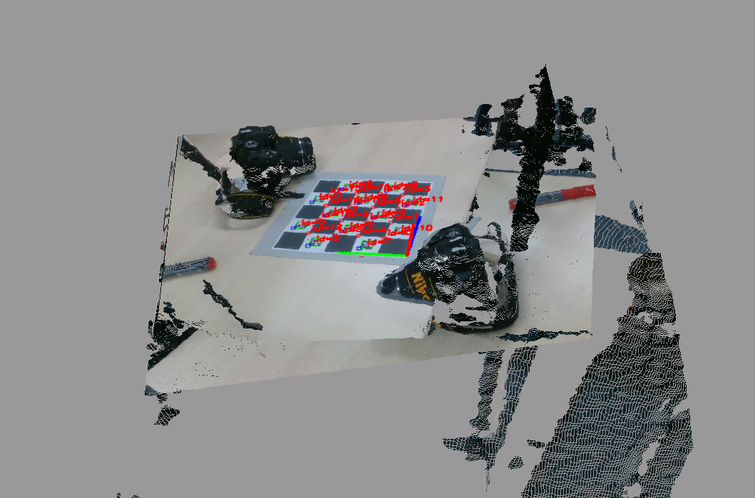
Pointcloud Rendering

Slide 5
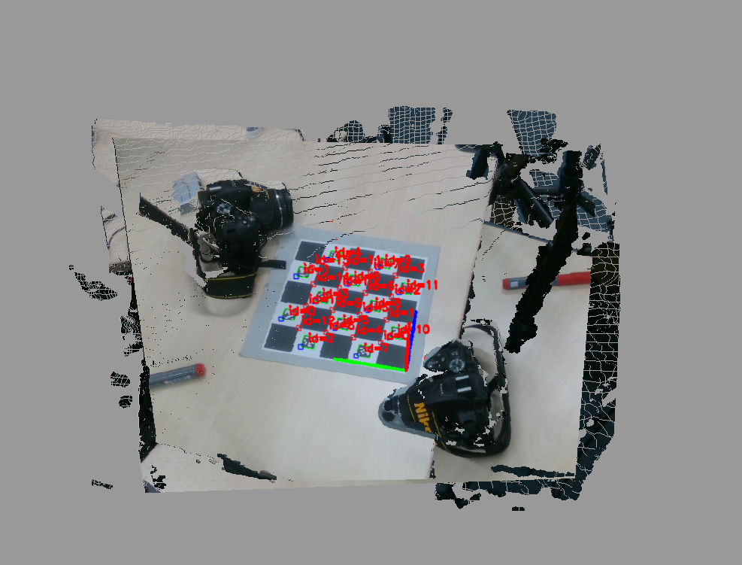
Pointcloud Rendering

Slide 6
In progress
Problem in estimating camera pose parameters
OpenGL rendering -> Fixed for now
CUDA computation support

Slide 7
Questions?

