Slide 1
3D Scanning and Spatial Learning Multi-view 4D Volumetric Capture
Marcel Bruckner, Kevin Bein, Moiz Sajid

Slide 2
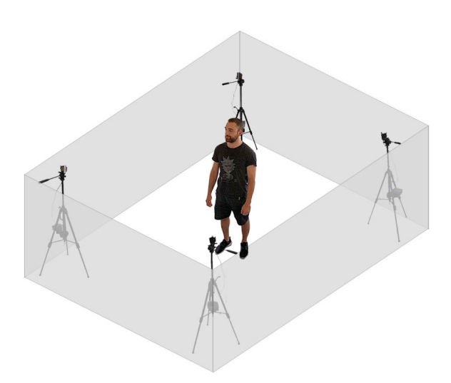
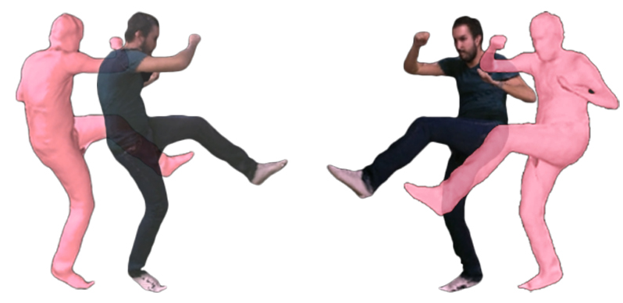
Multi-view RGB-D Capture Setup

Slide 3
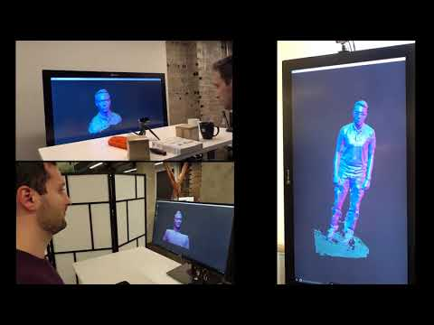
Multi-view RGB-D Capture Setup

Slide 4
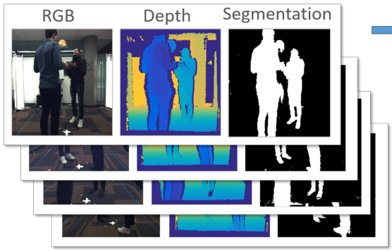
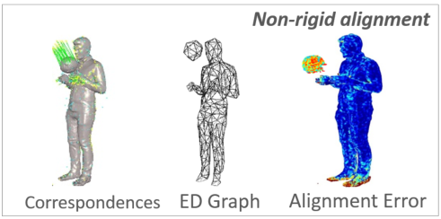
Multi-view RGB-D Capture Setup
Image preprocessing
Depth filtering, background subtraction, visual hull computation
Non-rigid shape reconstruction
Sparse voxel grid
Deformation graph construction
Non-rigid tracking
Projective depth ICP
Global sparse correspondences

Slide 5
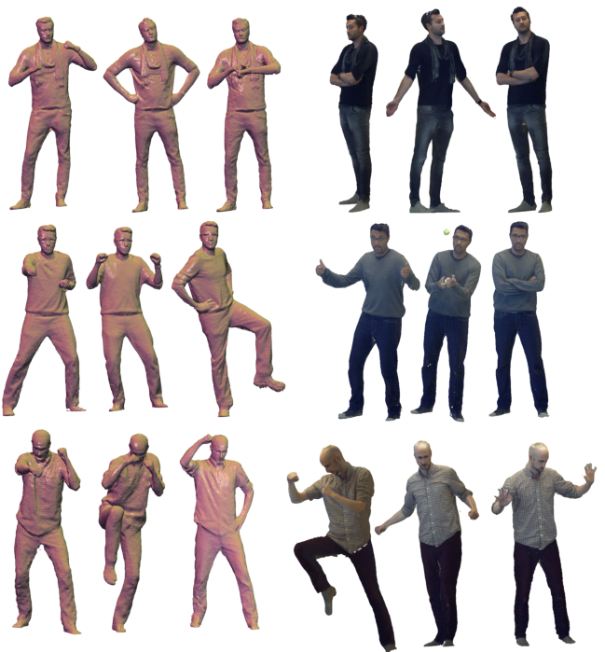
Multi-view RGB-D Capture Setup
Data:
4x Intel Realsense D415
Literature:
Motion2Fusion: Real-time Volumetric Performance Capture [Dou et al.]
Fusion4D: Real-time Performance Capture of Challenging Scenes [Dou et al.]
DynamicFusion: Reconstruction and Tracking of Non-rigid Scenes in Real-Time [Newcombe et al.]

Slide 6
Multi-view RGB-D Capture Setup
Data:
4x Intel Realsense D415
Literature:

Slide 7
Multi-view RGB-D Capture Setup
4x Intel Realsense D415
TODO Add images from master/images folder, Maybe replace right image

Slide 8
Multi-view RGB-D Capture Setup
DynamicFusion: Reconstruction and Tracking of Non-rigid Scenes in Real-Time [Newcombe et al.]
TODO Add shot description and images, core idea

Slide 9
Multi-view RGB-D Capture Setup
Fusion4D: Real-time Performance Capture of Challenging Scenes [Dou et al.]
TODO Add shot description and images, core idea

Slide 10
Multi-view RGB-D Capture Setup
Motion2Fusion: Real-time Volumetric Performance Capture [Dou et al.]
TODO Add shot description and images, core idea

Slide 11
Multi-view RGB-D Capture Setup
Done steps
C++ project setup
OpenGL and GLFW
Get in touch with OpenGL and GLFW by doing the OpenGL tutorial to implement a visualization program for the reconstructed scene
Basic window rendering and vertex buffer, vertex array and vertex index setup working
Basic shader program added to render the scene

Slide 12
Multi-view RGB-D Capture Setup
Done steps
Intel RealSense SDK
Get to know the API
Explore examples and setup Volumetric Fusion project for our needs based on the pointcloud example project
Exploring filter techniques for background segmentation

Slide 13
Multi-view RGB-D Capture Setup
Done steps
Basic Setup & Camera setup, Recordings, Visualization code
Multicamera pointcloud rendering (broken)
Advanced recording and replaying of depth and color data and pointclouds
Mac support
Basic setup with cmake

Slide 14
Multi-view RGB-D Capture Setup
Planned
OpenGL and GLFW
Gather further knowledge over OpenGL and GLFW by doing the OpenGL tutorial
Improve the visualization program to render dynamically generated scenes
Intel RealSense SDK
Custom image pre/post-processing filters
Basic Setup & Camera setup, Recordings, Visualization code
17.10. – 24.10.
Camera calibration
24.10. – 21.11

Slide 15
Multi-view RGB-D Capture Setup
Planned TODO Add timestamps
Voxel Grid implementation
Fusion of Voxel Grids into Depth maps
Rigid reconstruction
Canonical model
Non-rigid reconstruction
Tracking

Slide 16
Project Milestones
Camera setup
10.2019
Preprocessing
10.2019
Volumetric Fusion and Blending
12.2019
Non-rigid alignment
11.2019
Optimization
12.2019
Tracking
01.2020

Slide 17
Additional tasks
Optimization of implemented algorithms
Migration of CPU code to GPU

Slide 18
References
R. A. Newcombe, D. Fox, S. M. Seitz. DynamicFusion: Reconstruction and Tracking of Non-rigid Scenes in Real-Time. IEEE CVPR, 2015
M. Dou, S. Khamis, Y. Degtyarev, P. Davidson, S. R. Fanello, A. Kowdle, S. O. Escolano, C. Rhemann, D. Kim, J. Taylor, P. Kohli, V. Tankovich, S. Izadi. Fusion4D: Real-time Performance Capture of Challenging Scenes. ACM SIGGRAPH, 2016
M. Dou, P. Davidson, S. R. Fanello, S. Khamis, A. Kowdle, C. Rhemann, V. Tankovich, S. Izadi. Motion2Fusion: Real-time Volumetric Performance Capture. ACM SIGGRAPH, 2017

Slide 19
Questions?

