Slide 1
3D Scanning and Spatial Learning Volumetric Capture
Marcel Bruckner, Kevin Bein, Moiz Sajid

Slide 2
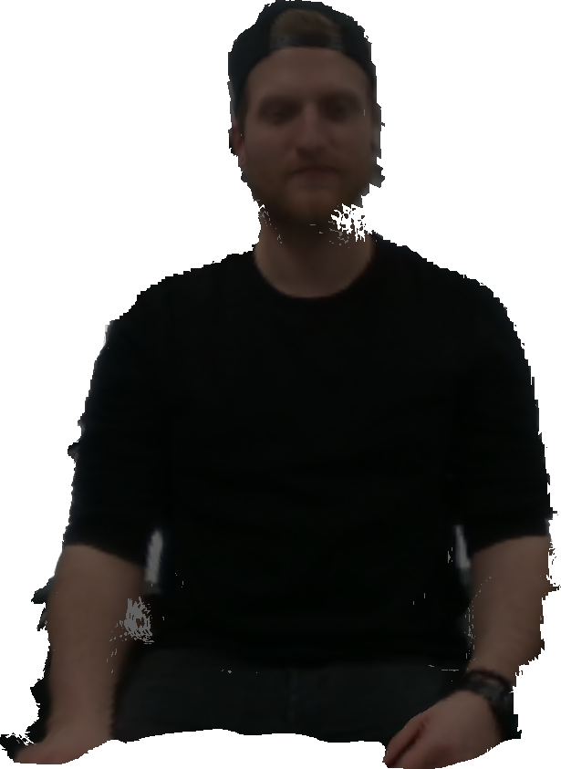
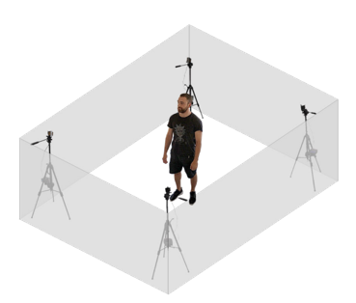
Volumetric Capture
Realtime 3D reconstruction using multiple cameras

Slide 3
Reconstruction Pipeline
RGB-D frame capture
Voxelgrid TSDF
Marching Cubes isosurface
Correspondence matching
3D pose estimation

Slide 4
RGB-D Frame Capture
Hardware setup
4 Intel RealSense Depth Camera D415

Slide 5
Thank you for your attention!

