Slide 1
3D Scanning and Spatial Learning Multi-view 4D Volumetric Fusion
Marcel Bruckner, Kevin Bein, Moiz Sajid

Slide 2
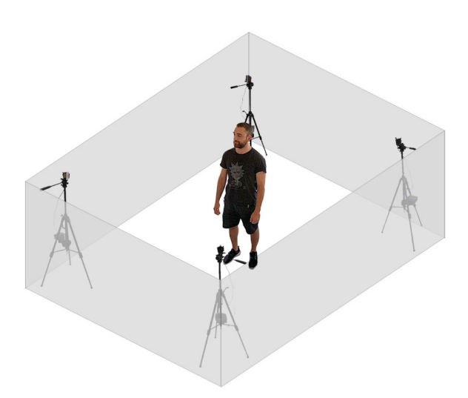
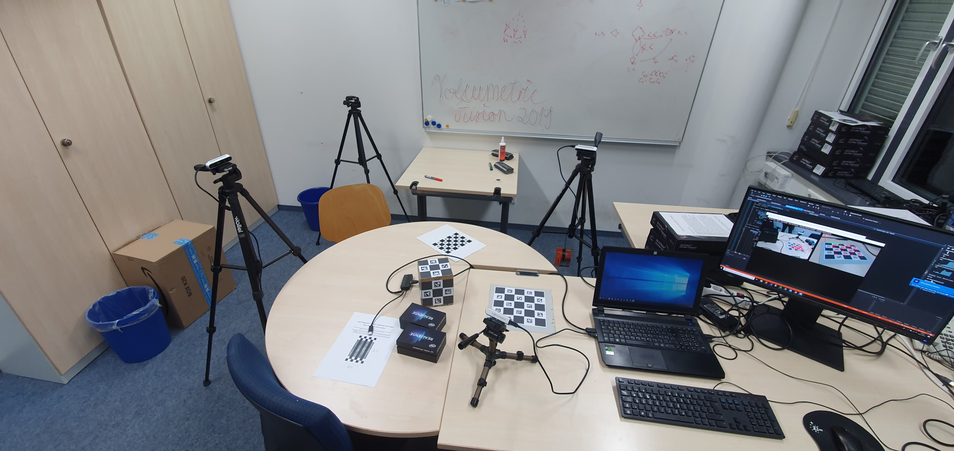
Multi-view 4D Volumetric Capture Setup

Slide 3
Project Milestones
Camera setup
10.2019
Preprocessing
10.2019
Volumetric Fusion and Blending
12.2019
Optimization
01.2020
Non-rigid Tracking
01.2020
Camera calibration
Most of 11.2019

Slide 4
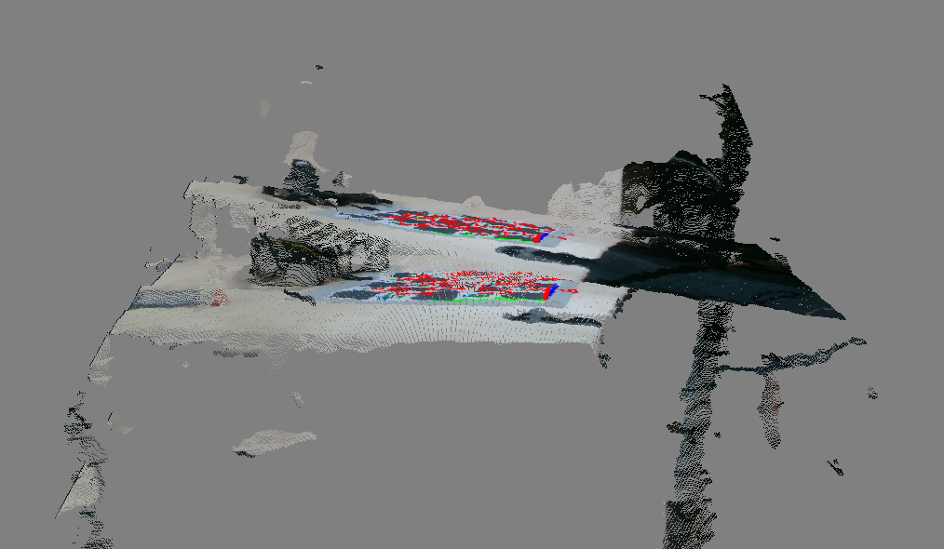
Project Milestones

Slide 5
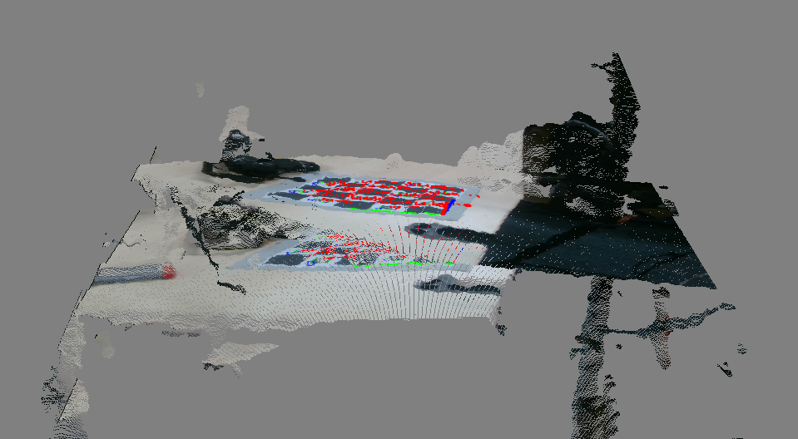
Project Milestones

Slide 6
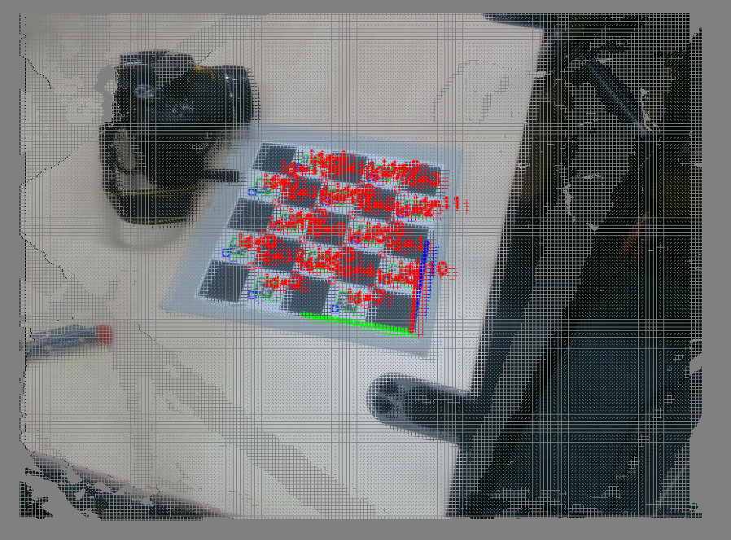
Project Milestones

Slide 7
In progress
Seminar weeks
OpenGL rendering
CUDA computation support

Slide 8
Project Milestones
Camera setup
10.2019
Preprocessing
10.2019
Volumetric Fusion and Blending
12.2019
Optimization
01.2020
Non-rigid Tracking
01.2020
Camera calibration
Most of 11.2019

