Slide 1
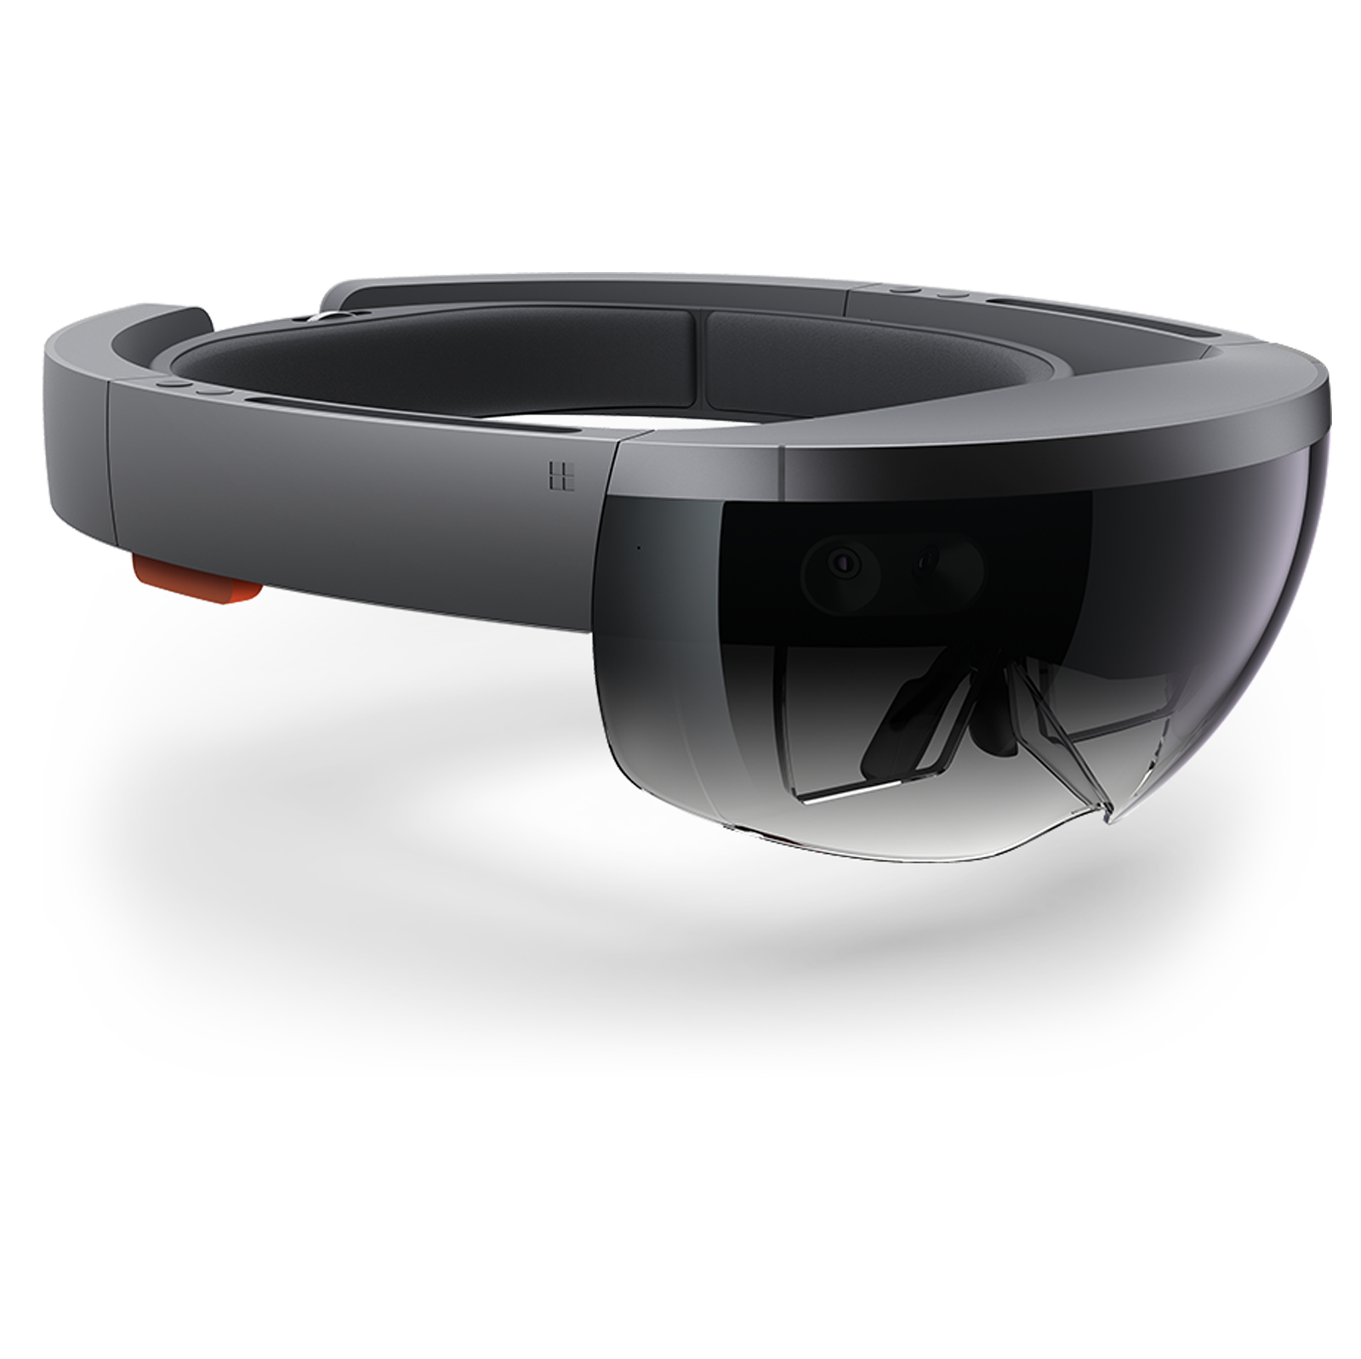
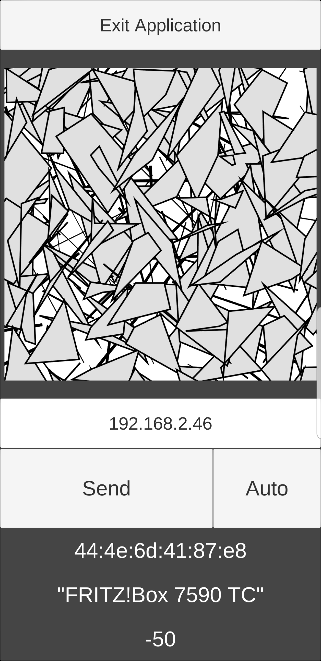

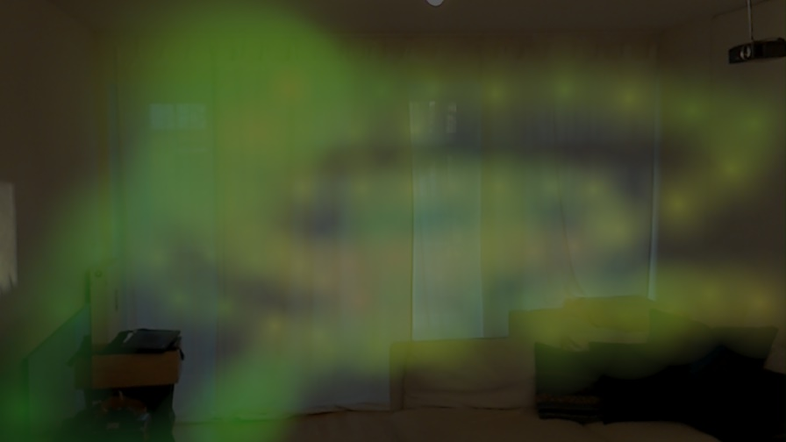
WiFi Signal Visualizer
Marcel Bruckner, Julian Hohenadel
Computer Aided Medical Procedures and Augmented Reality, Technical University of Munich
Background
Results
In some places the distribution of the WiFi strength is hard to understand, so a method to visualize it is needed.
The result of this project is a WiFi Signal Visualizer.
We use the Hololens to display the measured WiFi signal in real time.
The WiFi Signal Visualizer is a proof of concept for the visualization of different electromagnetic signals in augmented reality.
Signal dead spots and spikes can easily be detected with the visualization.
Possible other use cases are:
Radiography (X-Ray)
Magnetic Resonance Imaging (MRI)
3D Pose¹ →
← WiFi signal²
The Hololens tracks the 3D position of the smartphone.
The smartphone sends the captured WiFi signal to the Hololens.
Methods
Hololens cameras used for smartphone detection and position tracking.
Use of the smartphone WiFi module to capture signal strength.
Cross-platform communication between Hololens and smartphone via HTTP / IP.
Rendering of the measurement point cloud via the Hololens in augmented reality.
The color and transparency gradient for the measurements with
a captured WiFi strength in the range from -20db to -80db.
Conclusion
Augmented reality makes an immersive visualization of different signals possible.
Allows the user to view the signal in-situ and to dive into the measurement cloud.
Signal dead spots and spikes can be visualized and the signal sender position can be optimized thereby.
The visualization of the WiFi signal in our living room as seen through the Hololens.
Acknowledgements
Chair for Computer Aided Medical Procedures & Augmented Reality, Technical University of Munich
Nassir Navab, Prof. Dr.
Jakob Weiss, M.Sc., Research Assistant
Marcel Bruckner, mbruckner94@gmail.com; Julian Hohenadel, julian.hohenadel@gmail.com

