Slide 1
Record Cards
Patterns in Software Engineering
Marcel Bruckner
WS 2017/18
Prof. Bruegge

Slide 2
Patterns
Patterns are Knowledge
Reusable source for solving problems
We acquire and describe knowledge to solve recurring design problems
Patterns are a great way to describe reusable knowledge
There are even Antipatterns: They are useful for describing lessons learned
Knowledge is often acquired by accidents or through failure
Learning from failures is important
Popper's concept of falsication

Slide 3
General
Phenomenon | Object in the world as perceived
Concept | Describes common properties of phenomena <name, purpose, members>
Abstraction | Classification of phenomena into concepts
Modeling | Development of abstractions to answer specific questions about a set of phenomena while ignoring irrelevant details
Type | Concept in context of programming languages
Instance | Member of specific type
Class | Code template for a concept that is used to create instances

Slide 4
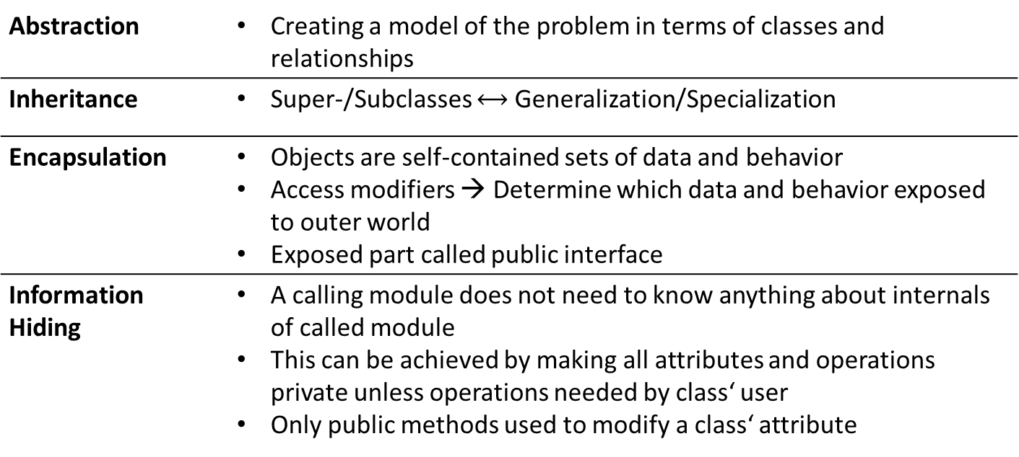
General
Abstraction | Creating a model of the problem in terms of classes and relationships
Inheritance | Super-/Subclasses $⟷$ Generalization/Specialization
Encapsulation | Objects are self-contained sets of data and behavior Access modifiers → Determine which data and behavior exposed to outer world Exposed part called public interface
Information Hiding | A calling module does not need to know anything about internals of called module This can be achieved by making all attributes and operations private unless operations needed by class‘ user Only public methods used to modify a class‘ attribute

Slide 5
Polymorphism
Polymorphism | Ability of an abstraction to be realized in multiple ways
Parametric Polymorphism | Generic Types and Operations Type parameterliste
Subtyping | Type A is a subtype of another type B, exactly when all A, considered as a set of values, is a subset of B. B can be substituted by A.
Liskov' substitution principle | If for each object OS of type S there is an object OT of type T such that for all programs P dened in terms of T, the behavior of P is unchanged when OS is substituted for OT, then S is a subtype of T. All subtype operations must have corresponding subtype operations Weaker preconditions and stronger postconditions
Subclassing | Usage of inheritance Overriding Selection of method based on type of object at runtime
Overloading | One featurename for one or more operations Selection decided by signature

Slide 6
Binding
Early Binding (Static binding, at compile time)
The premature choice of operation variant, resulting in possibly wrong results and (in favorable cases) run-time system crashes.
Late binding (Dynaming binding, at run time)
The guarantee that every execution of an operation will select the correct version of the operation, based on the type of the operation's target.
Delegation
Delegation is a mechanism for code reuse in which an operation resends a message to another class to accomplish the desired behavior. It involves passing a method call to another object, transforming the input if necessary. By that, the behavior of an object is extended.

Slide 7
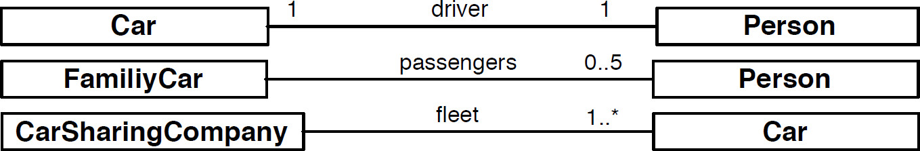
UML Syntax
Association
Link
Aggregation
Part of, consists of
Composition
Parts cannot exist without whole
Multiplicity

Slide 8
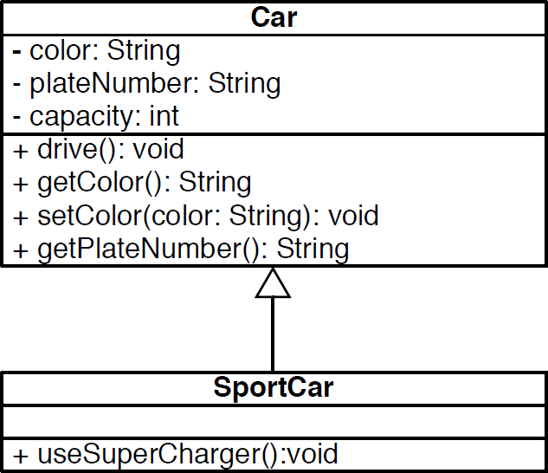
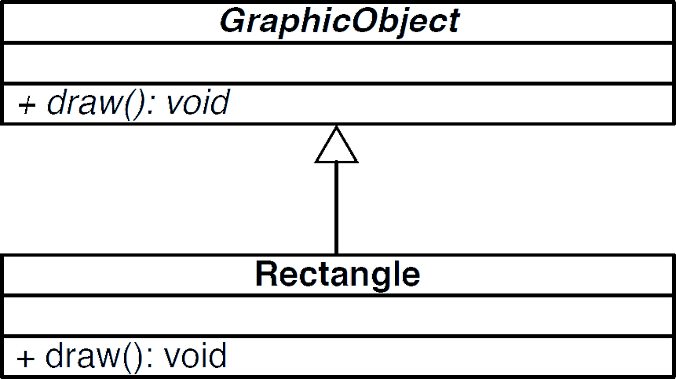
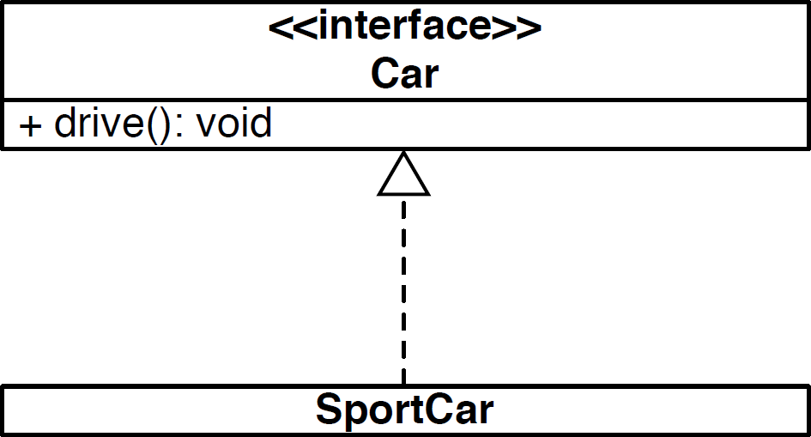
UML Syntax
Inheritance
Abstract class
Interface

Slide 9
Design Patterns

Slide 10
General
Structural Patterns
Reduce coupling between two or more classes
Introduce an abstract class to enable future extensions
Encapsulate complex structures
Behavioral Patterns
Allow a choice between algorithms and the assignment of responsibilities to objects (Who does
what?)
Simplify complex control ows that are dicult to follow at runtime
Creational Patterns
Allow a simplied view from complex instantiation processes
Make the system independent from the way its objects are created, composed and represented

Slide 11
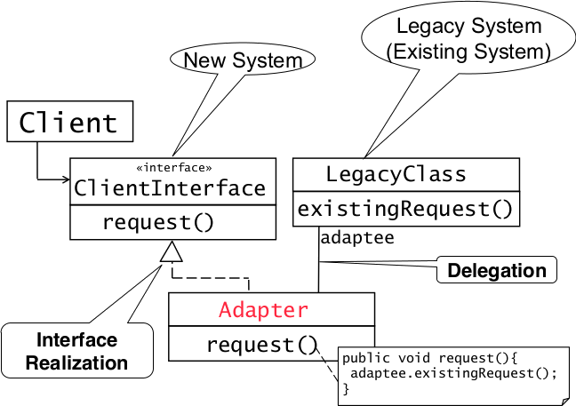
Adapter Pattern

Slide 12
Adapter Pattern
Connects incompatible components
Reuse existing components
Convert an interface to another interface

Slide 13
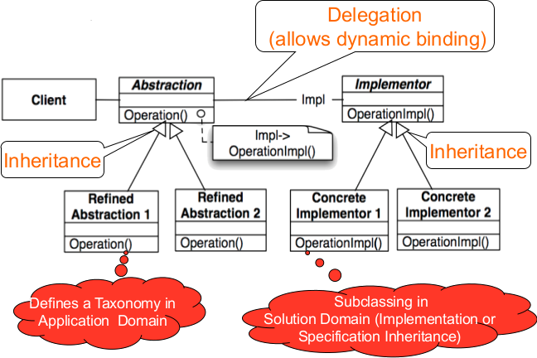
Bridge Pattern

Slide 14
Bridge Pattern
Allows to delay assignment of an implementation of an interface from compile to runtime
Degenerated Bridge is the same without taxonomy in application domain
Used to test application with mocks (e.g. component not yet implemented..)
Or support multiple vendors of a specific service (e.g. Database vendors..)
Used up-front in a design to let abstractions and implementations vary independently

Slide 15
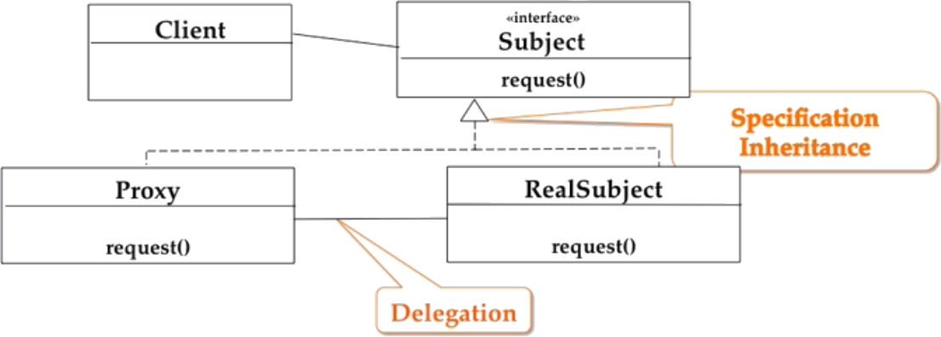
Proxy Pattern
The client never calls request() in RealSubject, instead it always calls the method in Proxy which might delegate it to RealSubject

Slide 16
Proxy Pattern
Allows to defer object creation and object initialization to the time you need the object
Use cases:
Caching (Remote Proxy)
Local objects representative for object in different adress space
Substitute (Virtual Proxy)
Object is expensive to create/download, proxy acts as stand-in
Access Control (Protection Proxy/Firewall)
Proxy object provides access control to the real object

Slide 17
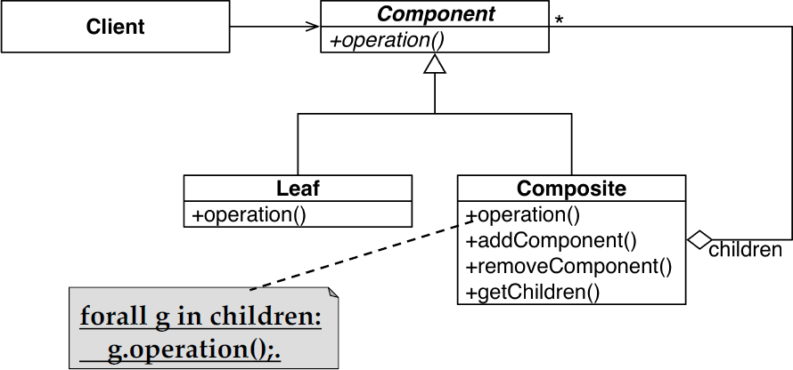
Composite Pattern
Tree structures which represent part-whole hierarchies with arbitrary depth and width.
Lets the client treat individual objects and groups uniformly

Slide 19
Behavioral Patterns

Slide 21
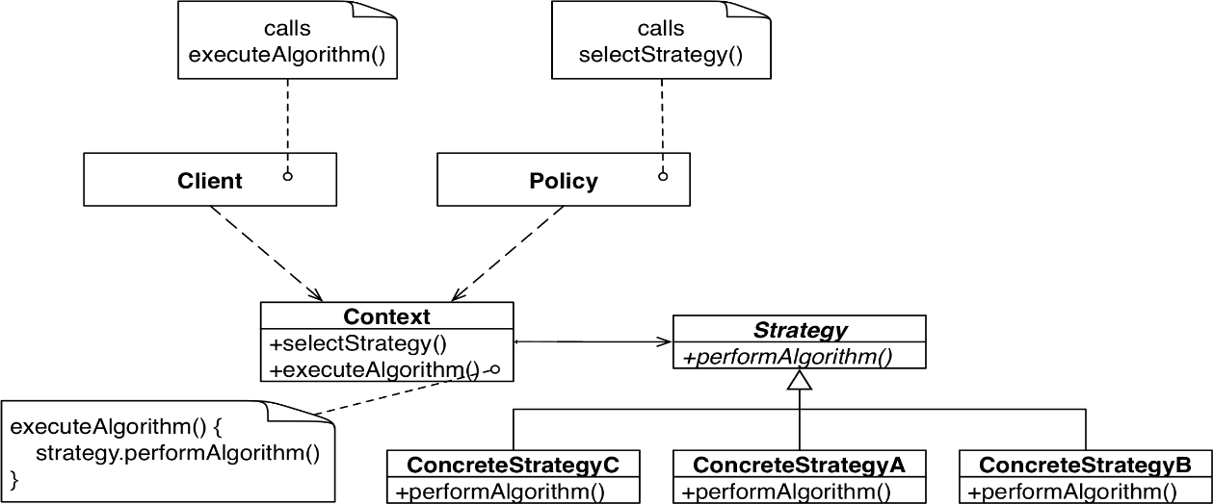
Strategy Pattern
A strategy is chosen on runtime by the Policy class before the client calls executeAlgorithm()

Slide 22
Strategy Pattern
Suited for situations where different algorithms are available for a problem
In contrast to the bridge pattern (structural decisions) it choses the implementation to use at runtime and therefore alters the bahavior

Slide 23
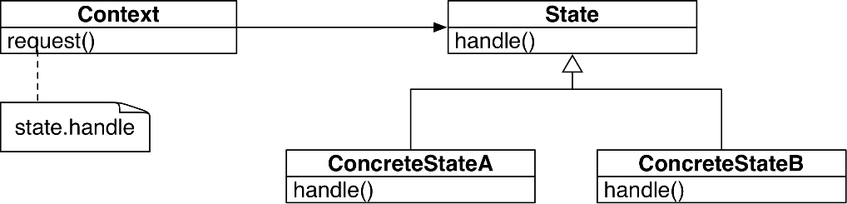
State Pattern

Slide 24
State Pattern
Dependent on current state of a system, an action should do different things
E.g. TCP open, close…
It avoids many if else statements and is flexible to add more cases/states
Also transitions between states are explicit
In contrast to strategy pattern (handles different algorithms) it handles different states of an object

Slide 25
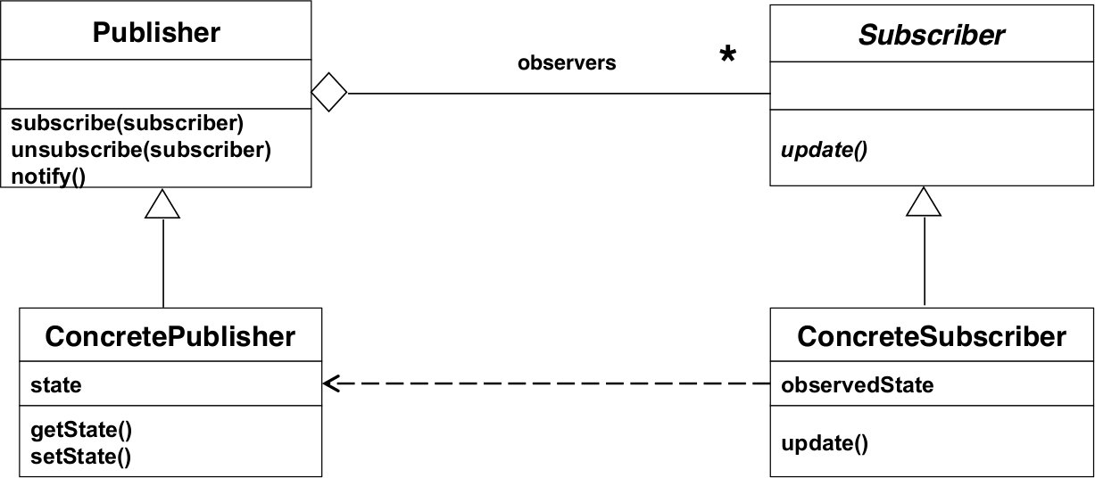
Observer Pattern

Slide 26
Observer Pattern
Handles changes in a publisher class and notifies all subscribers about that change
Maintains consistency
Decouples an abstraction from ist views
Three variants
Push Notification: Every time a state changes, all subscribers are notified
Push-Update Notification: The publisher also sends the state that has changed
Pull Notification: A subscriber inquiries about the state of the publisher

Slide 27
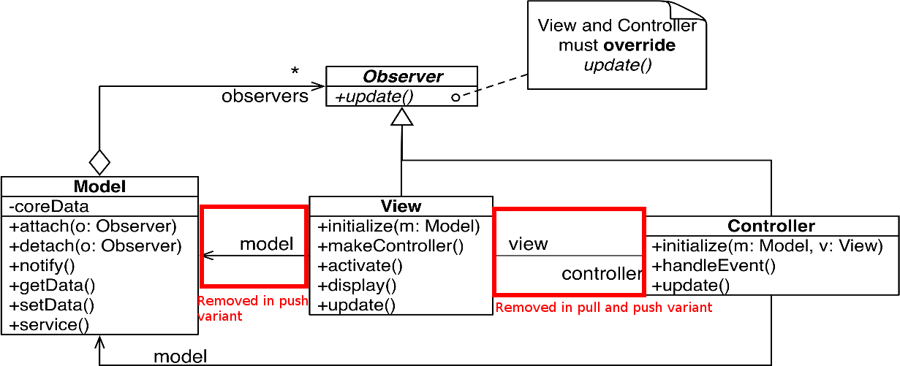
Model View Controller Pattern

Slide 28
Model View Controller Pattern
Decouples data access and data representation
The view handles the data representation
The model handles the data access
The controller handles the communication between the other two
Pull variant:
Connection between the controller and the view is removed
The view asks the model for the data explicitly
Push notification variant:
Both connections between view and model and controller are removed
When a change in the model occurs, the view and controller are updated via the observer pattern

Slide 29
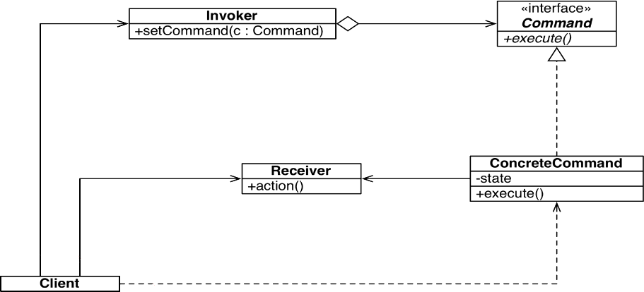
Command Pattern

Slide 30
Command Pattern
Design user interfaces with multiple commands without multiple if-statements
Used to make menus reusable across applications
Reduces complexity by decoupling boundary objects (menu buttons) from control objects (concrete objects)
Only these command objects can modify entity objects (the receivers)
When user interface changed, only boundary objects need to be modified
Command Applications:
Command manager
Redu/Undo manager
Queue
Dispatcher
5 steps to realize a command pattern
Create the command interface
Create the ConcreteCommand classes
Create the Receiver
Create the Invoker
Create the Client

Slide 31
Creational Patterns

Slide 33
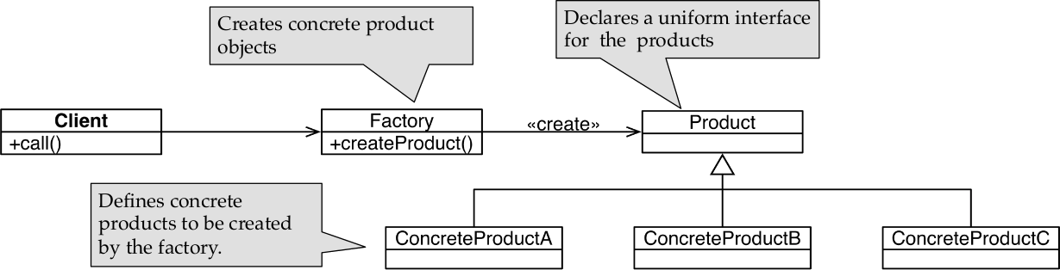
Factory Pattern

Slide 34
Factory Pattern
Handles the instantiation of objects inheriting from one superclass depending on a keyword or value
Acts as a delegate for the creation of products and allows the client to use a single interface to the products
Due to polymorphism the client can use each of the concrete products uniformly

Slide 35
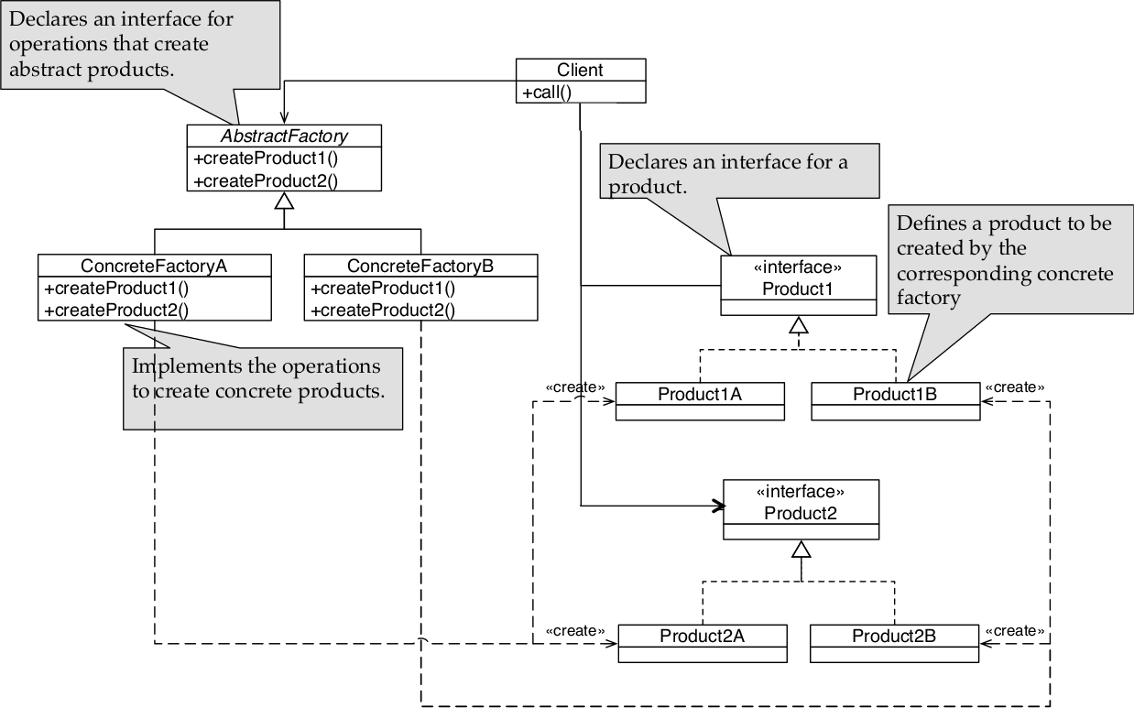
Abstract Factory Pattern

Slide 36
Abstract Factory Pattern
Instantiate or initialize an object consisting of more subparts
Every implementation of the abstract factory creates a set of components consisting of a variant of every part of the whole object

Slide 37
Comparisons
Adapter vs. Bridge
Adapter (inheritance followed by delegation) handles incompabilities
Bridge (delegation followed by inheritance) differentiates between abstraction and implementation up-front
Bridge vs. Strategy
Bridge used for structural decisions on system startup
Strategy handles behavioral decisions on runtime based on changing criteria
Strategy vs. State
Strategy handles different algorithms at runtime
State handles different states of an object in the architecture

Slide 39
Architectural Patterns

Slide 41
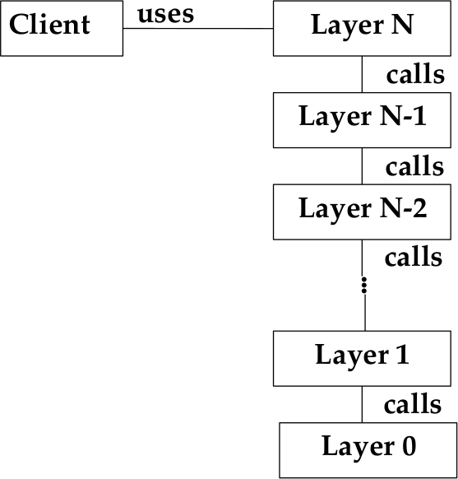
Layer Pattern
Advantages of the layer pattern
Reusability of layers, especially in a closed architecture
Support für standardization
Low coupling
Improved testability
Disadvantages
A local change in lower layer may require rework in higher layers
Lower efficiency

Slide 42
Layer Pattern
Closed Architecture (Opaque Layering)
Each layer can only call operations from the layer below
Open Architecture
Each layer can call operations from any layer below
5 Steps to create a Layered Architecture
Identify subsystems, specify interface for each layer
Structure the individual layers (patterns)
Specify the communication protocol between adjacent layers (push/pull)
Decouple adjacent layers (return results only as parameters to upper layers/use callbacks)
Design an error-handling strategy (handling on lowest possible layer)

Slide 43
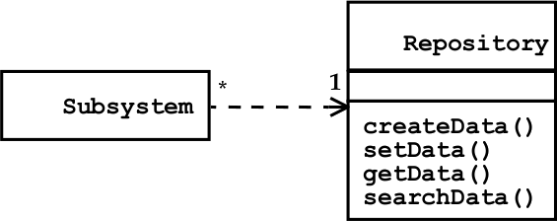
Repository Pattern

Slide 44
Repository Pattern
Used to support a collection of independent programs that work cooperatively on a common datastructure (Repository)
The subsystems exchange data via the repository and are therefore loosely coupled
The control flow is not specified
Control flow can be established by the subsystems themselves e.g. through locks and synchronization primitives

Slide 45
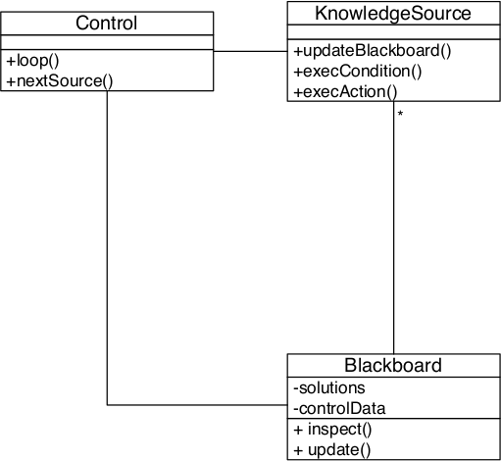
Blackboard Pattern
Advantages
Problem solving support
Changeability and maintainability
Fault tolerance and robustness
Disadvantages
Difficulty of testing
No solution guaranteed
Difficulty to establish a good control strategy
High development effort

Slide 46
Blackboard Pattern
Uses knowledge sources which communicate over a blackboard to solve a problem
Blackboard is the repository for the problem
Each knowledge source reads the content, processes it and generates new hypotheses
A control instance governs the flow of problem-solving activities
In general used when no algorithm for the problem is known
6 Steps to realize a Blackboard Pattern
Define the problem
Define the solution space
Identify the knowledge sources
Define the blackboard, identify needed representations
Define the control
Implement the knowledge sources

Slide 47
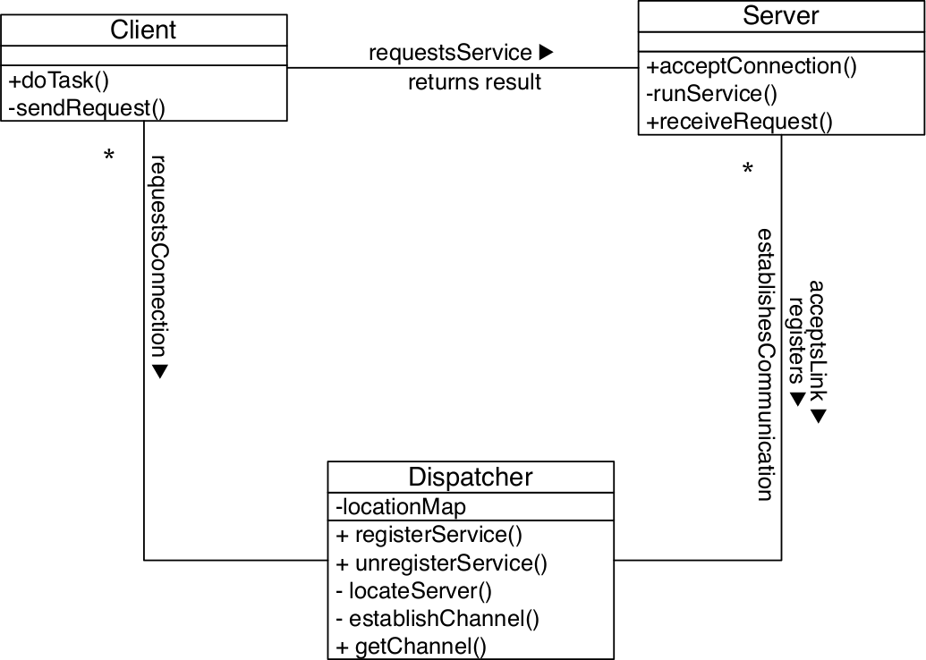
Client-Dispatcher-Server Pattern
Decouples client from server by seperating establishment of a connection and communication over the channel
Dispatcher allows the client to refer server by name instead of physical adress
Allows server to dynamically change it‘s location
CD protocol:
Spec. how a client must look for a server
Deals with communication errors
DS protocol:
Specifies how servers register with dispatcher
Determines activites needed to establish a communication channel between client and server
CS protocol:
Specifies the communication between client and server

Slide 48
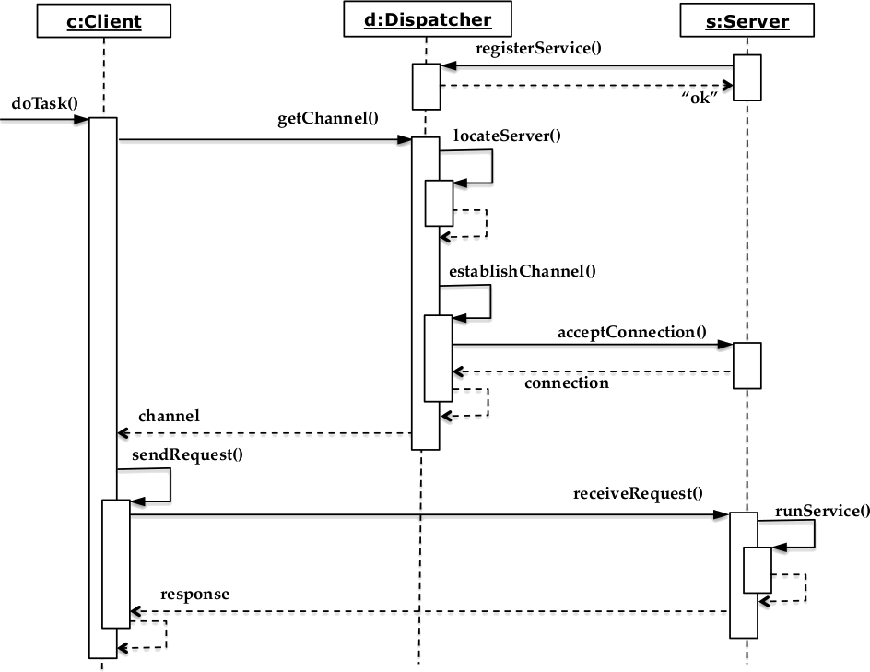
Client-Dispatcher-Server Pattern
6 Steps to implement Client-Server-Disp.
During system design, identify subsystems that act as clients and servers
Decide on the communication mechanism to be used for the protocols
Specify the protocols
Decide on a naming scheme for the dispatcher
Implement the dispatcher
Implement the client and server

Slide 49
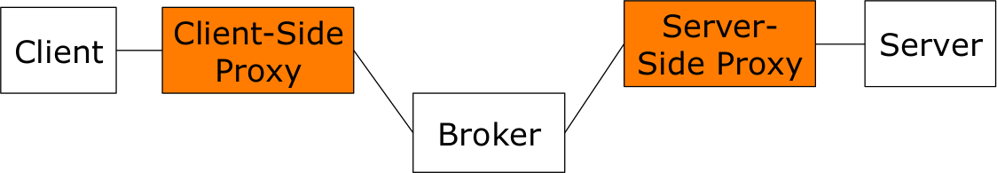
Broker Pattern
A broker coordinates the communication between heterogenous nodes
Nonfunctional requirements
Low coupling
Location Transparency
Runtime Extensibility
Platform Transparency
Client-Side Proxy
Lets the remote object appear as local one, hides the inter-process communication details
Provides(un-)marshalling

Slide 50
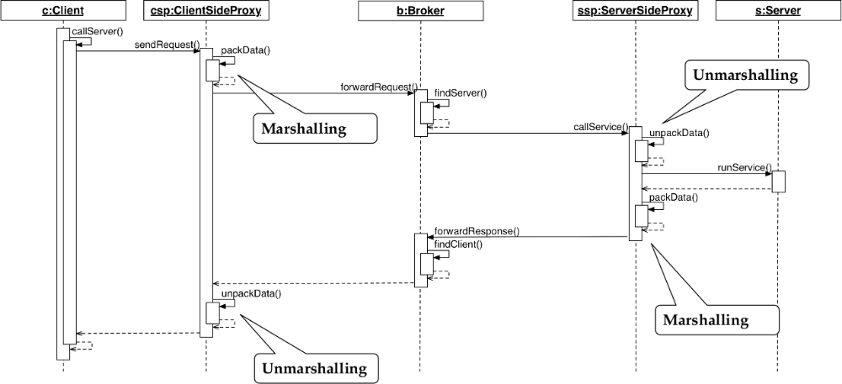
Broker Pattern
4 Steps to realize a Broker Pattern
Provide the object model and service definitions
Define the broker service
Implement the broker component and proxy object at the client and server side
Implement the client and server

Slide 51
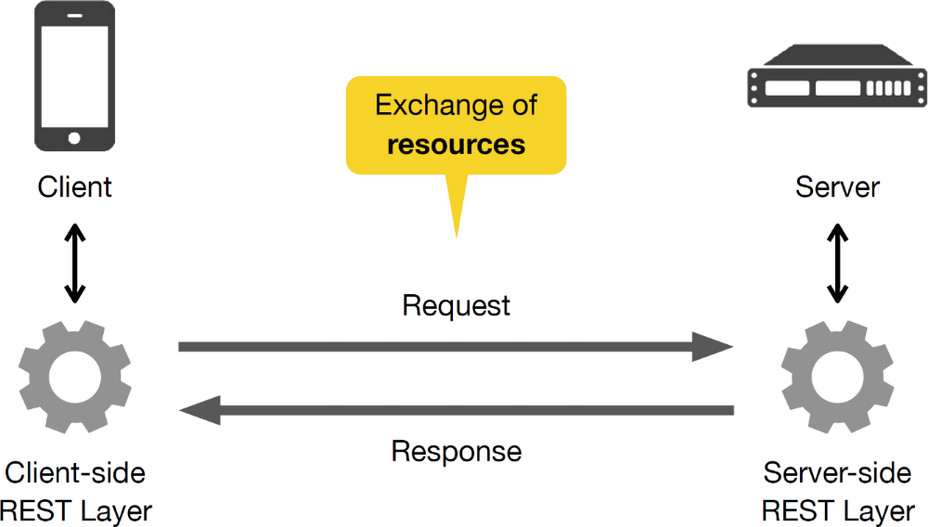
REST Pattern
Seperates between client and server
Provides access to resources
Server holds no session data → stateless
6 Elements of the REST architecture
Client-Server
Stateless
Cachable
Uniform Interface
Layered System
Code-On-Demand

Slide 52
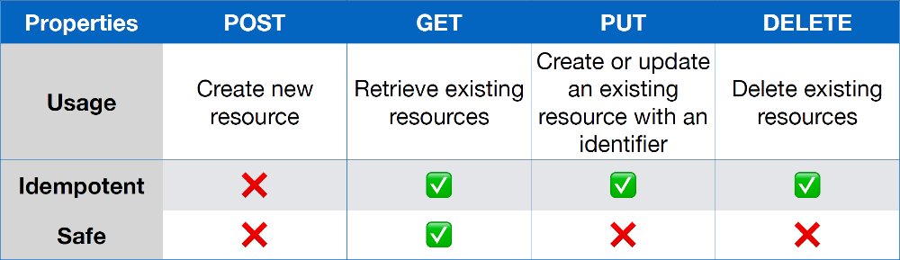
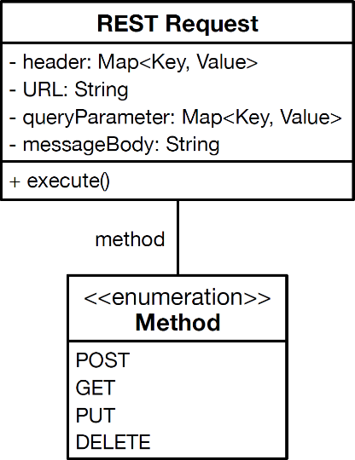
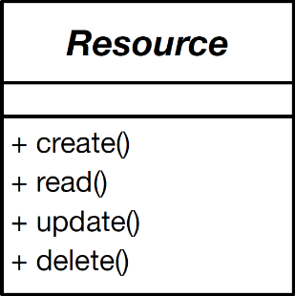
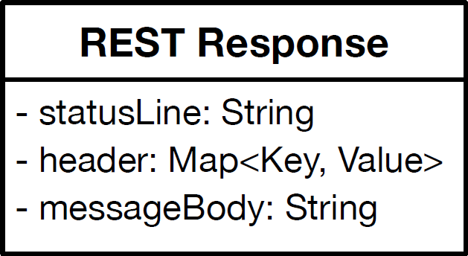
Rest Pattern
REST Methods
Create, Read, Update, Delete
POST, GET, PUT, DELETE
Request-Response
Requestor sends a message to a replier system
Replier system receives and processes the request
Replier returns a message in response

Slide 53
Antipatterns

Slide 55
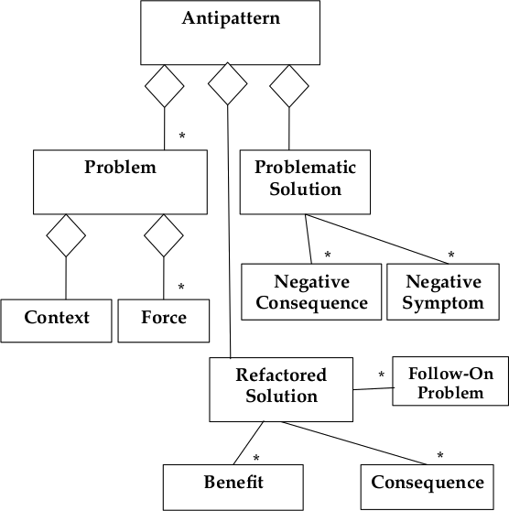
Antipatterns - General
Consists of a problem and two solutions
Problematic solution
Commonly occuring solution that generates overwhelming negative consequences
Refactored solution
How the problematic solution can be reengineered to avoid these negative consequences and lead to benefits again
Patterns can evolve into antipatterns when changes occur

Slide 56
Antipatterns - General
7 Typical mistakes in software development
Apathy
Not caring about problem, unwillingness to attempt a solution
Hastle
Solution based on hasty decisions
Narrow-mindedness
The refusal to use solutions that are widely known
Sloth
Making poor decisions based on easy answers
Avarice (excessive complexity)
No use of abstractions, excessive modeling of details
Ingorance
Failure to seek understanding
Pride
Not willing to adopt anything from the outside
3 Types of Antipatterns
Developer antipattern
Software refactoring
Modification of source code
Architecture
Partitioning of subsystems and components
Platform independent defenition of interfaces
Connectivity of components
Management
Software project organization/management
Software process model
Human communication
Rational management

Slide 57
Functional Decomposition Antipattern
Describes the decomposition of a system in terms of functions
Insted of use cases and/or objects (object-oriented decomposition)
So functions are hidden somewhere in the system where nobody might expect them
Recommended approach:
First decompose the system in use cases, then objects

Slide 58
Functional Decomposition Antipattern
Also known as | No OO
General form | Everything is a function, lots of files named misc, util, aux..
Symptoms and Consequences | Maintainer must understand the whole system to make changes Code is hard to understand Code is complex, high coupling between code sections in different files User interface os often awkward and non-intuitive
Typical causes | Wrong trained personal
Unbalanced forces | Management of complexity Change management
Refactored solution name | Object-oriented reengineering
Refactored solution type | Process

Slide 59
Golden Hammer Antipattern
General form | Developer has high level of competence in a particular solution Every new development effort is solved with this solution Developer is unwiliing to learn and apply new approach
Symptoms and Consequences | Identical tools used for many diverse products System architecture depends on a particular application suite and a specific vendor tool set
Typical Causes | Large investments in product for specific technologies maybe with exclusive features Reliance on proprietary product features that are not available from other vendors
Variants | Obsessive use of favorite software concept or GoF design pattern
Known Exceptions | Product is part of vendor suite that provides for all needs
Refactored Solution | Projet organization develops commitment to explore new technologies Software developers keep up to date on technology trends Management adopts commitment to open systems and architectures

Slide 60
Lava Flow
Also known as | Dead code
General form | Lava like flows of previous development hardened into basalt like mass of code Difficult to remove once solidified
Symptoms and Consequences | Unused or commented-out code Undocumented complex, important-looking code Functions or classes that do not relate to the system architecture Evolving architecture
Typical Causes | Research and development code placed into production Implementation of several trial approaches High programmer turnover rate Fear of breaking something and not knowing how to fix it Unclear, repeatedly changing project goals Architectural scars
Known Exceptions | Small-scale, papidly development
Refactored Solution | Architecture-centric Management Avoid architecture changes during active development

Slide 61
Blob Antipattern
Also known as | God class
General form | Majority of responsibilities are in one complex controller and are associated with simple data classes
Symptoms and Consequences | Huge class with many unrelated attributes and operations enapsulated Usually too complex to reuse and testing
Typical Causes | Lack of (object-oriented) architecture Too limited intervention in iterative projects
Known Exceptions | Wrapping of legacy systems
Refactored Solution | Identify or categorize related attributes and operations Move them into classes they belong to (Source code refactoring) Remove redundant, indirect associations

Slide 62
Spaghetti Code Antipattern
General form | Software with very little structure where object methods are invoked in a single, multistage process flow
Symptoms and Consequences | Methods are process oriented, objects are named as processes Execution flow is dictated by the class implementation of objects instead by the users of that class No inheritance, no polymorphism Source code difficult to reuse Point of diminishing returns: Software maintenance effort higher than a compete reengineering effort
Typical Causes | No design prior to implementation Inexperience with object-oriented design
Refactored Solution | Software Refactoring, Code Cleanup Incremental refactoring

Slide 63
Vendor Lock-In Antipattern
General form | A software project adopts product technology and becomes completely dependent of the vendors implementation
Symptoms and Consequences | Maintainance cycle driven by the product update cycle Promised product features are delayed or never delivered, subsequently causing failure to deliver application updates Application programming requires in-depth product knowledge
Typical Causes | Product is selected because of marketing instead of technical inspection Product varies from published open system standards beacause there is no effective conformance process for the standard
Known Exceptions | Single vendors code is the majority of the code needed for an application
Refactored Solution | Isolation layer (Closed architecture) Separation of infrastructure knowledge from application knowledge Level of abstraction between application software and lower-level infrastructure Adapter design pattern

Slide 64
Analysis Paralysis Antipattern
General form | Goal is to achieve perfection and completeness of the analysis phase Very detailed models
Symptoms and Consequences | Analysis cost exceeds expectations without a predictable end point Analysis documents no longer make sense to domain experts
Typical Causes | Management assumes waterfall progression of phases Analysis goals are not well defined
Refactored Solution | Vertical prototyping Scenario based design Sprint based development (Agile methods) Incremental, iterative, adaptive development

Slide 65
Code smells and Refactoring

Slide 66
Code smells
Symptoms in the source code of a program that possibly indicate bigger problems
It is a heuristic indicaton when to refactor and what specific technique to use
Method too long | Extract method
Duplicated code | Extract/pull up method, extract class
Class too large | Extract superclass
Parameter list too long | Replace parameter with explicit method, introduce parameter object
Feature envy (class uses methods of another class excessively) | Move class
Lazy class (no interesting behavior) | Turn class into attribute
Speculative generality (excessive use on inheritance) | Collapse inheritance tree
Refudes bequest (subclass reusing behavior of superclass, but no interface supported) | Replace inheritance with delegation

Slide 67
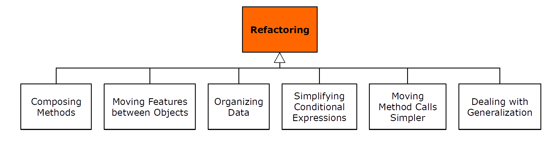
Refactoring

Slide 68
Replace Inheritance with Delegation
Dealing with Generalization
A subclass is only using parts of the superclass interface or does not want to inherit data
Results in source code that does one thing when your intention something else
Replace inheritance with delegation
This makes clear that only parts of the delegated class are used
4 Steps for dealing with generalization
Create a field in the subclass that refers to an instance of the superclass
In the subclass call public methods of the superclass via this field
Break the inheritance relationship by removing the extends declaration from the subclass definition
Create delegating methods in the subclass for those superclass methods that you want to use in the subclass

Slide 69
Refactorings
Extract Method (Composing Methods)
Shortens methods by extracting methods
Related parts of the methods body are extracted and moved to seperate methods
Extract Class (Moving Features between Objects)
If a class contains an implicit abstraction that is not explicitly modeled
Attributes can be summarized in a seperate class and then used in the original class
Replace Data Value with Object (Organizing Data)
A simple attribute of a class gets more versatile
The value can be replaced by an object of a newly introduced class

Slide 70
Replace Conditional with Polymorphism
Simplifying Conditional Expressions
A simple if-then-else may mutate to a switch-case over time
As possible cases grow code may become confusing and hard to maintain
Introduce polymorphism
Turn object on which decision is made into abstract class
Subtypes encapsulate different cases
E.g. Command pattern

Slide 71
Replace Error Codes with Exceptions
Making Method Calls Simpler
When error codes used as return values
Developers using methods have to resolve error code
Look up their meaning
Use exceptions to transfer information on the error to the caller of a method
Moves responsibilities to resolve the error to the caller

Slide 73
Testing Patterns
Test is successful if it generates a failure (Goal is falsification of a model)
Test is successful if it does not generate a failure (Commonly used)

Slide 74
Test Model
Test Cases/Tests | Description of the testing activities Derived from use cases
Test Driver | Programs executing tests
Input Data | Needed for the test
Oracle | Compares expected output with actual output of the test
Test Harness/Testing Framework | Software components/framework running tests under varying conditions and monitoring behavior

Slide 75
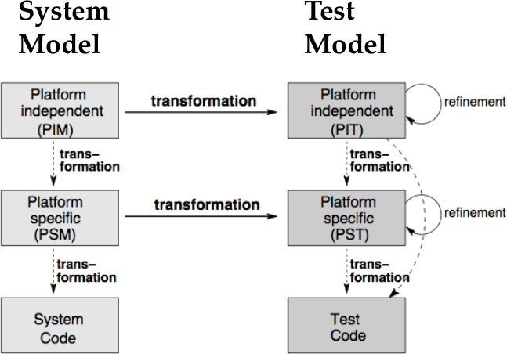
Model-Based Testing
System model is used for generation of the test model
Increses the effectiveness of testing, as costs are reduced and maintenance is easier
Analysis and design models are reused
The platform independent system model can be transformed into the platform independent test model
The platform specific test model can be derived from the platform specific system model or the platform independent test model
Enables early integration of testing into system development process (test driven development)

Slide 76
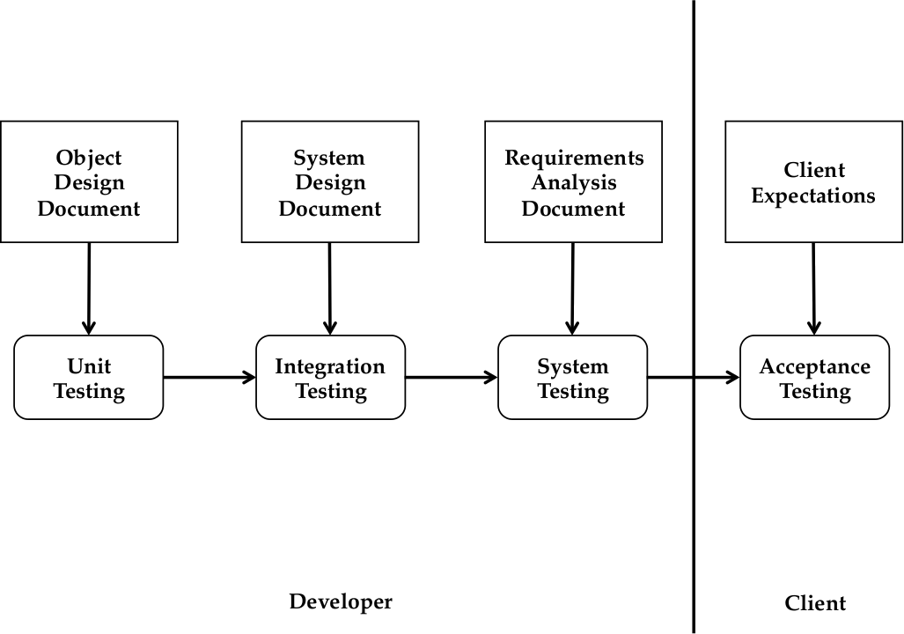
Testing Activities
Unit Testing/Module Testing
Developers test individual components, confirms correct coding of component or subsystem
Integration Testing
Developers test groups of subsystems, confirm interface specifications of subsytems
System Testing
Developers test the entire system, checks if system requirements are met
Acceptance Testing
Client evaluates the system by executing typical use cases, checks requirements
Tests after every change are called Regression Tests

Slide 77
JUnit Testing
@Test public void foo() | foo is a test
@Before public void bar() | bar is executed before every test
@After public void foobar() | Any test method must finish with call to foobar
@BeforeClass public void foofoo() | foofoo is executed before the start of all tests
@AfterClass public void blabla() | blabla is executed after all tests have nished
@Ignore(String s) | Ignores the prexed method and prints s instead
@Test(expected=IllegalArgumentException) | Tests if the test method throws the named exception
@Test(timeout=100) | Test fails, if it takes longer than 100 milliseconds

Slide 78
JUnit Testing
Assertions
assertTrue(predicate)
assertFalse(predicate)
fail(String) lets the method fail, used in code which should be unreachable
assertsEquals([String message], expected, actual)
assertsEquals([String message], expected, actual, tolerance) used for float and double
assertNull([message], object) prints message if object is null
assertNotNull([message], object)
assertSame([String], expected, actual) expected == actual (not equals!)
assertNotSame([String], expected, actual)

Slide 79
Object-Oriented Model-Based Testing
Dummy object | Used to fill parameter holes, never actually used
Fake object | Functional class, that has not yet the actual funcionality of the real class
Stub | Returns always the same values
Mock Object | Imitates real behavior of an object Requires a good architecture to let the mock object class inherit from the desired interface

Slide 81
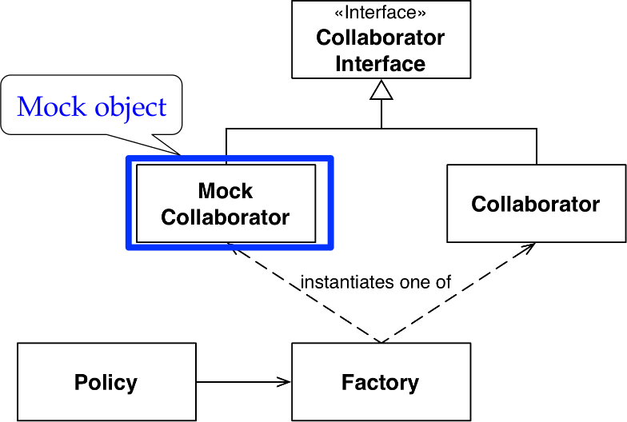
Mock-Object Pattern
Unit tests with nondeterministic behavior
Object is difficult to set up
Specific behavior is hard to trigger
Slow methods
Object has an user interface or is the user
The real object is not testable

Slide 82
Mock-Object Pattern
How to use Easy Mock
Instantiate mock object: mock = createMock(foo.class)
Specify the expected behavior
Void methods are called as in Java
Methods with return values use expect() to specify the return value and andReturn() to specify the expected value
times() defines how often the method can be called
Use replay(mock) to make the mock object available
Invoke methods in the SUT
Make sure the SUT used the mock object as specified with verify(mock)

Slide 83
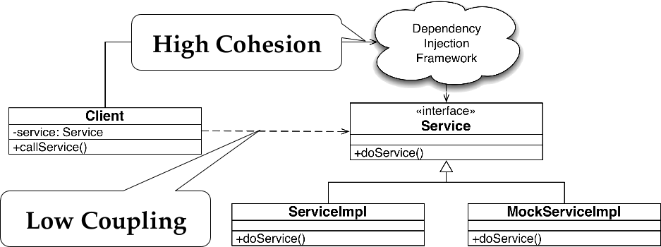
Dependency Injection Pattern
Avoid high coupling between test classes an SUT

Slide 84
Dependency Injection Pattern
Google Guice Framework
Place @Inject annotation (constructors, methods, fields)
Create a Module to define binding
configure(){
Bind(Service.class).to(ServiceImpl.class)
}
Instantiate an injector to tell which module to use
Guice.createInjector(new ProductionModule())
Instantiate an instance of the class needing injection
Injector.getInstance(Service.class)

Slide 85
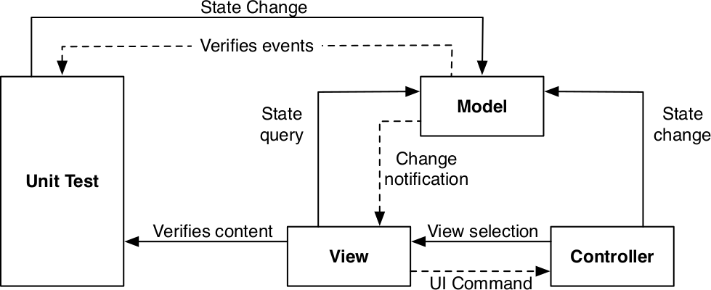
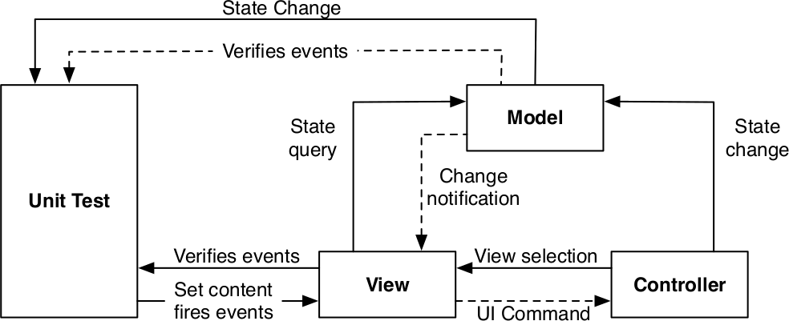
Four-Stage Testing Pattern
View-State Test Pattern
Is the view updated when the model changes?
Model-State Test Pattern
Is the model updated when the view is changed via the user

Slide 86
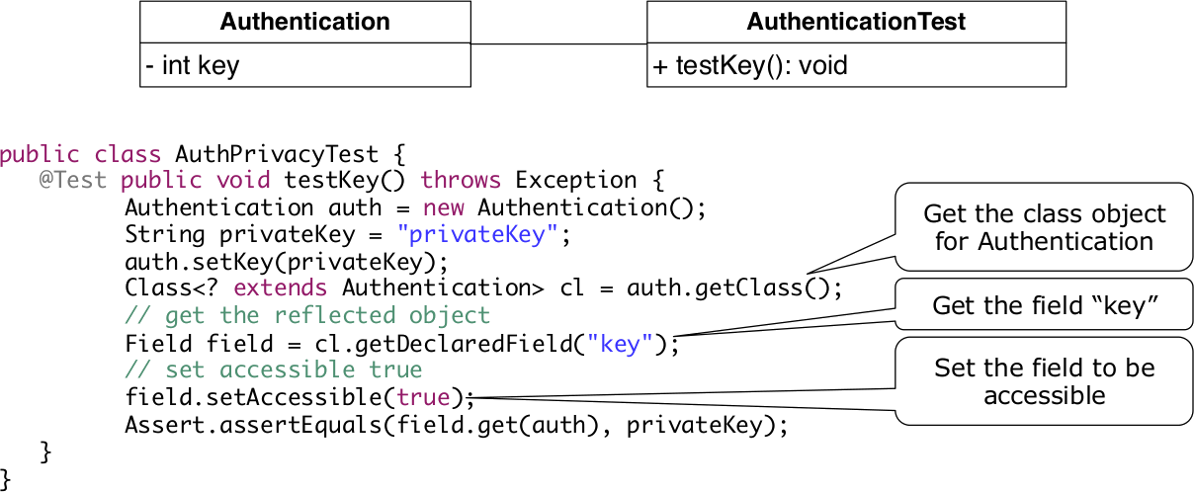
Reflection
Used to test private attributes

Slide 87
Pattern-based Reengineering

Slide 88
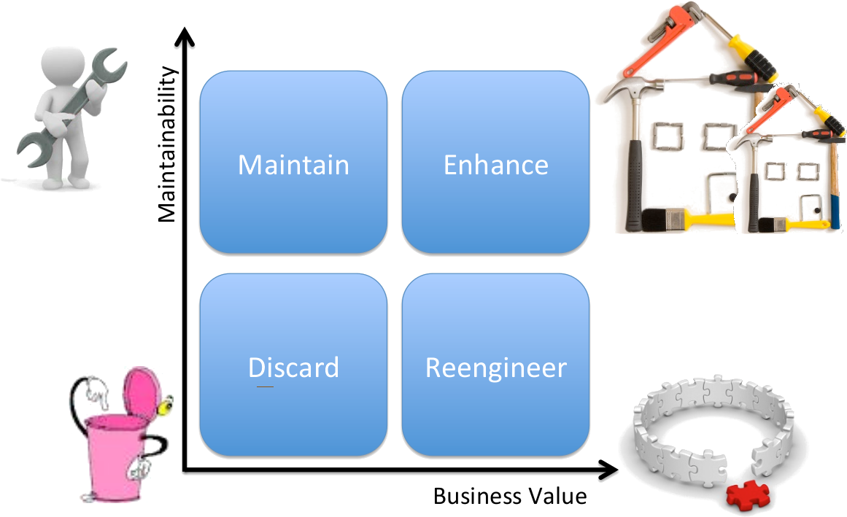
When to reengineer & Reenginering process
Inventory analysis
Refactoring
Analysis
Object Design
System Design

Slide 89
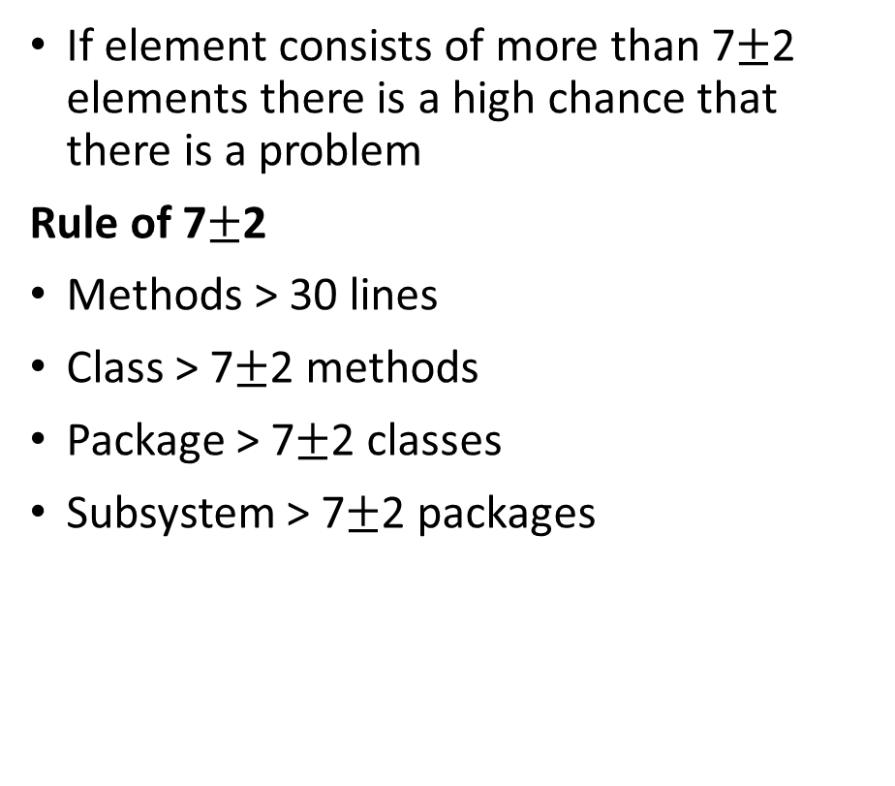
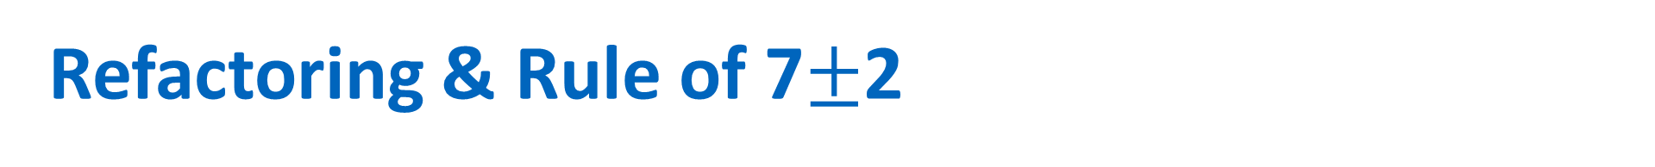
Refactoring & Rule of 7$±$2
Process of incrementally changing the bad structure of a system or organization
Functionality is not changed
Rules when refactoring
Small, locale and testable steps
Only refactor with automated tests
Test changes
Finish refactoring steps before beginning new ones
If element consists of more than 7$±$2 elements there is a high chance that there is a problem
Rule of 7$±$2
Methods > 30 lines
Class > 7$±$2 methods
Package > 7$±$2 classes
Subsystem > 7$±$2 packages

Slide 91
Terminology

Slide 93
Terminology
(Low) Coupling | measures the dependencies between subsystems
(High) Cohesion | Measures the dependencies among classes within a subsystem
Design Pattern | describes associations and collaborations of a set of classes
Architectural Style | is a pattern for a subsystem decomposition, i.e. describes relationships and collaborations of different subsystems
Software Architecture | is an instance of an architectural style
User Model | is imagined by the user in their mind. It helps the user to know and understand the underlying application domain model.
Natural Mapping (UI) | is a mapping between UI controls of a system and objects in the real world such that the mapping does not tax the user's memory when performing a task that involves the manipulation of these controls.
Components/Subsystems | Computational units with a specied interface
Connectors/Communication | Interactions between the components/subsystems
Failure | Deviation of the observed behavior from the specied one

Slide 94
Terminology
Fault/Bug | Mechanical or algorithmic cause of an error
Error | The system is in a state such that further processing by the system can lead to a failure.
Verification | Activity that checks if the observed behavior complies with the specied behavior of the system
Validation | Activity that checks if the observed behavior meets the needs informally expressed by a stakeholder
Marshalling | Transforming object to common representation and serializing afterwards to send over network
Unmarshalling | Deserializing data from network and transform the created object to a representation understandable by the receiver
Good Architecture | is the result of a consistent set of principles and techniques, applied consistently through all phases of a project. It is resilient in the face of changes and is a source of guidance throughout the product lifetime.
(A-)synchronous Communication | The client issues the method call and waits (blocks) until the result is returned, continues (non-blocking) and gets notied (Callbacks) by broker when the result is ready.

Slide 95
Taxonomies

Slide 96
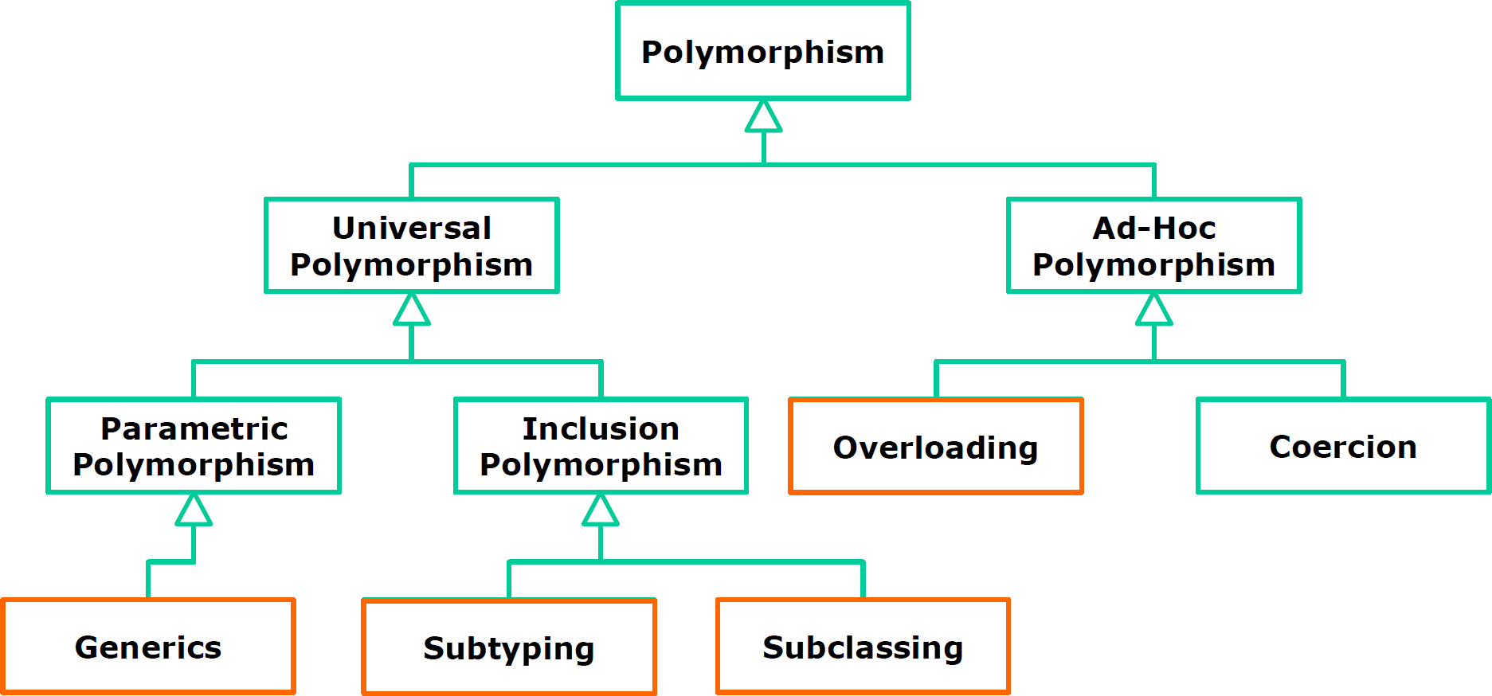
Polymorphism

Slide 97
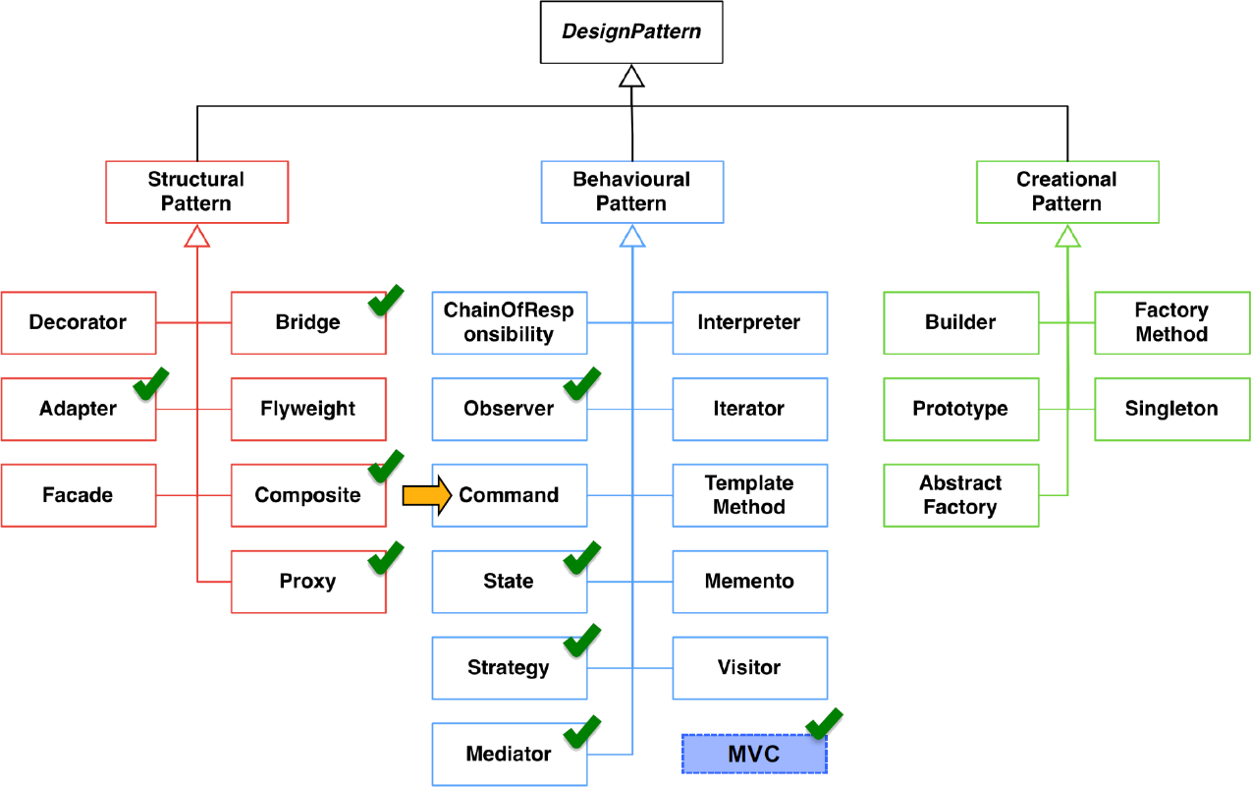
Design Patterns

Slide 98
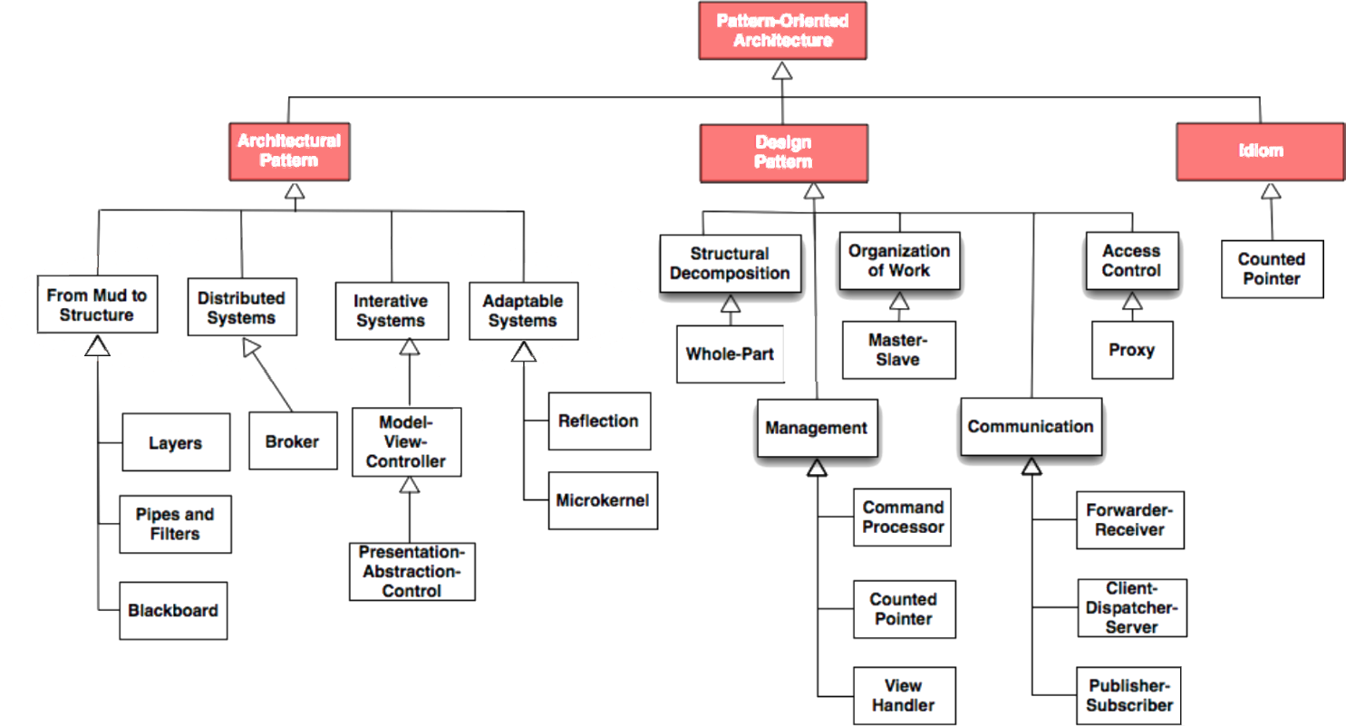
Pattern-oriented Architecture (GoF)

Slide 99
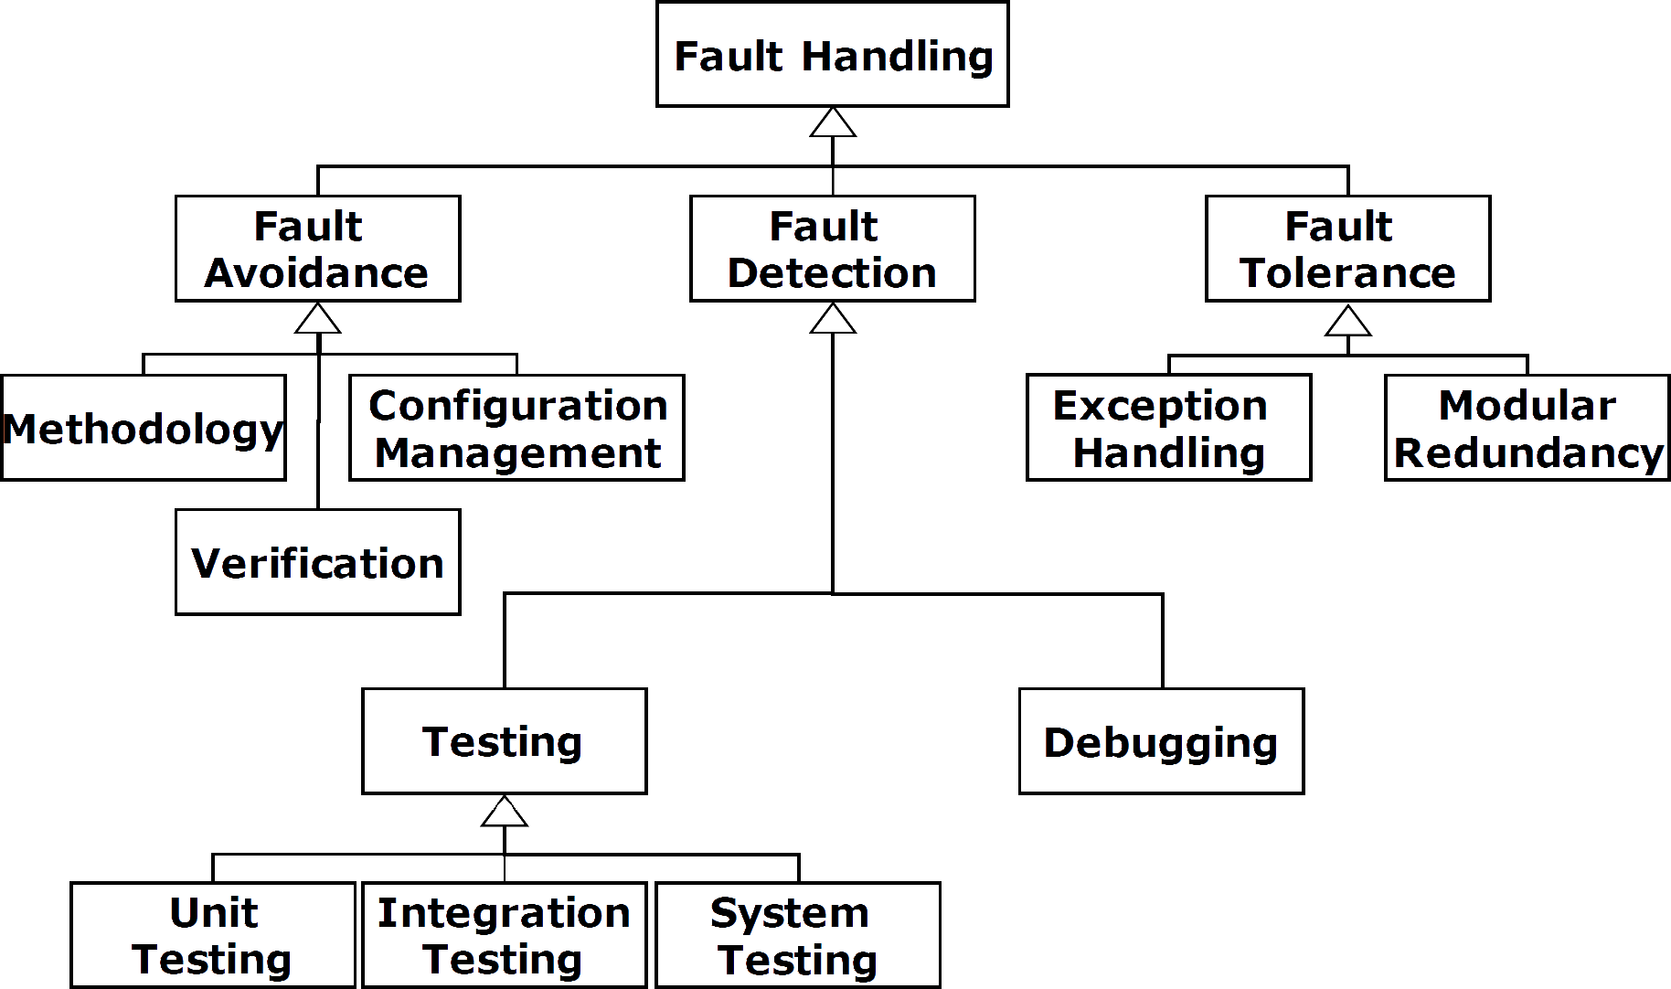
Fault Handling

Slide 100
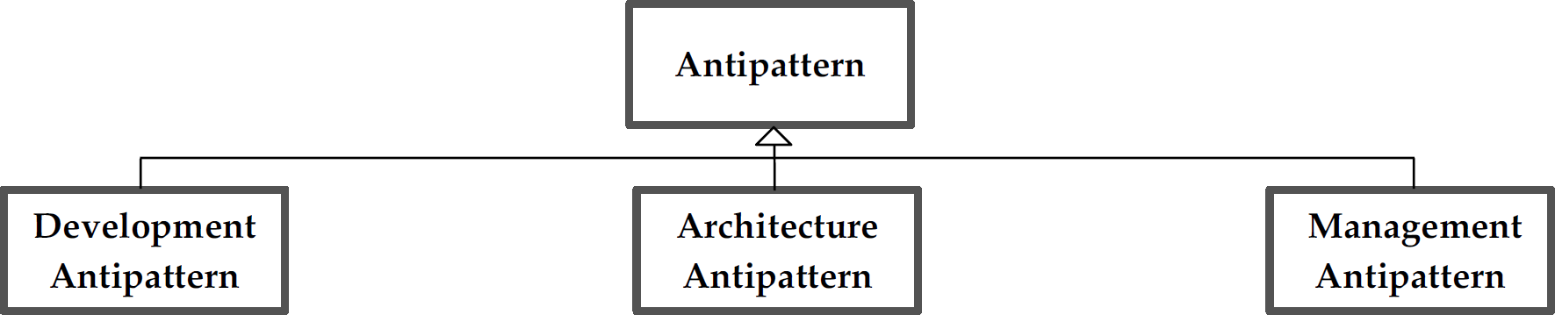
Antipattern

Slide 101
Source Code Refactoring

