Slide 1
Record Cards
Patterns in Software Engineering
Marcel Bruckner
WS 2017/18
Prof. Bruegge

Slide 2
Design Patterns

Slide 3
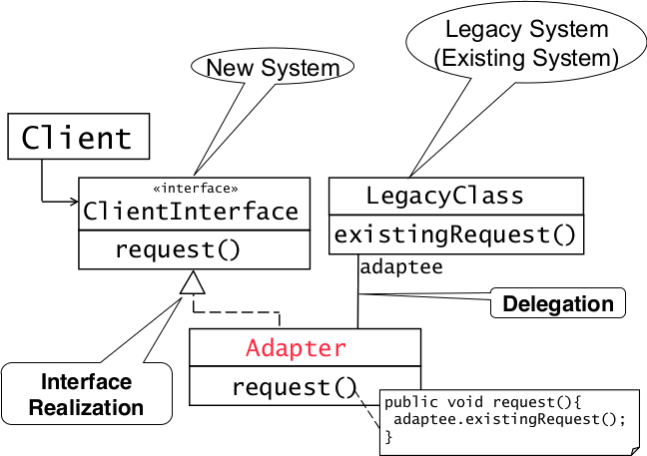
Adapter Pattern

Slide 4
Adapter Pattern
Connects incompatible components
  Reuse existing components
  Convert an interface to another interface

Slide 5
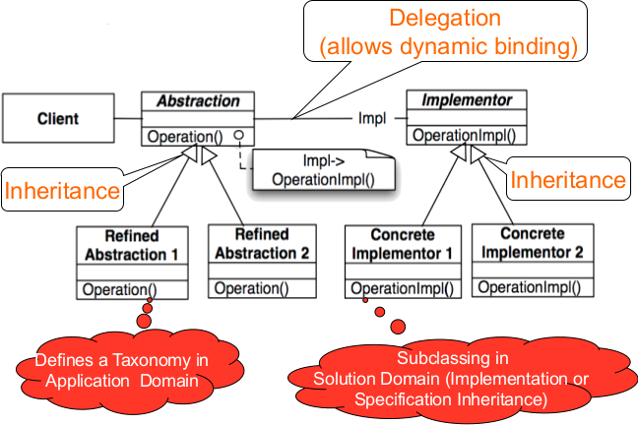
Bridge Pattern

Slide 6
Bridge Pattern
Allows to delay assignment of an implementation of an interface from compile to runtime
Degenerated Bridge is the same without taxonomy in application domain
Used to test application with mocks (e.g. component not yet implemented..)
Or support multiple vendors of a specific service (e.g. Database vendors..)
Used up-front in a design to let abstractions and implementations vary independently

Slide 7
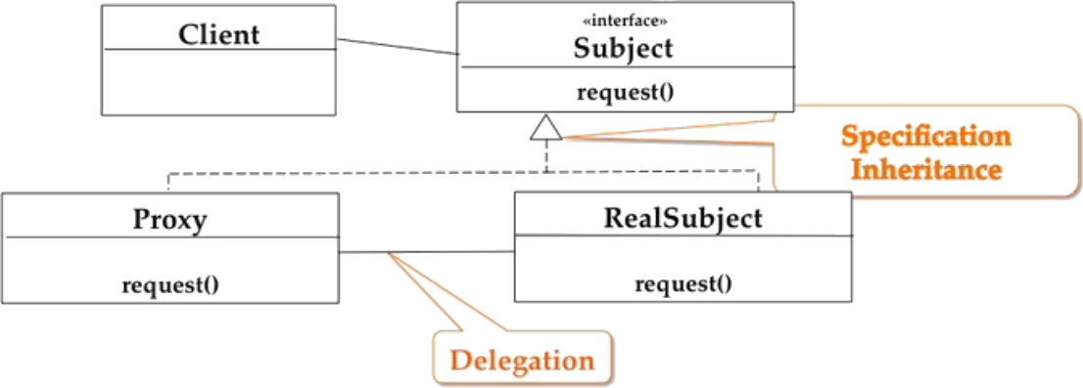
Proxy Pattern
The client never calls request() in RealSubject, instead it always calls the method in Proxy which might delegate it to RealSubject

Slide 8
Proxy Pattern
Allows to defer object creation and object initialization to the time you need the object
Use cases:
  Caching (Remote Proxy)
    Local objects representative for object in different adress space
  Substitute (Virtual Proxy)
    Object is expensive to create/download, proxy acts as stand-in
  Access Control (Protection Proxy/Firewall)
    Proxy object provides access control to the real object

Slide 9
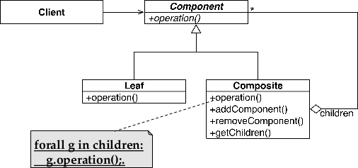
Composite Pattern

Slide 10
Behavioral Patterns

Slide 11
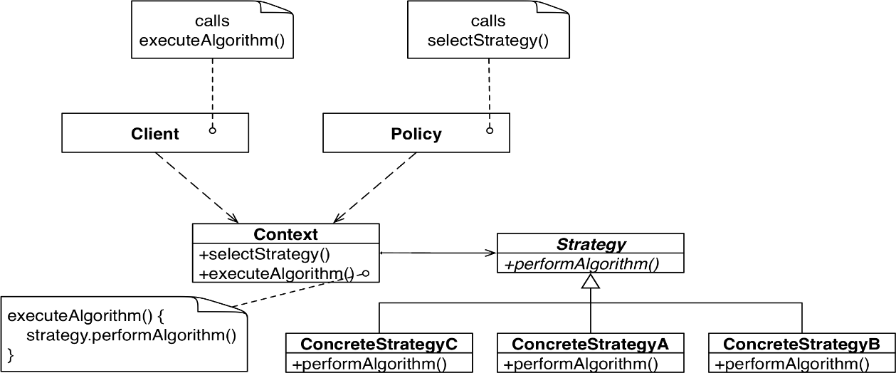
Strategy Pattern
A strategy is chosen on runtime by the Policy class before the client calls executeAlgorithm()

Slide 12
Strategy Pattern
Suited for situations where different algorithms are available for a problem
In contrast to the bridge pattern (structural decisions) it choses the implementation to use at runtime and therefore alters the bahavior

Slide 13
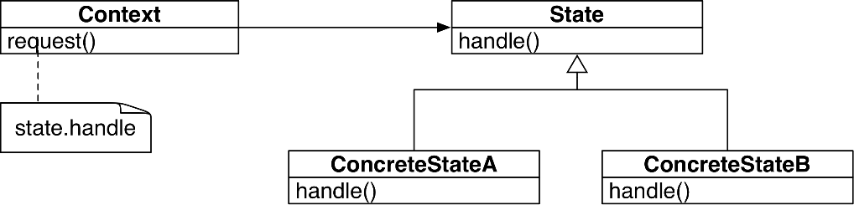
State Pattern

Slide 14
State Pattern
Dependent on current state of a system, an action should do different things
E.g. TCP open, close…
It avoids many if else statements and is flexible to add more cases/states
Also transitions between states are explicit
In contrast to strategy pattern (handles different algorithms) it handles different states of an object

Slide 15
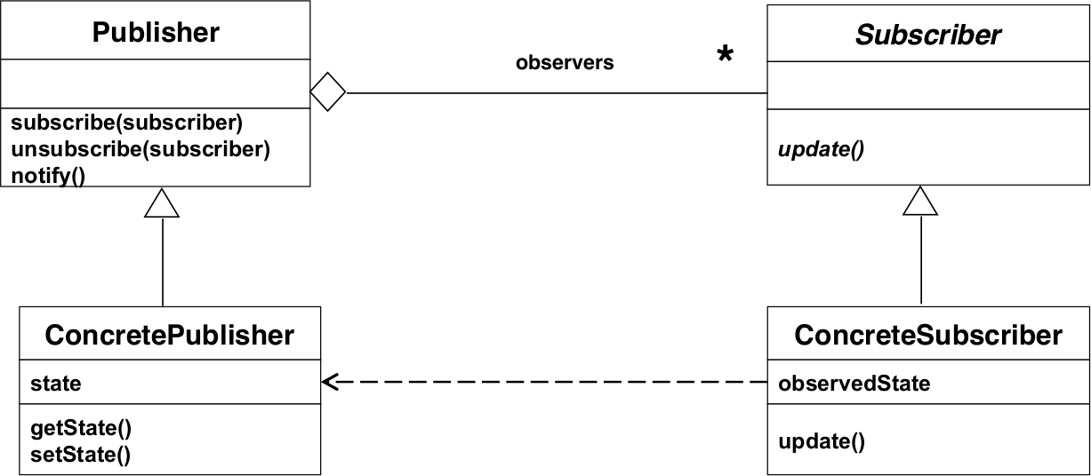
Observer Pattern

Slide 16
Observer Pattern
Handles changes in a publisher class and notifies all subscribers about that change
Maintains consistency
Decouples an abstraction from ist views
Three variants
  Push Notification: Every time a state changes, all subscribers are notified
  Push-Update Notification: The publisher also sends the state that has changed
  Pull Notification: A subscriber inquiries about the state of the publisher

Slide 17
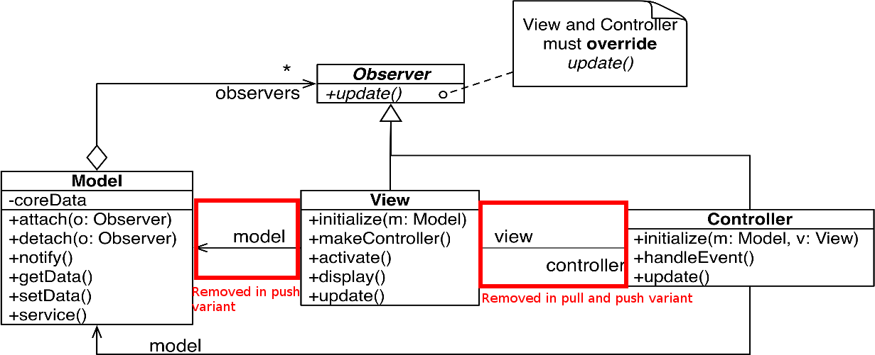
Model View Controller Pattern

Slide 18
Model View Controller Pattern
Decouples data access and data representation
The view handles the data representation
The model handles the data access
The controller handles the communication between the other two
Pull variant:
  Connection between the controller and the view is removed
  The view asks the model for the data explicitly
Push notification variant:
  Both connections between view and model and controller are removed
  When a change in the model occurs, the view and controller are updated via the observer pattern

Slide 19
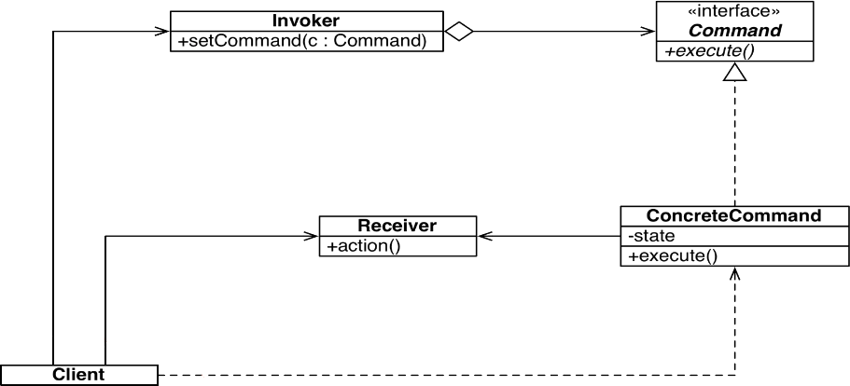
Command Pattern

Slide 20
Command Pattern
Design user interfaces with multiple commands without multiple if-statements
Used to make menus reusable across applications
Reduces complexity by decoupling boundary objects (menu buttons) from control objects (concrete objects)
Only these command objects can modify entity objects (the receivers)
When user interface changed, only boundary objects need to be modified
Command Applications:
  Command manager
  Redu/Undo manager
  Queue
  Dispatcher
5 steps to realize a command pattern
Create the command interface
Create the ConcreteCommand classes
Create the Receiver
Create the Invoker
Create the Client

Slide 21
Creational Patterns

Slide 22
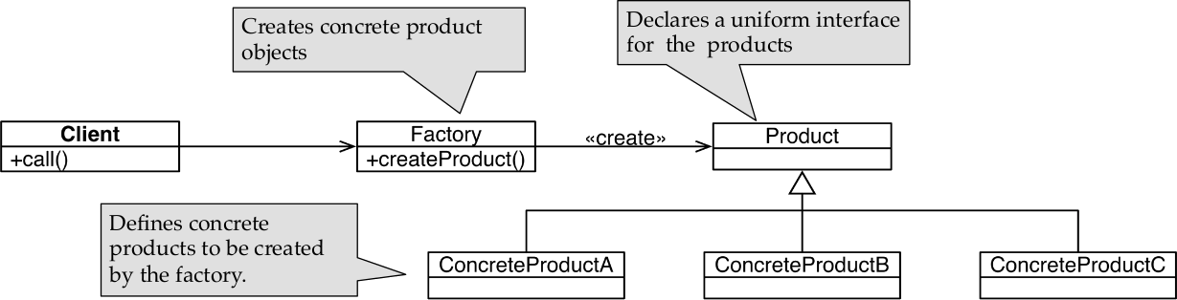
Factory Pattern

Slide 23
Factory Pattern
Handles the instantiation of objects inheriting from one superclass depending on a keyword or value
Acts as a delegate for the creation of products and allows the client to use a single interface to the products
Due to polymorphism the client can use each of the concrete products uniformly

Slide 24
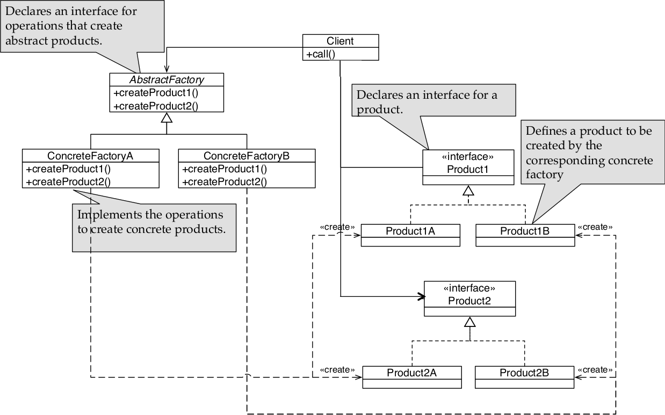
Abstract Factory Pattern

Slide 25
Abstract Factory Pattern
Instantiate or initialize an object consisting of more subparts
Every implementation of the abstract factory creates a set of components consisting of a variant of every part of the whole object

Slide 26
Comparisons
Adapter vs. Bridge
  Adapter (inheritance followed by delegation) handles incompabilities
  Bridge (delegation followed by inheritance) differentiates between abstraction and implementation up-front
Bridge vs. Strategy
  Bridge used for structural decisions on system startup
  Strategy handles behavioral decisions on runtime based on changing criteria
Strategy vs. State
  Strategy handles different algorithms at runtime
  State handles different states of an object in the architecture

Slide 27
Architectural Patterns

Slide 28
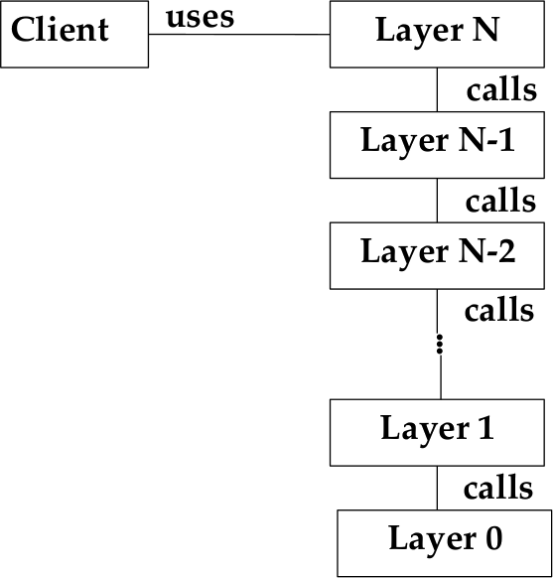
Layer Pattern
Advantages of the layer pattern
Reusability of layers, especially in a closed architecture
Support für standardization
Low coupling
Improved testability
Disadvantages
A local change in lower layer may require rework in higher layers
Lower efficiency

Slide 29
Layer Pattern
Closed Architecture (Opaque Layering)
Each layer can only call operations from the layer below
Open Architecture
Each layer can call operations from any layer below
5 Steps to create a Layered Architecture
Identify subsystems, specify interface for each layer
Structure the individual layers (patterns)
Specify the communication protocol between adjacent layers (push/pull)
Decouple adjacent layers (return results only as parameters to upper layers/use callbacks)
Design an error-handling strategy (handling on lowest possible layer)

Slide 30
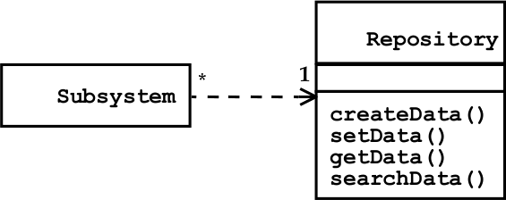
Repository Pattern

Slide 31
Repository Pattern
Used to support a collection of independent programs that work cooperatively on a common datastructure (Repository)
The subsystems exchange data via the repository and are therefore loosely coupled
The control flow is not specified
Control flow can be established by the subsystems themselves e.g. through locks and synchronization primitives

Slide 32
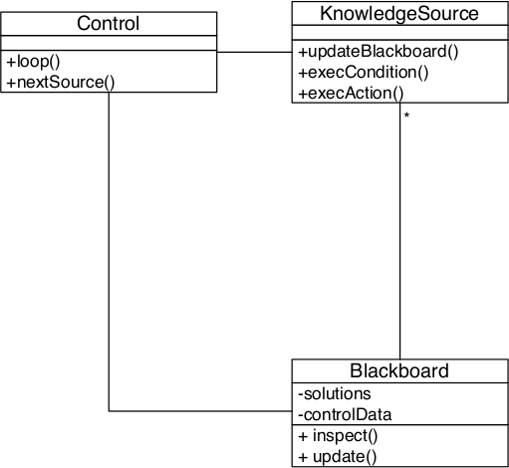
Blackboard Pattern
Advantages
Problem solving support
Changeability and maintainability
Fault tolerance and robustness
Disadvantages
Difficulty of testing
No solution guaranteed
Difficulty to establish a good control strategy
High development effort

Slide 33
Blackboard Pattern
Uses knowledge sources which communicate over a blackboard to solve a problem
Blackboard is the repository for the problem
Each knowledge source reads the content, processes it and generates new hypotheses
A control instance governs the flow of problem-solving activities
In general used when no algorithm for the problem is known
6 Steps to realize a Blackboard Pattern
Define the problem
Define the solution space
Identify the knowledge sources
Define the blackboard, identify needed representations
Define the control
Implement the knowledge sources

Slide 34
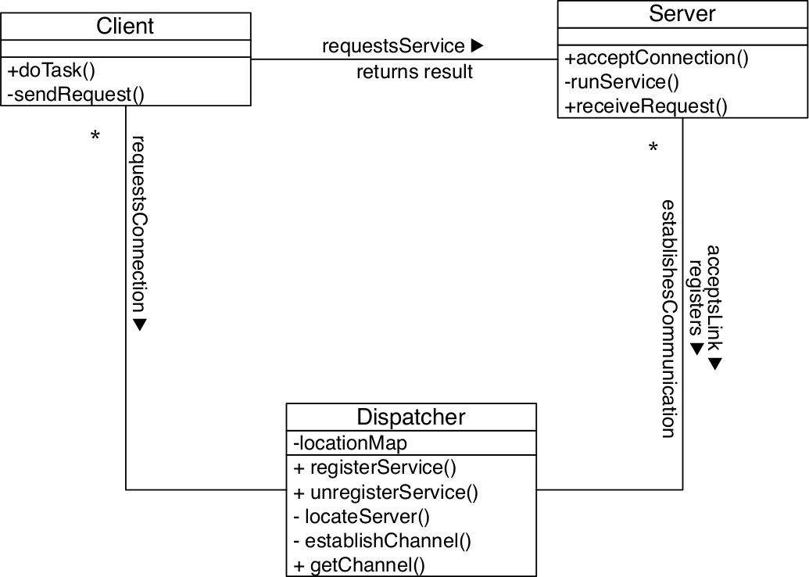
Client-Dispatcher-Server Pattern
Decouples client from server by seperating establishment of a connection and communication over the channel
Dispatcher allows the client to refer server by name instead of physical adress
Allows server to dynamically change it‘s location
CD protocol:
Spec. how a client must look for a server
Deals with communication errors
DS protocol:
Specifies how servers register with dispatcher
Determines activites needed to establish a communication channel between client and server
CS protocol:
Specifies the communication between client and server

Slide 35
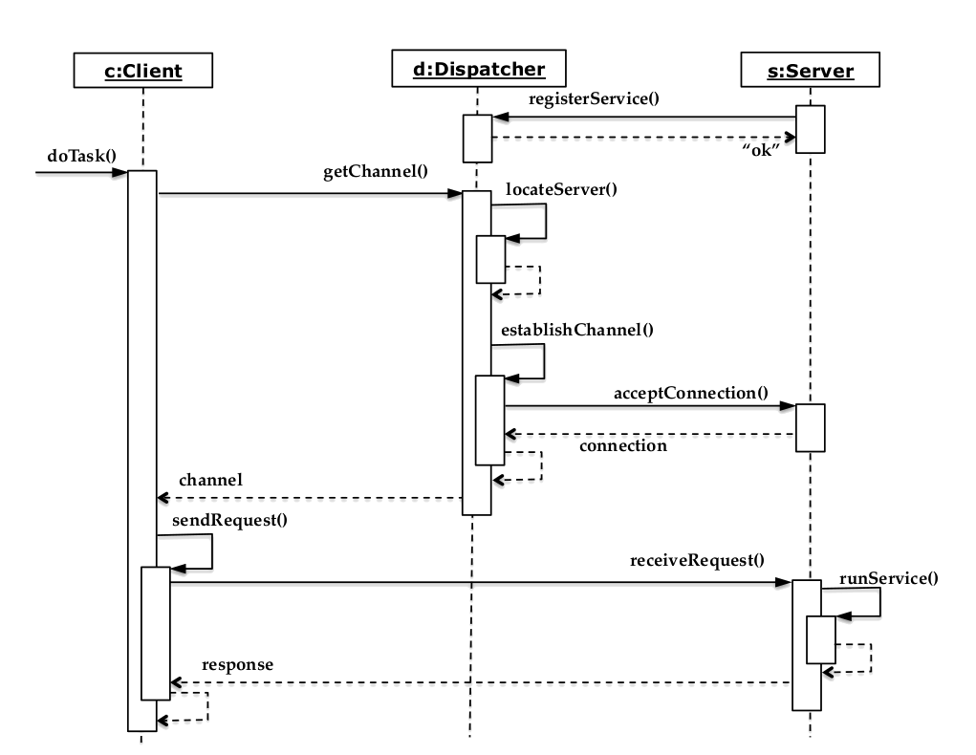
Client-Dispatcher-Server Pattern
6 Steps to implement Client-Server-Disp.
During system design, identify subsystems that act as clients and servers
Decide on the communication mechanism to be used for the protocols
Specify the protocols
Decide on a naming scheme for the dispatcher
Implement the dispatcher
Implement the client and server

Slide 36
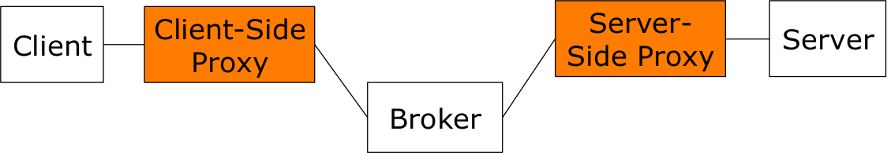
Broker Pattern
A broker coordinates the communication between heterogenous nodes
Nonfunctional requirements
Low coupling
Location Transparency
Runtime Extensibility
Platform Transparency
Client-Side Proxy
Lets the remote object appear as local one, hides the inter-process communication details
Provides(un-)marshalling

Slide 37
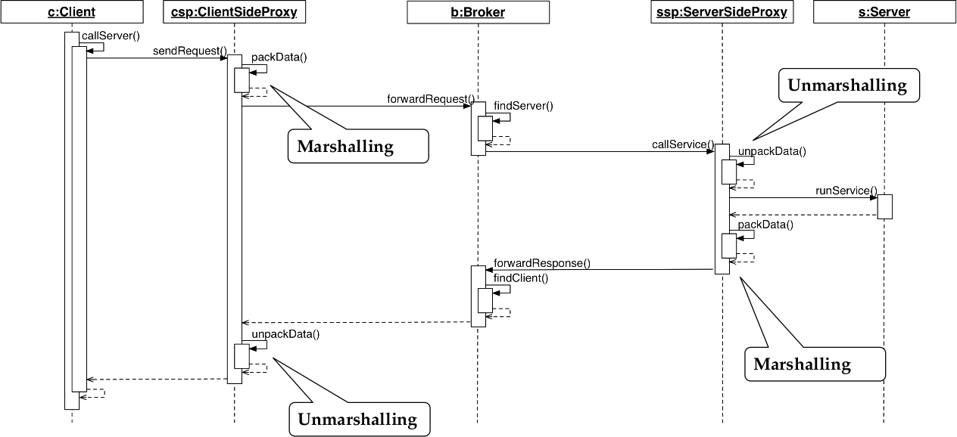
Broker Pattern
4 Steps to realize a Broker Pattern
Provide the object model and service definitions
Define the broker service
Implement the broker component and proxy object at the client and server side
Implement the client and server

