Slide 1
Record Cards
Patterns in Software Engineering
Marcel Bruckner
Prof. Bruegge
WS 2017/18

Slide 2
Design Patterns

Slide 3
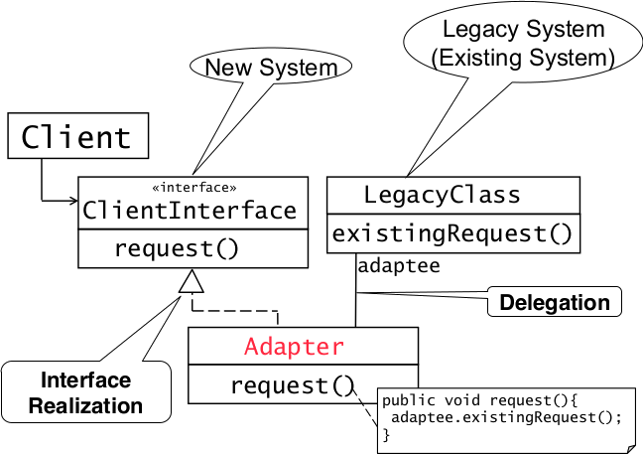
Adapter Pattern

Slide 4
Adapter Pattern
Connects incompatible components
Reuse existing components
Convert an interface to another interface

Slide 5
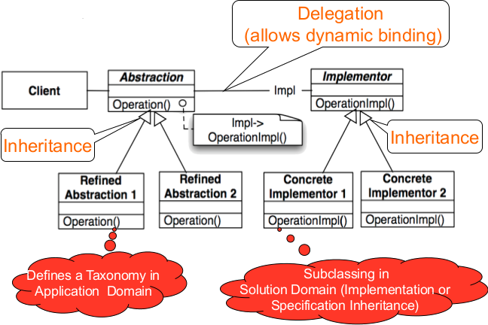
Bridge Pattern

Slide 6
Bridge Pattern
Allows to delay assignment of an implementation of an interface from compile to runtime
Degenerated Bridge is the same without taxonomy in application domain
Used to test application with mocks (e.g. component not yet implemented..)
Or support multiple vendors of a specific service (e.g. Database vendors..)
Used up-front in a design to let abstractions and implementations vary independently

Slide 7
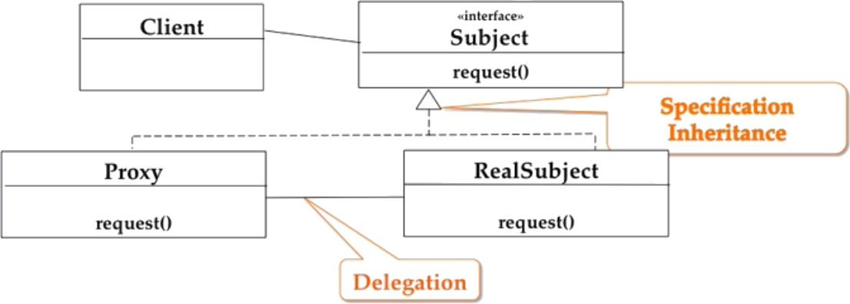
Proxy Pattern
The client never calls request() in RealSubject, instead it always calls the method in Proxy which might delegate it to RealSubject

Slide 8
Proxy Pattern
Allows to defer object creation and object initialization to the time you need the object
Use cases:
Caching (Remote Proxy)
Local objects representative for object in different adress space
Substitute (Virtual Proxy)
Object is expensive to create/download, proxy acts as stand-in
Access Control (Protection Proxy/Firewall)
Proxy object provides access control to the real object

Slide 9
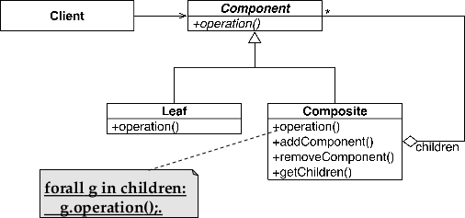
Composite Pattern

Slide 10
Behavioral Patterns

Slide 11
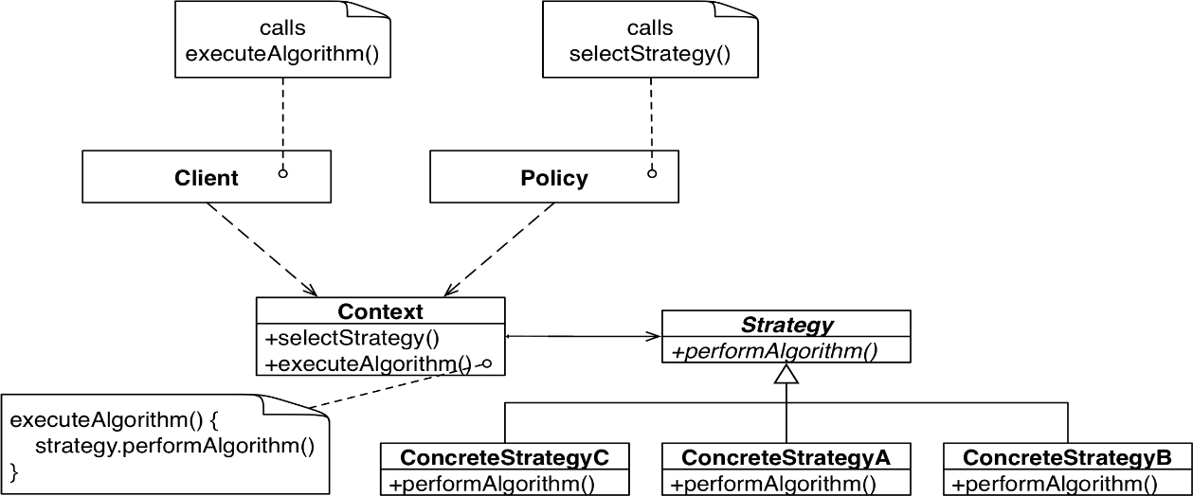
Strategy Pattern
A strategy is chosen on runtime by the Policy class before the client calls executeAlgorithm()

Slide 12
Strategy Pattern
Suited for situations where different algorithms are available for a problem
In contrast to the bridge pattern (structural decisions) it choses the implementation to use at runtime and therefore alters the bahavior

