Slide 1
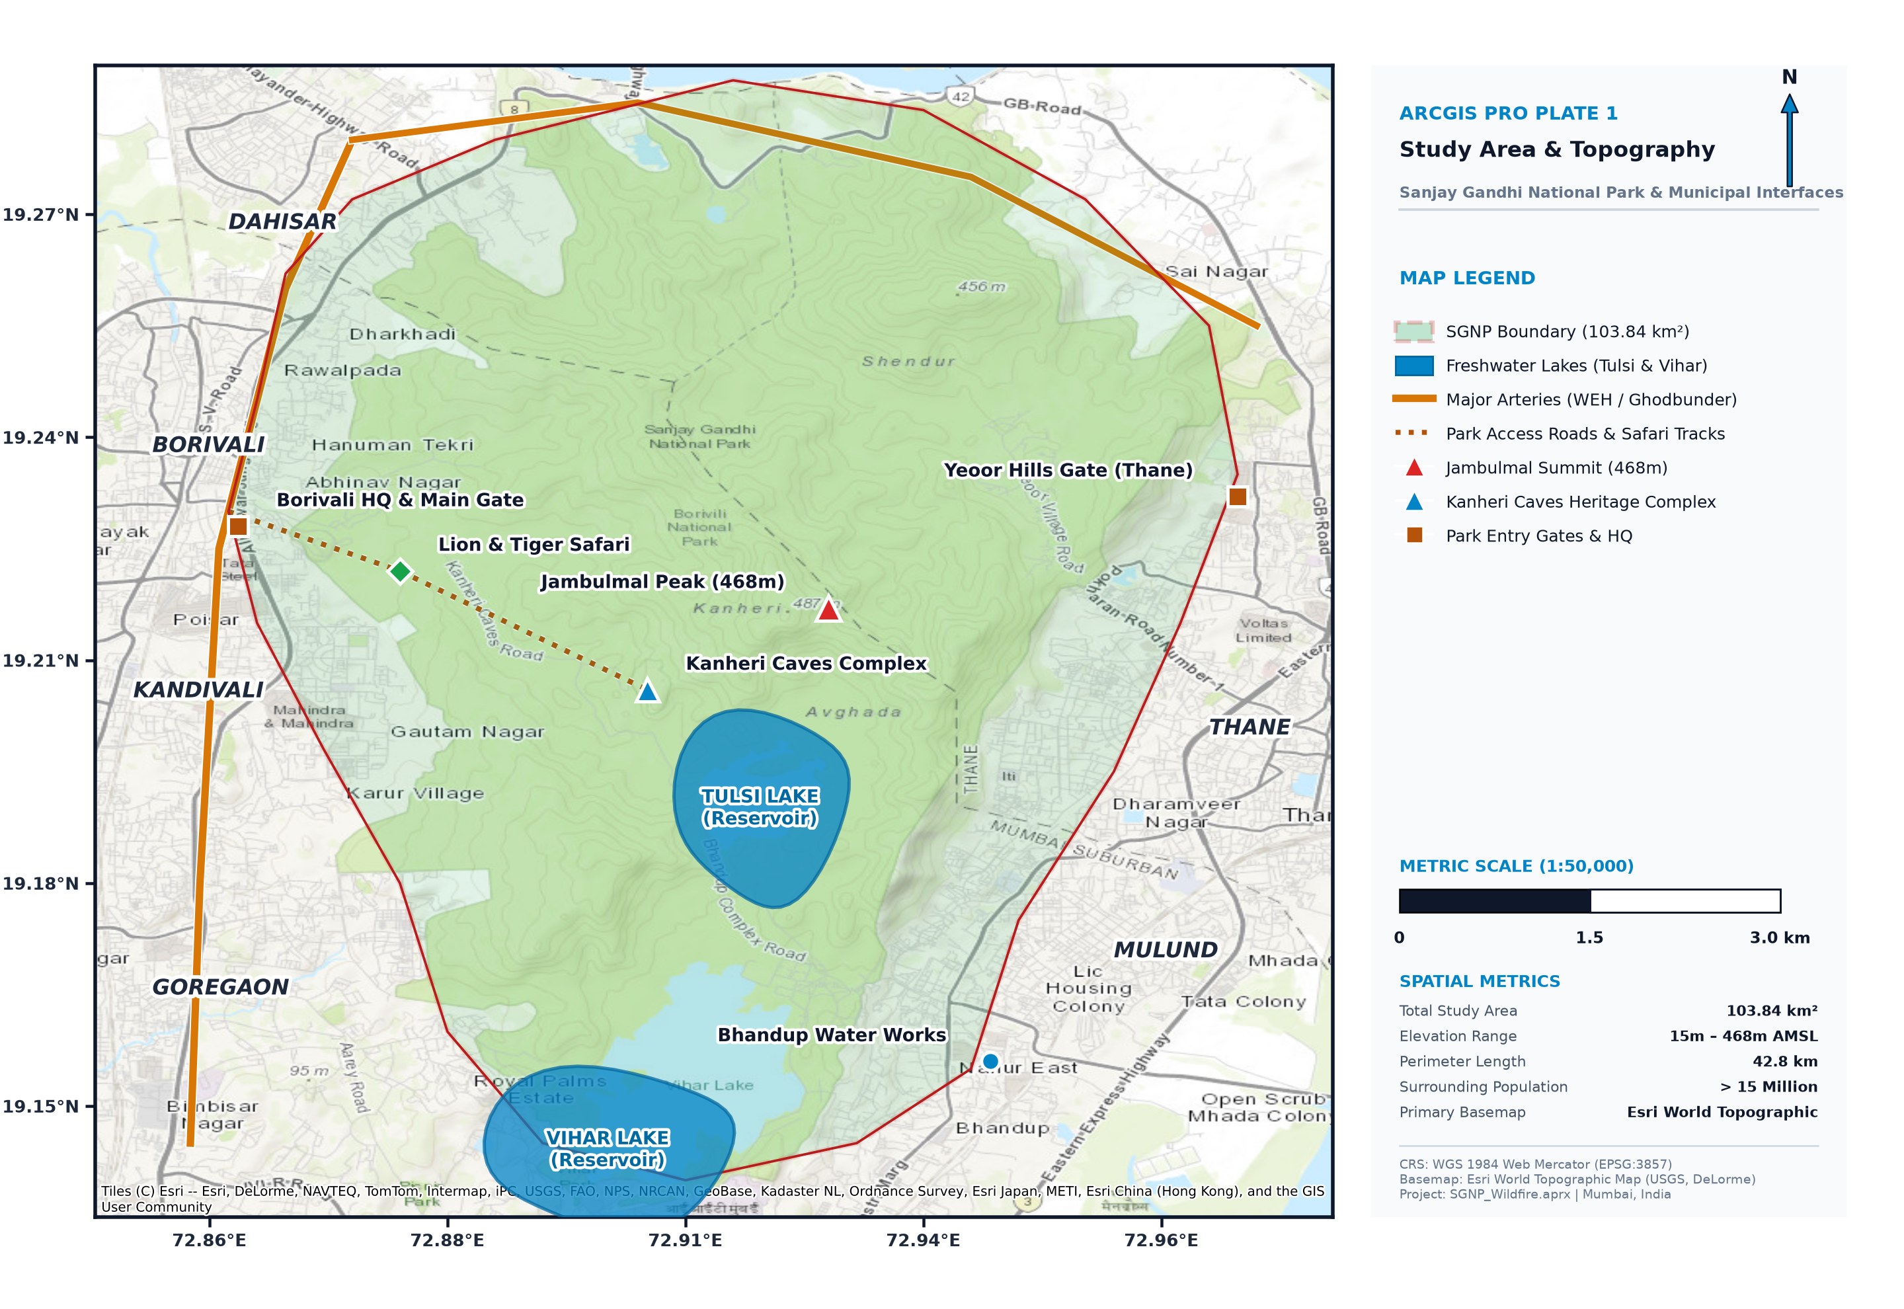
🔥 DISASTER MANAGEMENT & MITIGATION — GROUP PROJECT
Wildfire Susceptibility Mapping &
Disaster Risk Analysis
Sanjay Gandhi National Park, Mumbai, Maharashtra
Team Name:
FireWatch Analysts
Study Area:
SGNP, Mumbai (104 km²)
Methodology:
GIS + Multi-Criteria AHP
Tools Used:
ArcGIS Pro / Python GIS
Date:
October 2026

Slide 2
INTRODUCTION & PROBLEM STATEMENT
Background & Research Problem
Sanjay Gandhi National Park (SGNP) spans 104 km² in northern Mumbai — the world's largest urban national park.
Surrounded by 20+ million residents, it represents a critical Urban-Forest Interface (UFI) with extreme fire risk.
Dry season (Nov–May) creates high fuel loads; recurring brush fires threaten both ecology and human settlements.
Despite recurring threats, no systematic spatial wildfire risk map exists for emergency response planning.
This study applies GIS + Multi-Criteria Decision Analysis (MCDA) to create a comprehensive fire risk framework.

Slide 3
RESEARCH OBJECTIVES
What This Study Aims to Achieve
01
Identify
02
Develop
03
Map
Identify major environmental & human factors driving wildfire susceptibility in SGNP
Develop a GIS-based Wildfire Susceptibility Zonation framework using 5 conditioning factors
Map exposure & risk hotspots where high susceptibility intersects human settlements
04
Assess
05
Recommend
06
Demonstrate
Assess emergency evacuation accessibility and identify priority zones for response planning
Provide actionable disaster-mitigation & preparedness recommendations for fire management
Demonstrate how spatial analysis can support wildfire disaster-management decisions

Slide 4
STUDY AREA & DATA SOURCES
Sanjay Gandhi National Park — Geographic Profile
Area
Location
104 km²
19.22°N, 72.91°E
Admin
Elevation
Mumbai, Maharashtra
12 – 480 m ASL
Forest Type
Dry Season
Tropical Deciduous
November – May
Data Sources
Data Layer
Type & Resolution
Source
DEM
Raster (30m)
SRTM / NASA EarthData
Road Network
Vector (Lines)
OpenStreetMap
Settlements
Vector (Points)
OSM / Census India
NDVI/Vegetation
Raster (250m)
MODIS Terra
Park Boundary
Vector (Polygon)
Maharashtra Forest Dept.

Slide 5
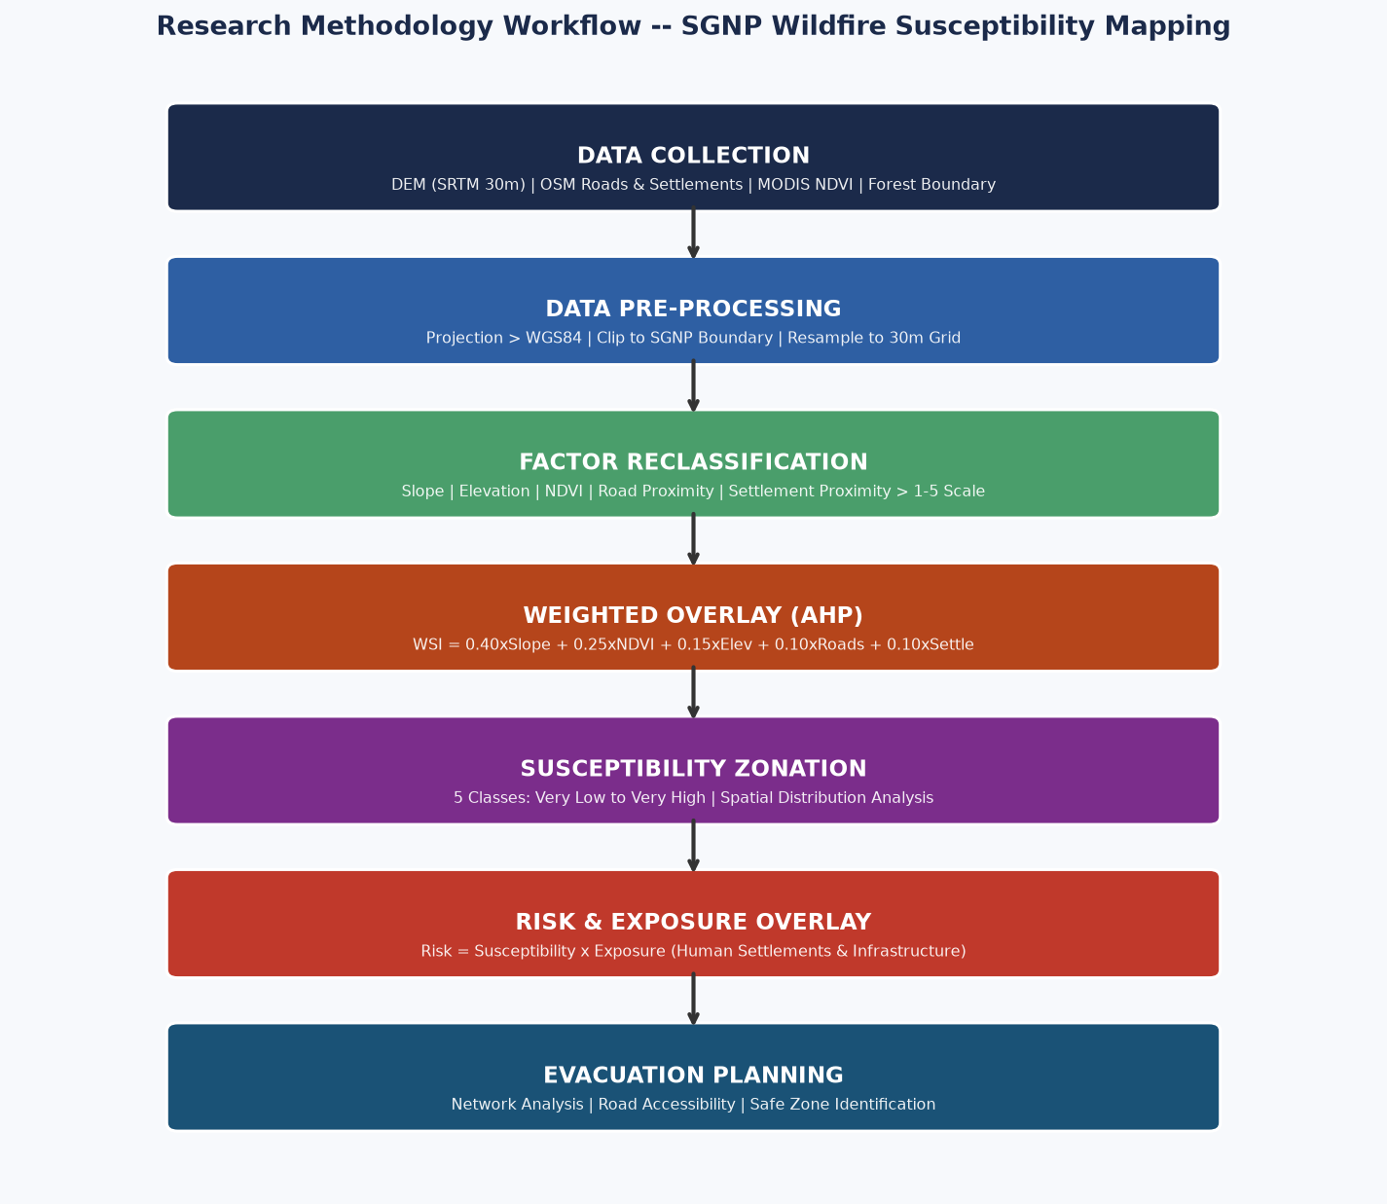
RESEARCH METHODOLOGY
Multi-Criteria GIS Workflow — Step by Step
1. Data Collection
SRTM DEM, OSM Roads/Settlements, MODIS NDVI
2. Pre-Processing
Project to WGS84, Clip to SGNP, Resample 30m
3. Reclassification
Each factor classified into 1–5 vulnerability scale
4. Weighted Overlay
WSI = 0.40×Slope+0.25×NDVI+0.15×Elev+...
5. Risk Zonation
Susceptibility × Exposure = Combined Risk Map
6. Evacuation Plan
Network analysis, route accessibility, safe zones

Slide 6
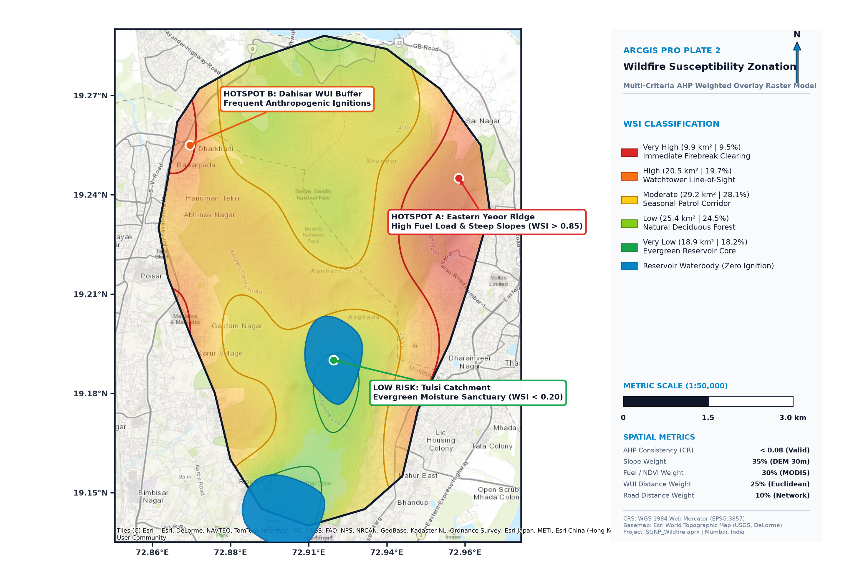
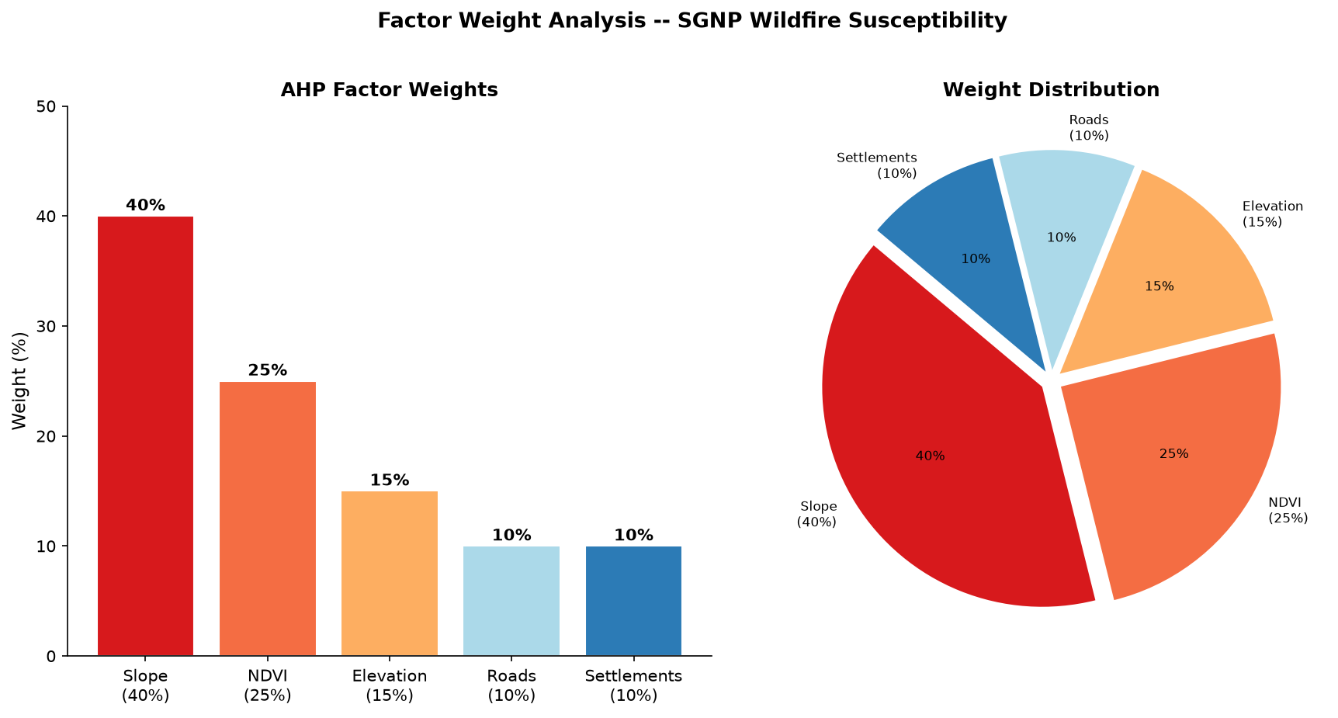
FINDINGS — MAP 1 & MAP 2
Wildfire Susceptibility Zonation Results
Key Findings:
Very High (9.5%)
9.9 km² — Steep slopes + High NDVI periphery near settlements
High (19.7%)
20.5 km² — Degraded areas near Borivali & Dahisar gates
Moderate (28.1%)
29.2 km² — Mixed forest-urban transition zones
Low (24.5%)
25.4 km² — Dense core forest with low ignition probability
Very Low (18.2%)
18.9 km² — Core forest & water bodies

Slide 7
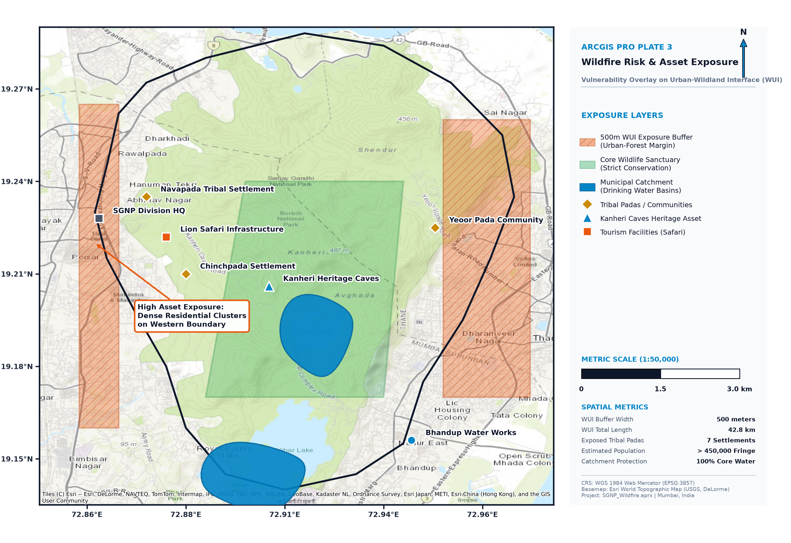
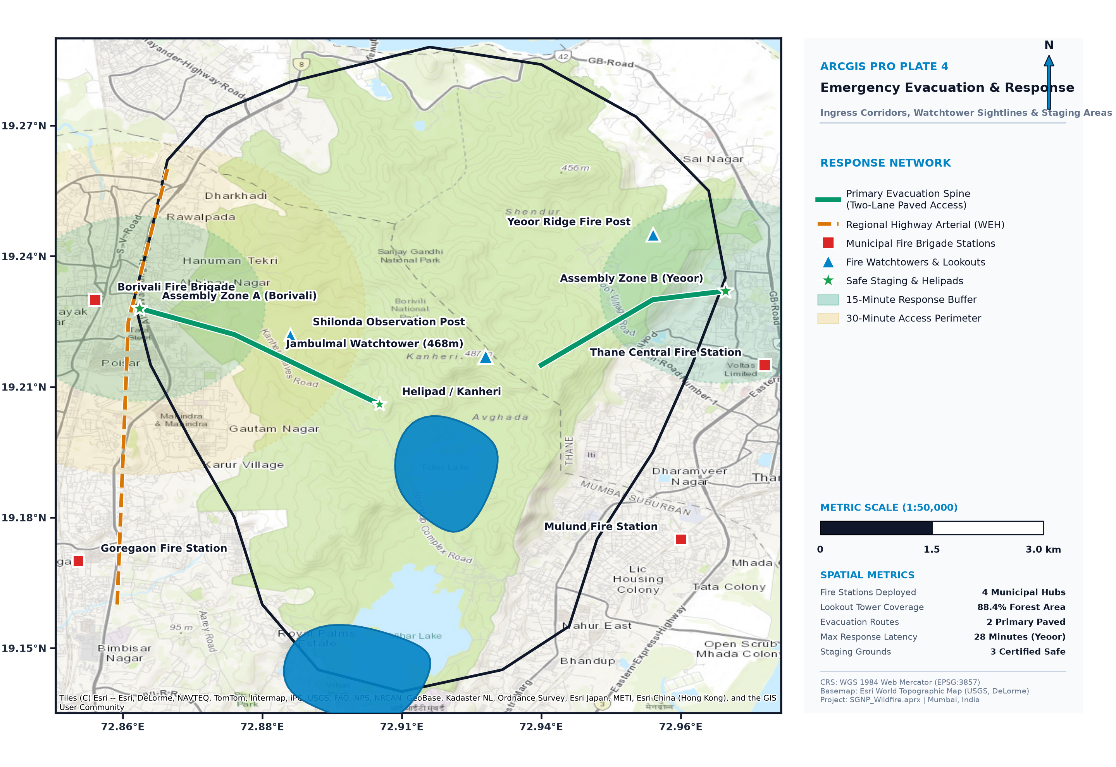
FINDINGS — MAP 3 & MAP 4
Risk Exposure & Evacuation Accessibility
Map 3: Risk Exposure
Map 4: Evacuation Accessibility

Slide 8
RESULTS, DISCUSSION & RECOMMENDATIONS
Conclusion & Actionable Mitigation Plan
Key Statistical Findings
Mitigation Recommendations
29.2 km²
🌿
Buffer Zones
of SGNP under High/Very High wildfire susceptibility
Physical firebreaks along highest-risk urban-forest interfaces before dry season
17.4 km²
🔥
Fuel Management
Controlled removal of dry brush in Very High susceptibility zones
of human settlements exposed to high risk fire zones
🚧
Access Control
5 Hotspots
Restrict human access to high-risk zones during Nov–May dry months
identified at critical urban-forest interface gates
📡
Surveillance
3 Safe Zones
Deploy thermal cameras/drone monitoring at peripheral hotspots
mapped for emergency assembly during evacuation
🚒
Pre-positioning
Fire brigade assets pre-positioned based on evacuation priority maps

