Slide 1
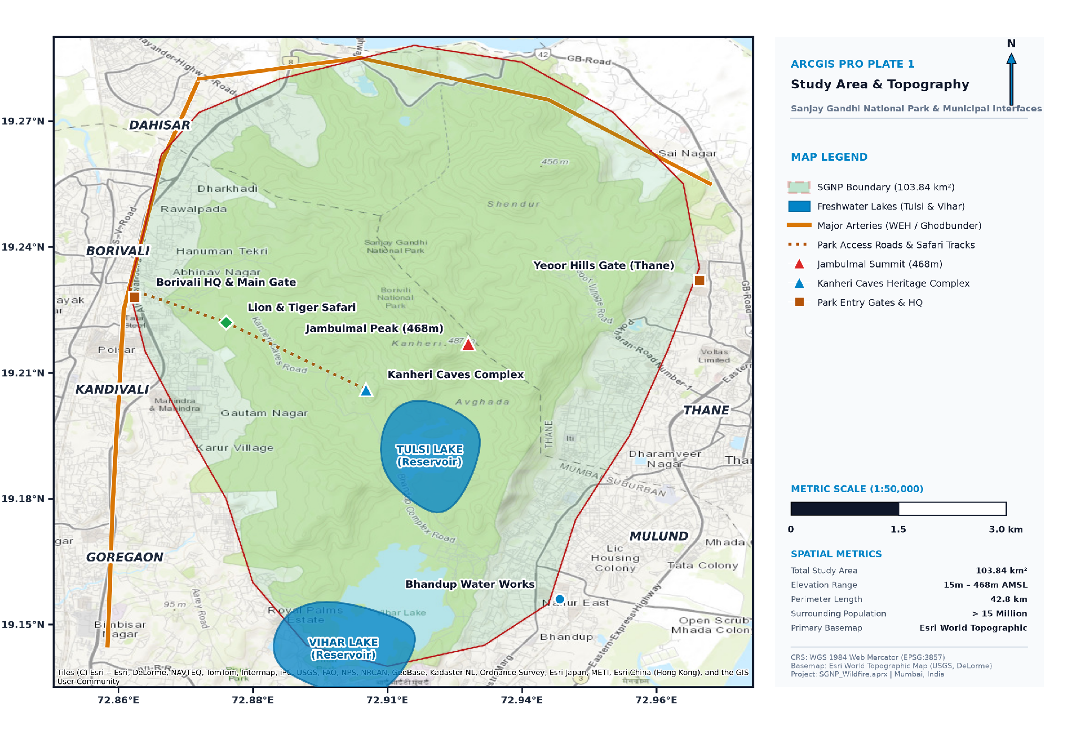
DISASTER MANAGEMENT & MITIGATION
OCTOBER 2026
WILDFIRE
SUSCEPTIBILITY MAPPING
Disaster Risk Analysis
Sanjay Gandhi National Park
Mumbai, Maharashtra
TEAM
FireWatch Analysts
STUDY AREA
SGNP, Mumbai (104 km²)
MEMBER NAMES / ROLL NUMBERS
1.Aniket Dhoke | Roll No.- 10
2. Jude Fernandez | Roll No. 14
3.Atharva Gawkar | Roll No. 17
4. Paras Ghanekar | Roll No. 18
5. Abdul Khalik Idrisi | Roll No. 20
6. Nissim Toke | Roll No. 61
A GIS + AHP framework for susceptibility, exposure and evacuation planning
SGNP WILDFIRE RISK ANALYSIS • OCTOBER 2026
01

Slide 2
CONTEXT
OCTOBER 2026
A high-value forest sits at a high-pressure urban interface
Background and problem statement as provided in the source deck.
Scale
SGNP spans 104 km² in northern Mumbai and is described in the source as the world’s largest urban national park.
Urban–forest interface
The park is surrounded by 20+ million residents, creating a critical urban–forest interface (UFI).
Seasonality
The dry season (November–May) raises fuel-load concerns; recurring brush fires threaten ecology and human settlements.
Planning gap
The source identifies a lack of a systematic spatial wildfire-risk map for emergency response planning.
Study response
The project applies GIS + Multi-Criteria Decision Analysis (MCDA) to create a spatial fire-risk framework.
Study-area map plate highlights the park boundary, lakes, arterial roads, gates, ridges and surrounding urban municipalities.
SGNP WILDFIRE RISK ANALYSIS • OCTOBER 2026
02

Slide 3
OBJECTIVES
OCTOBER 2026
Six objectives frame the analysis from susceptibility to response
Objectives reproduced from the source presentation.
01
Identify
02
Develop
03
Map
Major environmental and human factors driving wildfire susceptibility in SGNP.
A GIS-based Wildfire Susceptibility Zonation framework using five conditioning factors.
Exposure and risk hotspots where high susceptibility intersects human settlements.
04
Assess
05
Recommend
06
Demonstrate
Emergency evacuation accessibility and priority zones for response planning.
Actionable disaster-mitigation and preparedness actions for fire management.
How spatial analysis can support wildfire disaster-management decisions.
SGNP WILDFIRE RISK ANALYSIS • OCTOBER 2026
03

Slide 4
STUDY AREA & DATA
OCTOBER 2026
Study area and data sources
SGNP, Mumbai • 104 km² • 19.22°N, 72.91°E • Tropical deciduous forest • Dry season: Nov–May
DATA LAYER / TYPE / SCALE
SOURCE
DEM
SRTM / NASA EarthData
Raster · 30 m
Road network
OpenStreetMap
Vector · lines
Settlements
OSM / Census India
Vector · points
NDVI / vegetation
MODIS Terra
Raster · 250 m
Park boundary
Maharashtra Forest Dept.
Vector · polygon
SGNP WILDFIRE RISK ANALYSIS • OCTOBER 2026
04

Slide 5
METHODOLOGY
OCTOBER 2026
A seven-step GIS workflow turns spatial layers into response priorities
Multi-Criteria Decision Analysis (MCDA) with AHP-weighted overlay.
01
Data collection
SRTM DEM · OSM roads and settlements · MODIS NDVI · forest boundary
02
Pre-processing
Project to WGS84 · clip to SGNP · resample to 30 m grid
03
Factor reclassification
Slope · elevation · NDVI · road proximity · settlement proximity; each factor on a 1–5 scale
04
Weighted overlay (AHP)
WSI = 0.40×Slope + 0.25×NDVI + 0.15×Elevation + 0.10×Roads + 0.10×Settlements
05
Susceptibility zonation
Classify the weighted index into five classes, from Very Low to Very High
06
Risk and exposure overlay
Risk = susceptibility × exposure (human settlements and infrastructure)
07
Evacuation planning
Network analysis · road accessibility · safe-zone identification
The source deck also contains a colored workflow graphic; this slide re-expresses its stages in the supplied light theme.
SGNP WILDFIRE RISK ANALYSIS • OCTOBER 2026
05

Slide 6
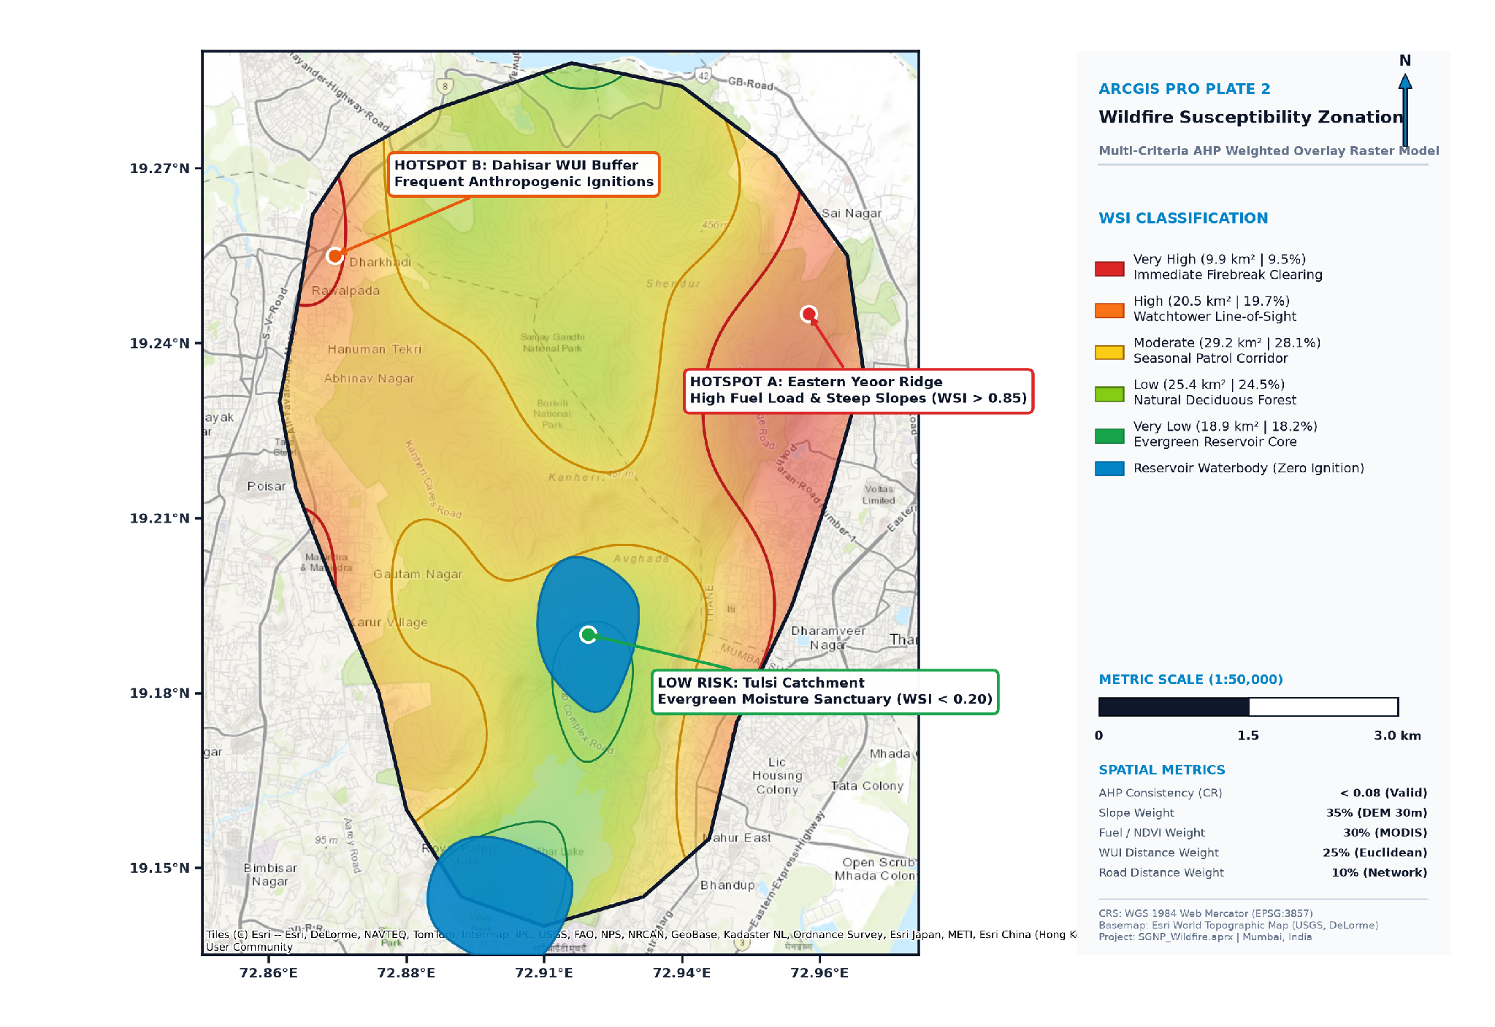
RESULTS · MAP 2
OCTOBER 2026
Susceptibility zones vary from exposed edges to moist core areas
Map plate and class statistics reproduced from the source deck.
AREA SHARE BY CLASS
Very High
9.9 km² · 9.5%
Steep slopes and high NDVI periphery near settlements
High
20.5 km² · 19.7%
Degraded areas near Borivali and Dahisar gates
Moderate
29.2 km² · 28.1%
Mixed forest–urban transition zones
Low
25.4 km² · 24.5%
Dense core forest with low ignition probability
Very Low
18.9 km² · 18.2%
Core forest and water bodies
The map legend additionally marks reservoir waterbodies as “zero ignition.”
SGNP WILDFIRE RISK ANALYSIS • OCTOBER 2026
06

Slide 7
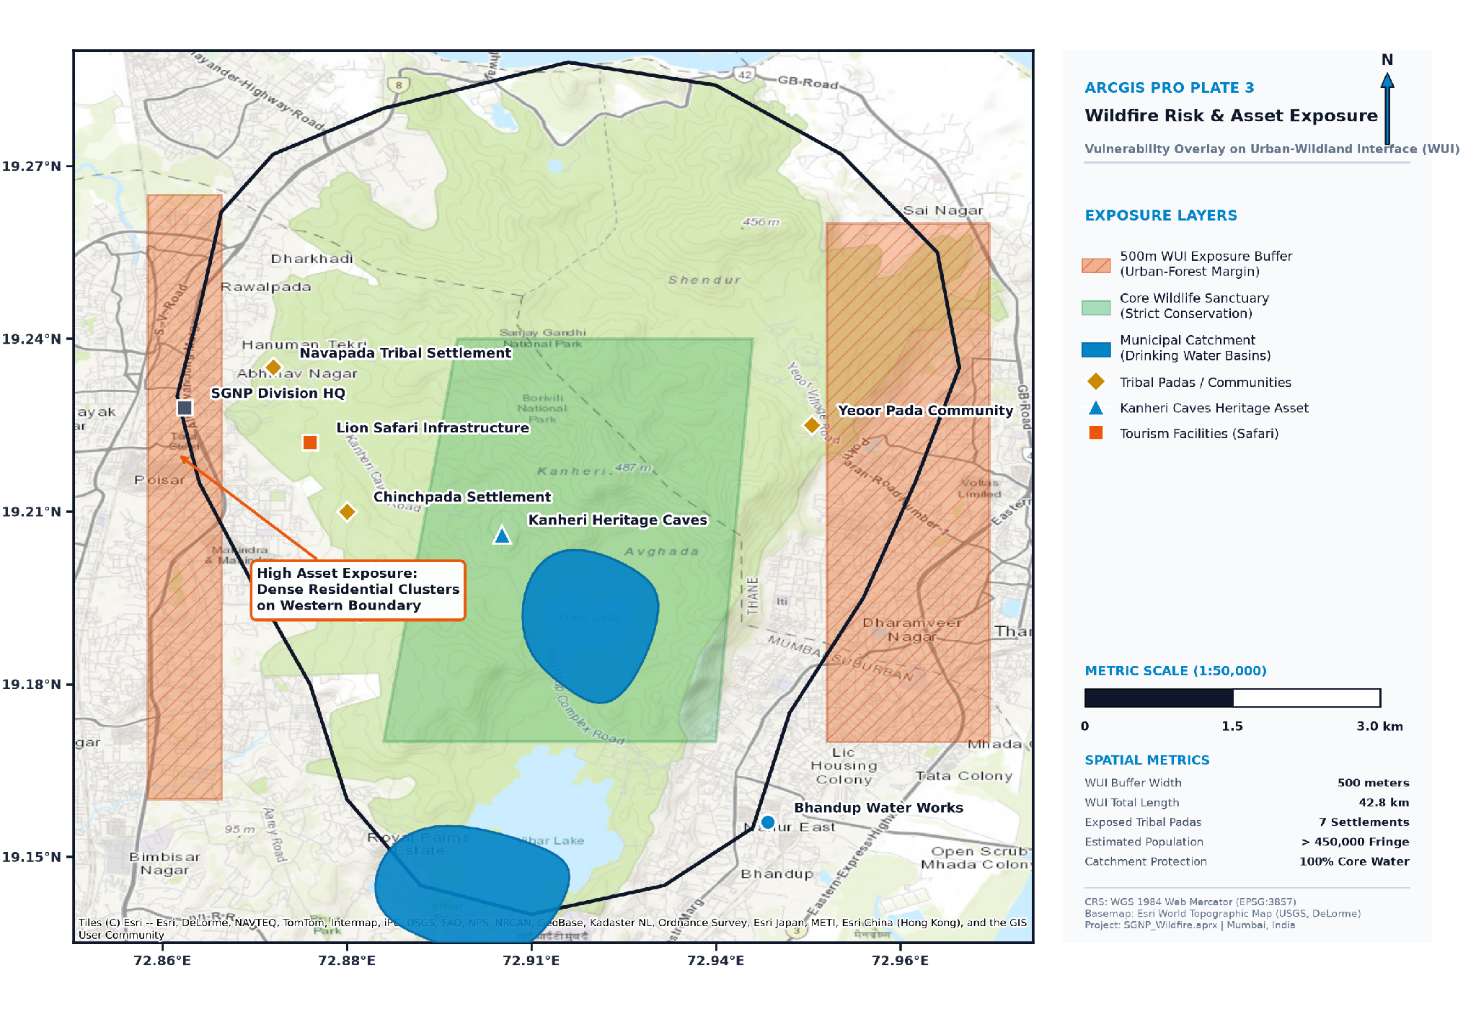
RESULTS · MAP 3
OCTOBER 2026
Exposure is concentrated along the urban–forest margin
Risk exposure map, asset layers and map-plate metrics from the source.
EXPOSURE INDICATORS
500 m
WUI exposure buffer
42.8 km
WUI total length
7
Exposed tribal padas / settlements
>450,000
Estimated fringe population
100%
Core water catchment protection shown
MAP CALLOUT
Dense residential clusters are marked as high asset exposure on the western boundary.
SGNP WILDFIRE RISK ANALYSIS • OCTOBER 2026
07

Slide 8
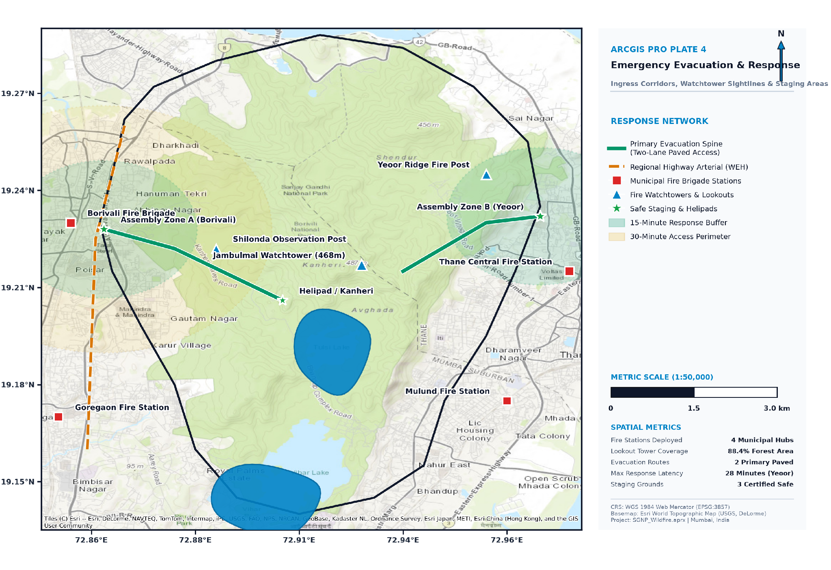
RESULTS · MAP 4
OCTOBER 2026
Accessibility analysis is intended to guide safe movement
Source framework: network analysis, road accessibility and safe-zone identification.
3
42.8 km
Safe zones mapped
WUI interface length
Planning logic
Use the road network and access routes to identify reachable assembly locations and prioritize response access.
Operational use
Combine evacuation accessibility with susceptibility and exposure so response planning reflects both fire likelihood and people/assets at risk.
SGNP WILDFIRE RISK ANALYSIS • OCTOBER 2026
08

