Slide 1
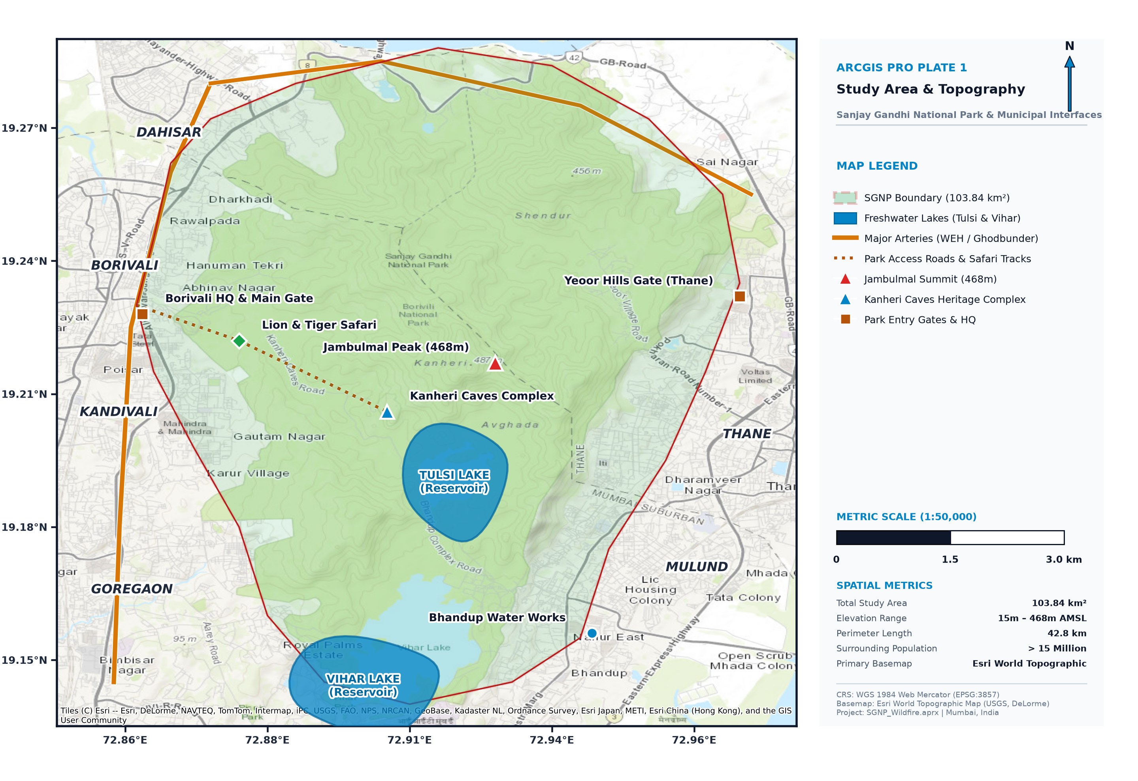
DISASTER MANAGEMENT & MITIGATION
OCTOBER 2026
WILDFIRE
SUSCEPTIBILITY MAPPING
Disaster Risk Analysis
Sanjay Gandhi National Park
Mumbai, Maharashtra
TEAM
FireWatch Analysts
STUDY AREA
SGNP, Mumbai (104 km²)
METHOD
GIS + Multi-Criteria AHP
TOOLS
ArcGIS Pro / Python GIS
A GIS + AHP framework for susceptibility, exposure and evacuation planning
SGNP WILDFIRE RISK ANALYSIS • OCTOBER 2026
01

Slide 2
EXECUTIVE OVERVIEW
OCTOBER 2026
The analysis connects terrain, vegetation and urban exposure
Source-reported headline findings from the SGNP wildfire presentation.
104 km²
5
5
3
Study area (reported)
Conditioning factors
Susceptibility classes
Mapped safe zones
What the framework does
Combines GIS layers through multi-criteria AHP, classifies wildfire susceptibility, overlays human and infrastructure exposure, then assesses evacuation accessibility.
Reported exposure
Priority signal
17.4 km² of human settlements are reported as exposed to high-risk fire zones.
The deck reports five hotspots at critical urban–forest interface gates; two are specifically labelled on the susceptibility map.
SGNP WILDFIRE RISK ANALYSIS • OCTOBER 2026
02

Slide 3
CONTEXT
OCTOBER 2026
A high-value forest sits at a high-pressure urban interface
Background and problem statement as provided in the source deck.
Scale
SGNP spans 104 km² in northern Mumbai and is described in the source as the world’s largest urban national park.
Urban–forest interface
The park is surrounded by 20+ million residents, creating a critical urban–forest interface (UFI).
Seasonality
The dry season (November–May) raises fuel-load concerns; recurring brush fires threaten ecology and human settlements.
Planning gap
The source identifies a lack of a systematic spatial wildfire-risk map for emergency response planning.
Study response
The project applies GIS + Multi-Criteria Decision Analysis (MCDA) to create a spatial fire-risk framework.
Study-area map plate highlights the park boundary, lakes, arterial roads, gates, ridges and surrounding urban municipalities.
SGNP WILDFIRE RISK ANALYSIS • OCTOBER 2026
03

Slide 4
OBJECTIVES
OCTOBER 2026
Six objectives frame the analysis from susceptibility to response
Objectives reproduced from the source presentation.
01
Identify
02
Develop
03
Map
Major environmental and human factors driving wildfire susceptibility in SGNP.
A GIS-based Wildfire Susceptibility Zonation framework using five conditioning factors.
Exposure and risk hotspots where high susceptibility intersects human settlements.
04
Assess
05
Recommend
06
Demonstrate
Emergency evacuation accessibility and priority zones for response planning.
Actionable disaster-mitigation and preparedness actions for fire management.
How spatial analysis can support wildfire disaster-management decisions.
SGNP WILDFIRE RISK ANALYSIS • OCTOBER 2026
04

Slide 5
STUDY AREA
OCTOBER 2026
SGNP’s topography meets a dense municipal edge
Geographic profile values shown in the source text and map plate.
AREA
LOCATION
104 km²
19.22°N, 72.91°E
ADMIN
ELEVATION
Mumbai, Maharashtra
12–480 m ASL
FOREST TYPE
DRY SEASON
Tropical deciduous
November–May
MAP-PLATE METADATA
Boundary: 103.84 km² • Elevation: 15–468 m AMSL
Perimeter: 42.8 km • Surrounding population: >15 million
Basemap: Esri World Topographic • CRS: WGS 1984 Web Mercator (EPSG:3857)
SGNP WILDFIRE RISK ANALYSIS • OCTOBER 2026
05

Slide 6
INPUTS
OCTOBER 2026
Five spatial layers supply the analysis
Source inventory: layer, geometry/resolution and provider.
DATA LAYER
TYPE / RESOLUTION
SOURCE
ROLE IN WORKFLOW
DEM
Raster · 30 m
SRTM / NASA EarthData
Derive slope and elevation
Road network
Vector · lines
OpenStreetMap
Road proximity and access network
Settlements
Vector · points
OSM / Census India
Settlement proximity and exposure
NDVI / vegetation
Raster · 250 m
MODIS Terra
Vegetation / fuel-condition proxy
Park boundary
Vector · polygon
Maharashtra Forest Dept.
Study-area clip and boundary
Pre-processing listed in the source: project to WGS84, clip to the SGNP boundary, and resample to a 30 m grid.
SGNP WILDFIRE RISK ANALYSIS • OCTOBER 2026
06

Slide 7
METHODOLOGY
OCTOBER 2026
A seven-step GIS workflow turns spatial layers into response priorities
Multi-Criteria Decision Analysis (MCDA) with AHP-weighted overlay.
01
Data collection
SRTM DEM · OSM roads and settlements · MODIS NDVI · forest boundary
02
Pre-processing
Project to WGS84 · clip to SGNP · resample to 30 m grid
03
Factor reclassification
Slope · elevation · NDVI · road proximity · settlement proximity; each factor on a 1–5 scale
04
Weighted overlay (AHP)
WSI = 0.40×Slope + 0.25×NDVI + 0.15×Elevation + 0.10×Roads + 0.10×Settlements
05
Susceptibility zonation
Classify the weighted index into five classes, from Very Low to Very High
06
Risk and exposure overlay
Risk = susceptibility × exposure (human settlements and infrastructure)
07
Evacuation planning
Network analysis · road accessibility · safe-zone identification
The source deck also contains a colored workflow graphic; this slide re-expresses its stages in the supplied light theme.
SGNP WILDFIRE RISK ANALYSIS • OCTOBER 2026
07

Slide 8
AHP MODEL
OCTOBER 2026
Slope carries the largest weight in the five-factor formulation
Weights reproduced from the source workflow and factor-weight chart.
AHP FACTOR WEIGHTS
WEIGHTED SUSCEPTIBILITY INDEX
Slope
40%
WSI = 0.40×Slope
+ 0.25×NDVI + 0.15×Elevation
+ 0.10×Roads + 0.10×Settlements
NDVI
25%
Elevation
15%
Interpretation
Roads
10%
The chart places slope first (40%), vegetation second (25%), elevation third (15%), and roads and settlements at 10% each.
Settlements
10%
Important review note
A separate map plate reports 35% slope, 30% fuel/NDVI, 25% WUI distance and 10% road distance. See the final review slide before relying on either specification.
Total weight = 100%
SGNP WILDFIRE RISK ANALYSIS • OCTOBER 2026
08

Slide 9
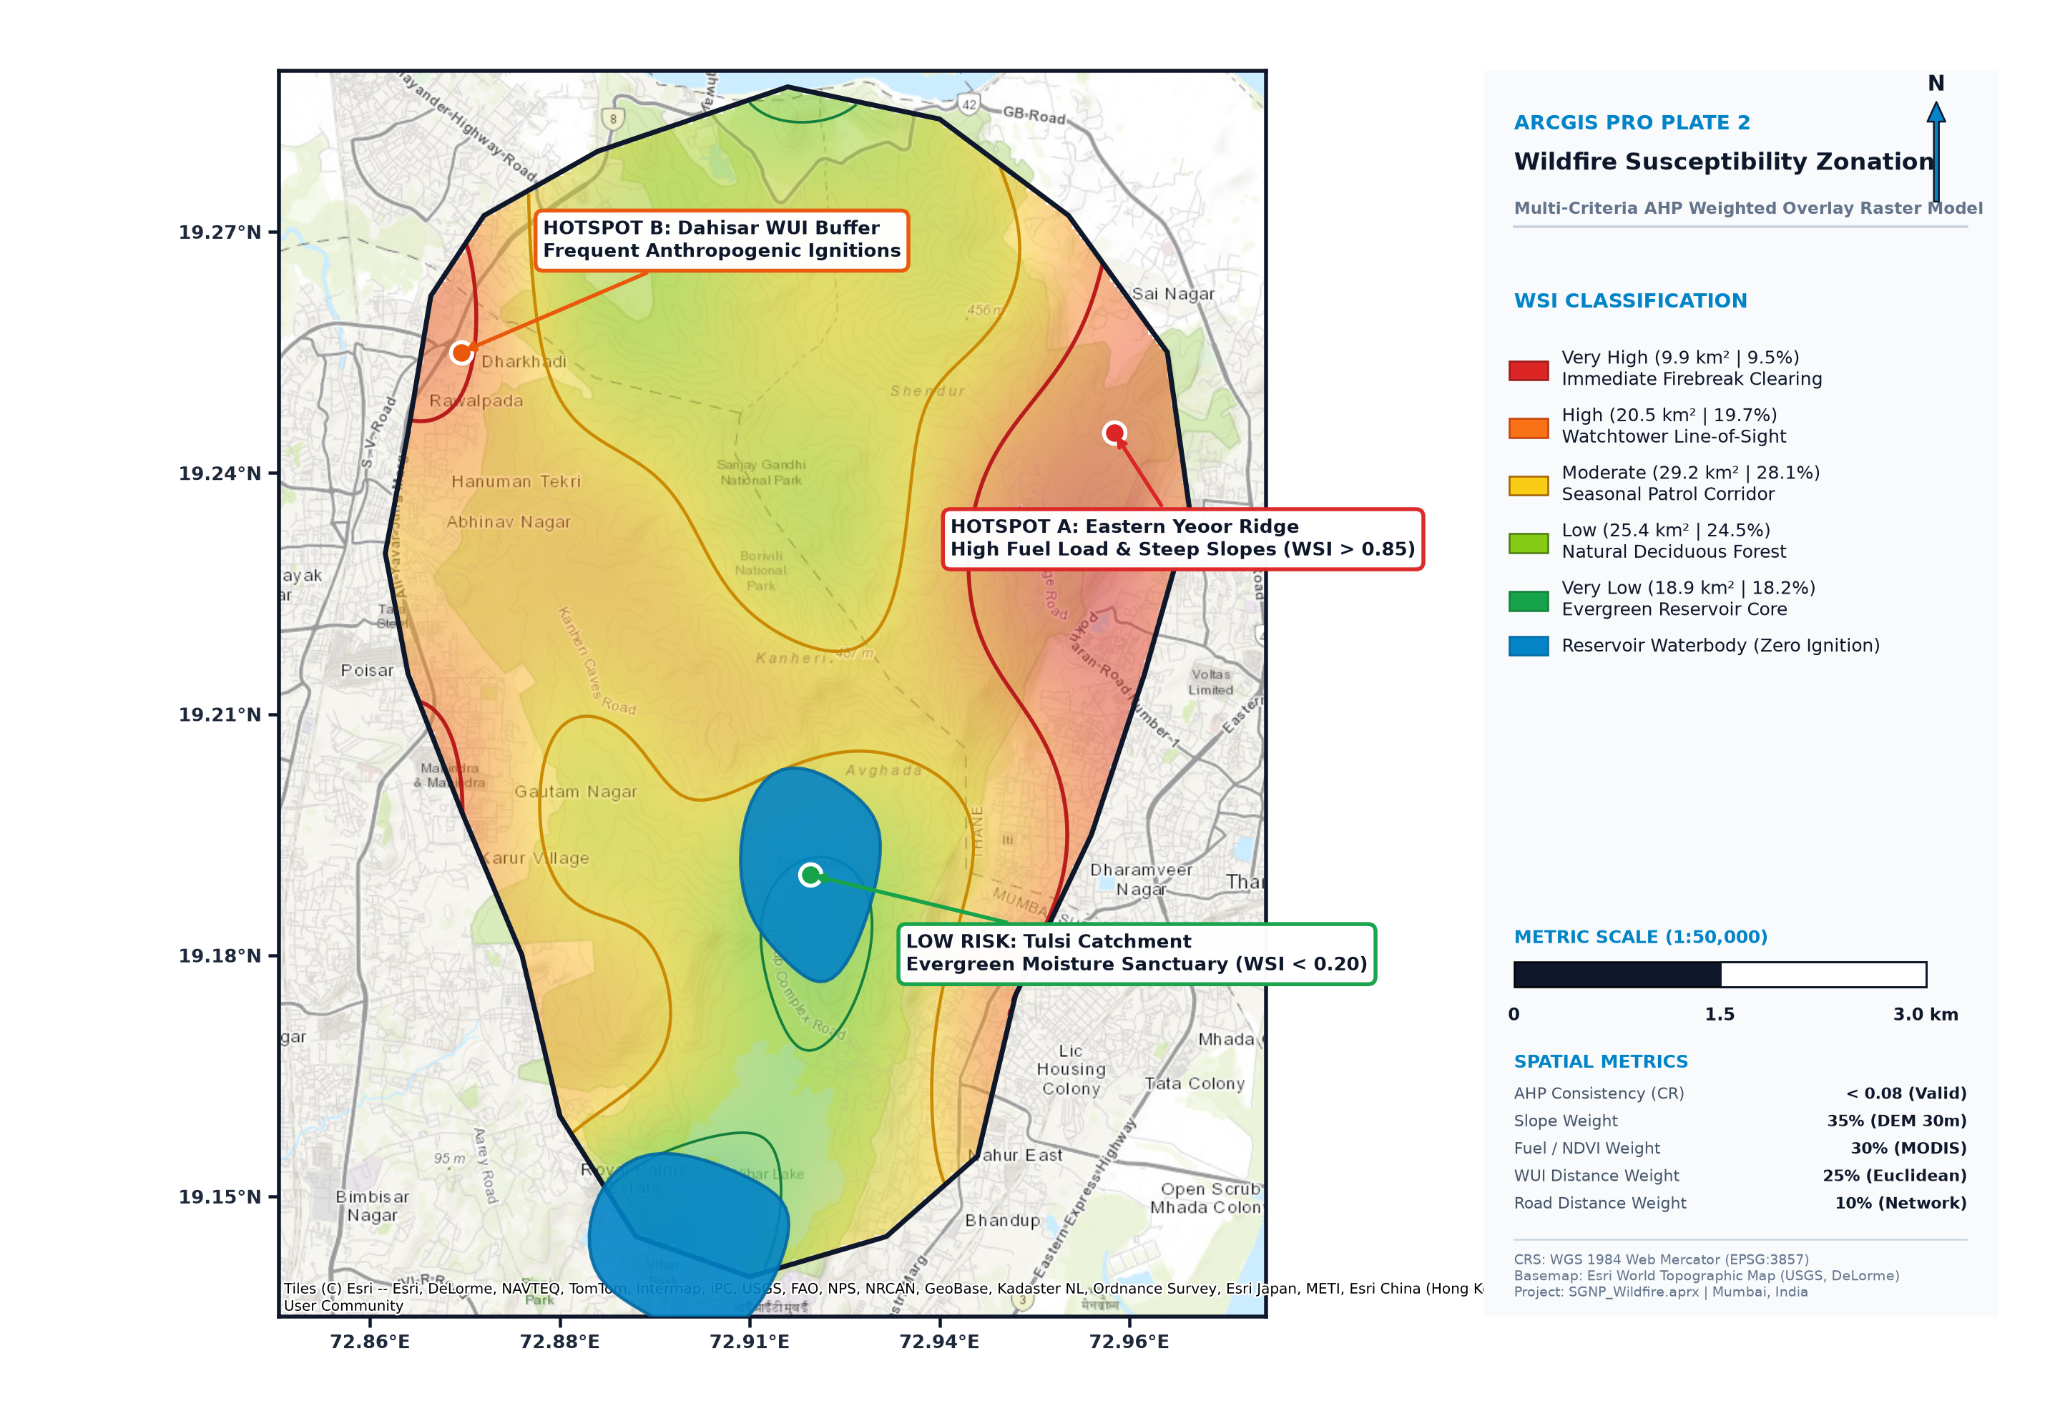
RESULTS · MAP 2
OCTOBER 2026
Susceptibility zones vary from exposed edges to moist core areas
Map plate and class statistics reproduced from the source deck.
AREA SHARE BY CLASS
Very High
9.9 km² · 9.5%
Steep slopes and high NDVI periphery near settlements
High
20.5 km² · 19.7%
Degraded areas near Borivali and Dahisar gates
Moderate
29.2 km² · 28.1%
Mixed forest–urban transition zones
Low
25.4 km² · 24.5%
Dense core forest with low ignition probability
Very Low
18.9 km² · 18.2%
Core forest and water bodies
The map legend additionally marks reservoir waterbodies as “zero ignition.”
SGNP WILDFIRE RISK ANALYSIS • OCTOBER 2026
09

Slide 10
SPATIAL INTERPRETATION
OCTOBER 2026
Three mapped locations illustrate different risk mechanisms
Hotspot callouts are transcribed from the susceptibility map plate.
HOTSPOT A · EASTERN YEOOR RIDGE
High fuel load and steep slopes. The map callout reports WSI > 0.85.
HOTSPOT B · DAHISAR WUI BUFFER
Frequent anthropogenic ignitions are highlighted near the western/northwestern urban–forest edge.
LOW RISK · TULSI CATCHMENT
Evergreen moisture sanctuary around Tulsi; the map callout reports WSI < 0.20.
Source conclusion reports five hotspots overall; only two high-risk hotspots and one low-risk area are explicitly labelled on this map plate.
SGNP WILDFIRE RISK ANALYSIS • OCTOBER 2026
10

Slide 11
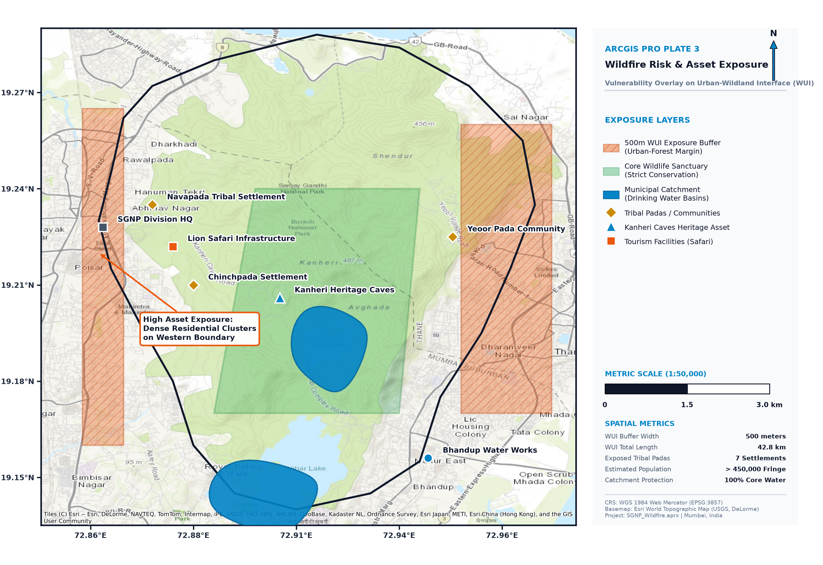
RESULTS · MAP 3
OCTOBER 2026
Exposure is concentrated along the urban–forest margin
Risk exposure map, asset layers and map-plate metrics from the source.
EXPOSURE INDICATORS
500 m
WUI exposure buffer
42.8 km
WUI total length
7
Exposed tribal padas / settlements
>450,000
Estimated fringe population
100%
Core water catchment protection shown
MAP CALLOUT
Dense residential clusters are marked as high asset exposure on the western boundary.
SGNP WILDFIRE RISK ANALYSIS • OCTOBER 2026
11

Slide 12
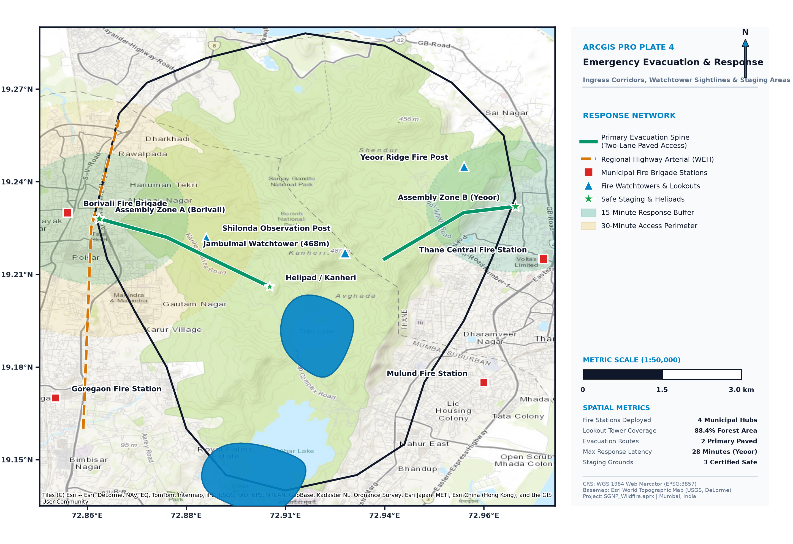
RESULTS · MAP 4
OCTOBER 2026
Accessibility analysis is intended to guide safe movement
Source framework: network analysis, road accessibility and safe-zone identification.
3
42.8 km
Safe zones mapped
WUI interface length
Planning logic
Use the road network and access routes to identify reachable assembly locations and prioritize response access.
Operational use
Combine evacuation accessibility with susceptibility and exposure so response planning reflects both fire likelihood and people/assets at risk.
SOURCE LIMIT
The source states three safe zones are mapped, but the summary text does not name them individually.
SGNP WILDFIRE RISK ANALYSIS • OCTOBER 2026
12

Slide 13
CLASS DISTRIBUTION
OCTOBER 2026
Moderate and low classes occupy the largest reported shares
Shares and areas follow the five-class susceptibility results in the source deck.
SHARE OF STUDY AREA
19.7%
28.1%
24.5%
18.2%
Very High
High
Moderate
Low
Very Low
9.9 km²
20.5 km²
29.2 km²
25.4 km²
18.9 km²
Highest susceptibility
Largest single class
Core and water bodies
Very High + High classes are reported as 9.5% + 19.7% of the area. Their listed areas sum to 30.4 km².
Moderate susceptibility is the largest single class at 29.2 km² (28.1%), concentrated in forest–urban transition zones.
Low and Very Low classes total 44.3 km² (42.7% by reported percentages), including core forest and water bodies.
Percentages total 100.0%; areas total 103.9 km² because of rounding in the source figures.
SGNP WILDFIRE RISK ANALYSIS • OCTOBER 2026
13

Slide 14
RESULTS SYNTHESIS
OCTOBER 2026
The source deck’s headline numbers point to an operational response agenda
Figures below are reproduced as stated in the conclusion slide.
29.2 km²
17.4 km²
5
3
Reported as High / Very High susceptibility
Human settlements exposed to high-risk fire zones
Hotspots at critical urban–forest interface gates
Safe zones mapped for emergency assembly
DISCUSSION
The urban–forest interface is the central exposure zone: the map identifies dense residential clusters along the western boundary.
Steep slopes and fuel/vegetation conditions are emphasized in the eastern Yeoor Ridge hotspot callout.
The Tulsi catchment is called out as a low-susceptibility moisture sanctuary in the source map.
Note: the reported 29.2 km² headline does not match the sum of the two listed High and Very High class areas. See source-validation notes.
SGNP WILDFIRE RISK ANALYSIS • OCTOBER 2026
14

Slide 15
MITIGATION
OCTOBER 2026
Five recommended actions target fuels, access and early response
Recommendations reproduced from the source conclusion slide.
01
Buffer zones
02
Fuel management
03
Access control
Create physical firebreaks along the highest-risk urban–forest interfaces before the dry season.
Use controlled removal of dry brush in Very High susceptibility zones.
Restrict human access to high-risk zones during the November–May dry months.
04
Surveillance
05
Pre-positioning
Deploy thermal cameras and drone monitoring at peripheral hotspots.
Pre-position fire-brigade assets based on evacuation-priority maps.
Timing emphasis in the source: strengthen preparedness before the dry season; apply targeted access controls during November–May.
SGNP WILDFIRE RISK ANALYSIS • OCTOBER 2026
15

Slide 16
RESPONSE PLANNING
OCTOBER 2026
Sequence mitigation, monitoring and evacuation readiness around the dry season
A presentation-friendly organization of actions and analytical outputs named in the source deck.
01
BEFORE DRY SEASON
Establish physical firebreaks at highest-risk interfaces; carry out controlled dry-brush removal in Very High zones.
02
NOVEMBER–MAY
Restrict access to high-risk areas; focus thermal-camera / drone monitoring on peripheral hotspots.
03
RESPONSE READINESS
Pre-position fire-brigade assets using susceptibility, exposure and evacuation-priority maps.
04
EVACUATION PLANNING
Use road-network accessibility and mapped safe zones for emergency assembly planning.
No new locations or timing thresholds have been added beyond the supplied presentation; this sequence only organizes its listed actions.
SGNP WILDFIRE RISK ANALYSIS • OCTOBER 2026
16

Slide 17
APPENDIX · INTERNAL REVIEW
OCTOBER 2026
Resolve these source-figure differences before external submission
All values below appear in the uploaded SGNP deck; differences are preserved, not silently reconciled.
STUDY AREA
104 km² in the narrative vs 103.84 km² on the map plate.
Likely rounding; adopt one preferred display value.
ELEVATION
12–480 m ASL in the profile vs 15–468 m AMSL on the map plate.
Confirm the intended source/range and vertical reference.
POPULATION CONTEXT
20+ million residents in the problem statement vs >15 million on the map plate; >450,000 “fringe” population in the risk metrics.
Clarify geographic scope and definitions for each population figure.
AHP WEIGHTS
Workflow/chart: 40/25/15/10/10 across five factors. Map plate: 35/30/25/10 across four criteria.
Confirm which weighting specification produced the susceptibility map.
HIGH / VERY HIGH AREA
Conclusion states 29.2 km², while class table reports 9.9 + 20.5 = 30.4 km².
Verify the intended aggregate; 29.2 km² is also the Moderate-class area.
HOTSPOT COUNT
Conclusion reports five hotspots; the shown map labels two high-risk hotspots and one low-risk area.
Add the other hotspot locations or qualify the map’s selected callouts.
This slide is an internal quality-control aid and can be removed from the audience-facing version after figures are confirmed.
SGNP WILDFIRE RISK ANALYSIS • OCTOBER 2026
17

