Slide 1
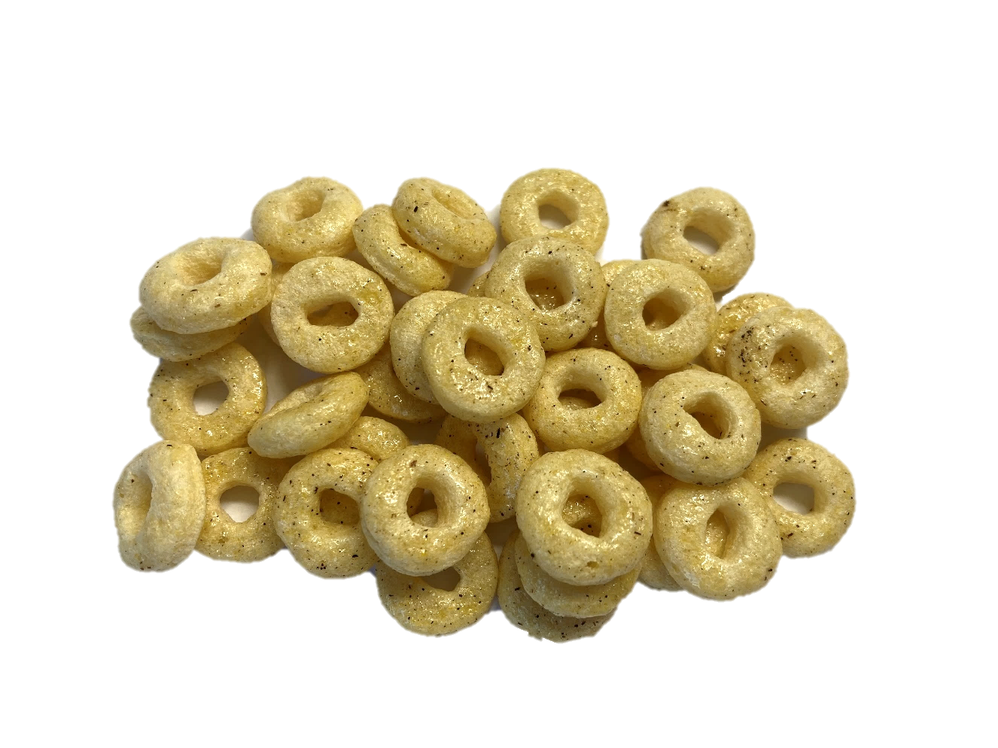
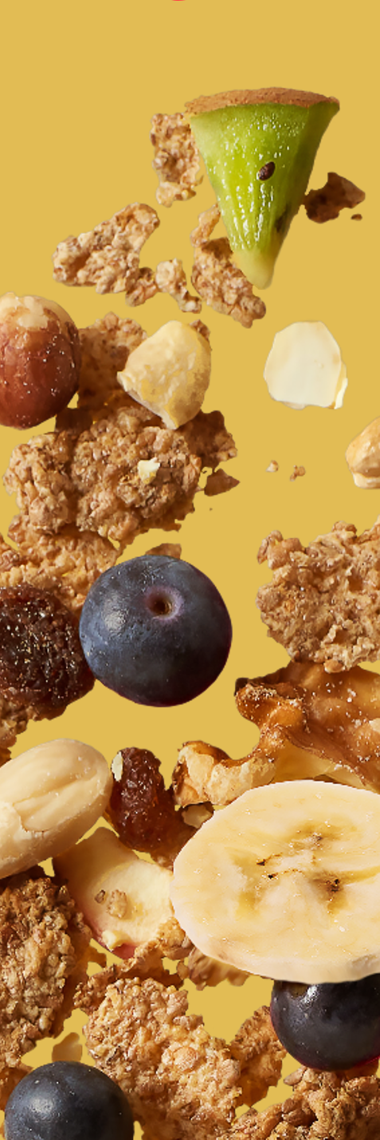

high protein rings with vanilla taste – with sweetener ref.: 000004010409
Ingredients |  | In %
maize semolina |  | 52
WHEAT gluten |  | 23,4
sweetener: maltitol |  | 21
calcium carbonate |  | 3,1
natural flavouring type vanilla |  | 0,2
ground extracted vanilla |  | 0,14
natural flavouring type butter |  | 0,11
salt |  | 0,07
Nutrition information | per 100g | per 30 g
kJ calories | 1477 349 | 443 105
Fat (g) of which saturates (g) | 1,7 0,4 | 0,5 0,1
Carbohydrates (g) of which total sugars (g) | 64,4 0,3 | 19,3 0,1
Polyols (g) | 17,7 | 5,3
Fibre (g) | 1,7 | 0,5
Protein (g) | 25,3 | 7,6
Salt (g) | 0,08 | 0,02
Storage conditions :
14 months in original package at temperatures below 20 °C and less than 60 % relative air humidity (to be verified by means of a BBD test)
Claims
high source of protein low in sugar low in fat low in sat fat low in salt
Allergen information :
Contains allergens according to the list of ingredients. Manufactured in a facility where the following allergens are present: cereals containing gluten, milk and soya products, mustard, lupin.

