Slide 1

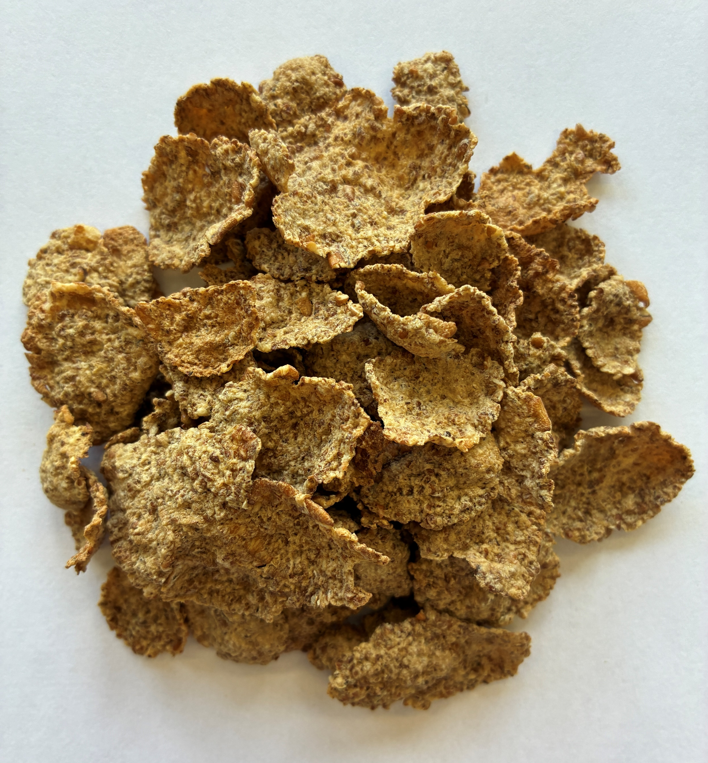

high protein wholegrain wheat flakes with wheatbran
Ref.: 000004010736
Ingredients |  | In %
wholegrain WHEAT |  | 60
WHEAT gluten |  | 22,3
sugar |  | 8,5
WHEAT bran |  | 7,7
BARLEY malt extract |  | 0,7
salt |  | 0,1
emulsifier: mono- and diglycerides of fatty acids |  | 0,1
Ingredients :
wholegrain WHEAT 60%, WHEAT gluten 22,3%, sugar, WHEAT bran 7,7%, BARLEY malt extract, salt, emulsifier: mono- and diglycerides of fatty acids [1] [1] processing aid
Nutrition information | per 100g | per serving size (30g) + 125 ml fat reduced milk | % RI
kJ calories | 1577 373 | 722 171 | 8,6 8,5
Fat (g) of which saturates (g) | 2,9 0,6 | 2,9 1,3 | 4,1 6,6
Carbohydrates (g) of which total sugars (g) | 52,9 10,2 | 21,9 9,1 | 8,4 10,1
Fibre (g) | 10,7 | 3,2
Protein (g) | 28,6 | 12,8 | 25,5
Salt (g) | 0,34 | 0,2 | 4,1
Allergen information :
Contains allergens according to the list of ingredients. Manufactured in a facility where the following allergens are present: cereals containing gluten, milk and soya products, mustard, lupin.
Claims
wholegrain content: 75% source of fibre high protein
Storage conditions :
12 months in original package at temperatures below 20 °C and less than 60 % relative air humidity

