Slide 1
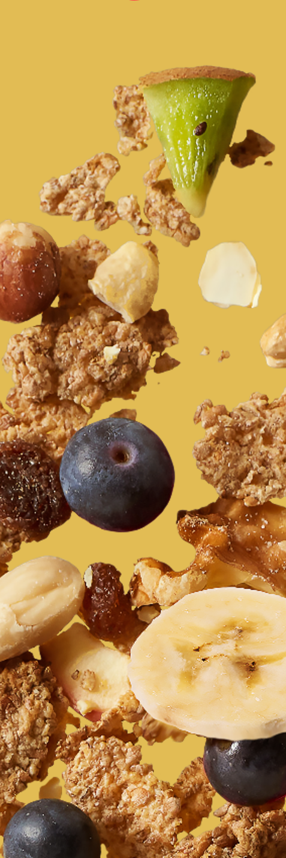

crunchy muesli with sunflower seeds and nuts ref.: 000004010918
Ingredients |  | In %
crunchy muesli | wholegrain OAT flakes, WHEAT extrudate (WHEAT gluten, WHEAT flour), wholegrain BARLEY flakes, oligofructose, whole grain SPELT flakes, sunflower seeds, sunflower oil (with antioxidant: tocopherol-rich extracts), WHEAT gluten | 79,5
sunflower seeds |  | 10,5
chopped, roasted ALMONDS |  | 5
chopped, roasted HAZELNUTS |  | 5
Nutrition information | per 100g | per 50 g
kJ calories | 1989 476 | 994 237
Fat (g) of which saturates (g) | 23,6 2,6 | 11,8 1,3
Carbohydrates (g) of which total sugars (g) | 33,9 2,4 | 17,0 1,2
Fibre (g) | 13,6 | 6,8
Protein (g) | 25,4 | 12,7
Salt (g) | <0,01 | < 0,01
Description of product :
This crunchy muesli is a mixture of whole grain rolled cereal flakes, extrudates and other ingredients. It obtains its crunchiness through a final baking process. The product is enhanced by adding sunflower seeds and nuts.
Allergen information :
Contains allergens according to the list of ingredients. Manufactured in a facility where the following allergens are present: cereals containing gluten, peanuts, sesame, nuts, milk and soya products, mustard, lupin.
Claims
wholegrain content: 38 % high source of fibre source of protein low in sugar no added sugar very low in salt
Storage conditions :
12 months in original package at temperatures below 20 °C and less than 60 % relative air humidity

