Slide 1
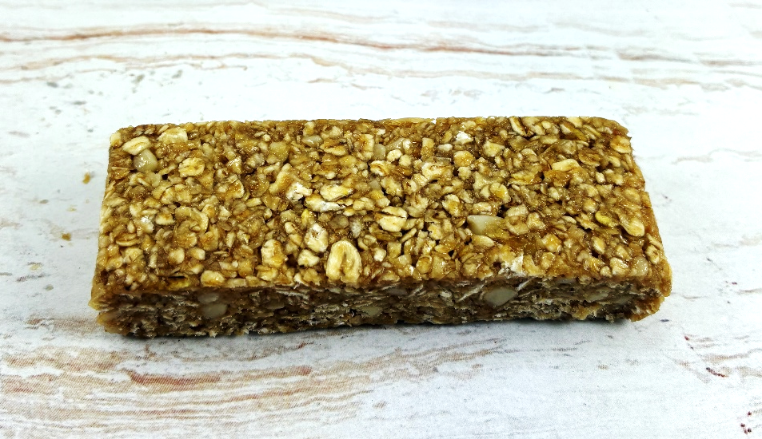
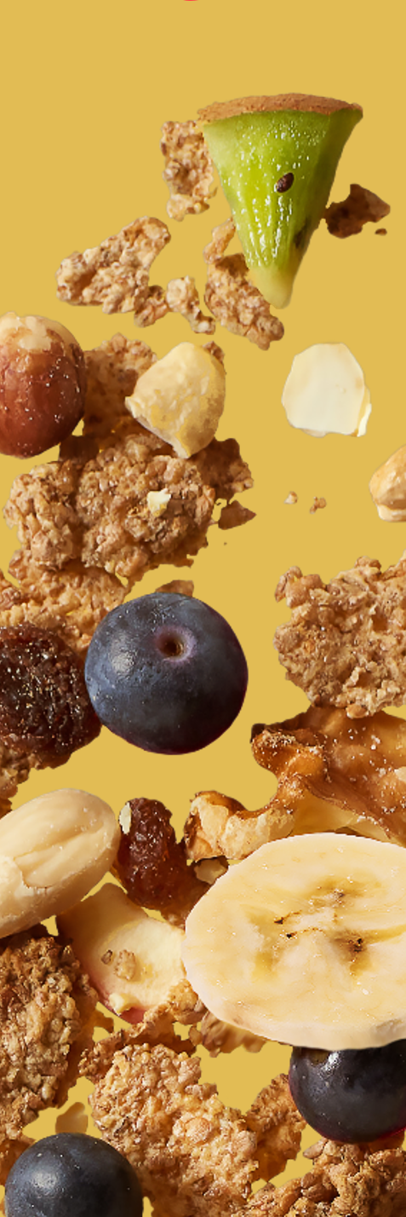

oat bar with almond and caramel
REF.: 000004010970
Ingredients |  | In %
whole grain OAT flakes |  | 48,1
glucose-fructose syrup |  | 20,9
glucose syrup |  | 15,2
Caramel paste with salted butter | glucose syrup, sugar, sweetened condensed milk (whole MILK, sugar), water, salted BUTTER, CREAM, salt, thickener: pectins | 5,9
chopped, blanched ALMONDS |  | 5,0
coconut fat |  | 3,3
emulsifier: lecithins
natural flavouring
caramelised sugar syrup
salt
Nutrition information | per 100g | per bar (35g)
kJ calories | 1638 389 | 573 136
Fat (g) of which saturates (g) | 10,7 4,3 | 3,7 1,5
Carbohydrates (g) of which total sugars (g) | 62,5 23,4 | 21,9 8,2
Fibre (g) | 5,5 | 1,9
Protein (g) | 8,1 | 2,8
Salt (g) | 0,32 | 0,11
Description of product :
This bar is a mixture whole grain oat flakes, caramel paste and other ingredients. After homogenisation and forming the ingredient mass is cut into portions.
Claims :
source of fibre
Allergen information :
Contains allergens according to the list of ingredients. Manufactured in a facility where the following allergens are present: cereals containing gluten, peanuts, sesame, nuts, milk and soya products, mustard, lupin.
Storage conditions :
12 months in original package at temperatures below 20 °C and less than 60 % relative air humidity

