Slide 1
Checkers’
Bruhathi Mandhala
Mahesh Potu
Teja Moparthi

Slide 2

Intro to Artificial Intelligence
Prof. Shivanjali Khare

Slide 3
Contents:
Objective
Introduction
Methodology
Code
Execution
Evaluation Metrics
Results
Conclusion

Slide 4

Objective:
The main aim of this project is to create a checkers game environment between Human vs AI and AI vs AI. (alpha beta pruning and Q learning Agent)

Slide 5
Introduction:
Checkers game is a traditional English Draughts game, which simply consists of 12 pieces for each player and can move according to the games.(red and blue for players)
To make a checkers gameplay using AI is the interesting task.
In this project, Human game play is defined and Alpha Beta Pruning game play is defined, and environment is set, so that there can be a interesting game between them.
This project also has AI vs AI gameplay between(Q-Learning Agent and Alpha Beta Pruning)

Slide 6
Introduction:
Alpha Beta Pruning is a an algorithm, that is used in game trees to read the no.of nodes evaluated.
This keeps in track of alpha(best value of maximum player) and beta (best value for min player)
Q-Learning: It is a model-free reinforcement learning algorithm, that keeps on learning and updating.
It keeps the track of win rewards, lose rewars

Slide 7
Methodolgy:
1. Board Representation: (2D representation on console) using red,blue colors for player1 and player2
Game rules: traditional rules
Defining the human player
Defining Alpha Beta learning algorithm
Defining Q learning algorith

Slide 8

Code Demonstation:

Slide 9
Execution and Evaluation Metrics

Slide 10
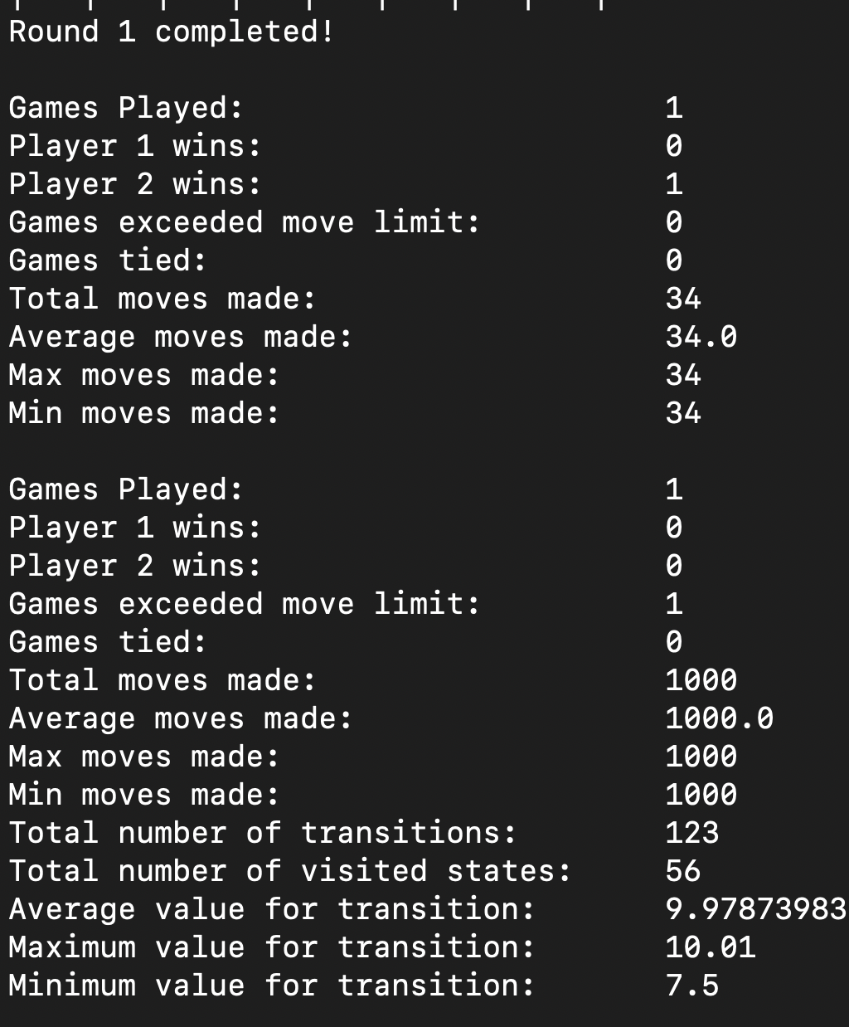
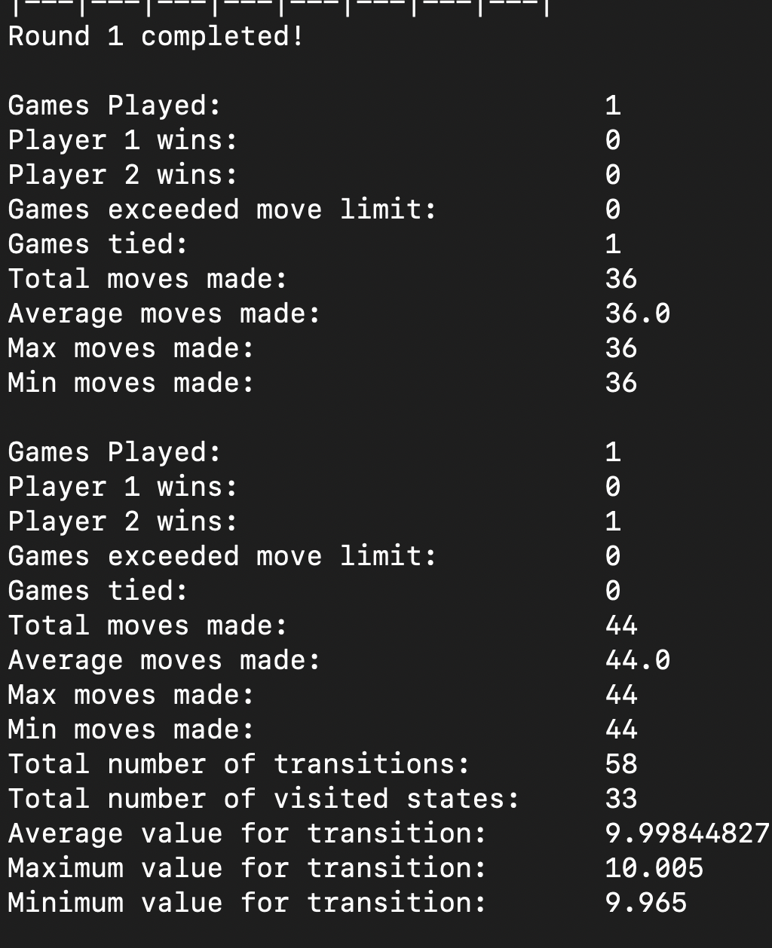
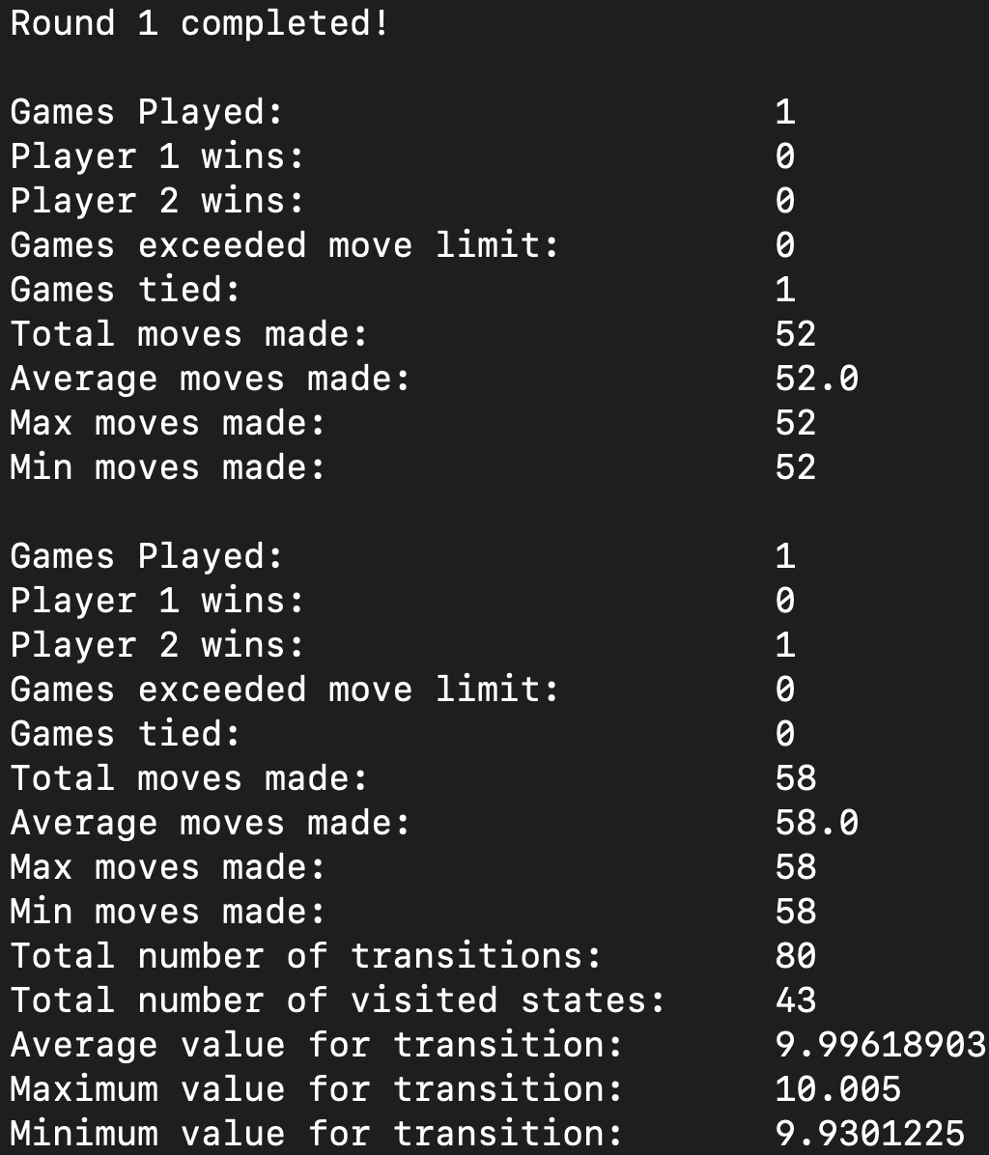

Results:
Upon the execution of code, the out put is as follows: on 1st round: Alpha beta and Q learning game is tied
The below are the results i.e visisted states, no.of moves, rewards of AI vs AI game.

Slide 11
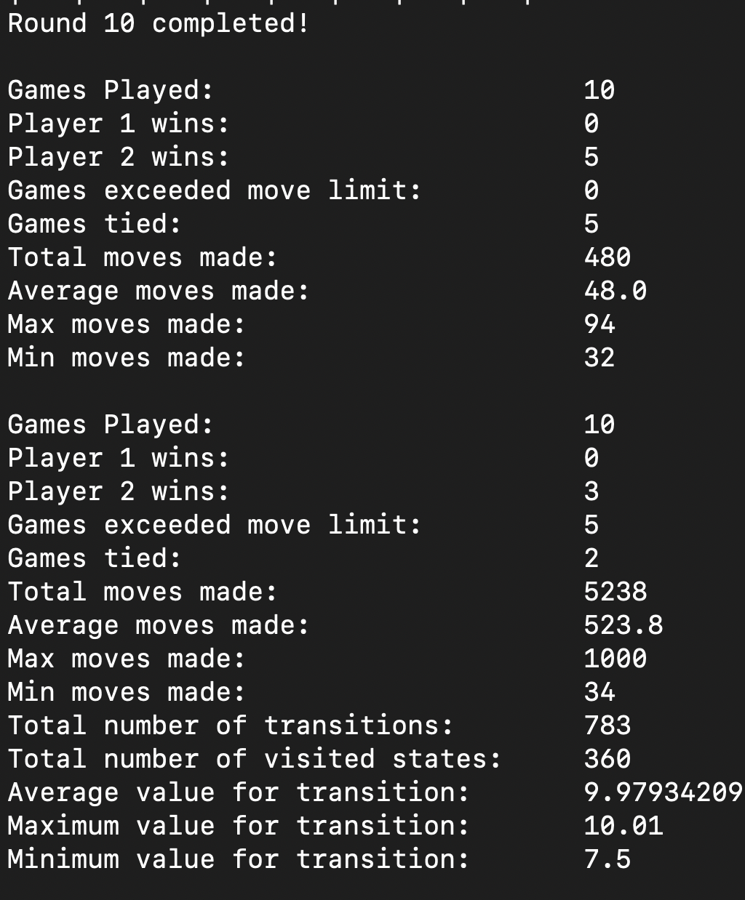
Results:
The AIs when put on training loop of 10 rounds Q learning has won 5 games, whereas other 5 games were tied, The results are as follows:

Slide 12
Conclusion:
To conclude this the Q-Learning agent has played better when it is put on a training loop.
This project can be further modelized to compare the Q-learning agent with other model-free Reinforcement agents
Analysing the different combination of moves and their weighted values are more important inunderstanding the game of checkers.
While designing the interface of game itself is not so difficult, designing an efficient way to build required more analysis.

