Slide 1
◆
ThreatHunter
A standalone PowerShell TUI for Windows incident response & threat hunting
◆ Single .ps1
◆ 11 modules
◆ Evidence-aware
no installs, no modules
events · procs · net · persistence · IOC · …
auto session log, exports, MD report
Compatible with Windows PowerShell 5.1 and PowerShell 7+
Internal IR · Threat Hunting · v1.0

Slide 2
THE PROBLEM
Triaging a Windows endpoint, fast
A workstation looks suspicious. You have a remote shell, RDP or physical access, and roughly an hour.
FRICTION WITHOUT IT
◆
You forget the right Get-WinEvent filter under pressure.
You need a consistent set of views over events, processes, network and persistence — without dragging a toolkit onto the host.
◆
Process tree, signing status and command lines live in three different cmdlets.
Whatever you find must end up as evidence: timestamped, exportable and reviewable later.
◆
Every analyst captures evidence differently — some not at all.
◆
Off-host tools require deployment, approval and trust the analyst won’t have.
◆ ThreatHunter
02 / 15

Slide 3
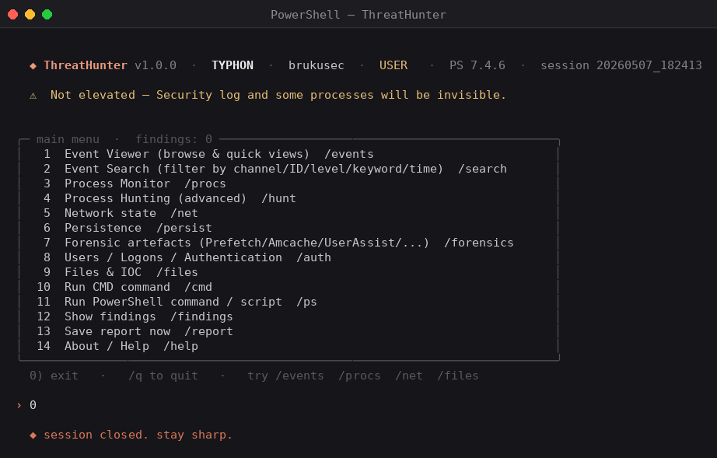
THE SOLUTION
A single file. Eleven hunting modules.
A single self-contained .ps1 that you can drop on any modern Windows endpoint and run.
Eleven curated modules and arbitrary cmd / PowerShell execution, all behind a chat-style terminal interface.
No install
No modules
No telemetry
Windows PowerShell 5.1 · PowerShell 7+
Auto-detects ANSI (Windows Terminal, PS 7, VS Code, ConEmu) and falls back to console colours on legacy conhost.
the main menu — numbered options + slash commands
◆ ThreatHunter
03 / 15

Slide 4
THE MODULES
What ships in the box
/events
/search
/procs
/hunt
Event Viewer
Event Search
Process Monitor
Process Hunting
Browse channels, quick views over System / Security / PowerShell / Sysmon.
Filter by channel, event ID, level, message regex and time range.
Live snapshot, parent/child tree, signing, owners, command lines, DLLs.
Pre-built queries: unsigned, suspicious paths, LOLBin chains, network-active.
/net
/persist
/forensics
/auth
Network state
Persistence
Forensic artefacts
Users / Logons
TCP/UDP with PID, listening ports, DNS cache, ARP, firewall, SMB.
Tasks, services, run keys, WMI subs, Winlogon, drivers, PS profiles.
Prefetch, Amcache, ShimCache, BAM, RecentApps, UserAssist, MUICache.
4624, 4625, 4672, 4740, 4648, RDP sessions, privileged groups.
/files
/cmd
/ps
/report
Files & IOC
Run cmd
Run PowerShell
Reports
Hashes, recent files, IOC matching, Sysmon parser.
Arbitrary cmd.exe with destructive-pattern detection.
Arbitrary PowerShell or .ps1 file with pattern detection.
Findings, exports, consolidated Markdown report on exit.
◆ ThreatHunter
04 / 15

Slide 5
INTERFACE BASICS
Numbers, slash commands, and one prompt
◆
Numbered menus
Type 1–14 for the main menu. Same convention inside each module. 0 always goes back / exits.
◆
Slash commands
/events, /procs, /net, /files, /q… jump straight to a module from any main menu.
◆
Free text
When a module asks for a path, regex, time range or PowerShell expression — type it in.
the › prompt accepts: numbers, slash commands, or free text
◆ ThreatHunter
05 / 15

Slide 6
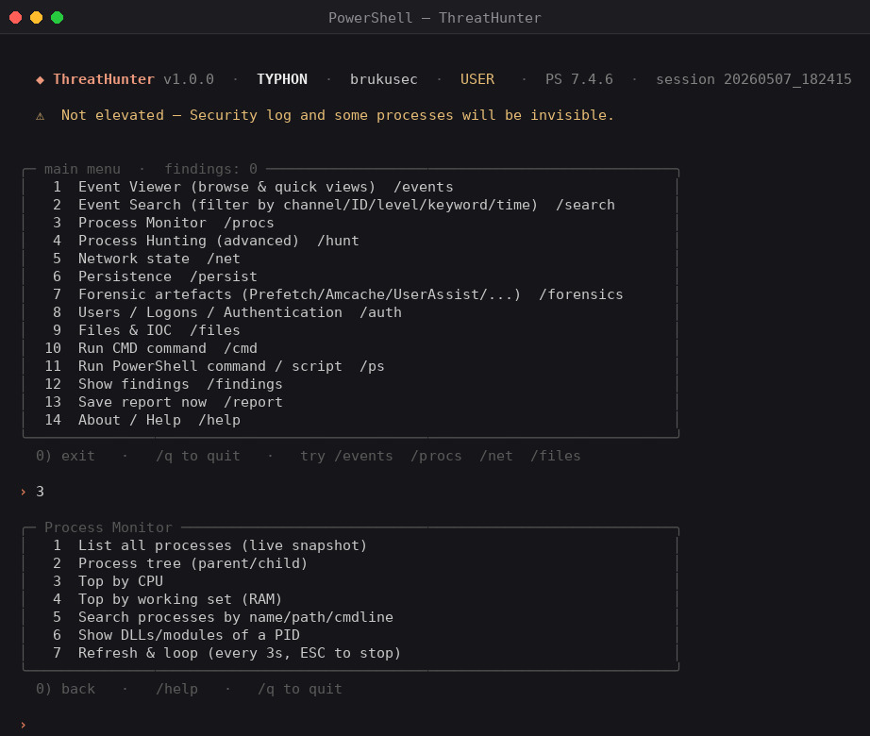
PROCESS HUNTING
Find what should not be running
Inside /procs
▸
Live snapshot
Full process table enriched with parent PID, signing status, owner and command line.
▸
Parent/child tree
Inline tags surface invalid signatures and processes living in Temp, AppData, ProgramData or Public.
▸
Top by CPU / memory
Quick triage of resource hogs.
▸
Search / DLL inspection
Regex over name/path/cmdline; list loaded modules of any single PID.
▸
Live refresh
A 3-second loop view for incident watch.
◆ ThreatHunter
06 / 15

Slide 7
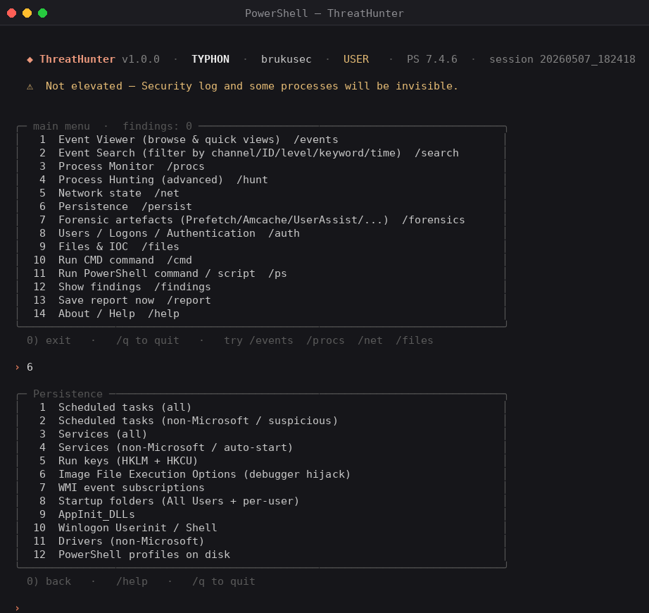
PERSISTENCE
Twelve places attackers like to hide
What it covers
◆
Tasks & Services
Full and "non-Microsoft / auto-start" filtered views.
◆
Registry foothold
Run / RunOnce, IFEO debugger hijacks, Winlogon, AppInit_DLLs.
◆
WMI
Permanent EventFilter / Consumer / Binding triplet.
◆
Filesystem
Startup folders (machine + user), PowerShell profiles.
◆
Drivers
Non-Microsoft system drivers.
◆ ThreatHunter
07 / 15

Slide 8
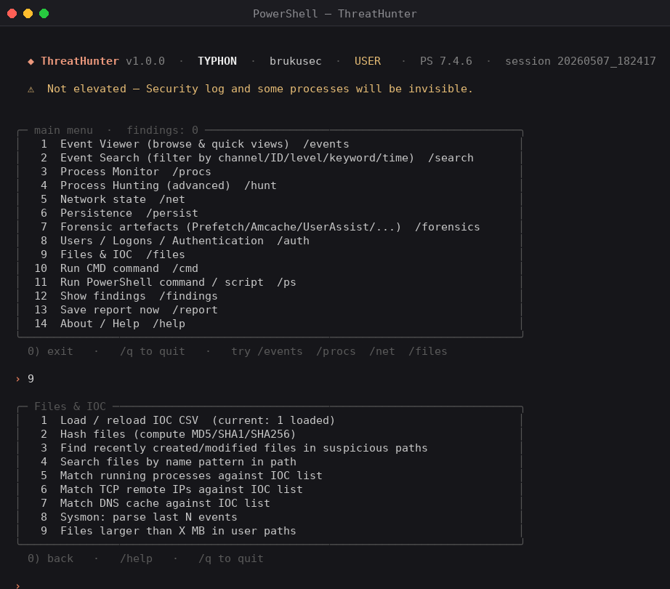
FILES & IOC
Sweep a host against an indicator list
IOC CSV format
type,value,description
sha256,e3b0c44298fc1…,placeholder
ip,185.220.101.1,known-bad
domain,evil-cdn.xyz,c2 sample
filename,mimikatz.exe,creddump
regkey,HKCU:\…\fodhelper,UAC bypass
Auto-matching
▸ Hash files → match against md5 / sha1 / sha256 IOCs.
▸ Live TCP remotes → match against ip IOCs.
▸ DNS cache entries → match against domain IOCs.
▸ Running processes → match against filename IOCs.
Hash hits auto-flag as CRITICAL findings.
◆ ThreatHunter
08 / 15

Slide 9
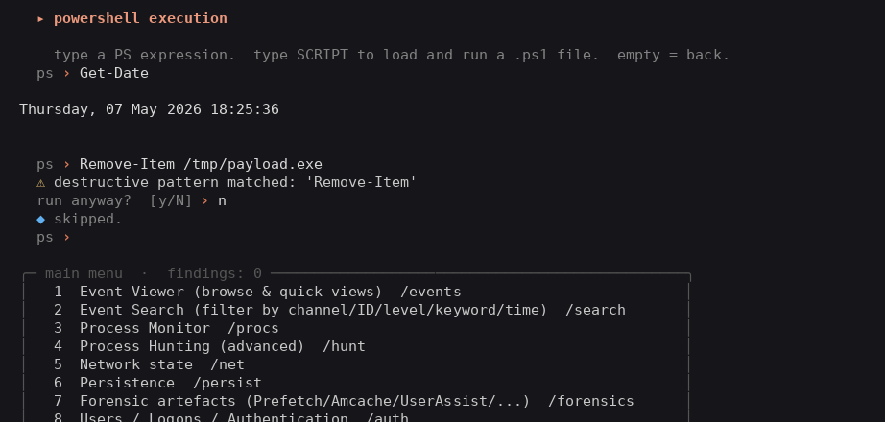
SAFETY NET
Destructive commands always prompt
Patterns that trigger a confirm
· Remove-Item · rm · del · Format-Volume
· Stop-Computer · Restart-Computer · shutdown
· Stop-Process · taskkill · Stop-Service
· Clear-EventLog · wevtutil cl
· reg delete · Remove-ItemProperty
· Disable-NetAdapter · netsh advfirewall reset
· Invoke-Expression · iex · DownloadString
· Set-MpPreference -DisableRealtimeMonitoring
How it behaves
A hint, not a hard block. The analyst can still confirm with y to run the command — but it cannot be done by accident. Every command and its output is appended to the session log regardless.
◆ ThreatHunter
09 / 15

Slide 10
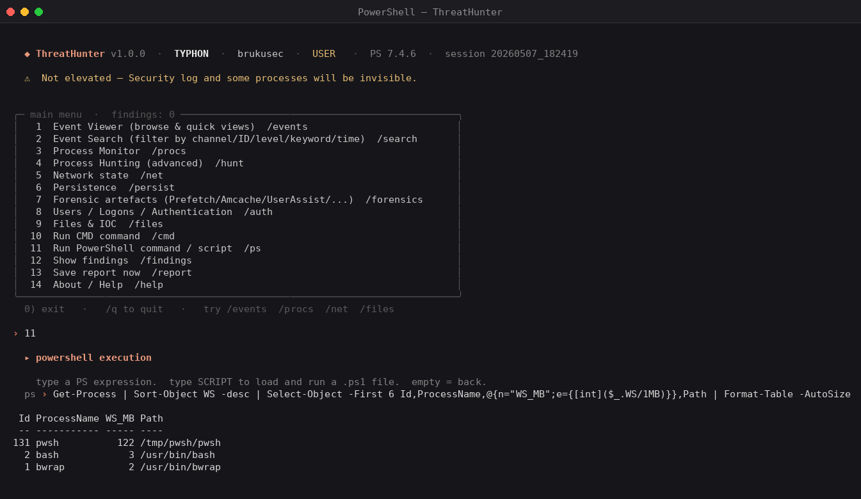
IN ACTION
Run a query, render a table, capture evidence
Result-view actions
e
export CSV / JSON
f
flag finding
v
view all rows
↵
continue
◆ ThreatHunter
10 / 15

Slide 11
OUTPUT & EVIDENCE
Every session is its own folder
What gets written
ThreatHunt_Output\
└─ 20260507_142133\ # session id (YYYYMMDD_HHMMSS)
├─ session.log # every action + raw output
├─ exports\
│ ├─ 142357_evt_search.csv
│ ├─ 142412_proc_list.json
│ └─ …
└─ report.md # consolidated MD on exit
session.log
Append-only, timestamped. Captures actions, rendered tables and every command run.
exports/
CSV/JSON snapshots saved on demand from any result view (key e).
report.md
Consolidated Markdown — session metadata, table of findings, index of exports.
◆ ThreatHunter
11 / 15

Slide 12
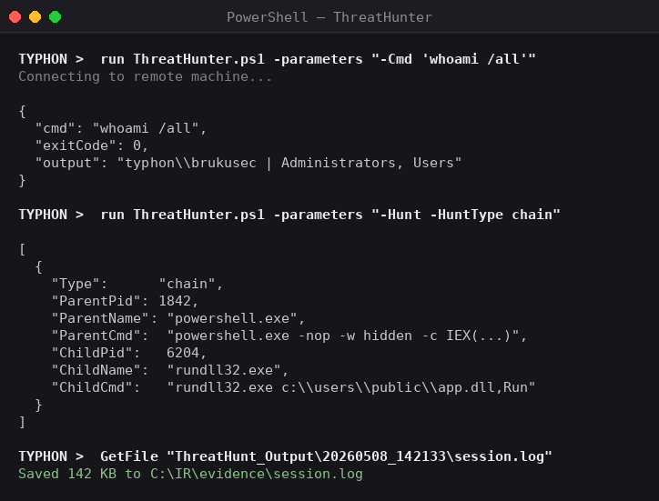
DEFENDER LIVE RESPONSE
Every action also runs by parameter
How it behaves
▸
Auto-detects redirected output
When stdout is captured (Live Response, pipe, redirect), the script emits clean JSON. Interactive consoles still get the formatted table.
▸
No banner, no menu
Adding any action switch suppresses the TUI chrome automatically. Live Response captures only the action result.
▸
Chain-of-custody preserved
Every command and its output is appended to session.log even in non-interactive mode. Pull the folder back as evidence.
▸
Safety net still applies
Destructive patterns (Remove-Item, wevtutil cl, Set-MpPreference, …) reject with exit code 2. Use -Force to bypass.
a Defender Live Response session driving the script with -parameters
RECIPE
PutFile ThreatHunter.ps1 · run ThreatHunter.ps1 -parameters "-Cmd 'whoami'" · GetFile session.log
◆ ThreatHunter
12 / 15

Slide 13
HUNTING WORKFLOWS
Three short playbooks
"Something feels off"
IOC sweep
Auth anomaly
rapid triage in ~10 minutes
you have indicators, check this host
login behaviour investigation
01
/hunt → unsigned binaries running
01
launch with -IocFile incident.csv
01
/auth → 4625 failed logons
02
/hunt → procs from Temp / AppData
02
/files → match procs / TCP / DNS
02
/auth → 4624 by LogonType
03
/net → established TCP + PIDs
03
/files → hash %TEMP% & %APPDATA%
03
/auth → 4672 privileged · 4648 explicit
04
/persist → tasks (non-Microsoft) + run keys
04
hash matches auto-flag CRITICAL
04
/auth → account changes (4720…4738)
05
/q → save the report
05
/findings · /report
05
/auth → RDP session history
◆ ThreatHunter
13 / 15

Slide 14
INSTALLATION
Drop the file. Run it.
# from your usual prompt
Compatibility
cd C:\Tools\ThreatHunter
.\ThreatHunter.ps1
✓
Windows 10 / 11
# bypass execution policy (session only)
✓
Windows Server 2016+
powershell.exe -ExecutionPolicy Bypass -File .\ThreatHunter.ps1
✓
PowerShell 5.1
# recommended on a target endpoint
✓
PowerShell 7+
pwsh -NoProfile -File .\ThreatHunter.ps1
# load IOCs at startup
✓
Windows Terminal
.\ThreatHunter.ps1 -IocFile .\iocs.csv
✓
conhost.exe (legacy)
# custom output, monochrome
✓
VS Code terminal
.\ThreatHunter.ps1 -OutputRoot D:\IR\Cases\Q2 -NoColor
✓
ConEmu
◆ ThreatHunter
14 / 15

Slide 15
◆
Stay sharp.
Self-contained. Evidence-aware. Built for the analyst on the keyboard.
YOU GET
WHAT TO DO NEXT
▸ ThreatHunter.ps1 — single-file TUI
◆ Read the HTML guide — full reference.
▸ iocs.sample.csv — starter IOC list
◆ Drop the .ps1 onto a test VM and explore.
▸ ThreatHunter-Guide.html — UK-English manual
◆ Build your own iocs.csv against your threat intel feed.
▸ this deck (.pptx + .pdf)
◆ Iterate: add modules, tune patterns, share findings.
◆ ThreatHunter
15 / 15

