Slide 1
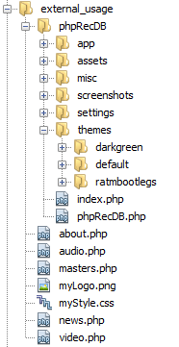
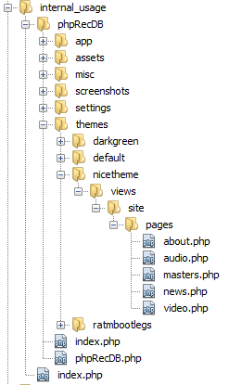
phpRecDB script
themes-folder
external pages
using phpRecdB
phpRecDB script
themes-folder
internal pages
in a particular theme
index file, starting phpRecDB

