Slide 1
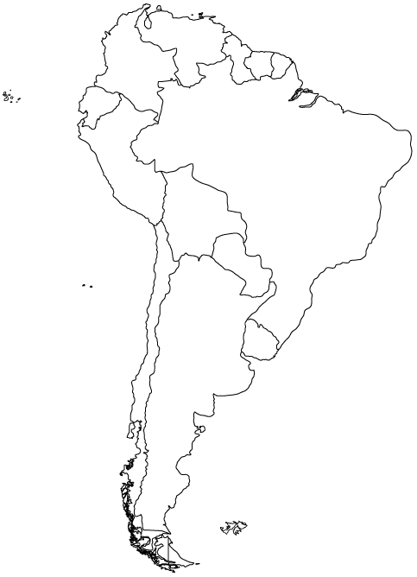
FF-5
(10-ha)
2° 20’ 00” S
CF-5
CF-4
FF-7
(10-ha)
FF-1
(1-ha)
Manaus
FF-2
(1-ha)
CF-1
FF-4
(1-ha)
FF-6
(10-ha)
2° 25’ 00” S
CF-6
FF-3
(1-ha)
CF-3
CF-2
N
Geo
2° 30’ 00” S
Scale (m)
0
3000
60° 05’ 00” W
60° 00’ 00” W
59° 55’ 00” W
59° 50’ 00” W
59° 45’ 00” W

Slide 2
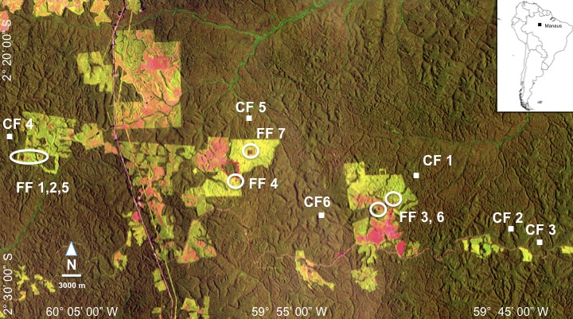
Fig. 3. Satellite image of the BDFFP. Heliconia demography plots shown as white points (Continuous Forest, CF) or circles (Forest Fragments, FF). Dark green is primary forest, light green & red are regenerating forest & pasture. See Table 1 for plant abundance in plots.

