Slide 1
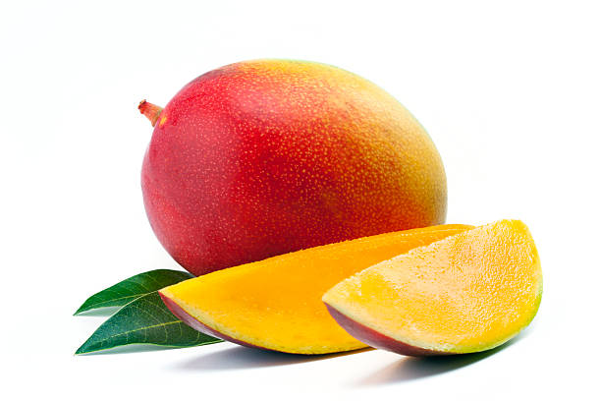
Mango
Mangifera indica

Slide 2
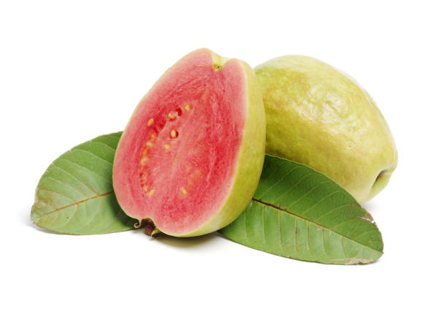
Guava
Psidium guajava

Slide 3
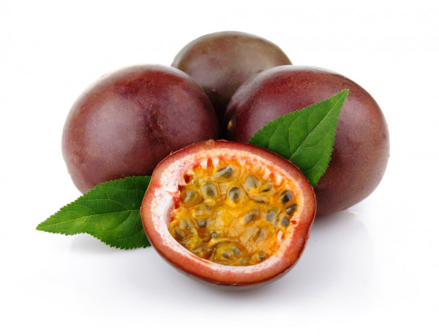
Passion Fruit
Passiflora edulis

Slide 4
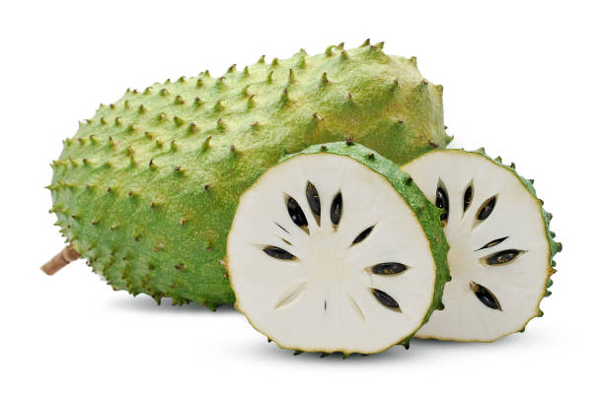
Guanabana aka Soursop
Annona muricata

Slide 5
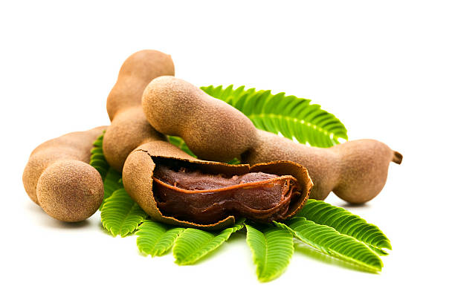
Tamarind
Tamarindus indica

Slide 6
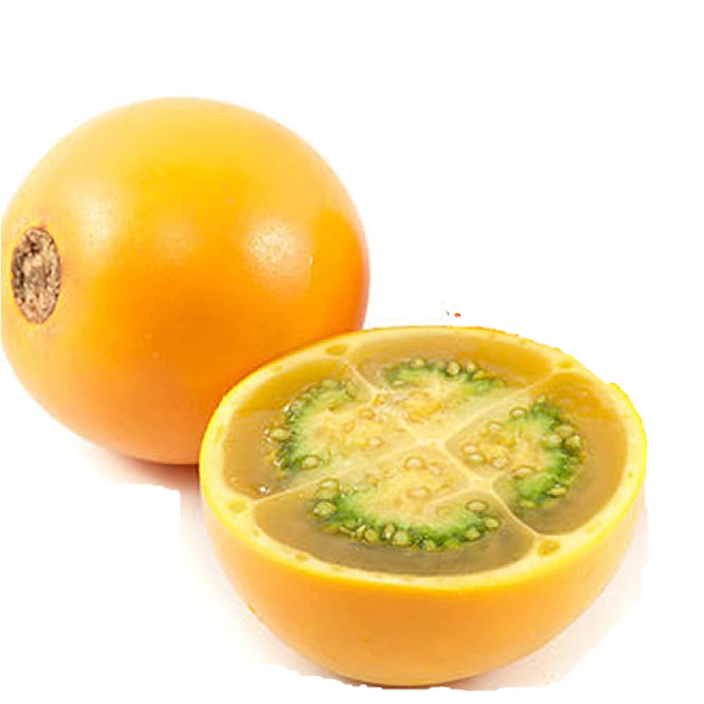
Lulo
Solanum quitoense

Slide 7
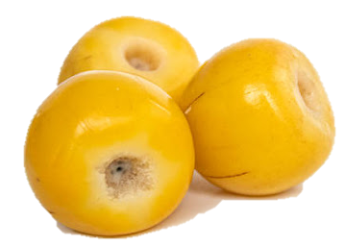
Nance
Byrsonima crassifolia

Slide 8
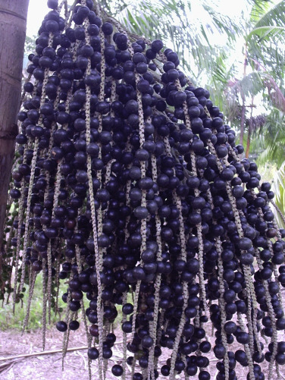
Açaí
Euterpe oleraceae

Slide 9
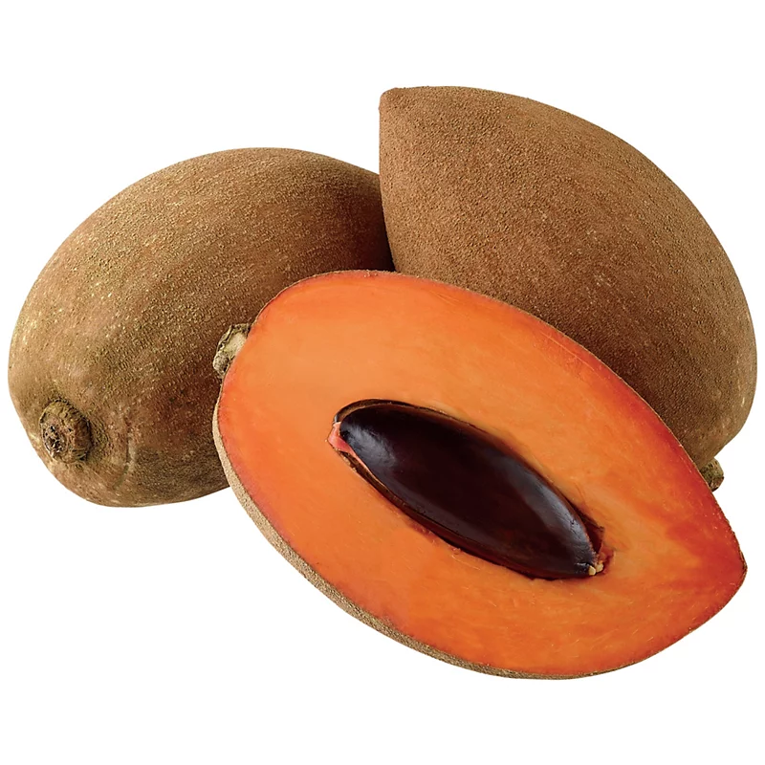
Mamey
Pouteria sapota

Slide 10
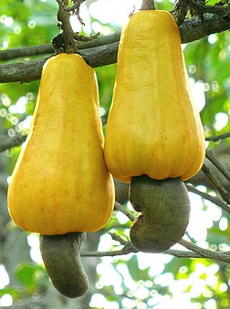
Cashew
Anacardium occidentale

Slide 11
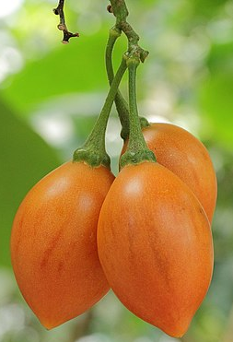
Tamarillo
Solanum betaceum

Slide 12
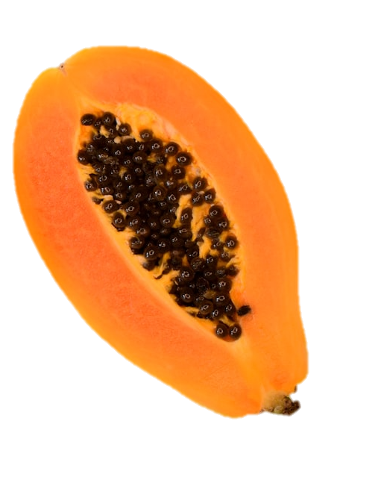
Papaya
Carica papaya

