Slide 1
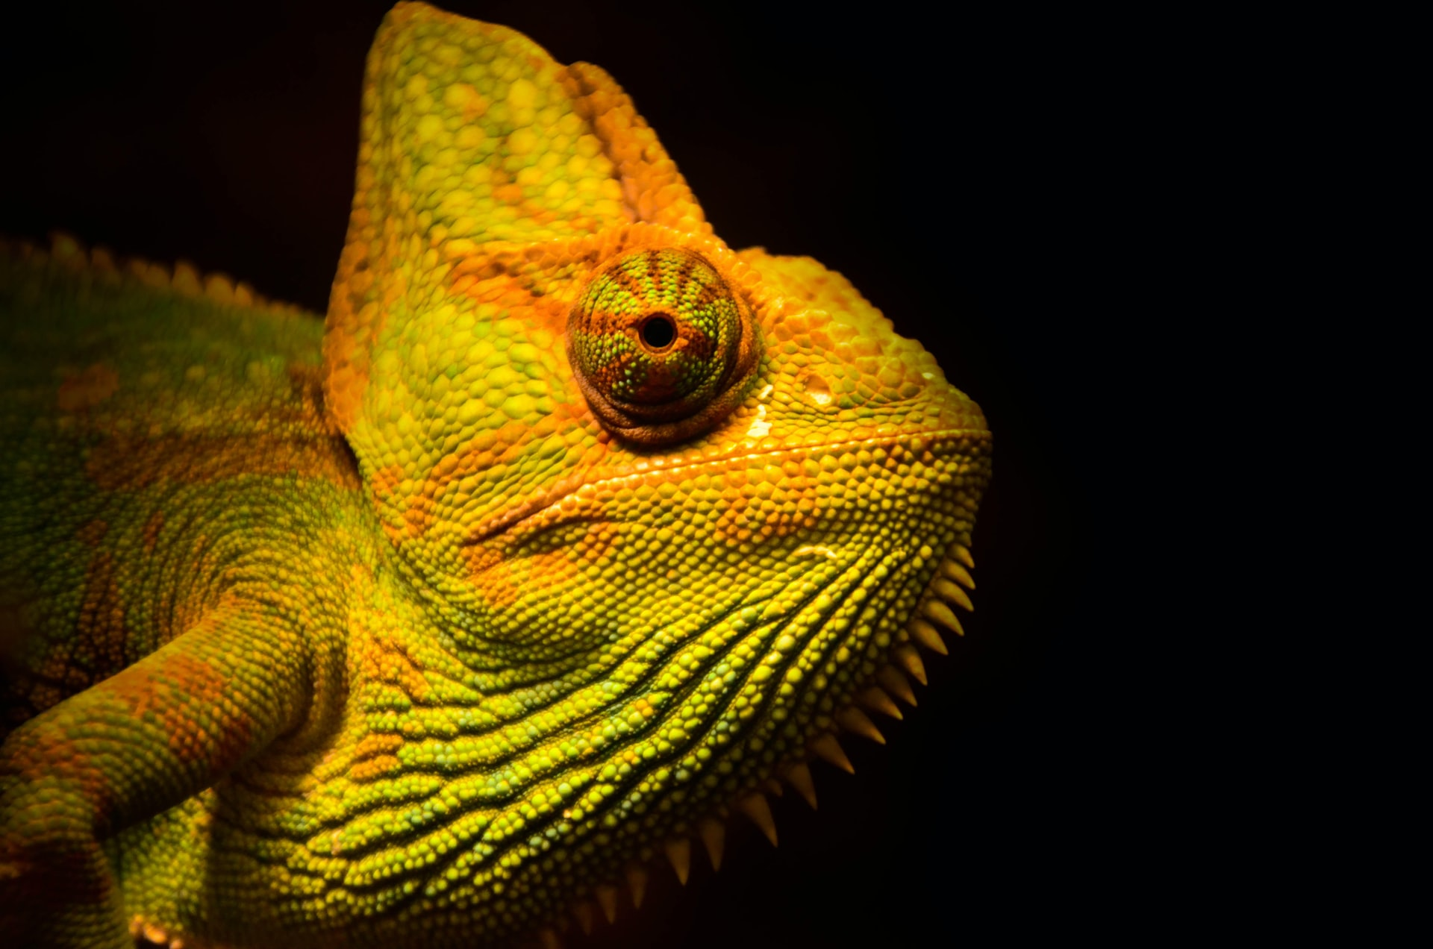
The Future of Tropical Rain Forests IDS 2935
13-1 Protected Areas

Slide 2
