Slide 1
“Typical” (old-school) Research Flow
Project
Planning
Data Acquisition
Data Analysis
Publications

Slide 2
Contemporary “Research Data Life-Cycle”
Project Planning
includes plans for data management
Data Collection
Data Analysis
Publication
& Data Archiving
Data Rediscovery & Reuse

Slide 3
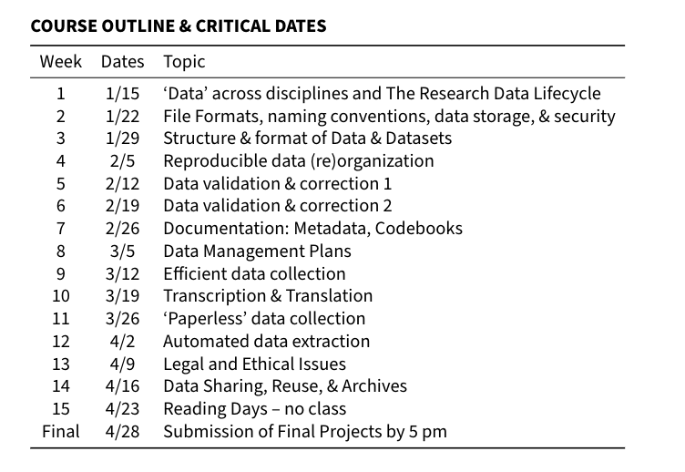
My data are a mess…
...and I can’t remember what some of these things mean.
If only I had planned...
…how I was going to collect & archive my data.
Notes:
Open science, transparency, and reproducibility of results are becoming increasingly important outside of academia, as the media and public have interest in how public research dollars are spent, and how scientific conclusions/evidence affect the real world.

Slide 4

Before Class
Read, Watch, Reflect
During Class
Exercises to Reinforce
Discuss Readings
Work on Individual Project

Slide 5
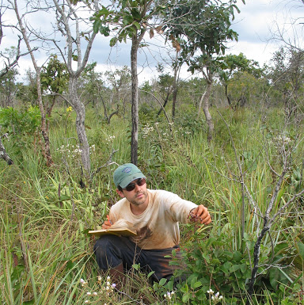
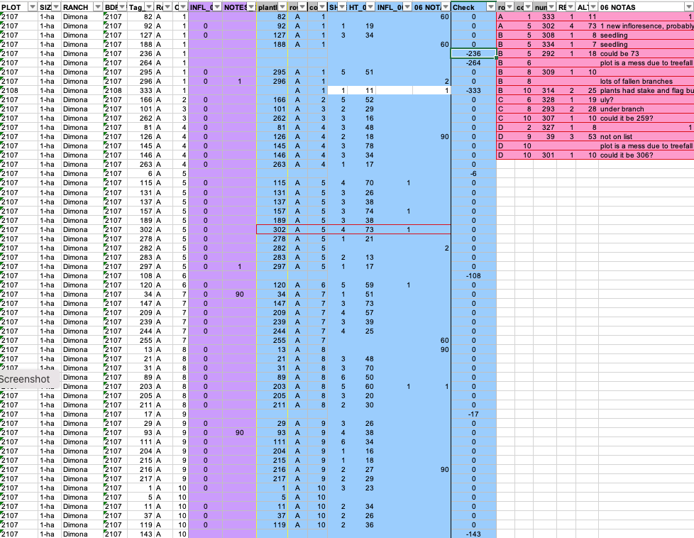
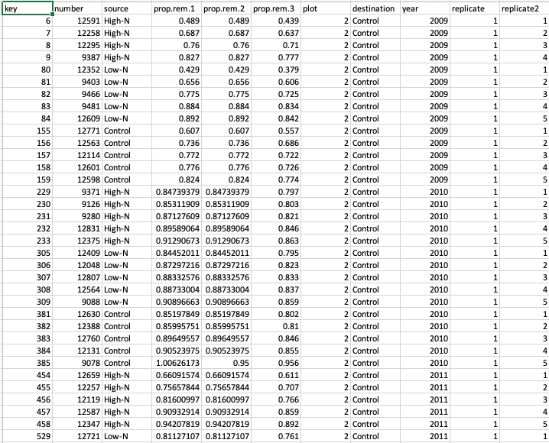

This class is an excuse to do
what you have to do anyway.

Slide 6
Let’s find out a little more…
In-Class Exercise Wk. 1

