Slide 1
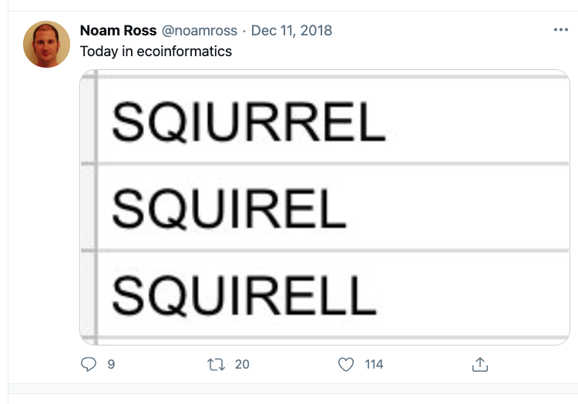

Slide 2
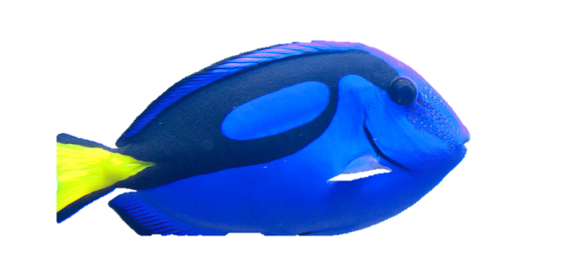
Our memory is not as good as we think it is.
Photo: Nathan Rupert
(CC BY-NC-ND 2.0)

Slide 3
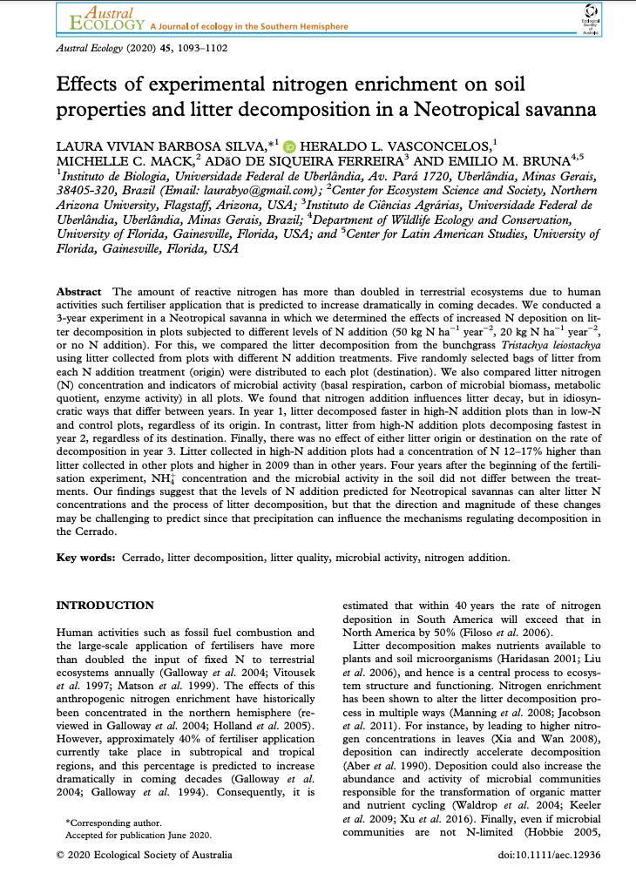
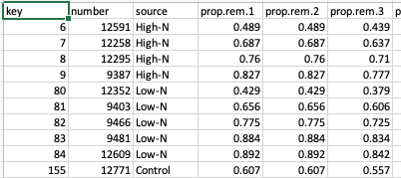

Slide 4
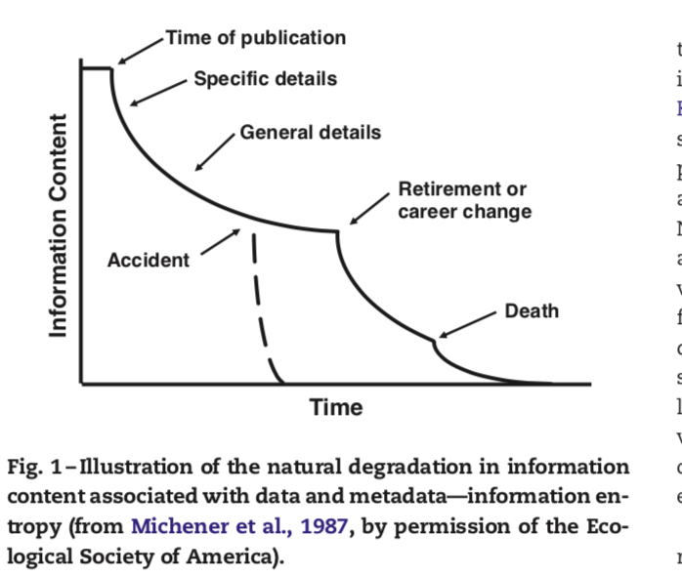
This is what these numbers mean
I need to double-check what these numbers mean
I’m can guess what these numbers mean
I don’t know / don’t care what these numbers mean
He was such a wonderful person.
If only we had taken the time to ask him what these numbers mean.

Slide 5
metadata
(Data about your Data)

Slide 6
WHY
were the data collected?
HOW
were the data collected?
WHEN
were the collected?
WHO
collected the data?
WHERE
were the data collected?
WHAT
is the content of the data?
(the Codebook, for you social scientists)

Slide 7
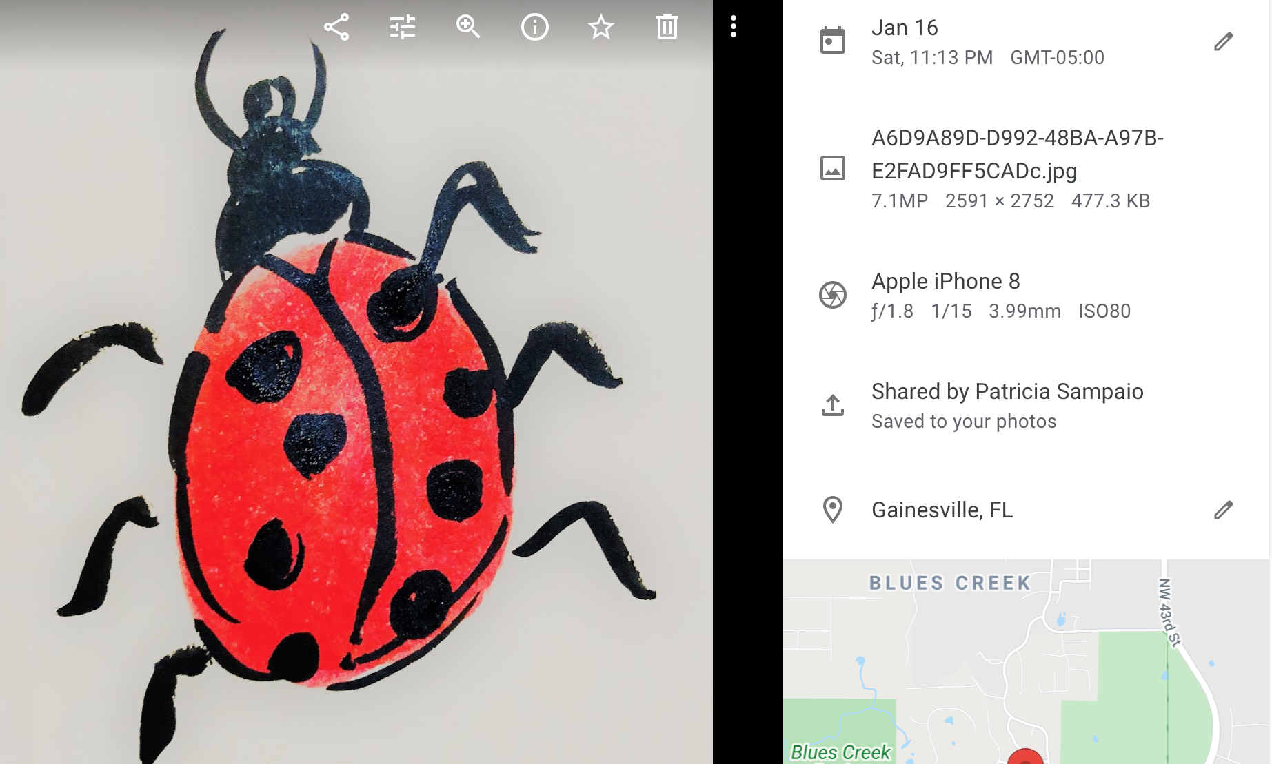
Metadata are nothing new….
DATA
(the photo)
METADATA
when
what
how
who
where

Slide 8
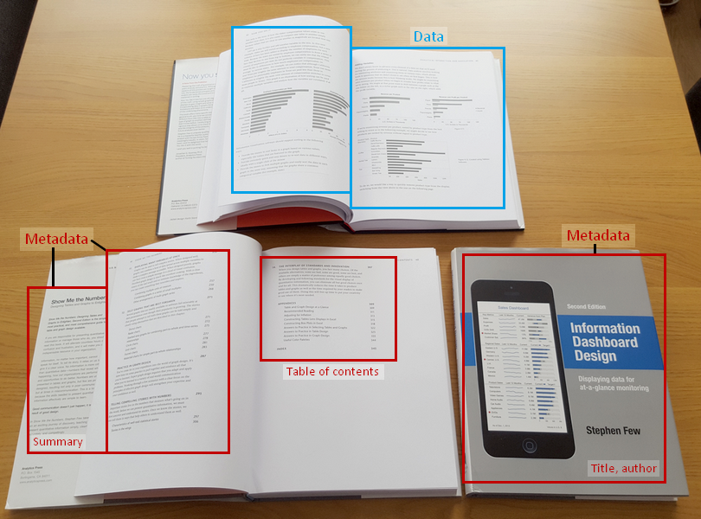
https://dataedo.com/kb/data-glossary/what-is-metadata

Slide 9
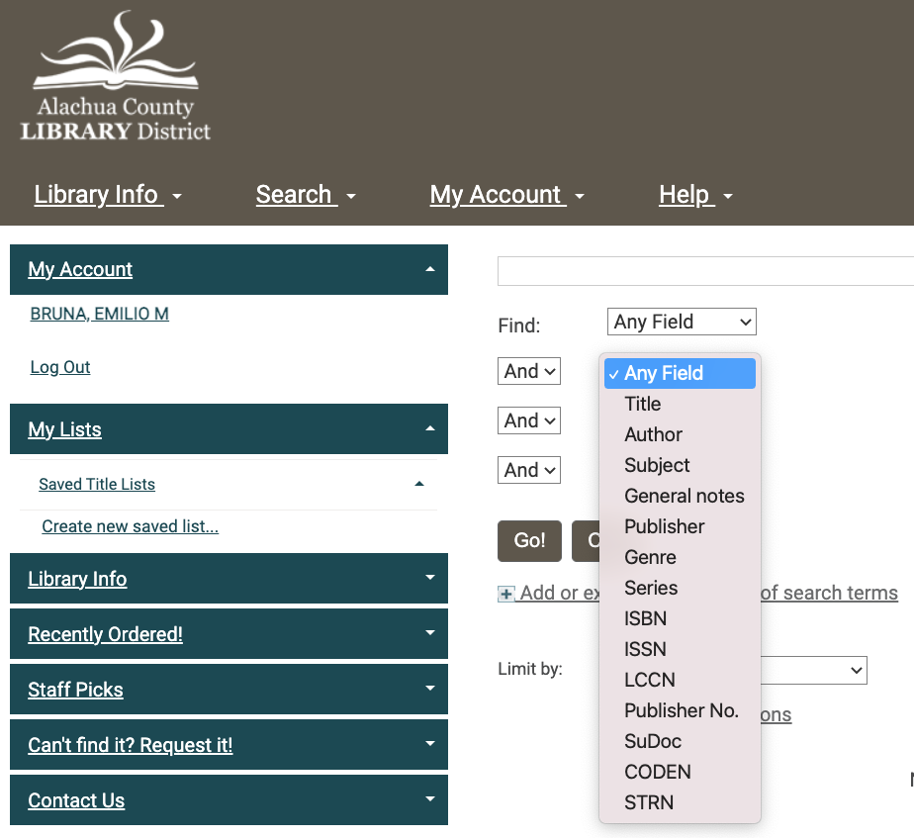
What are metadata good for?
1. Capture Information
2. Facilitates reuse
3. Facilitates discovery

Slide 10

What is the value of Metadata?
Notes:
Researchers & other Data Creators?
Avoid data duplication
Share reliable information
Publicize efforts & promote the work of a scientist
Efficiency: saves time and resources
Data users?
Ability to Search, retrieve, and evaluate dataset
Find data: Determine what data exists for a geographic location and/or topic
Determine applicability: Decide if a dataset meets a particular need
Discover how to acquire the dataset identified; process and use the dataset
Understand the dataset, including definitions of column names, or expected numerical ranges found in the data
Organizations?
Metadata helps ensure an organization’s investment in data: Documentation of data processing steps, quality control, definitions, data uses, and restrictions
Ability to use data after initial intended purpose
Allows organization to track data use and facilitates publication Transcends people and time: Offers data permanence
Creates institutional memory
Advertises an organization’s research: Creates possible new partnerships and collaborations through data sharing

Slide 11
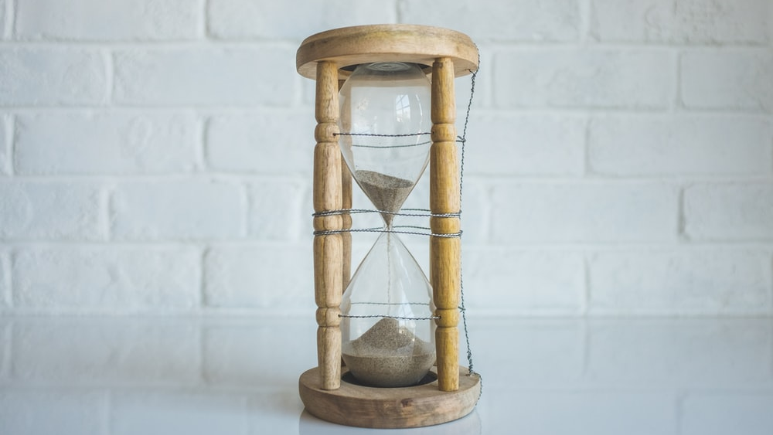
GOOD
METADATA
TAKES
TIME

Slide 12

START EARLY
STANDARDS
Notes:
Concerns About Creating Metadata
Concern Solution
Workload required to capture accurate robust metadata
Incorporate metadata creation into data development process – distribute the effort
Time and resources to create, manage, and maintain metadata
Include in grant budget and schedule
Readability / usability of metadata Use a standardized metadata format
Discipline specific information and ontologies Use a standard ‘profile’ that supports discipline specific information

Slide 13
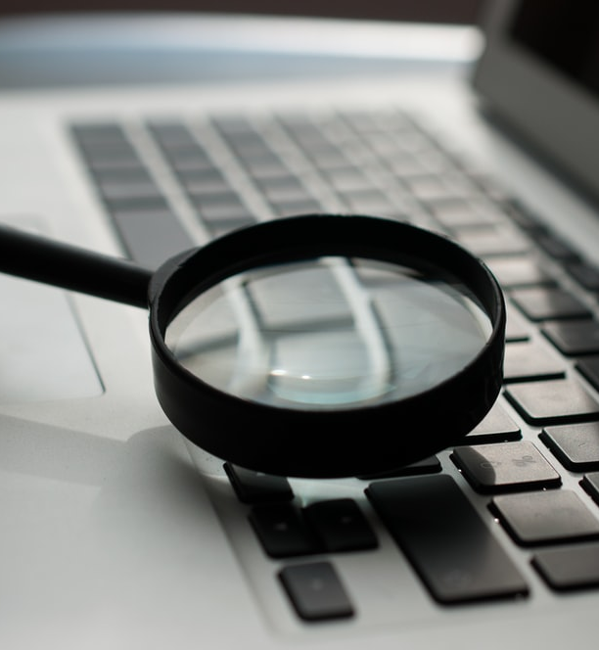
Strive to make your data FAIR
Findable: persistent identifiers & basic machine-actionable metadata
Accessible: can be read by machines & humans
Interoperable: use shared vocabularies / ontologies, machine-accessible (meta)data
Re-Usable: descriptions allow others to reuse and link with other data sources

Slide 14
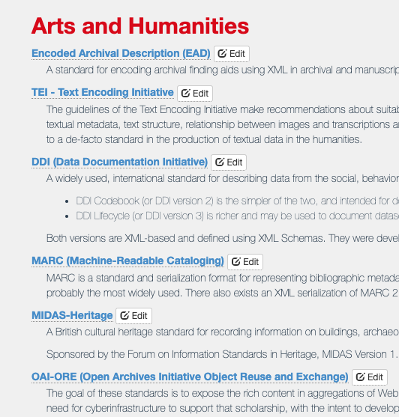

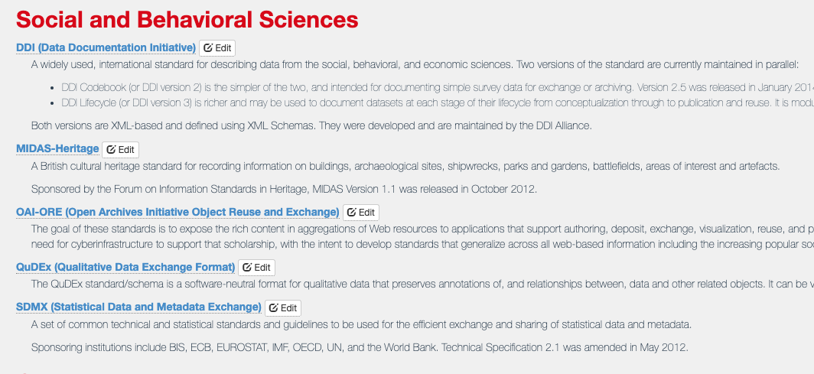
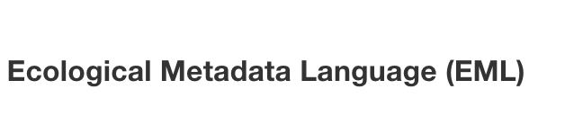

METADATA STANDARDS

Slide 15
Metadata “Descriptors”
(Michener et al. 1997)
Class I: alert potential secondary users to the existence of data sets that fall within specific temporal, spatial, and thematic domains.
Class II: describe the research resulting in a data set.
Class III: status of the data set and information on its accessibility.
Class IV: all the attributes related to the structure of the data file.
Class V: all other related information that might be necessary for secondary usage, publishing the data set, or auditing the data set.

Slide 16

Metadata is a declaration of Purpose. Constraints, Completeness, Liability
Notes:
Metadata is a declaration of
Purpose: the originator’s intended application of the data Use Constraints: inappropriate applications of the data Completeness: features or geographies excluded from the data
Distribution Liabilityexplicit liability of the data producer and assumed liability of the consumer

Slide 17
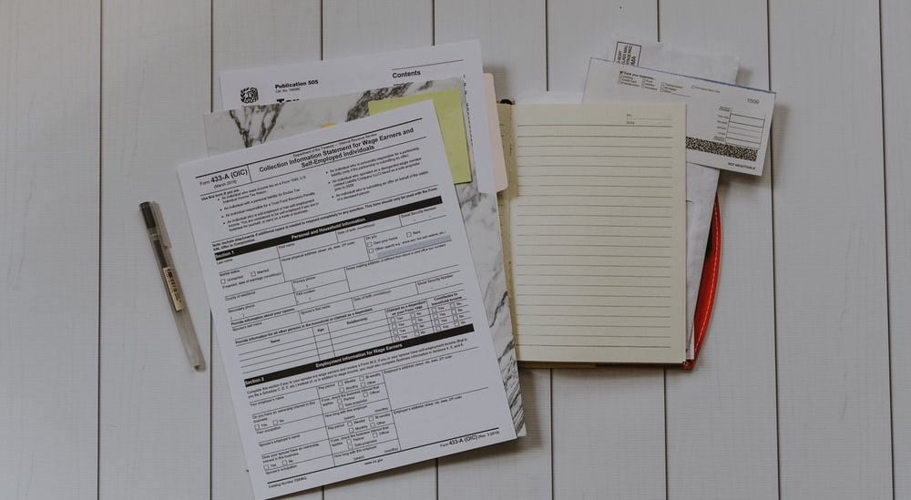
Steps to Creating Quality Metadata
Organize your materials (proposals, manuscripts, field notes, key references)
Use a metadata tool (helps ensure machine readability)
Review for accuracy and completeness
Have someone else read it.
Revise and review again
Update as needed.
Notes:
1. Organize your information Did you write a project abstract to obtain funding for your proposal? Reuse it in your metadata! Did you use a lab notebook or other notes during the data development process that define measurements and other parameters? Do you have the contact information for colleagues you worked with? What about citations for other data sources you used in your project? 2. Write your metadata using a metadata tool 3. Review for accuracy and completeness 4. Have someone else read your record 5. Revise the record, based on comments from your reviewer 6. Review once more before you publish

