Slide 1
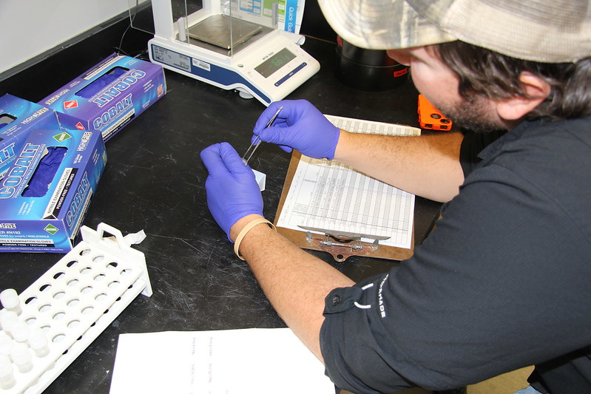
1
After collecting lizards in traps, a piece of each animal’s liver is removed, weighed using a scale, and stored in a plastic tube filled with ethanol. The data are later entered into a spreadsheet for analysis
Photo: FWC Fish & Wildlife Research Institute (CC BY-NC-ND 2.0)

Slide 2
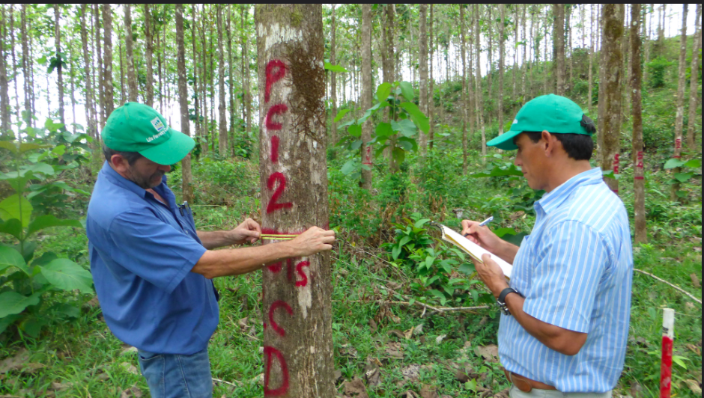
2
Each tree in the plot is identified to species and marked with a unique ID number. The diameter of each tree in the survey plot is measured with a tape measure. A leaf is collected from each tree and saved in a plastic bag for later DNA analysis. The diameter, species, and location (x,y coordinates) are recorded and entered into a spreadsheet after returning to the office.
Photo: Life Forestry (CC BY-NC-ND 2.0)

Slide 3
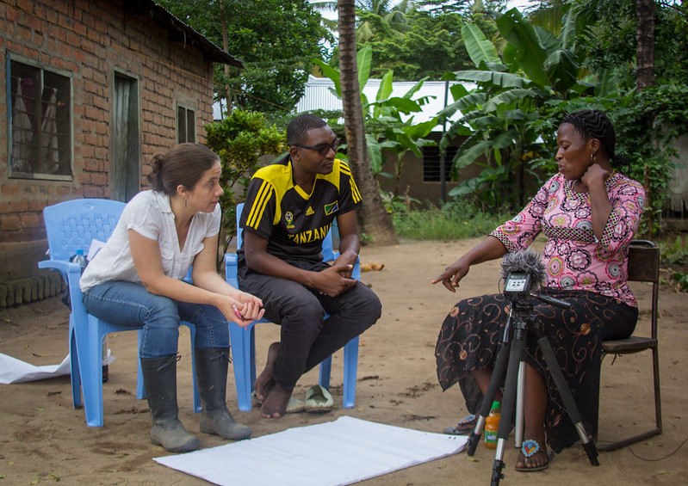
3
Villagers in Tanzania were interviewed to understand their agricultural practices. In addition to the interview, conducted via a translator, the participants were asked to make a “resource allocation map”: a drawing of the relative amount of their budget allocated to things like food, education, farming supplies, etc..
The recorded interviews were translated and transcribed to MS Word documents by bilingual students from the university. The maps were brought back to university so the researchers could compare each subject’s responses during the interview with the budget allocations they drew on the map. Data about each map (subject who made it, location, content, etc. were recorded in a spreadsheet).
Photo: Nkumi Mtimgwa/CIFOR (CC BY-NC-ND 2.0)

