Slide 1



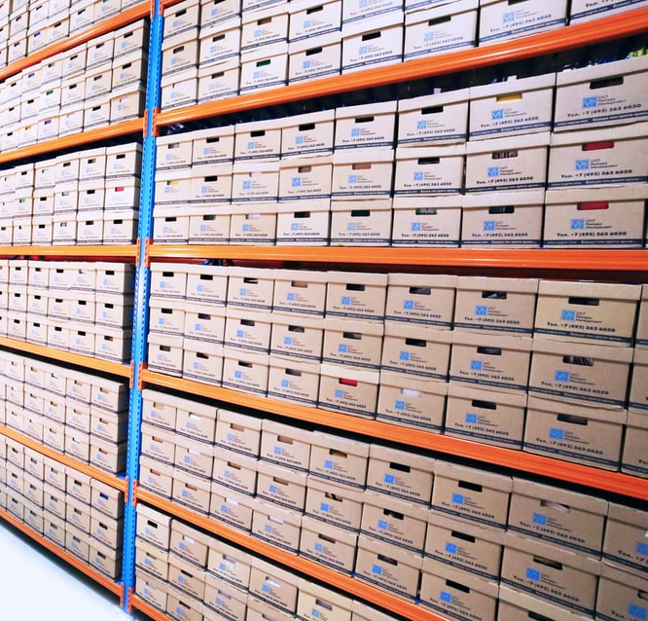
Data Storage and Backup
First some terminology…
Original Data
Operation Data
Backup
Archive

Slide 2
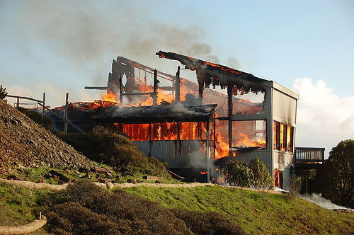
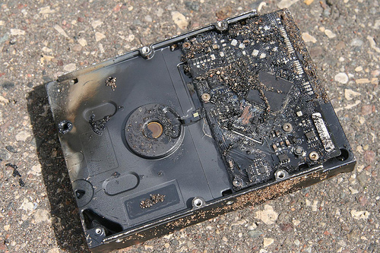
Why Bother?
Server hardware/software failure
data requests / FOIA/ Lawsuits / legal requirement
funder mandates
Format obsolescence
Loss of financial stability
hardware failure
natural disasters
software or media faults
virus infection or malicious hacking
power failure
human error
results validation

Slide 3
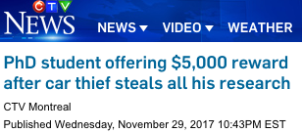

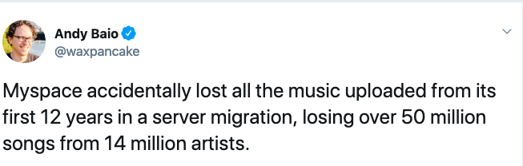
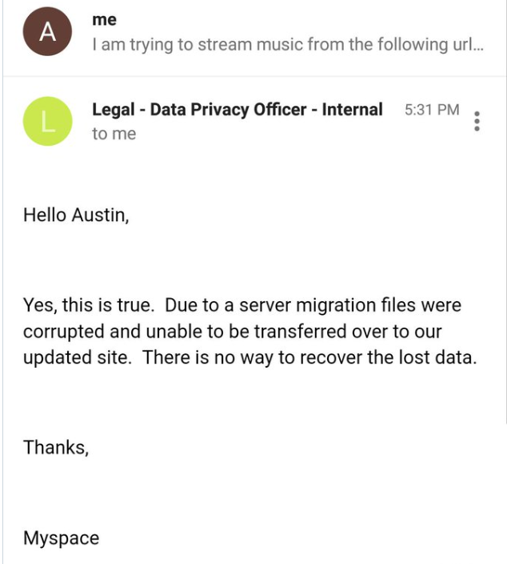
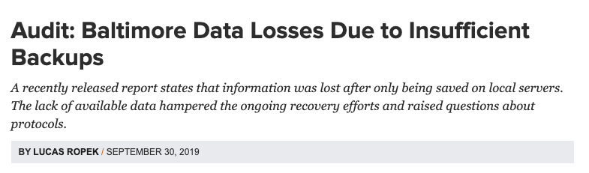
“The thief stole a backpack containing his laptop, a notebook, and a thumb drive with all his backup material... With all his work gone, he will likely have to head back to the lab and redo experiments, delaying graduation by months.”
https://www.govtech.com/security/Audit-Baltimore-Data-Losses-Due-to-Insufficient-Backups.html

Slide 4
3-2-1
3 copies of your data on
2 types of storage media with
1 copy off-site
Notes:
**3-2-1:** A secure backup requires a *minimum* of **3 copies** of your data on **2 types of storage media** with **one copy off-site**. Having 1 copy off-site protects your data from local risks like theft, lab fires, flooding, or natural disasters. Using 2 storage media improves the likelihood that at least one version will be readable in the future should one media type become obsolete or degrade unexpectedly. Having 3 copies helps ensure that your data will exist somewhere without being overly redundant. **_Be sure to migrate data from physical storage every 3-5 years_**

Slide 5

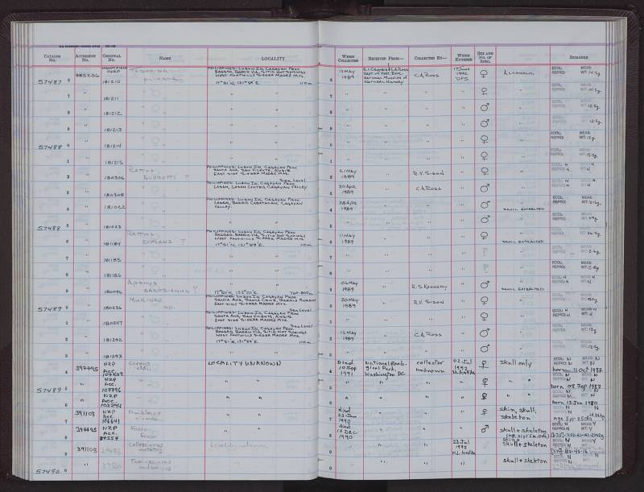
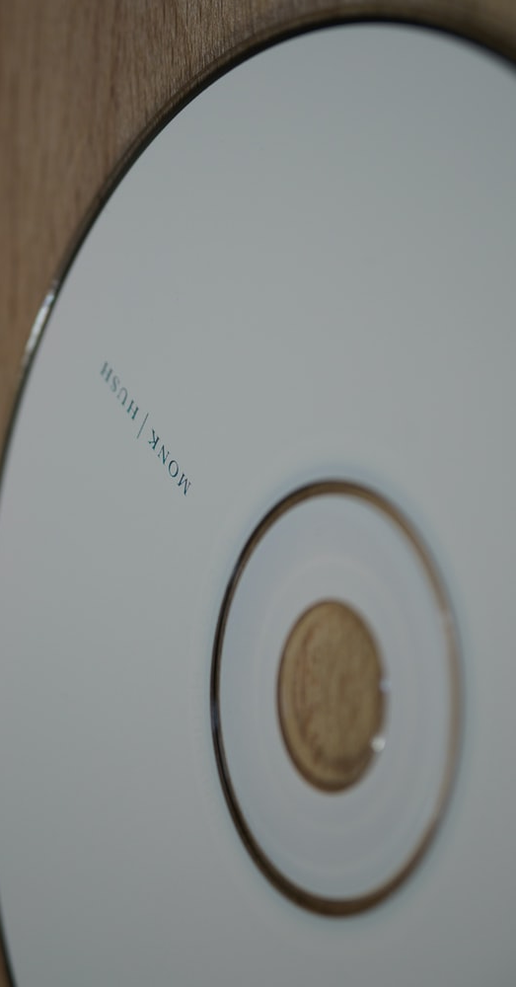
Storage Media
Desktop and Laptop Computers
Campus servers
Commercial Cloud Backup
External hard drives
Optical Storage (CD, DVD)
Paper
(original notebooks, printouts of spreadsheets, text files)
Notes:
**Successful preservation depends in great part on storage media that are in good physical and operational condition.** There are many different kinds of storage media that can be used to save and back-up digital files; each has pros and cons. They include:

Slide 6
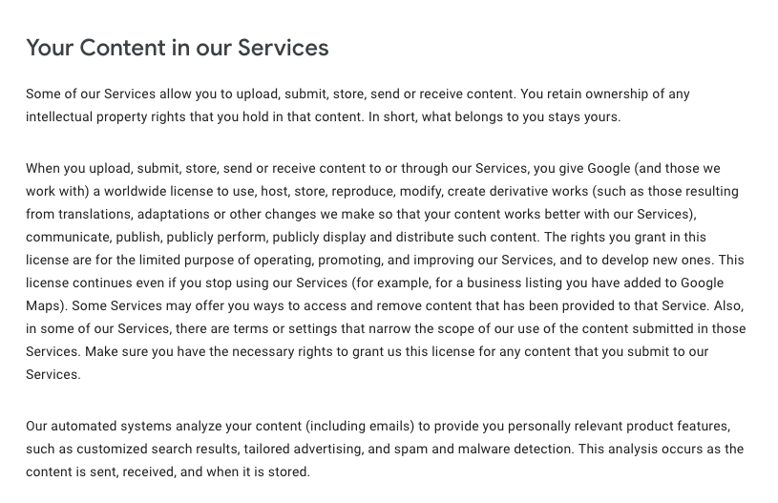

Slide 7
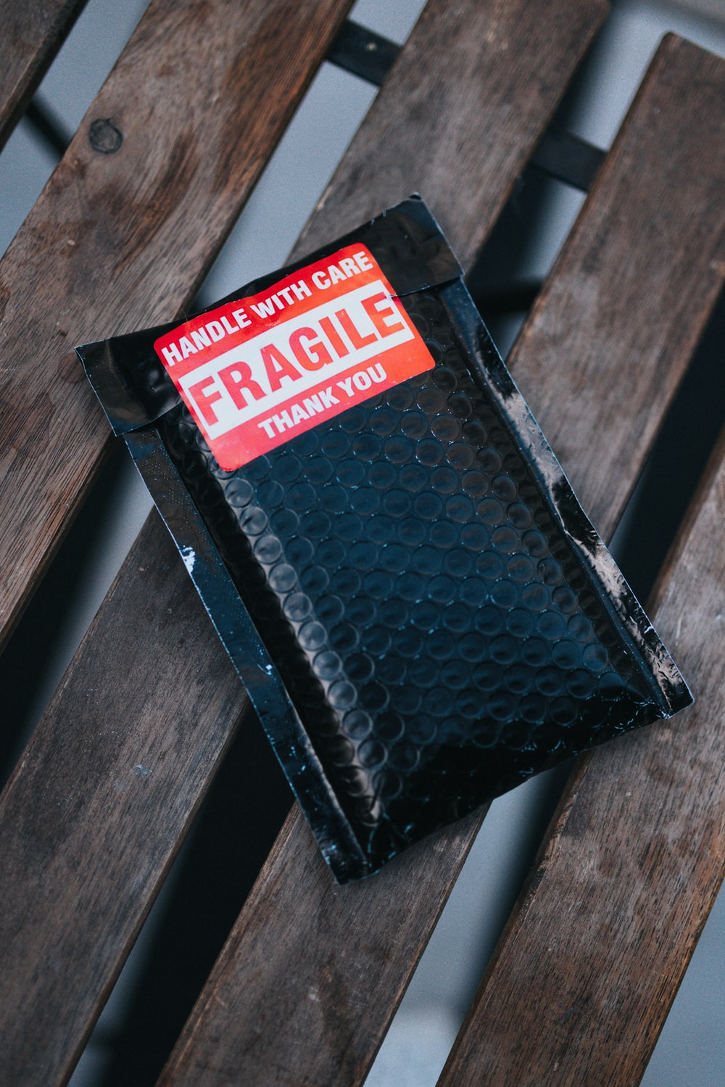
Storage Media (cont.)
Test Your Storage Media Regularly
Beware of Early Hardware Failures
Determine the Life of Your Hard Drives
4. Routinely Inspect and Replace Data Discs
5. Handle and Store Your Media With Care
Notes:
1. **Test Your Storage Media Regularly:It is important to routinely perform test retrievals or restorations of data you are storing for extended periods on hard drives, discs or tapes. It is recommended that storage media that is used infrequently be tested at least once a year to ensure the data is accessible.
2. **Beware of Early Hardware Failures: **A certain percentage of storage media will fail early due to manufacturing defects. In particular, hard drives,
thumb drives and data tapes that have electronic or moving parts can be susceptible to early failure. When putting a new drive or tape into service,
it is advisable to maintain a redundant copy of your data for 30 days until the new device “settles in.”
3. **Determine the Life of Your Hard Drives: **When purchasing a new drive unit, note the Mean Time Between Failure (MTBF) of the device, which should be listed on its specifications sheet (device specifications are usually packaged with the unit, or available online). The MTBF is expressed in the number of hours on average that a device can be used before it is expected to fail. Use the MTBF to calculate how long the device can be used before it needs to be replaced, and note that date on your calendar (For example, if the MTBF of a new hard drive is 2,500 hours and you anticipate having the unit powered on for 8 hours a day during the work week, the device should last about 2 years before it needs to be replaced).
4. **Routinely Inspect and Replace Data Discs: **Contemporary CD and DVD discs are generally robust storage media that will fail more often from mishandling and improper storage than from deterioration. However lower quality discs can suffer from delamination (separation of the disc layers) or oxidation. It is advisable to inspect discs every year to detect early signs of wear. Immediately copy the data off of discs that appear to be warping or discolored. Data tapes are susceptible both to physical wear and poor environmental storage conditions. In general, it is advisable to move data stored on discs and tapes to new media every 2-5 years (specific estimates on media longevity are available on the web).
5. **Handle and Store Your Media With Care:** All storage media types are susceptible to damage from dust and dirt exposure, temperature extremes,
exposure to intense light, water penetration (more so for tapes and drives than discs), and physical shock. To help prolong its operational life, store
your media in a dry environment with a comfortable and stable room temperature. Encapsulate all media in plastic during transportation. Provide cases or plastic sheaths for discs, and avoid handling them excessively.

Slide 8

Backup vs Archive
6. Multimedia (e.g., photo, video, audio) backup is more challenging, in part because transcriptions and captioning can be important for interpretation, discovery, and accessibility.
Notes:
Storage of images solely on local hard drives or servers is not recommended. Unaltered images should be preserved at the highest resolution possible. Store original images in separate locations to limit the chance of overwriting and losing the original image.There are a number of options for metadata for multimedia data, including [MPEG standards](http://mpeg.chiariglione.org/), [PBCore](http://pbcore.org), and the US Library of Congress standards for [still images](https://www.loc.gov/preservation/digital/formats/content/still.shtml), [sound](https://www.loc.gov/preservation/digital/formats/content/sound.shtml), and [moving images](https://www.loc.gov/preservation/digital/formats/content/video.shtml).

Slide 9
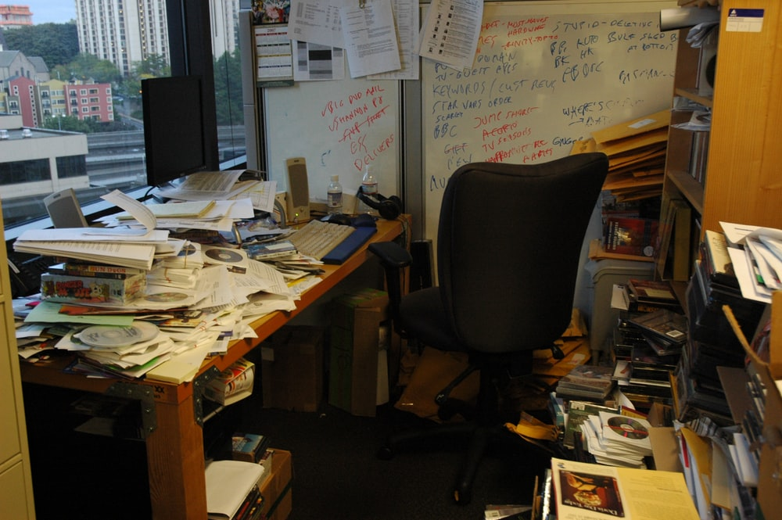
What about the Originals?
7. Finally, consider the short- and long-term security of the originals: specimens, samples, documents and data sheets, photographs, or other physical items.
Campus Office
Lab or Museum/Herbarium
Departmental Office
Commercial storage facility
Home
Library
Notes:
7. **Finally, consider the short- and long-term security of the originals:** specimens, samples, documents and data sheets, photographs, or other physical items. Options include:
* Campus Office
* Lab or Museum/Herbarium
* Departmental Office
* Commercial storage facility
* Home
* Library

Slide 10

Make a plan.
Write it down.
what needs to be prepared and for how long
where backups are located
who can access backups and how contacted
how often data should be backed up
what kind of backups are performed
who is responsible for performing the backups
hardware and software used for performing backups
how / how often to check if backups is successful
the media are used to backup data
a list of any data that are not archived or backed up
Notes:
1. **Plan ahead, and write down your plan.** A written data back-up and security plan includes such information as:
* where backups are located
* who can access backups and how they can be contacted
* how often data should be backed up
* what kind of backups are performed
* who is responsible for performing the backups and their contact information. For large projects or projects with high-volume data streams include a person with secondary responsibility (the back-up back-up) in case the primary person responsible is unavailable
* what hardware and software are used or recommended for performing backups
* how and how often to check if backups have been performed successfully
* the media are used to backup data
* a list of any data that are *not* archived or backed up

Slide 11
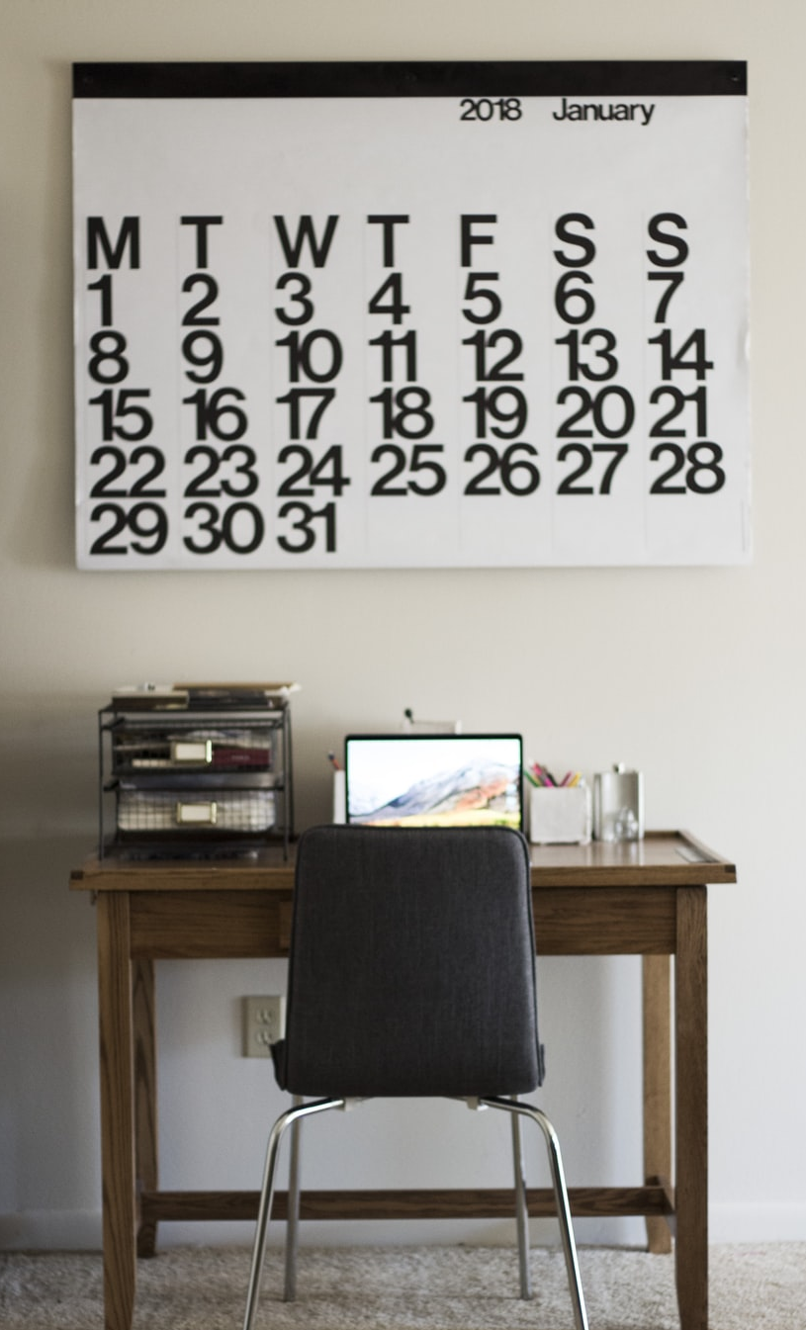
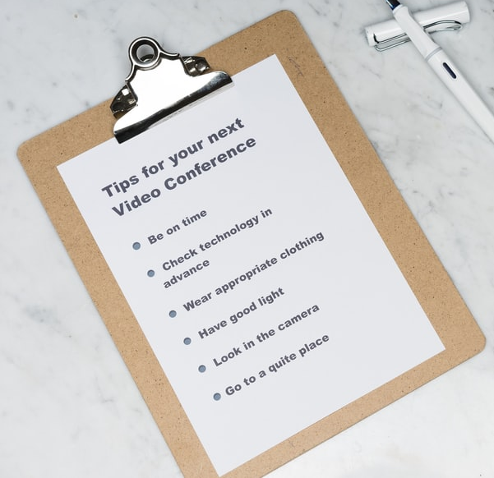
Backup Strategies
Backup your data at regular (optimized) frequencies
Make it easy to follow your plan
Automate
Remember: synced computer and cloud drive are not independent copies
__Laptop to portable HD
__Check pictures
__Do checksums)
Automate as much as possible. ** Automation simplifies frequent backups. but be careful with accidental file loss and that back-up copies are actually independent (e.g. Dropbox and a synced folder on your laptop are *not* independent copies).
Notes:
Backup your data at regular frequencies**, with backup strategies (e.g., full, incremental, differential) optimized for the data collection process and data type. For instance, you should (at least):
* Back up when you complete your data collection activity
* Back up after you edit / clean data
* Streaming data (e.g., from data loggers) should be backed up at regularly scheduled points in the collection process
* High-value data should be backed up at much higher frequencies (daily)
3. **Put procedures in place to make sure you follow your plan.**
* set up calendar reminders
* use checklists.
* Ensure backup copies are identical to the original copy (using checksums, file counts, etc.)
* Be sure of one of the regular calendar items is to verify successful recovery from a backup copy.
* **Automate as much as possible. ** Automation simplifies frequent backups. but be careful with accidental file loss and that back-up copies are actually independent (e.g. Dropbox and a synced folder on your laptop are *not* independent copies).

Slide 12
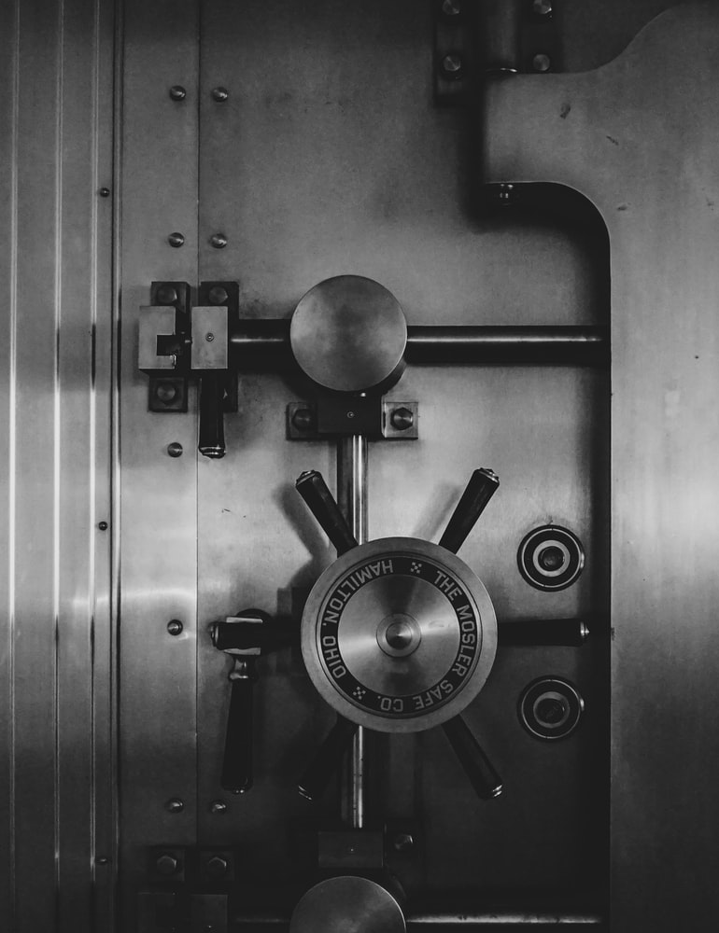
Restricted Data
Know if your data require extra protection
Take steps to ensure the security of Restricted data
Notes:
4. **Ensure the Security of Restricted Data.**
* All data collected by UF affiliates falls into one of the classifications defined in the [UF Data Policy](https://it.ufl.edu/policies/information-security/data-classification-policy/). Both original and electronic archives must be secured; failure to do so can have serious consequences for both researchers and institutions.

Slide 13
And finally….
ensure your data will be readable by many systems & for many years
USE OPEN
(non-proprietary)
DATA FORMATS
Notes:
Use formats that ensure your data ca
For long term preservation is it necessary to store data in file formats that will be readable in the future. It is also important to provide descriptive information on these data file types and formats. This will facilitate data retrieval and reuse.
1. Document and store data using file-types that are open (ie., non-proprietary), uncompressed, unencrypted (if at all possible), and stable:

