Slide 1
Contemporary “Research Data Life-Cycle”
Project Planning
includes plans for data management
Data Collection
Data Analysis
Publication
& Data Archiving
Data Rediscovery & Reuse

Slide 2
Contemporary “Research Data Life-Cycle”
Project Planning
includes plans for data management
2
DMP
Data Rediscovery & Reuse
Data Collection
3
metadata
Publication
& Data Archiving
Data Analysis
1

Slide 3
‘Data Management Plans’ become ‘Metadata’
DMP
metadata
Project Planning
includes plans for data management
Publication
& Data Archiving

Slide 4
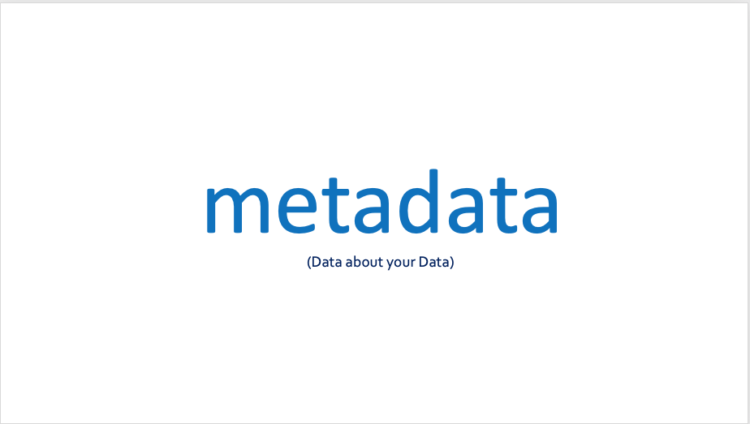
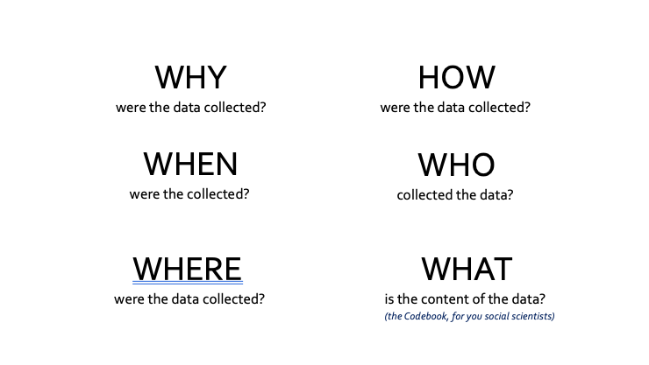
Data Management Plans
Formal document that lays out your plan for managing the data you will collect (or have collected).
Outlines what you will do with your data during and after you complete your research
Ensures your data is safe for the present and the future
Does this sound familiar?

Slide 5



Why do a DMP?
Save time
Less work later
Increase research efficiency
You may not have a choice.

Slide 6
Components of a DMP
Information about data & data format
Metadata content and format
Policies for access, sharing and re-use
Long-term storage and data management
Roles and responsibilities
Budget
Again: Does this sound familiar?

Slide 7
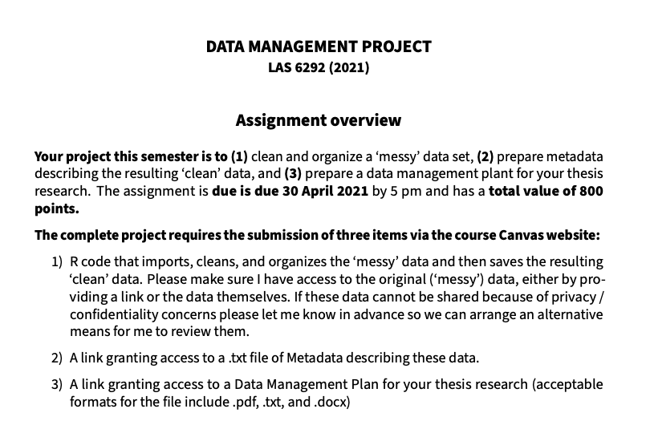
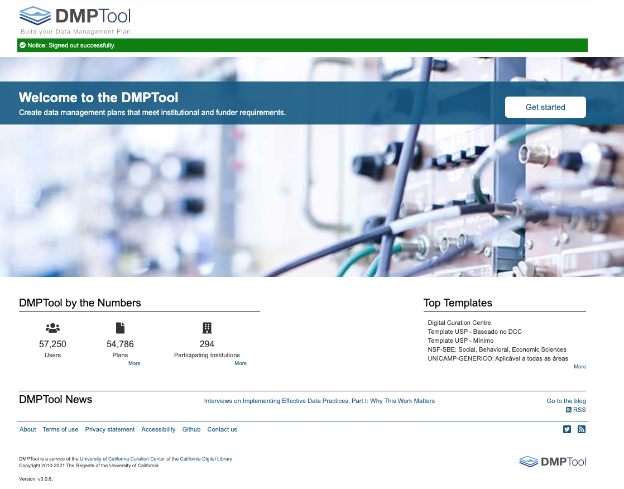
Today….
dmptool.org

