Slide 1
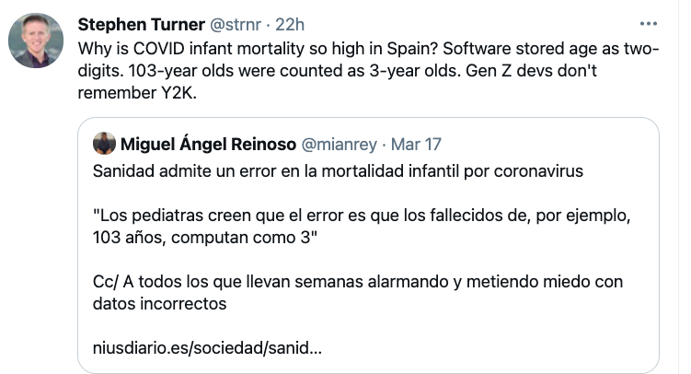
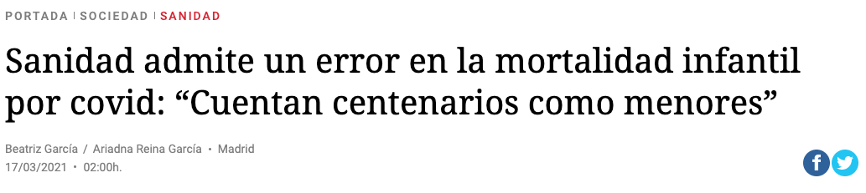
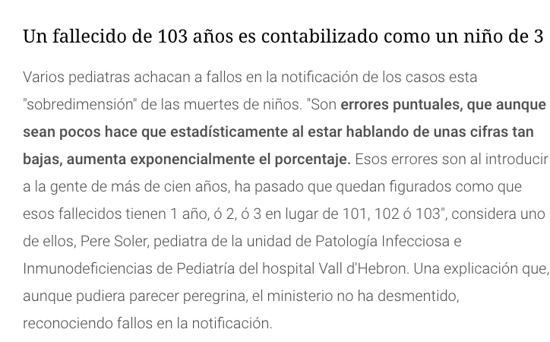

Slide 2

WHY TRANSCRIBE?
Can skim quickly to see if passage / interview is relevant
Avoid degradation the original audio media
Help in comprehension of voices on that are difficult to hear or understand
Can annotate with metadata and additional notes
Can read metadata/text into a computer for analysis
WHY NOT TRANSCRIBE?
Time consuming. Do you really need a (close to) verbatim transcription? Will notes during the interview or when inspecting the original object be sufficient?

Slide 3
REMEMBER
Transcription is not a substitute for being there. It is complementary documentation of the same event.
Always take contemporaneous notes.
Always use tools to make the work more efficient (1-10-100). Software, style guide etc.
DO NOT TRANSCRIBE FROM THE ORIGINAL MEDIA.

Slide 4
Interview Synopsis
[included as part of the Interview Information Form which identifies the project name, interviewer name, narrator name, length of interview, media, donor form signed, and if the interview was transcribed]
"This interview was recorded on August 12, 2005, as part of the Ace School Oral History Project. During the interview, Jane Doe, the narrator, a former student at the school, discussed the following topics:
Her background and ties to Ace School
Her first memories of attending the school
The subjects taught in the school
The teachers
The school building exterior
The interior layout and what the classrooms looked like
Recess
Holidays and fun times
Her perspective on what her education there meant to her
This interview is one of 20 in the Ace School Oral History Project, a project of the Douglas County Historical Society. Narrators represent former students, teachers, school administrators, service personnel, community leaders and school board members. The interviewer is Mary Smith."
https://www.nebraskahistory.org/lib-arch/research/audiovis/oral_history/Synopsis.htm

Slide 5
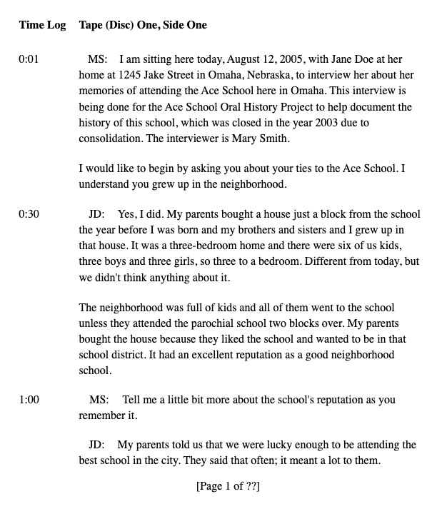
TRANSCRIPT
Oral History Interview with Jane Doe, Ace School Oral History Project
Interviewed on September 13, 2006 Interviewed at 1245 Jake Street Omaha, Nebraska
Interviewed by Mary Smith
JD = Jane Doe MS = Mary Smith
https://www.nebraskahistory.org/lib-arch/research/audiovis/oral_history/Transcript.htm

Slide 6
CONSISTENCY = EFFICIENCY
If there are multiple people working on the same project, use a “style guide” to ensure consistency (headers, font, format, abbreviations, capitalization, numbers
Always indicate change in speaker
Indicate time stamps at regular intervals, and when there is an inaudible portion
Whatever you do, be consistent
When in doubt, use Chicago Manual of Style

Slide 7
TRANSCRIBING IS AN ART, NOT A SCIENCE!
Common issues:
• False starts
• Run-on sentences
• Non verbals
• Dialects
• Filler words

Slide 8
REMEMBER THE OBJECTIVE OF TRANSCRIPTION
• Should not embarrass the narrator or make them look foolish
• Should capture the flavor of a narrator’s speech
• Should be clarified when appropriate with the use of brackets

Slide 9
STANDARDIZE THE HEADER (THIS IS YOUR METADATA)
[1] Document Name: AA00062074.pdf o Doe_diario_1889_ss
[2] Document Location: UFDC https://ufdc.ufl.edu/AA00076547/00001/pdf
[3] BIBid (bibliographic identification): AA00076547
[4] Transcribers Note: This section should include all information, comments, or explanations about the transcript not found in the original text.

Slide 10
Use Brackets To Indicate Anything You Have Added To The Document
[inaudible 00:33:04]
[end of interview]
My grandfather is buried there [pointing out the window], under that oak tree.
[laughing]
I work in the DCC [Digital Collections Center]every day.
[crosstalk 00:04:45]

Slide 11
https://ufdc.ufl.edu/AA00062074/00001/pdf

