Slide 1




File Names (really)
Files
How To Organize Them
How To Store them
How to Keep Safe

Slide 2
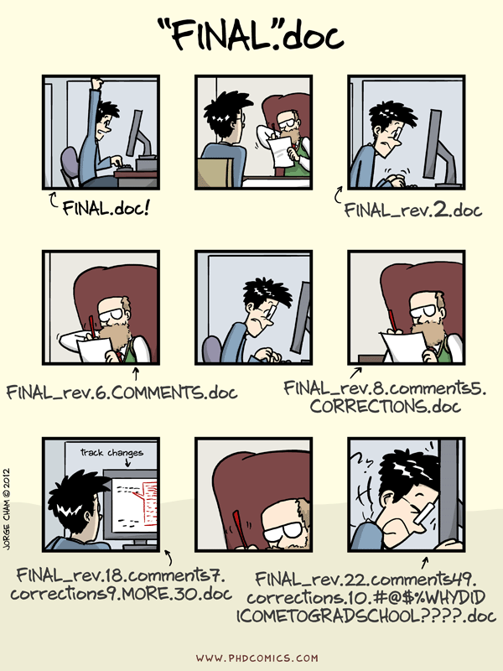

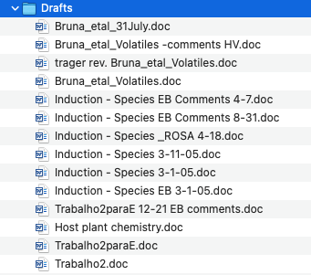

Slide 3
The first (and easiest) way to get started organizing your data:
a simple, clear, consistent system for naming files
Files will be easier to find
You won’t have to open files to see what they are
Files are easier to sort
Files are easier to share with collaborators (and for collaborators to use)
It helps prevent accidentally overwriting or deleting files

Slide 4
Files names should:
Tell you about the contents of the file and allow you to uniquely identify it
‘data 1998’
‘survey data’
‘survey data 1998’
‘mammal survey 1998’
2. Be as short as possible
< 25 characters
3. Avoid using special characters and spaces
$ % ^ & # | :
4. Start with letters, never numbers
YES:
data_1998
NO:
1998_data
Notes:
For instance (compare 'data 1998' vs 'survey data' vs 'survey data 1998' vs 'small mammal survey data 1998'). You can use things like the an acronym for the project, abbreviation for the study, location where collected, the name of the investigator, the year or month when collected, the type of data type, etc.
Many database systems (like MS One Drive) have limits on file name length. Use a max of 25 characters, and aim for less than that.

Slide 5
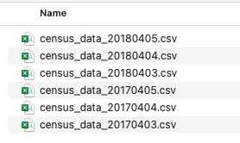



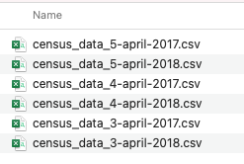
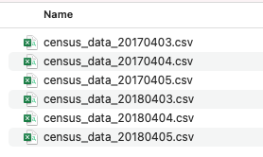
5. Help you quickly sort files chronologically or numerically.
Notes:
Dates are very useful in file names because they can help identify the most recent files easily. You can not rely on the file date associated with the file on the computer! However, it is really important to use a clear format for dates, especially if collaborating internationally. I learned the hard way that not everyone reads 'census_data_3-4-2018' the same way I do, so I switched to 'census_data_4march2018'. However, even this isn’t ideal because of how it sorts things in a folder. Now I now use this format: 'file_name_yearmonthday'('census_data_20180403'). You can also use file_name_year_month_day. In addition to the benefit of sorting more easily, you’ll never have to use the the dreaded '_____.final.docx' and '_____.actual_final.docx' in your file names ever again…you’ll always know which is the last one. If the files don’t require a date, but you want to maintain a sequence, use leading zeros to maintain sort order. 7 and 701 don’ty sort the way you expect them to, so use 007 and 701.

Slide 6
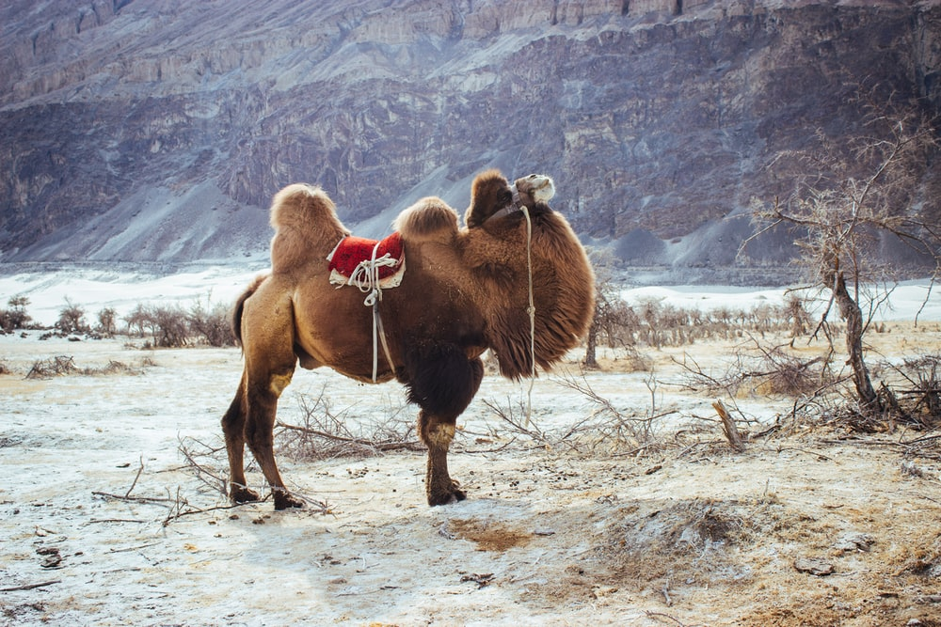

6. Use a consistent method of dealing with spaces and letter case.
'survey responses maria'
'survey_responses_maria'
'SurveyResponsesMaria'
'survey-responses-maria'
'survey_responses_Maria'

Slide 7

Once you have a system, write it down
Remember: make the names simple, informative, and unique
survey
data
behavioral
data
data_2017
data_2017
survey_responses_2017
behavior_obs_2017

Slide 8
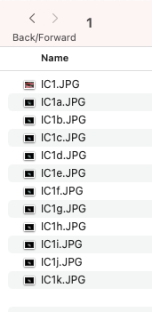
TOOLS

