Slide 1
Legal & Ethical Issues in Data Collection and Management
Research Methods
for Gathering Data
How we use and care for the
data after we’ve collected it

Slide 2
LAW
POLICY
The government says
“You must do this” or
“You cannot do this”
Government or Institution says
“We will do this because it is expedient, safer, a good idea, etc.”
ETHICAL GUIDELINE
“We will do this because it is the right thing to do”

Slide 3
What dictates how your data should be collected, stored, & managed?
LAW
POLICY
ETHICAL GUIDELINES

Slide 4
What dictates how your data should be collected, stored, & managed?
LAW
Data must be collected, stored, and made available in accordance with relevant federal & state laws
HIPPA - Health Insurance Portability and Accountability Act, 1996: personal storage and use of personal health information (PHI)
FISMA - Fed Info Management Security Act, 1992: Regulates storage of data for parties working as federal contractors
FOIA Freedom of Information Act: agencies are required to disclose any information requested under the FOIA unless it falls under one of nine exemptions which protect interests such as personal privacy, national security, and law enforcement.
FERPA (Fed Ed Right to Privacy Act): governs the access to educational information and records by public entities such as potential employers, publicly funded educational institutions, and foreign governments.
Florida Public Records Law: Section 119.011(12) of the Florida Statutes: defines public record as: "all documents, papers, letters, maps, books, tapes, photographs, films, sound recordings, data processing software, or other material, regardless of the physical form, characteristics, or means of transmission, made or received pursuant to law or ordinance or in connection with the transaction of official business by any agency." https://guides.law.fsu.edu/c.php?g=84861&p=547361

Slide 5
What dictates how your data should be collected, stored, & managed?
POLICY
Data must be collected, stored, and made available in accordance with agency and institutional policies
NSF: Investigators are expected to share with other researchers, at no more than incremental cost and within a reasonable time, the primary data, samples, physical collections and other supporting materials created or gathered in the course of work under NSF grants. Grantees are expected to encourage and facilitate such sharing. See Proposal & Award Policies & Procedures Guide (PAPPG) Chapter XI.D.4. (for NIH: https://grants.nih.gov/grants/policy/data_sharing/
Foreign Country / Collaborating Institution: the General Data Protection Regulation ("GDPR") is a regulation in EU law on data protection and privacy for all individuals within the European Union (EU) and the European Economic Area (EEA). Stipulates that the data subject has the right to revoke this consent at any time and that you not keep data longer than necessary
Corporate Entity (if collaborating with industry/private sector)
Journals: mandatory data sharing and archiving policies.
University of Florida

Slide 6
All data at the University of Florida shall be assigned one of the following classifications.
RESTRICTED
Data in any format collected, developed, maintained or managed by or on behalf of the university, or within the scope of university activities, that are subject to specific protections under federal or state law or regulations or under applicable contracts.
Examples include, but are not limited to medical records, social security numbers, credit card numbers, Florida driver licenses, non-directory student records and export controlled technical data.

Slide 7
Sensitive
Data whose loss or unauthorized disclosure would impair the functions of the university, cause significant financial or reputational loss or lead to likely legal liability.
Examples include, but are not limited to, research work in progress, animal research protocols, financial information, strategy documents and information used to secure the university’s physical or information environment.

Slide 8
Open
Data that does not fall into any of the other information classifications. This data may be made generally available without specific information owner’s designee or delegate approval.
Examples include, but are not limited to, advertisements, job opening announcements, university catalogs, regulations and policies, faculty publication titles and press releases.

Slide 9
Compliance with laws & policies for
protecting research subjects
IACUC, IRB
Working with endangered species, national security…
Protect UFs
Intellectual Property
IP: creations of the mind, e.g., inventions; literary and artistic works; designs; and symbols, names and images used in commerce.”
World Intellectual Property Organization
Protect UF’s Reputation and
Shield it from Legal Liability

Slide 10

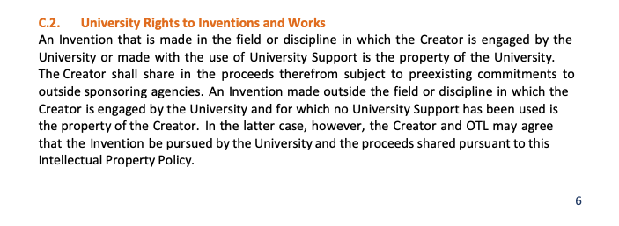

Slide 11
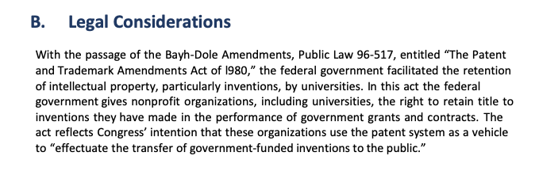
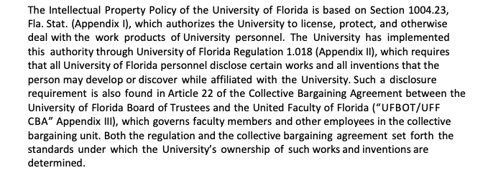
Notes:
For Creators
to derive benefit as a result of their work
For others
To avoid potential legal trouble
To know where to get permission for use.

Slide 12
DIRECT
vs.
INDIRECT IDENTIFIERS

Slide 13
DIRECT
Name
Address
Phone
Email
IP
SSN or other National ID No.
Drivers License No.
Med Record No.
Credit Card Number
Photos
Voice Recordings
INDIRECT
Gender
Ethnicity
Birth Date
Birth Place
Location
Marital Status
Number of Children
Yrs. Of School
Total Income
Profession
Social media activity
Publicly available data (court records, etc.)
Public comments on websites

Slide 14
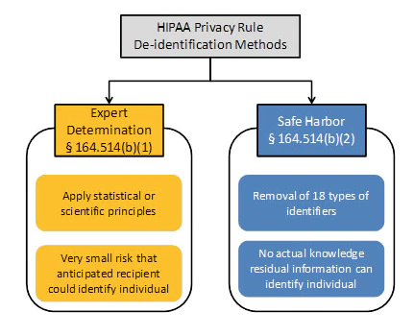
De-Identification Standards
(for HIPPA)
A person with appropriate knowledge of and experience with generally accepted statistical and scientific principles and methods for rendering information not individually identifiable:
Applying such principles and methods, determines that the risk is very small that the information could be used, alone or in combination with other reasonably available information, by an anticipated recipient to identify an individual who is a subject of the information; and
Documents the methods and results of the analysis that justify such determination
The following identifiers of the individual or of relatives, employers, or household members of the individual, are removed:

Slide 15
THE 18 IDENTIFIERS
(1) Names
(2) All geographic subdivisions smaller than a state
(street address, city, county, precinct, ZIP code except for the initial three digits of ZIP code if, according to the current publicly available data from the Bureau of the Census:(1) The geographic unit formed by combining all ZIP codes with the same three initial digits contains more than 20,000 people; and (2) The initial three digits of a ZIP code for all such geographic units containing 20,000 or fewer people is changed to 000
(3) All elements of dates (except year) for dates that are directly related to an individual
(including birth date, admission date, discharge date, death date, and all ages over 89 and all elements of dates (including year) indicative of such age, except that such ages and elements may be aggregated into a single category of age 90 or older)
(4) Telephone numbers
(5) Vehicle identifiers & serial numbers, incl. plate nos.
(6) Fax numbers
(7) Device identifiers and serial numbers
(8) Email addresses
(9) Web Universal Resource Locators (URLs)
(10) Social security numbers
(11) Internet Protocol (IP) addresses
(12) Medical record numbers
(13) Biometric identifiers, incl. finger & voice prints
(14) Health plan beneficiary numbers
(15) Full-face photographs and any comparable images
(16) Account numbers
(17) Any other unique ID no., characteristic, or code
(18) Certificate/license numbers

Slide 16
Anonymizing is hard.

Slide 17
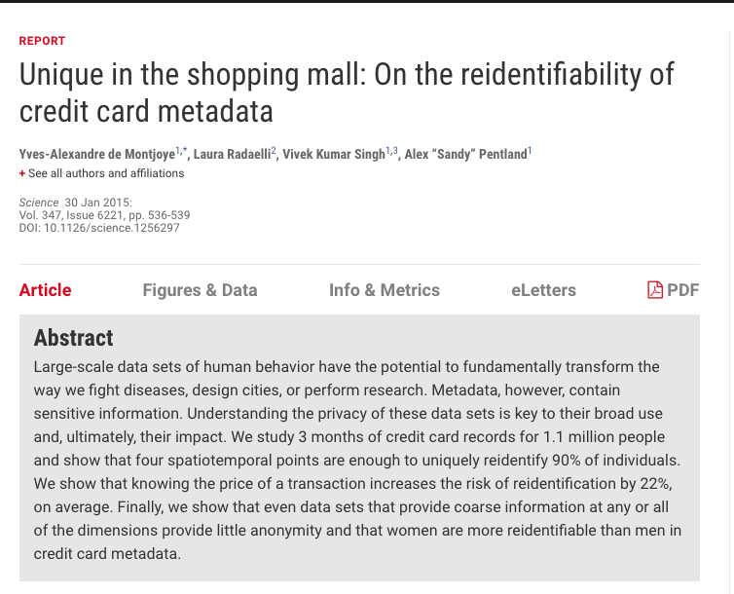
https://hbr.org/2015/02/theres-no-such-thing-as-anonymous-data

Slide 18


Slide 19
ANONYMIZING QUANTITATIVE DATA
(1) Remove all direct Identifiers not needed for secondary research
(2) Aggregate Data (age range, city)
(3) Generalize meanings (“respondent has one medical specialty” instead of “respondent is a cardiologist”)
(4) Restrict upper and lower bounds (income <$1000 per month or >$100K
(5) Anonymize relational data (names of employers)
(6) Reduce precision in geographical data
ANONYMIZING QUALITATIVE DATA
(1) Don’t collect if not needed
(2) Pseudonyms
(3) Take care with search and replace to avoid missing spelling errors, abbreviations, etc.
(4) Carefully identify in the text with [brackets] or XML <anonsec>section to be anonymized<anonsec>
(5) Keep an Anonymization Log
(6) Use anonymizing tools
(7) Retain originals/unedited in a secure locations

Slide 20
Do you really need to collect personal data? Does it need to be that detailed?
If you do need to collect personal data, have you informed your participants?
Are the data really “personal data”? If anonymized they aren’t. But are they truly anonymized?
PLAN

Slide 21
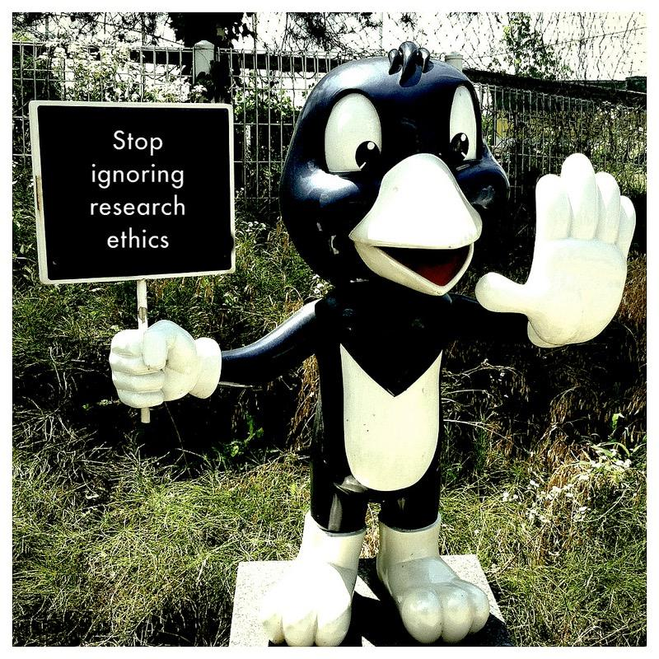
Ethical Use of Data
Before you share your data
Understand your funder/institution policies on data sharing
Review your IRB protocols and approvals
Remove personal data
Using someone else’s data
Give credit
Respect the license
Protect the data appropriately
Photo Attribution: https://www.flickr.com/photos/michaelgallagher/14592386702/

Slide 23
