Slide 1
Conceptual Domain
Transcends Methodological & Systemic Domain
Systemic Domain
Transcends Conceptual & Methodological Domains
Conservation
Biology
Integrative
Biology
insect
biology
avian
biology
plant
biology
Evolutionary
Biology
island
biology
grassland
biology
Methodological Domain
Transcends Conceptual & Systemic Domains
Mathematical
Biology
Comparative
Biology
Molecular
Biology
Systematic
Biology

Slide 2














A
B
Conceptual Domain
Transcends Methodological & Systemic Domain
Systemic Domain
Transcends Conceptual & Methodological Domains
C
Methodological Domain
Transcends Conceptual & Systemic Domains
African Society for Bioinformatics
and Computational Biology

Slide 3
a
b
c
Conceptual
Domain
Systemic Domain
Methodological Domain
c
Transcends Methodological
& Systemic Domains
Transcends Conceptual & Methodological Domains
Transcends Conceptual & Systemic Domains
Conceptual
Domains
Systemic Domain
African Society for Bioinformatics
and Computational Biology
Transcends Conceptual, System, & Methodological domains
Methodological Domain

Slide 4
A
B
C
Conceptual
Domain
Transcends Methodological &
Systemic Domains
Systemic Domain
Transcends Conceptual & Methodological Domains
Methodological Domain
Transcends Conceptual & Systemic Domains
African Society for Bioinformatics
and Computational Biology

Slide 5
A
Conceptual
Domain
Transcends Methodological &
Systemic Domains
B
Systemic Domain
Transcends Conceptual & Methodological Domains
C
Methodological Domain
Transcends Conceptual & Systemic Domains
African Society for Bioinformatics
and Computational Biology

Slide 6
A
B
C
Conceptual
Domain
Transcends Methodological &
Systemic Domains
Systemic Domain
Transcends Conceptual & Methodological Domains
Methodological Domain
Transcends Conceptual & Systemic Domains
African Society for Bioinformatics
and Computational Biology

Slide 7
Europe
Nature
Biology
New & Mysterious
Tropical Regions
Unique
Tropical Species & Habitats
Tropical
Biology

Slide 8
Renaissance Europe
Tropical
World is
Radically Different

Slide 9
Natural
History
Species & Ecosystems in the Tropics Are Unique

Slide 10
Biological Sciences
Tropical
Biology

Slide 11
Biology
Tropical
Biology

Slide 12
Ecosystems
The Temperate Zone
‘Unique’
Ecosystems
(The Tropics)

Slide 13
Conceptual Domain
Transcends Methodology & System
Conservation
Biology
Integrative
Biology
Evolutionary
Biology

Slide 14

Study System
Transcends Domains & Methodology
insect
biology
avian
biology
plant
biology
island
biology
grassland
biology

Slide 15

Methodology
Transcends Domains & System
Systematic
Biology
Comparative
Biology
Molecular
Biology
Mathematical
Biology

Slide 16
Conceptual Domain
Transcends Methodology & System
Conservation
Biology
Integrative
Biology
Evolutionary
Biology

Slide 17
Study System
Transcends Domains & Methodology
insect
biology
avian
biology
plant
biology
island
biology
grassland
biology

Slide 18
Methodology
Transcends Domains & System
Systematic
Biology
Comparative
Biology
Molecular
Biology
Mathematical
Biology

Slide 19
Taxonomic Group
Transcends Conceptual Domains & Approaches
BIOLOGY
Fungal
Plant
TROPICAL
Avian
Insect

Slide 20
Approach & Tools
Transcends Taxonomic Groups & Conceptual Domains
BIOLOGY
In Vitro
Comparative
TROPICAL
Experimental
Mathematical

Slide 21
Conceptual Domain
Transcends Taxonomic Groups & Approaches
BIOLOGY
Systematic
Conservation
TROPICAL
Evolutionary
Behavioral

Slide 22
Taxonomic Group
Transcends Conceptual Domains & Approaches
BIOLOGY
Fungal
Plant
TROPICAL
Avian
Insect

Slide 23
Approach & Tools
Transcends Taxonomic Groups & Conceptual Domains
BIOLOGY
In Vitro
Comparative
TROPICAL
Experimental
Mathematical

Slide 24
Study System
Transcends Domains & Methodology
Conceptual Domain
Transcends Methodology & System
Methodology
Transcends Domains & System
avian
biology
insect
biology
plant
biology
Conservation
Biology
Mathematical
Biology
BIOLOGY
Evolutionary
Biology
Comparative
Biology
grassland
biology
marine
biology
Integrative
Biology
Molecular
Biology
island
biology
Tropical Biology

Slide 25
Conceptual Domain
Transcends Taxonomic Groups & Approaches
TROPICAL
Systematic
Conservation
Evolutionary
Behavioral
BIOLOGY

Slide 26
Conceptual Domain
Transcends Taxonomic Groups, Approaches, & (Bio)Geography
BIOLOGY
Systematic
Conservation
TROPICAL
Evolutionary
Behavioral

Slide 27
Taxonomic Group
Transcends Conceptual Domains, Approaches, and (Bio)Geography
BIOLOGY
Fungal
Plant
TROPICAL
Avian
Insect

Slide 28
Approach & Tools
Transcends Taxonomic Groups, Conceptual Domains, & (Bio)Geography
BIOLOGY
In Vitro
Comparative
TROPICAL
Experimental
Mathematical

Slide 29
(Bio)Geography
Transcends Conceptual Domains, Taxonomic Groups, & Approaches
BIOLOGY
Deserts
Wetlands
TROPICAL
Islands
Grasslands

Slide 30
Geography
Transcends Conceptual Domain, Approach, & Taxonomic Group
BIOLOGY
Temperate
TROPICAL
Arctic
Island

Slide 31
Conceptual Domain
crosses systems & approaches
+
Systematic
+
Conservation
+
Evolutionary
TROPICAL
BIOLOGY

Slide 32

Approach &
Tools
crosses systems & conceptual domains
BIOLOGY
Tropical

Slide 33

Conceptual
Domain
crosses systems & approaches
+
+
TROPICAL
BIOLOGY

Slide 34




Study System
crosses conceptual domain & approaches
taxonomy
TROPICAL
BIOLOGY
geology/
geography
Grassland Society
of Southern Africa
(bio)geography
Notes:
ISOMED • International Society for Mediterranean Ecology (defnnct)
Polar Science
[Polar Biology](https://www.springer.com/journal/300)
[Arctic Science](https://cdnsciencepub.com/journal/as)
[Boreal Environment Research](https://borenv.com/)
Austral Ecology
Austral Entomology
MEDITERRANEAN BOTANY
BOREAL ENVIRONMENT RESEARCH
[Antarctic Science](https://www.cambridge.org/core/journals/antarctic-science)
1959-1982 - Pacific Insects
[Pacific Science](https://uhpress.hawaii.edu/title/ps/) of the Pacific Science Association

Slide 35
Tropical Places & People are
Radically Different
Tropics Ecosystems are
Unique & Unusual
Renaissance Europe
Natural
History
Biological Sciences
Tropical
Biology

Slide 36
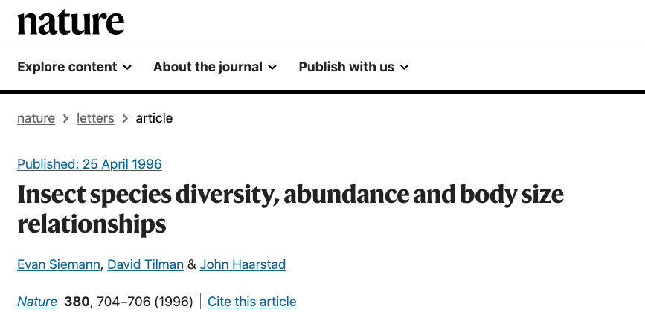
in a North American Grassland

Slide 37
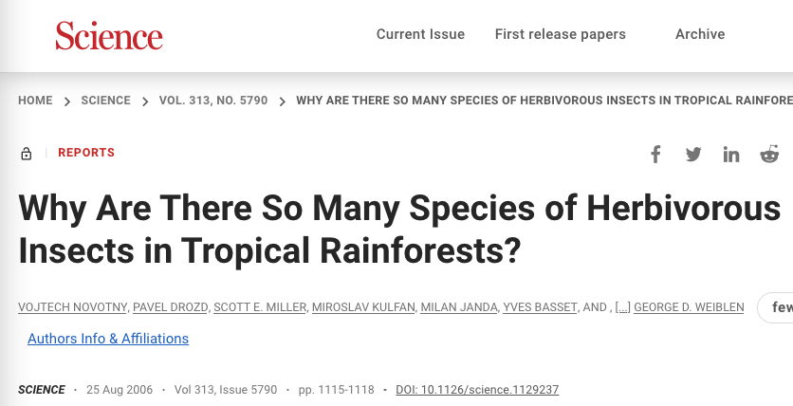
?

Slide 38
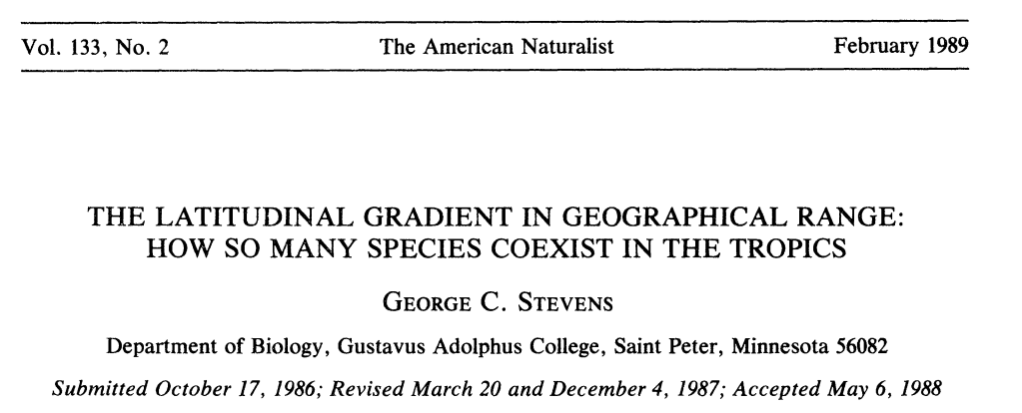
THE LATITUDINAL GRADIENT IN GEOGRAPHICAL RANGE:
WHY SO FEW SPECIES IN THE TEMPERATE ZONE

Slide 39
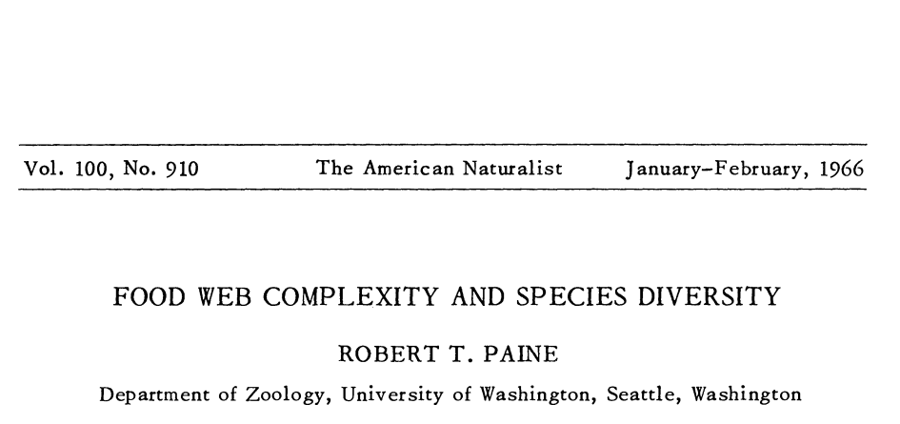
UNEXPECTED EFFECTS OF PREDATORY STARFISH ON FOOD WEBS AND SPECIES DIVERSITY IN NORTH AMERICAN TIDE-POOLS.

Slide 41
in a North American Grassland

Slide 43
?

Slide 45
THE LATITUDINAL GRADIENT IN GEOGRAPHICAL RANGE:
WHY SO FEW SPECIES IN THE TEMPERATE ZONE

Slide 47
EFFECT OF PREDATORY STARFISH ON FOOD WEBS AND SPECIES DIVERSITY IN NORTH AMERICAN TIDE-POOLS.

Slide 48



TEMPERATE

Slide 49
The Biology of the Tropics is “unique”
Tropical
Biology
Fine-tuning
Biology
Foundation

Slide 50
The Biology of the Tropics is ‘unique’
Tropical
Biology
Biology

Slide 51
The Tropics are ‘other’ & ‘unique’
Tropical
Zone
Temperate
Zone

