Slide 1
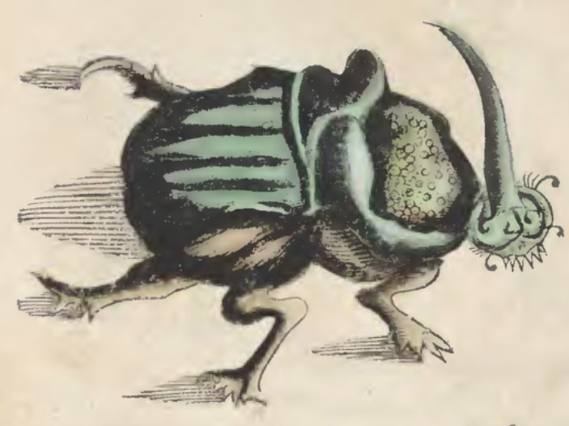
The Influence of Connectivity on Dung Beetle Communities
Eric Escobar-Chena
Historia Naturalis Brazilia - 1648

Slide 2
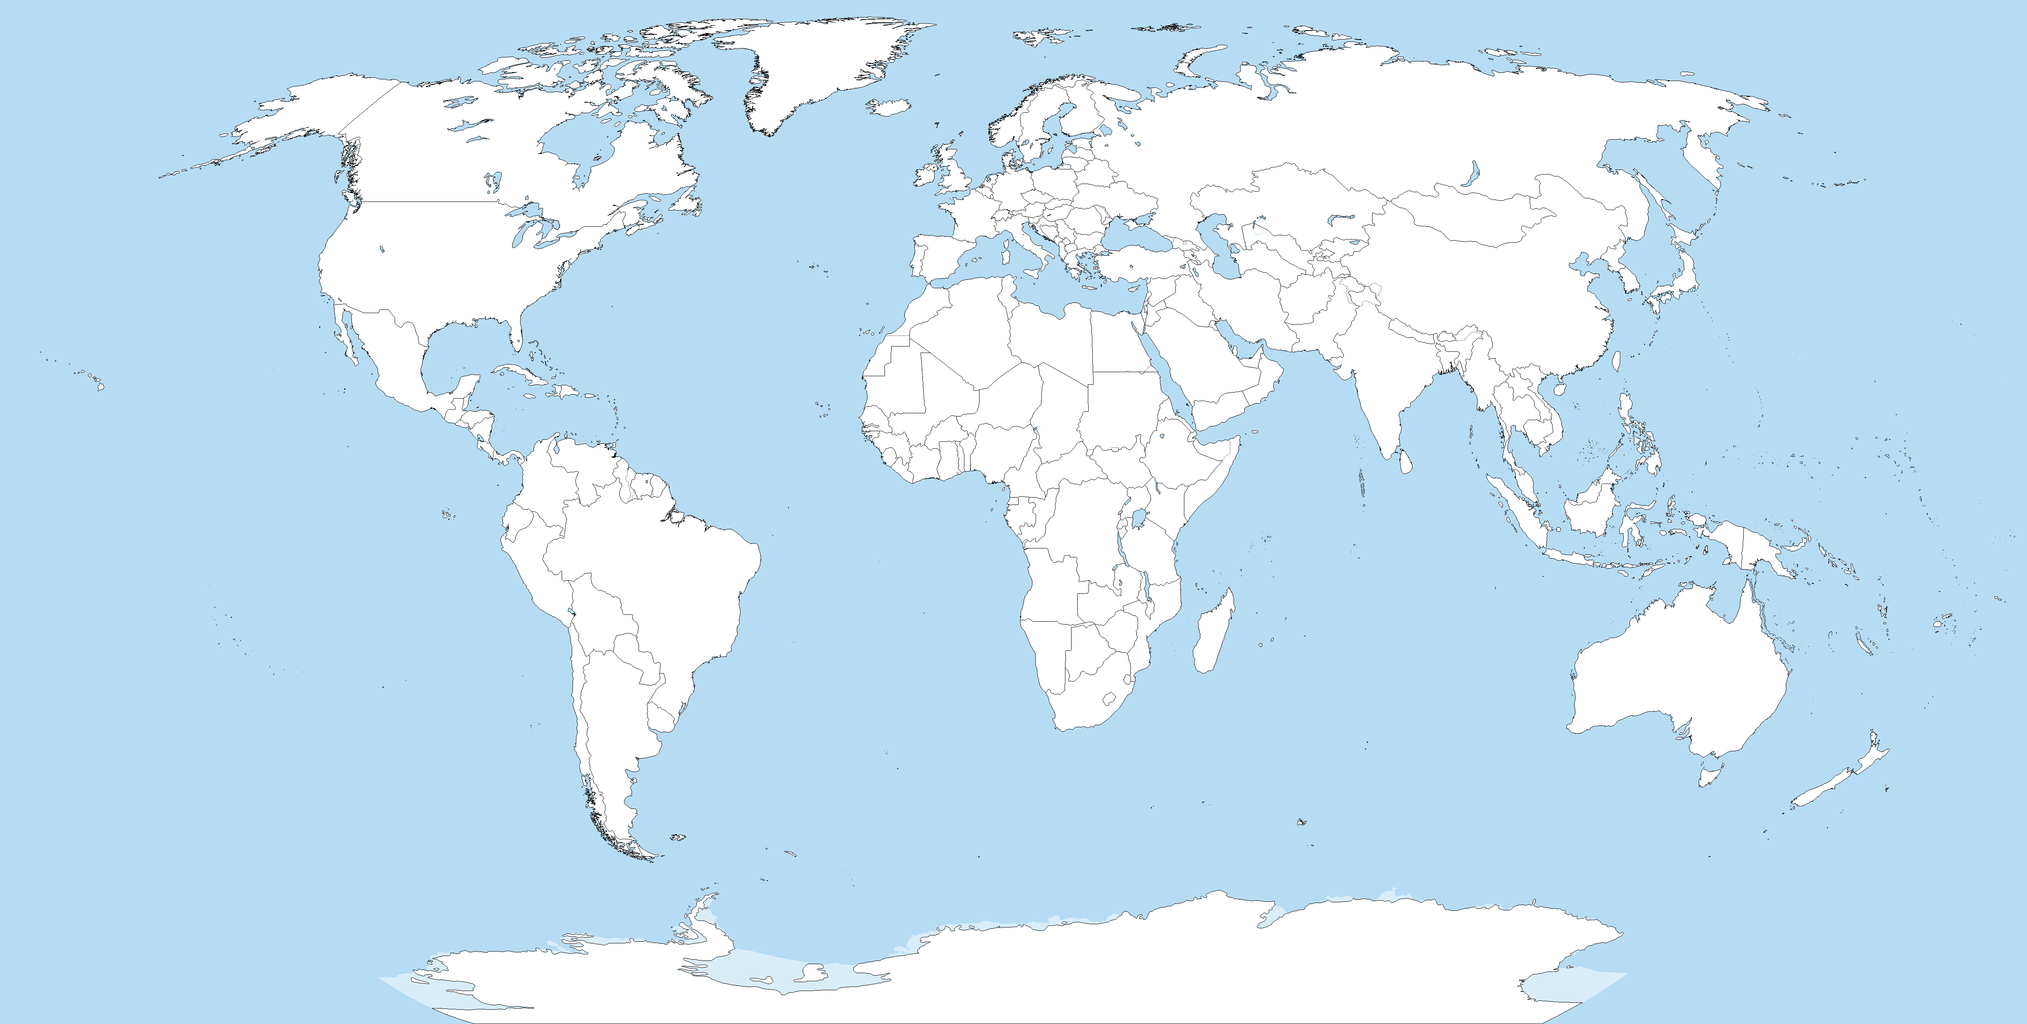
Roslin 2001
Rosenlew 2008
Amezquita 2010
Andresen 2003
Bourg 2016
Whitworth 2021
Norris 2010
Chapman 2003
Bustamante 2004
Campos 2015
Filgueiras 2011

Slide 3
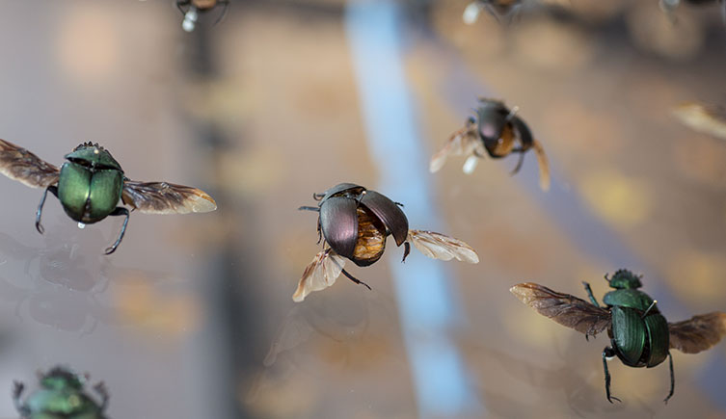
So many fragmentation studies…
Fewer relating to connectivity
None in the United States

Slide 4
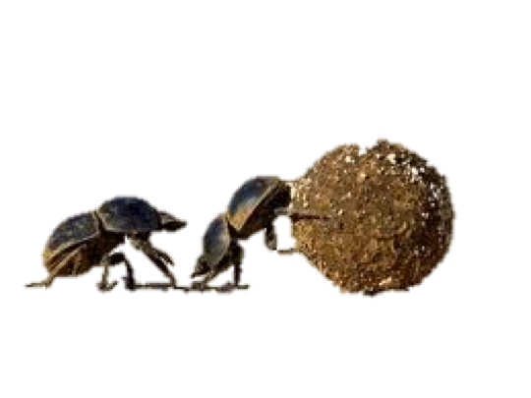
What did I want to know?
Does connectivity help?
Where are dung beetles coming from?
What is the Dynamic?

Slide 5
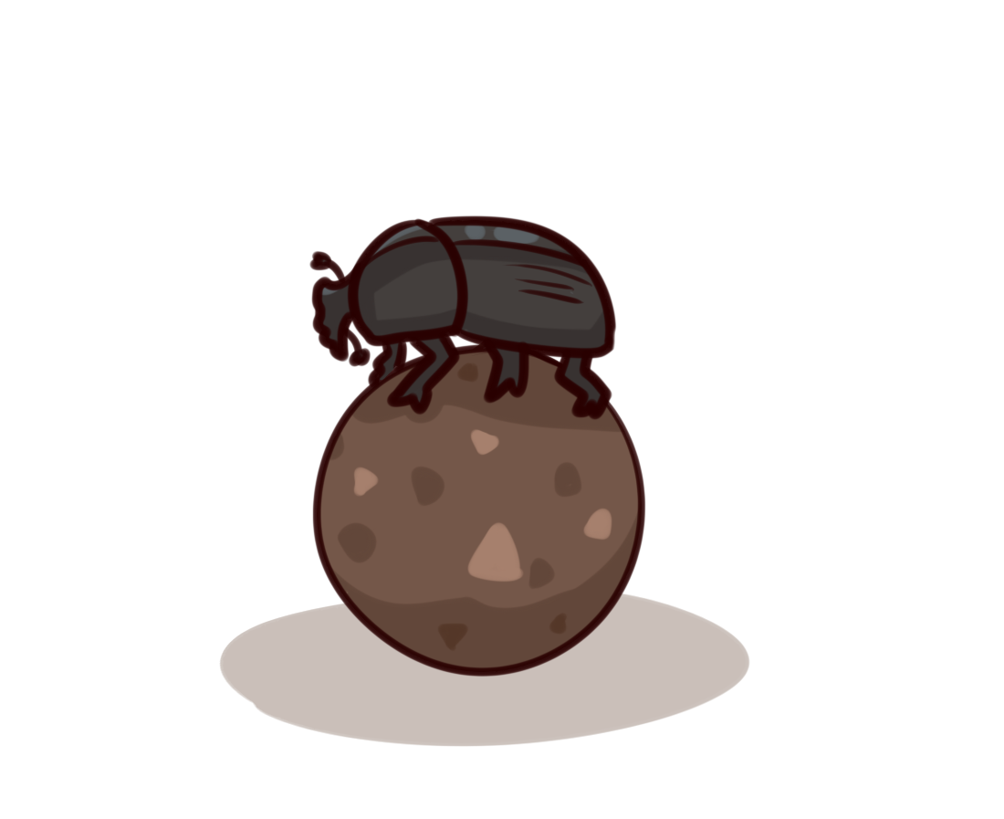

What did I find?
Dung beetles were most abundant in forested matrix.
Connected patches of open habitat were most similar in abundance to matrix.
Larger landscape variation impacts diversity, richness, and abundance.

Slide 6
Defense time!

Slide 7
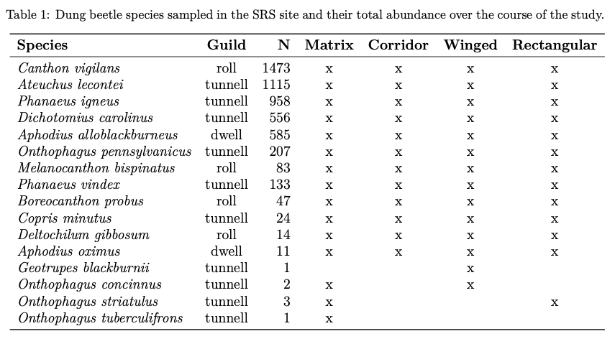
Species counts and feeding guilds

Slide 8
Abundance

Slide 10
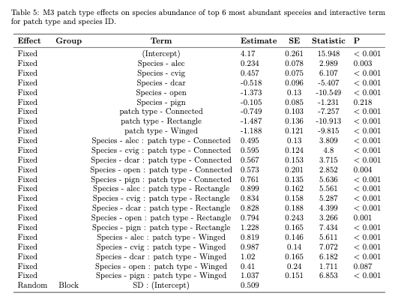
Patch effects by species

Slide 11
Richness

Slide 12
Diversity

Slide 13
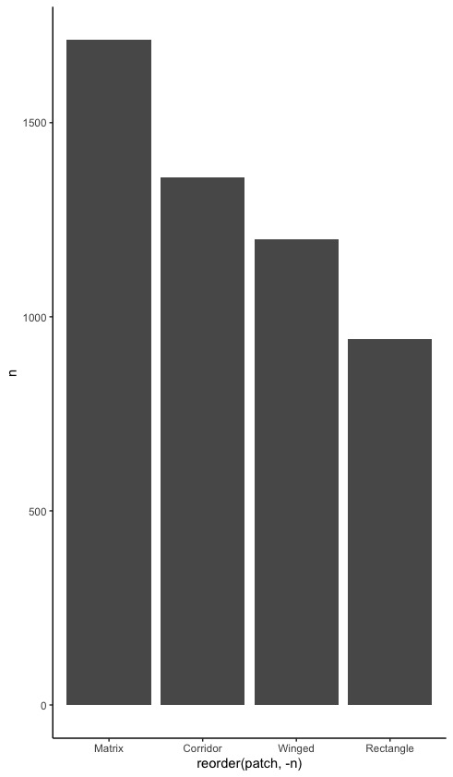
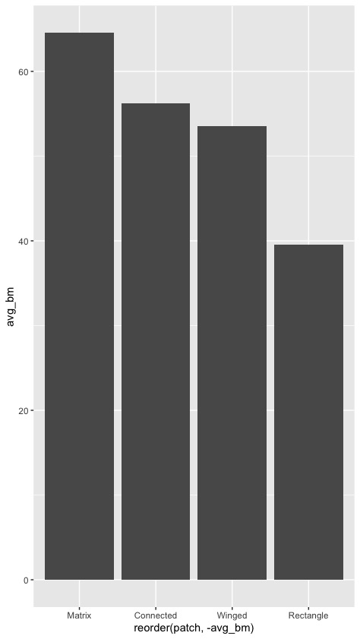
Biomass

