Slide 1
DSA 6000 Project Classification Model Benchmarking Group 7
Presented By:
Dinesh Arasavalli
Brunda Someshekhar
Rani Sravanthi Devi Lankalapalli
Ashwini Awathe
Anurag Awathe
Harshavardhan Aitha

Slide 2
Overview:
Background
Datasets.
Model
Methods
Results
Conclusion

Slide 3
Background:
In our supervised learning project, we conducted a comparison of classification models using a set of 20 datasets.
The project comprised two distinct phases: in the first phase, we utilized default predictors, while in the second phase, models were constructed through forward model selection.
For Model evaluation parameters/metrics, we are considering two parts training and Testing. The dataset was partitioned into 70% training data and 30% test data, allowing for the evaluation of Area Under the Curve (AUC) and accuracy. Our focus centered on binary responses, encompassing both categorical and continuous predictors.
The key metrics for comparison included AUC, accuracy, Precision, error rate and F-score. Additionally, we delved into exploring the potential impact of dataset size and predictor count on the overall performance of the models across the 20 datasets.

Slide 4
Datasets.
Dataset | Classification | N | P | Source
loan_data | Loan eligibility | 614 | 11 | Kaggle
liver_patient | Prediction for liver disease | 583 | 10 | UCI
stroke | Prediction for Brain stroke | 4932 | 10 | Kaggle
diabetes | Diabetes Prediction | 768 | 8 | Kaggle
heart_attack | Prediction of heart stroke | 302 | 13 | Kaggle
breast_cancer | Predict for breast_cancer | 569 | 32 | UCI
Wine quality | Wine quality predictions | 1600 | 12 | UCI
Default | Credit card Yes or no/Student | 10000 | 3 | ISLR
diabetes2 | Prediction for diabetes | 520 | 16 | Kaggle
Heart_failure | Post-surgery heart failure prediction | 299 | 13 | UCI
Student_ data | Academic success and dropout predict | 4424 | 37 | UCI

Slide 5
Cell_samples | Prediction of classification of cell samples into 2 types | 700 | 11 | Github
New_model | Prediction for kidney disease | 400 | 14 | Kaggle
Metabolic Syndrome | Presence or absence of metabolic syndrome | 2401 | 15 | Kaggle
gbsg | Breast cancer prediction yes/no | 686 | 12 | Kaggle
drug200 | Classification of drugs into certain types | 200 | 6 | Github
babies | Classification whether the baby's mom does smoke/not smoke | 1237 | 8 | Kaggle
Disease_syptom_and_ patient | Prediction of diagnosis/asses sment of specific disease | 349 | 10 | Kaggle
rice_classification | Rice grain type prediction | 18186 | 11 | Kaggle
heart | Prediction of heart disease | 919 | 12 | Kaggle

Slide 6
Models:
These are a different type of machine learning model that we have used for our classification task
stats :: glm(): Logistic Regression
MASS :: lda(): Linear Discriminant Analysis
MASS :: qda(): Quadratic Discriminant Analysis
bsnsing :: bsnsing(): Boolean Sensing Decision Tree
randomForest :: randomForest(): Random Forest Decision Tree
e1071 :: svm(): Support Vector Machine
e1071 :: naiveBayes(): Naive Bayes.

Slide 7
Methods
LDA (Linear Discriminant Analysis)
SVM(Support Vector Machine)
bsnsing(): Boolean Sensing Decision Tree
Random Forest
QDA(Quadratic Discriminant Analysis)
(SVM)Support Vector Machine
Naïve Bayes
(GLM) Logistic Regression

Slide 8
Methods: Cleaning/Preprocessing
Non predictive Variables removed
Remove null/missing values
Test each method once
Raw Dataset
Binary label 0 & 1
Error
Find & remove
problem variable.
Data ready to use

Slide 9
Methods: Part 1
Part 1: Benchmarking
For each dataset (20 total):
For 20 iterations:
Train (70%) - Test (30%) split
Train each model on the training dataset; record the training time
Test each model on the test dataset; record the model AUC
For each iteration, all models are trained and tested on the same dataset, using all variables
To accomplish the above, an R function was written to accept a dataset and # of iterations, record the training time, test AUC and test accuracy, Precision, error rate and F-score for each model at each iteration, and return dataframes containing the values
This function was used to loop over all 20 datasets in an R script
For 20 datasets, 20 iterations each
Dataset
70% Train
30% Test
Trained Models
Training Time
AUC, Accuracy

Slide 10
Methods: Part 2
Part 2: Forward Selection
For each dataset:
Split 70% training and 30% final testing
Split the training set again into 70% training, 30% validation
Use forward selection procedure on training data to select best predictors for each model to maximize validation AUC
Test best predictors for each model on the final testing dataset and record AUC
An R function was written to accept a dataset and its training & validation split along with the desired modeling method, and loop over all possible predictors, adding them if validation AUC increases, and returns the formula
This function was incorporated into an R script to get formula for each model for each dataset, and use this on the remaining test set
For 20 datasets, one iteration each
70% Train
30%
Final Test
70% Validation Train
Model trained on best predictors
30% Validation Test
Formulas, Training Time
AUC, Accuracy

Slide 11
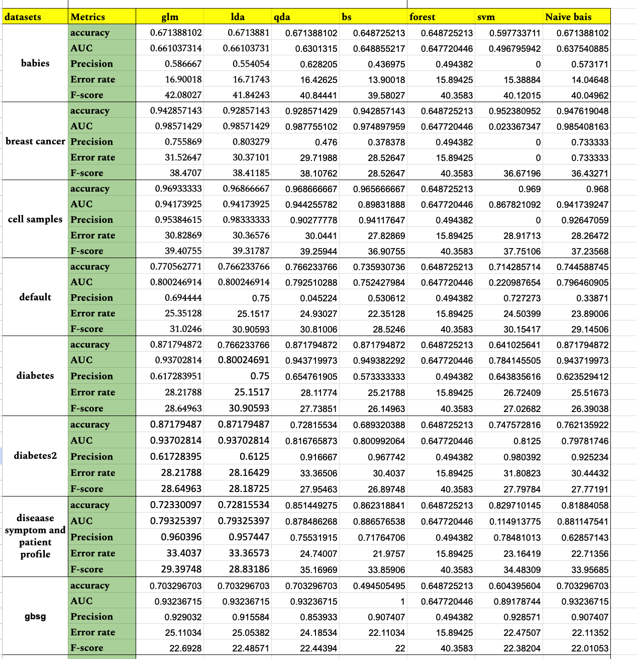
Model wise Metrics

Slide 12
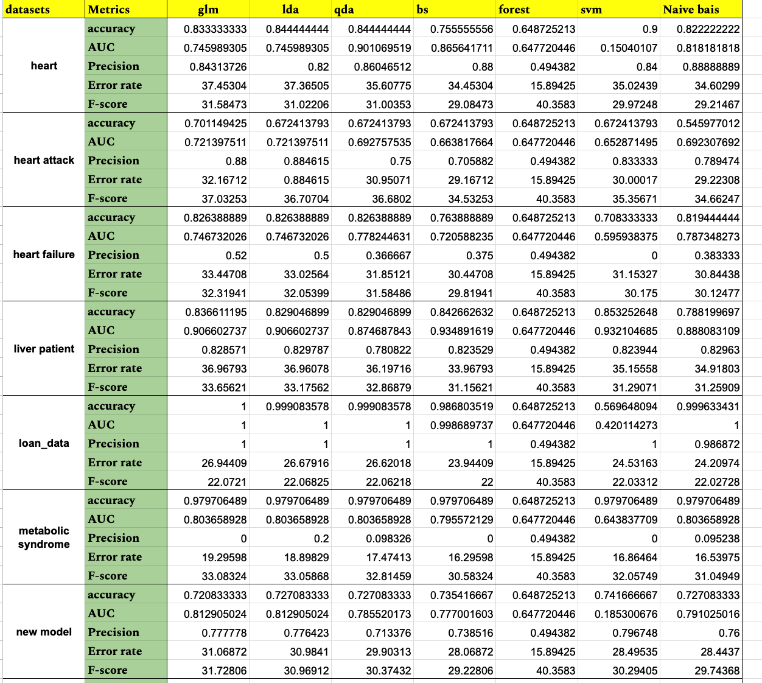
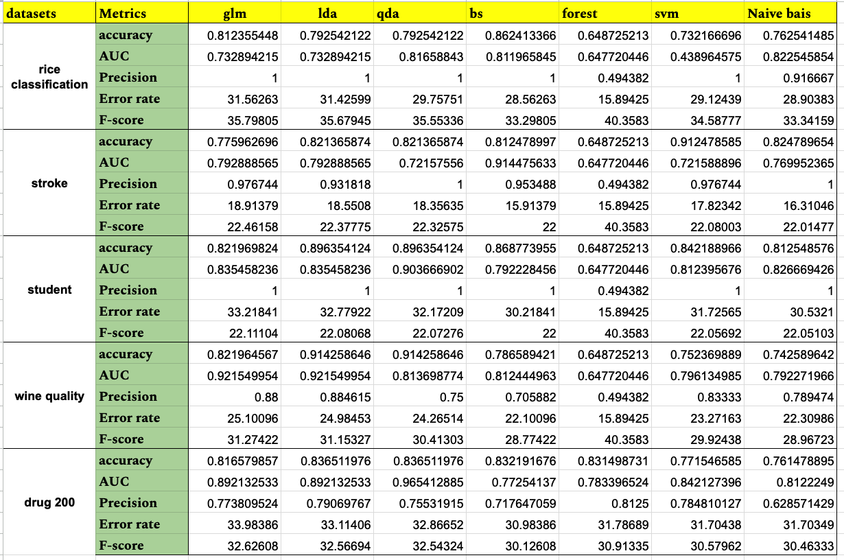
Model wise Metrics continued

Slide 13
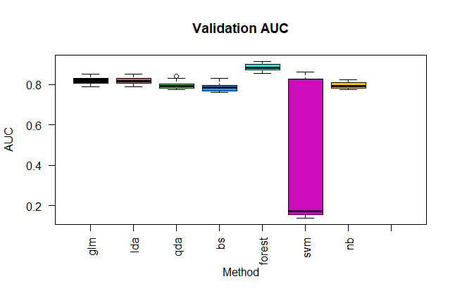
Part 1 Results & Discussion
Based on the Analysis from the graph All the models are relatively closer to each other except SVM(Support Vector Machine) model which has less AUC value ~ 0.60.

Slide 14
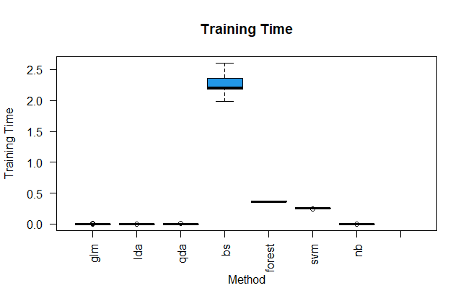
Part 2 Results & Discussion
Based on the Analysis from the graph bsnsing method has taken more time to execute the model ~9.66 due to several iterations acting as outliers
Tree-based methods and SVM on average took much longer to train

Slide 15
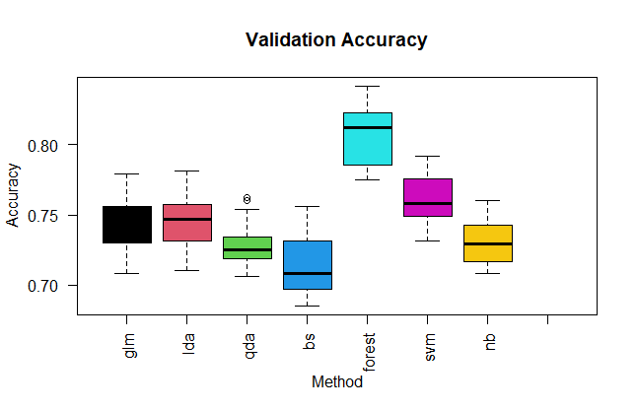
Part 3 Results & Discussion
Based on the Analysis from the graph all the models are relatively closer each other there is little high on Random Forest model (0.88) and there are outliers in naive bayes model.

Slide 16
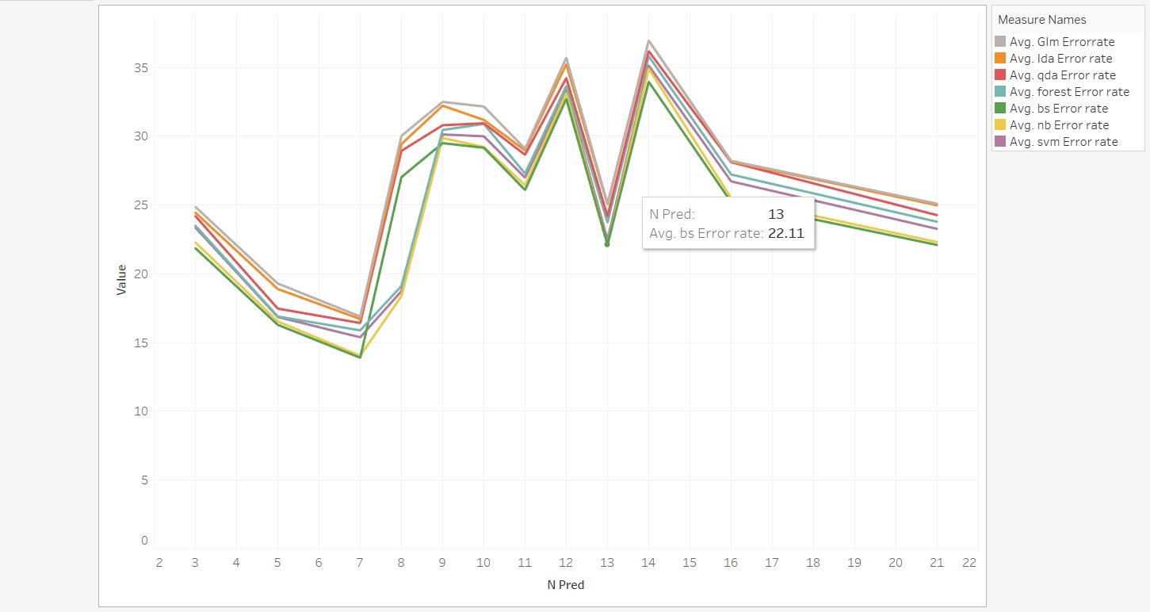
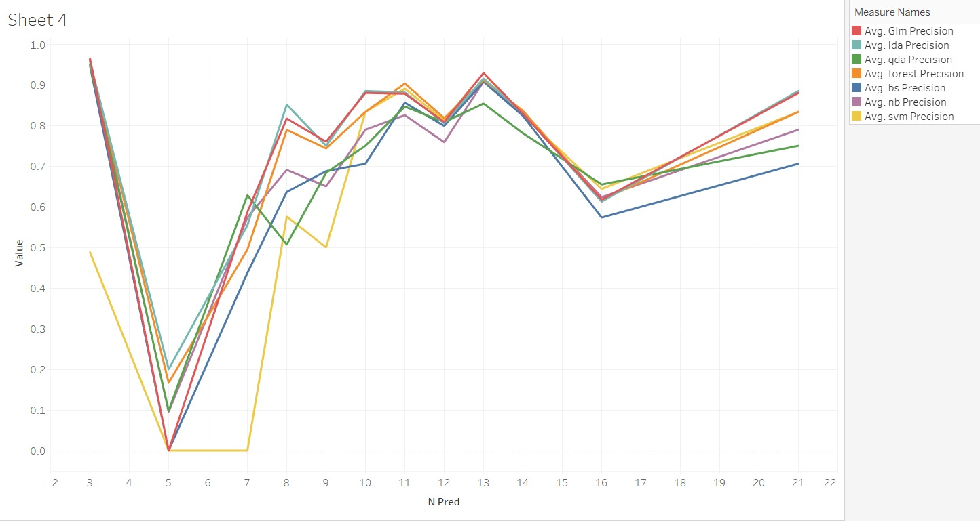
Part 1 Results & Discussion

Slide 17
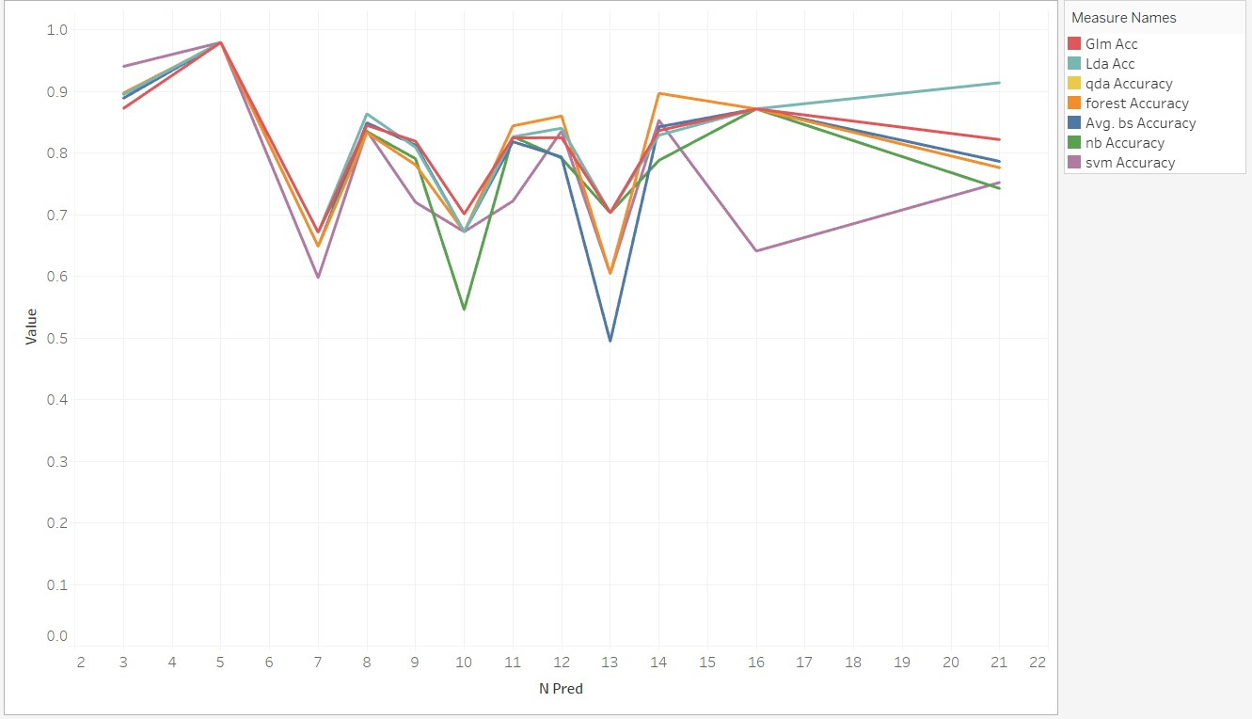
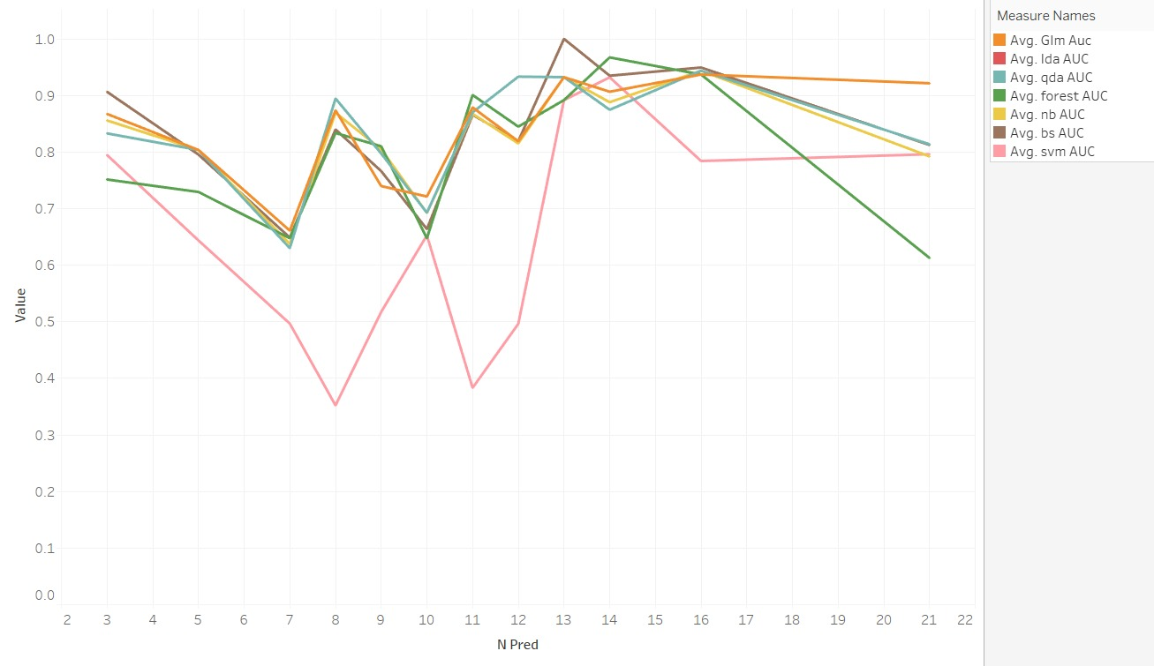
Part 1 Results & Discussion

Slide 18
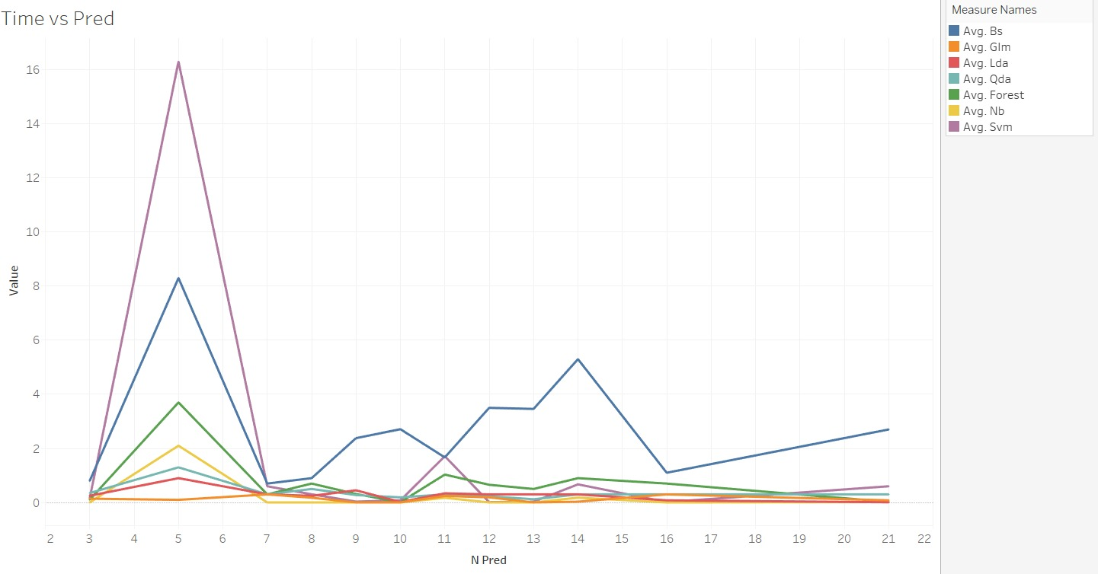
Part 1 Results & Discussion

Slide 19
Conclusion:
Part 1(Default Parameters)
quadratic discriminant analysis(qda) model and decision tree models (bsnsing, randomForest) performed the best in regards to AUC and Accuracy, but had high training times that increased greatly with dataset size
most methods had AUC and Accuracy close to each other for a given dataset, the largest variations in performance were between datasets
Part 2 (Forward Selection)
Many methods had similar AUC and Accuracy to each other, despite the forward selection resulting in a different mix of predictors per model
Tree-based methods were still overall the best
Models trained on selected parameters were similar in performance to models from Part 1
A random seed was used for the train test split; a different random seed could result in different predictors and thus different model performance

Slide 20
References
James, G., Witten, D., Hastie, T., & Tibshirani, R. (2013). An introduction to statistical learning with applications in R. Springer.
2. https://cran.r-project.org/web/packages/available_packages_by_name.html
3. https://cran.r-project.org/web/packages/lda/index.html
4. https://rdrr.io/cran/MASS/man/qda.html
5. https://cran.r-project.org/web/packages/e1071/vignettes/svmdoc.pdf
6. https://cran.r-project.org/web/packages/naivebayes/index.html

