Slide 1
SOTERIA AI TECHNOLOGIES INC. · DELAWARE C-CORPORATION
Global Office
The AI-Native Business Operating System
for Emerging Market Enterprises
Pre-Seed Investment Opportunity · $1.5M
Wisdom Jonathans, Founder & CEO · Lagos, Nigeria
CONFIDENTIAL — 2026
Notes:
Opening. Introduce yourself: Wisdom Jonathans, Founder & CEO of Soteria AI Technologies. We're building Global Office — the operating system for the next generation of businesses in emerging markets. This deck is a pre-seed investment opportunity for a $1.5M round. Set the tone: institutional, evidence-based, ambitious. Pause 3 seconds after the cover.

Slide 2
THESIS
One AI-native platform to run the operational core of every emerging-market enterprise — the category incumbents never built for.
WISDOM JONATHANS · FOUNDER & CEO
GLOBAL OFFICE / CONFIDENTIAL INVESTOR MATERIALS
02 / 22
Notes:
The one-sentence thesis. Read slowly. Small and mid-sized enterprises are the economic backbone of emerging markets, yet they operate on fragmented, imported software that was never designed for them. Global Office consolidates the entire operational stack — attendance, execution, communication, HR, finance, intelligence — into one AI-native platform, priced and engineered for how these businesses actually run. Emphasize the words "AI-native" and "one platform."

Slide 3
WHY NOW
Three shifts are converging — one platform for this market is finally viable.
01
Digital economy tailwind
Africa's digital economy is projected to reach $712B by 2050, contributing 8.5% of GDP. SSA is the fastest-growing tech investment region per capita.
02
Generative AI cost collapse
Cost per token has fallen ~80% year-over-year; enterprise workflows that required 12-month builds now ship in weeks. AI-native architecture is the new baseline.
03
SME cloud adoption inflection
SME cloud/SaaS adoption in Sub-Saharan Africa grew at ~34% CAGR from 2020–2024, outpacing all other regions. Buyer readiness is here.
Sources: GSMA Mobile Economy Sub-Saharan Africa 2024; Endeavor Nigeria Insights 2023; Stanford AI Index 2024; IFC/Partech Africa Tech Venture Capital Report 2024.
GLOBAL OFFICE / CONFIDENTIAL INVESTOR MATERIALS
03 / 22
Notes:
Three concurrent shifts create the window. (1) Africa's digital economy is projected at $712B by 2050 — GSMA, Endeavor. (2) Generative AI has collapsed the cost of building enterprise workflows by an order of magnitude — Stanford AI Index 2024. (3) SME cloud adoption in SSA grew ~34% CAGR 2020–2024 — IFC, Partech Africa. The result: for the first time, it is economically viable to build one AI-native platform for this market. Windows like this open once per decade.

Slide 4
PROBLEM
Emerging-market SMEs run on fragmented, foreign software that was never built for them.
Fragmentation
Foreign pricing
The typical 20–200 person SME runs 8–12 disconnected tools. Data lives in silos; decisions rely on manual reconciliation.
USD-priced SaaS consumes 3–5x more of local operating budgets than in OECD markets. Enterprise tiers are out of reach entirely.
Missing context
No intelligence layer
Global suites assume high-bandwidth, formalized workflows, and English-only teams. None of that holds in Lagos, Nairobi, or Accra.
Existing stacks record activity; they do not interpret it. Owners have data but no decision support.
GLOBAL OFFICE / CONFIDENTIAL INVESTOR MATERIALS
04 / 22
Notes:
The problem is not "SMEs need software." SMEs already use 8–12 tools. The problem is fragmentation. Every emerging-market SME runs on a Frankenstein stack of WhatsApp, Excel, Google Sheets, a locally-hosted HR tool, a foreign accounting tool priced in USD, and paper. Nothing talks to each other. Owners spend 40%+ of their week reconciling data across tools instead of running the business. This is not a UX problem; it is a structural problem.

Slide 5
SOLUTION
Global Office — one AI-native platform for the entire operational core.
01
02
03
Attendance & Leave
Execution & Tasks
Communication Hub
04
05
06
HR & Payroll
Finance & Invoicing
Meetings & Docs
07
08
09
Executive Control
Workflow Automation
AI Intelligence Layer
Unified data model · Multi-tenant · Role-based · Offline-tolerant · Low-bandwidth optimized
GLOBAL OFFICE / CONFIDENTIAL INVESTOR MATERIALS
05 / 22
Notes:
Global Office is one platform, one login, one data model, spanning attendance, execution, communication, HR, finance, and intelligence. It is AI-native — meaning intelligence is not a feature bolted on; it is the substrate. The system observes work, learns patterns, and surfaces decisions. Think of it as the operating system for a mid-market business, priced and localized for the markets it serves.

Slide 6
CATEGORY
A new category: AI-Native Business Operating System (AI-BOS).
Category
Primary role
Architecture
Deployment reality
Traditional ERP
Records transactions
Suites of modules
IT-led, 12–24mo deploy
Work OS / PM
Coordinates tasks
Horizontal, per-seat
Team-led, weeks
AI features on top
Adds copilots
Bolted onto legacy UX
Uneven, siloed
AI-BOS (Global Office)
Observes, interprets, orchestrates
Unified operational core
Org-wide, days to weeks
Framework: category-creation playbook per Play Bigger (2016); pattern precedents include Salesforce (CRM), ServiceNow (ITSM), HubSpot (Inbound).
GLOBAL OFFICE / CONFIDENTIAL INVESTOR MATERIALS
06 / 22
Notes:
We are defining a new category: the AI-Native Business Operating System, or AI-BOS. This is different from a CRM (Salesforce), an ERP (SAP/NetSuite), or a work OS (Monday, ClickUp). Those are horizontal tools with AI features. AI-BOS is a vertical, unified system where AI is the substrate — it observes, interprets, and orchestrates work across every function. Categories are how enterprise software wins: Salesforce created CRM, ServiceNow created ITSM. We are creating AI-BOS.

Slide 7
PRODUCT ARCHITECTURE
One event stream. One intelligence layer. Every module contributes and benefits.
AI Intelligence Layer
Anomaly detection · Workload balancing · Predictive alerts · Suggestive decisions
Unified Event Bus
Every module emits and subscribes — one canonical view of the organization
Operational Modules
Attendance · Execution · HR · Finance · Comms · Meetings · Docs · Workflows
Multi-Tenant Foundation
Org > Dept > User hierarchy · Row-level security · Role-based access · Audit trail
GLOBAL OFFICE / CONFIDENTIAL INVESTOR MATERIALS
07 / 22
Notes:
Architecturally, Global Office is a multi-tenant platform with strict organizational isolation, a unified event bus, and an intelligence layer that sits above all modules. Every action becomes an event; every event feeds the AI layer, which produces insights, alerts, and recommendations back into the modules. This is what makes AI-native different from AI-added.

Slide 8
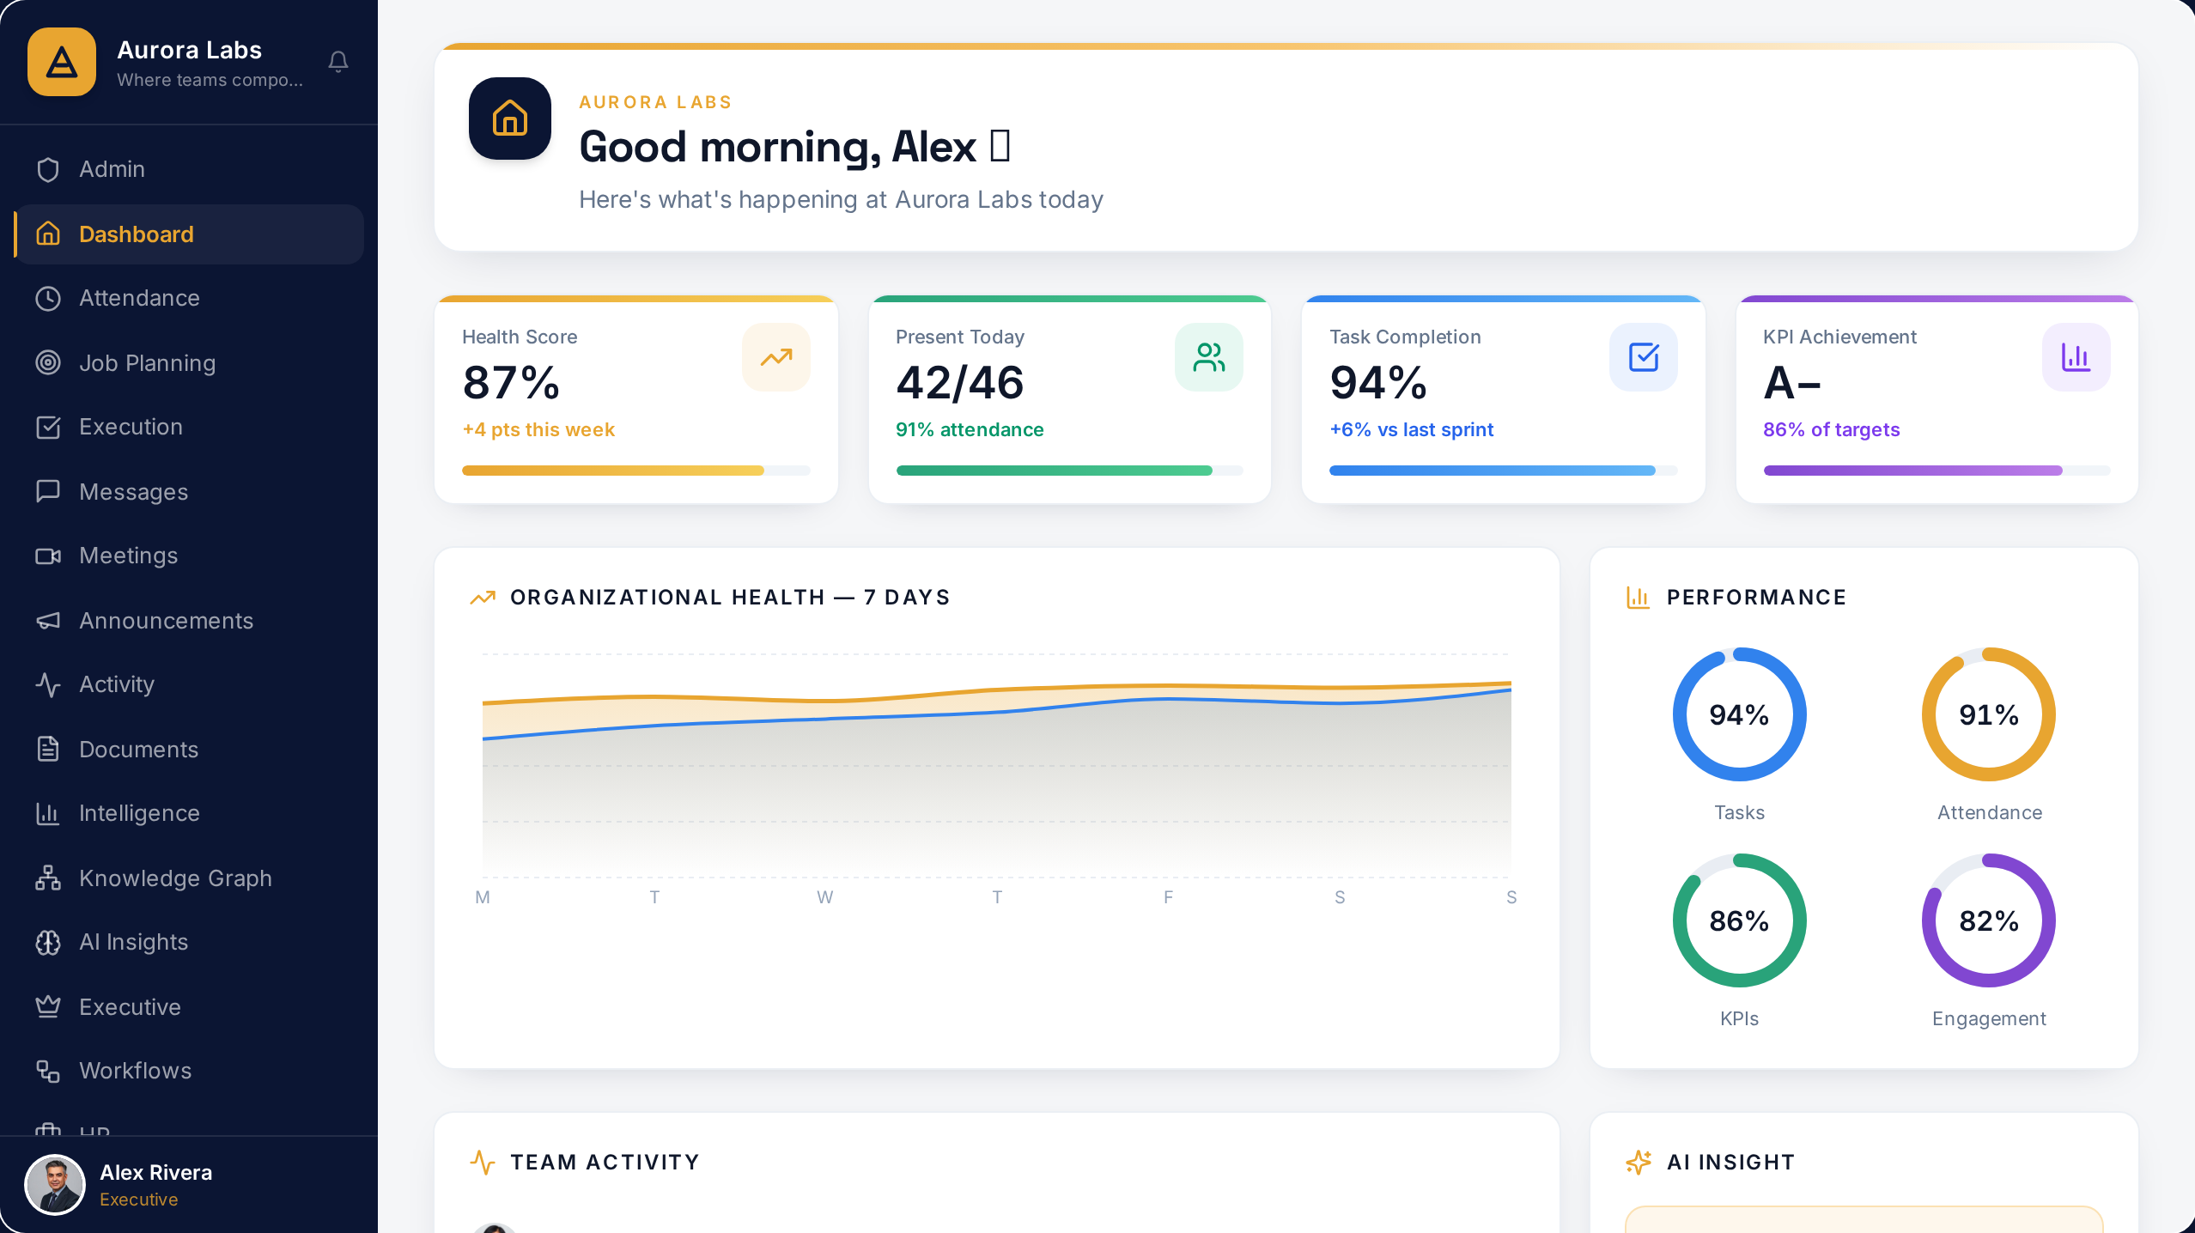
PRODUCT
Organization Health Dashboard
Real activity signal — attendance, execution, KPIs and AI insight in one glance.

Slide 9
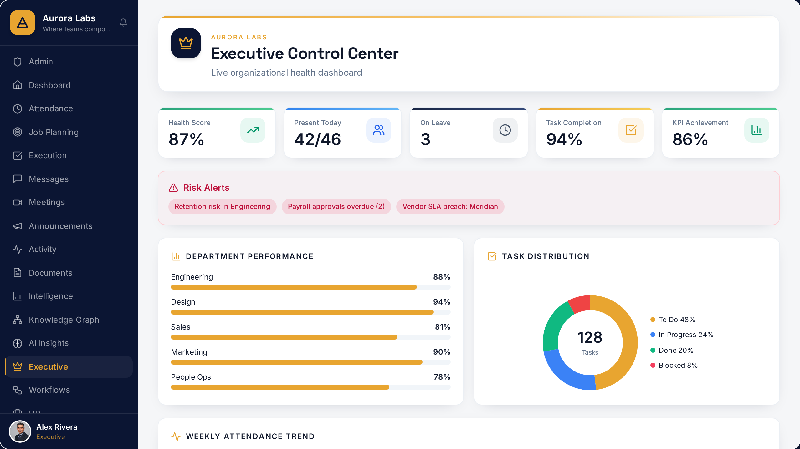
PRODUCT
AI Executive Control Center
Weighted health score, risk alerts and department performance in a single command surface.

Slide 10
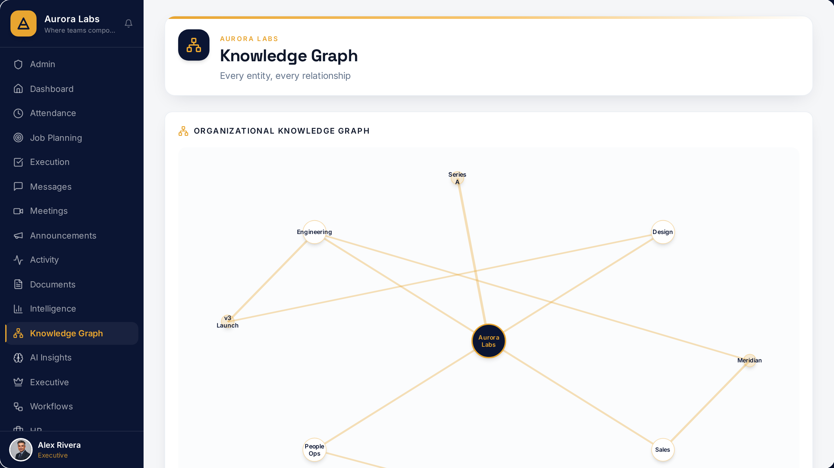
PRODUCT
Knowledge Graph Explorer
Every person, task, message and decision as a queryable node.

Slide 11
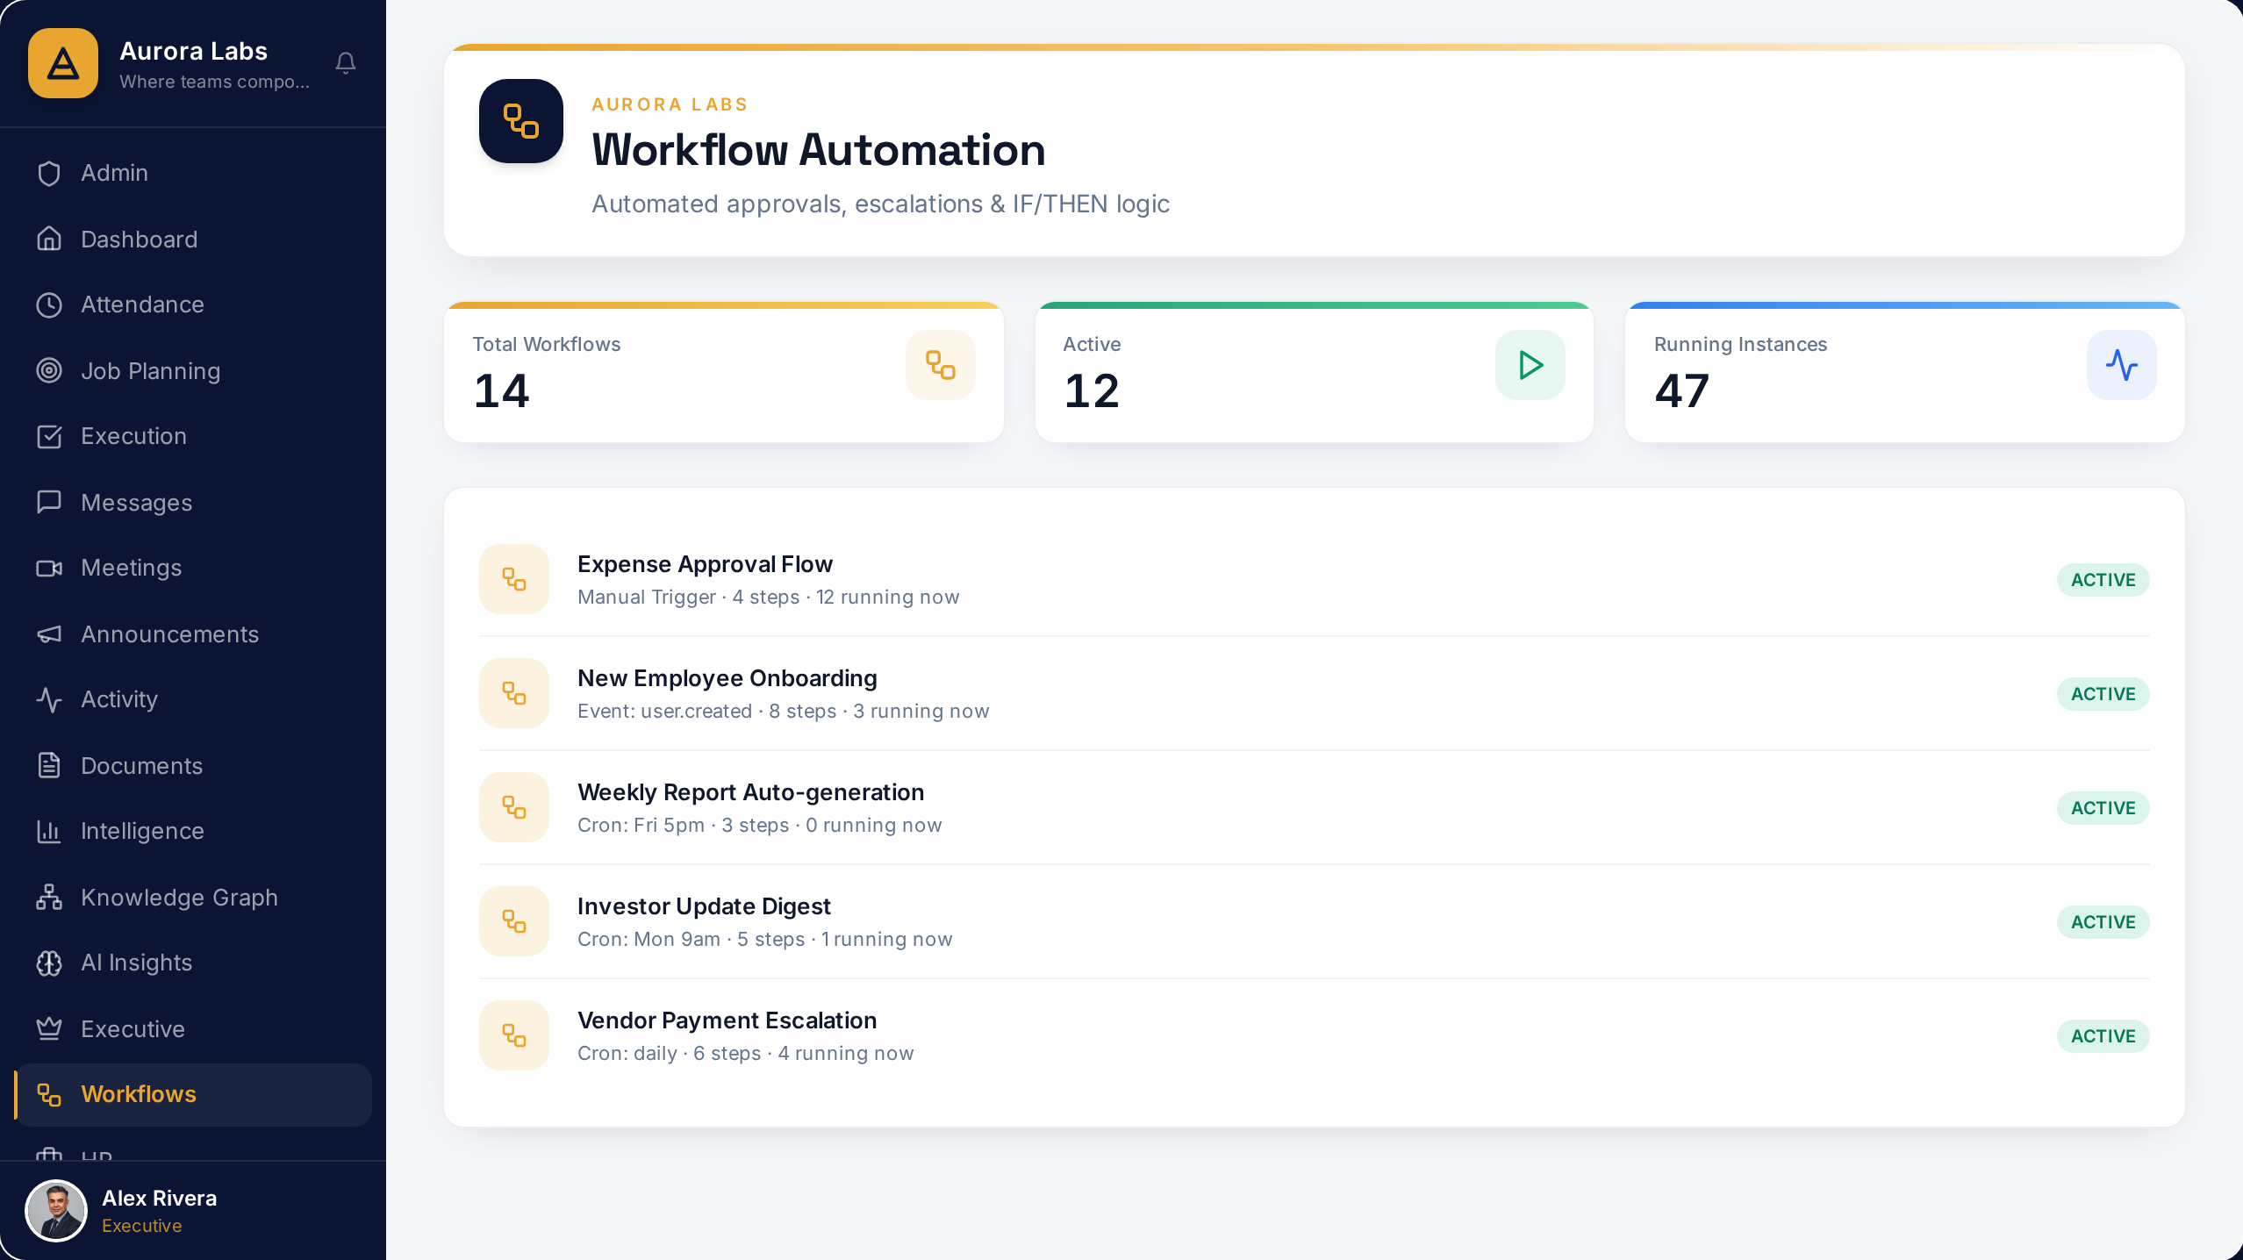
PRODUCT
Workflow Builder
Visual IF/THEN automation across every module — composed by operators.

Slide 12
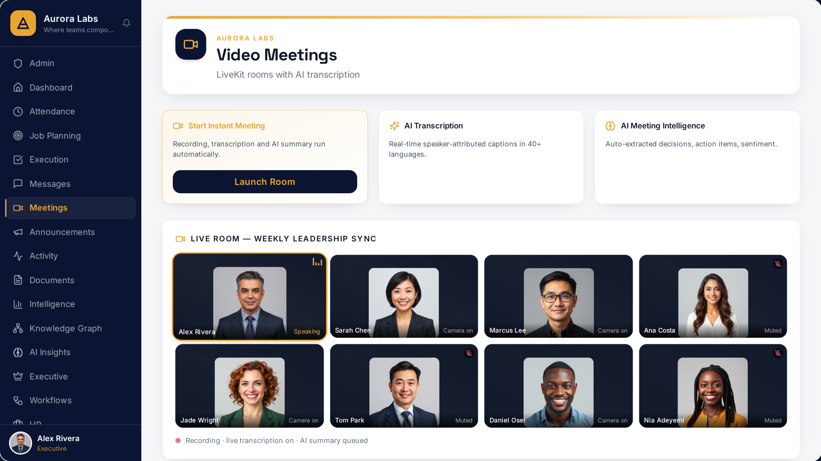
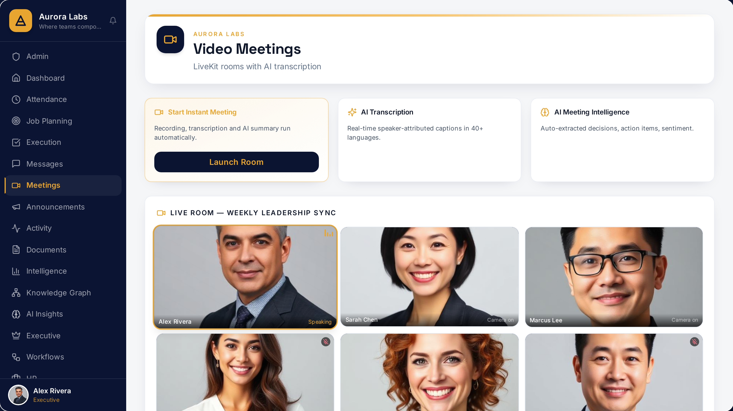
PRODUCT
Meetings Intelligence
Live video with AI transcription, summaries and auto-extracted action points.

Slide 13
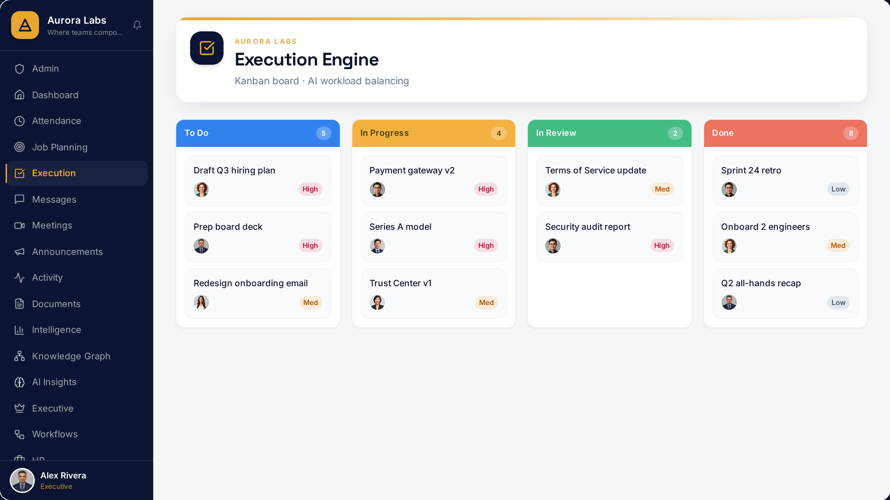
PRODUCT
Execution Engine
Kanban delivery with AI priority scoring, workload balancing and slip prediction.

Slide 14
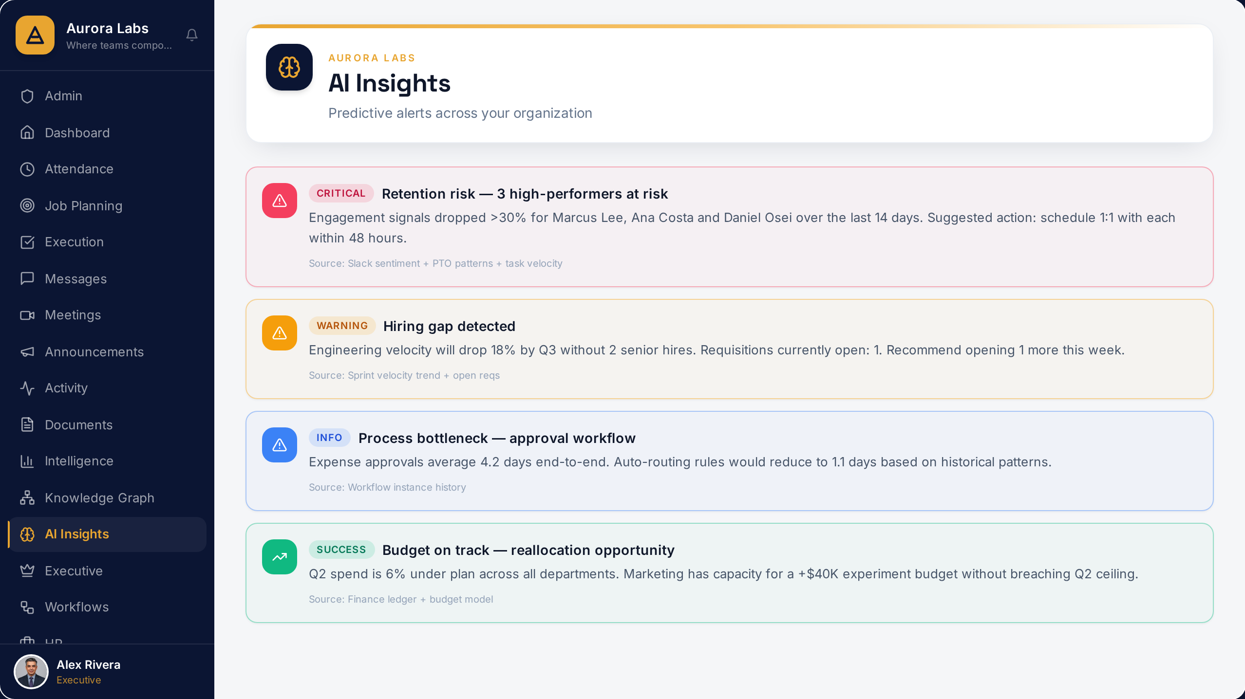
PRODUCT
Predictive AI Insights
Proactive alerts on slipping work, burnout risk and revenue exposure — before they cost money.

Slide 15
MARKET
A large, cited, bottom-up market — with an evidence-based path to $100M ARR.
TAM
SAM
SOM (Yr 5)
$250B+
$18–24B
$90–120M
Global SME operational software spend by 2027
SSA + adjacent EM SME software, ~50M formal SMEs by 2030
0.5% share of SAM — 15–25K paying organizations
Gartner Enterprise Software Forecast 2024; IDC Worldwide SMB Spending Guide 2024
IFC MSME Finance Report 2023; Endeavor 2023; Partech Africa 2024
Strategic assumption based on comparable SaaS penetration curves
SOM presented as a strategic assumption, not a forecast. Ranges reflect uncertainty in formalization rates and FX exposure.
GLOBAL OFFICE / CONFIDENTIAL INVESTOR MATERIALS
08 / 22
Notes:
Market sizing, bottom-up. TAM: global SME software spend is $250B+ by 2027 per Gartner and IDC. SAM: Sub-Saharan African + adjacent emerging market SME software is estimated at $18–24B by 2030, based on ~50M formal SMEs and per-org spend benchmarks (IFC, Endeavor, Partech). SOM: capturing 0.5% of SAM in 5 years is $90–120M ARR — a credible, evidence-based path. These are ranges, not point estimates, because we refuse to fabricate precision.

Slide 16
COMPETITION & WHITE SPACE
The upper-right quadrant is empty. That is where Global Office lives.
Notion / ClickUp
Global Office
Google Workspace
White space
Monday.com
Microsoft 365
Intelligence depth →
Zoho One
NetSuite / SAP
Operational breadth →
GLOBAL OFFICE / CONFIDENTIAL INVESTOR MATERIALS
09 / 22
Notes:
Competitive landscape mapped on two axes: horizontal breadth versus intelligence depth. Microsoft 365, Google Workspace — broad but shallow, priced for OECD. NetSuite, SAP — deep but ERP-heavy, IT-led, 12+ month deploys. Monday, ClickUp, Notion — horizontal work OS, AI features bolted on. Zoho — broad but fragmented UX, weak AI. The white space is upper-right: unified breadth plus AI-native intelligence, engineered for emerging-market SMEs. That is Global Office.

Slide 17
BUSINESS MODEL
Per-organization SaaS, local-currency pricing, metered AI credits.
STARTER
GROWTH
SCALE
Up to 20 users
Up to 100 users
100–500 users
Core operational modules
Full modules + AI insights
Full platform + workflow automation + priority support
Entry price ≈ local equivalent of $49/org/mo
Entry price ≈ local equivalent of $299/org/mo
Entry price ≈ local equivalent of $999/org/mo
Add-ons: AI credits (metered) · Enterprise Edition · Partner channel revenue-share · Verticalized editions from Year 3
Gross margin target 75–82% consistent with vertical SaaS benchmarks (Meritech Public Comps 2024). All figures are strategic assumptions pending pilot data.
GLOBAL OFFICE / CONFIDENTIAL INVESTOR MATERIALS
10 / 22
Notes:
Business model is per-organization SaaS with three tiers: Starter, Growth, Scale, priced in local currency to remove FX friction. AI credits meter compute-intensive features so cost scales with value. Expected gross margins in the 75–82% range consistent with vertical SaaS benchmarks — this is a range, not a claim. Enterprise editions and partner channels unlock the upper end of the market from year three onward.

Slide 18
GO-TO-MARKET
Wedge first. Then adjacent segments. Then verticals.
YEAR 1
WEDGE
SMEs 20–200 employees in 5 anchor cities: Lagos, Nairobi, Accra, Cairo, Johannesburg. Founder-led sales + product-led onboarding.
YEAR 2
EXPAND
Mid-market (200–1,000). Partner channels: accounting firms, HR consultancies, business associations. Country coverage doubles.
YEAR 3
VERTICALIZE
Industry editions: Education, Healthcare, Hospitality, Professional Services. Government pilots. Enterprise Edition GA.
GLOBAL OFFICE / CONFIDENTIAL INVESTOR MATERIALS
11 / 22
Notes:
GTM is sequenced. Wedge: 20–200 person SMEs in Lagos, Nairobi, Accra, Cairo, Johannesburg. Motion: founder-led sales + product-led onboarding + partner channels (business associations, accounting firms, HR consultancies). Year 2 opens mid-market. Year 3 opens enterprise editions and vertical channels (education, healthcare, hospitality, government).

Slide 19
STAGE & SIGNALS
Pre-seed. Pre-launch. Platform-ready. We state this plainly.
WHAT WE HAVE
WHAT WE DO NOT — YET
Full multi-tenant platform shipped across 15+ modules
AI intelligence layer live (insights, anomaly detection)
Founder–market fit: builder is a Nigerian SME operator
Category thesis validated with 40+ SME operator conversations
Design partner pipeline in Lagos, Nairobi, Accra
Paid ARR — not yet; first pilots planned post-round
Retention cohorts — cannot be reported before pilots
Signed LOIs at scale — pipeline, not commitments
Enterprise references — planned Year 2
Investor posture reference: Endeavor/DFI pre-seed pattern — evidence of product readiness and market insight, not fabricated traction.
GLOBAL OFFICE / CONFIDENTIAL INVESTOR MATERIALS
12 / 22
Notes:
Honest posture. We are pre-seed, pre-launch. What we have: (1) full working platform architected and shipped — not a prototype; (2) founder–market fit — I am building for the market I come from; (3) design partner conversations underway. What we do not have and will not fabricate: paid ARR, retention cohorts, LOIs at scale. The purpose of this round is to convert product-readiness into signed pilots and retention data in the next 9 months.

Slide 20
DEFENSIBILITY
Four moats that compound over time.
DATA
WORKFLOW
Intelligence flywheel
Operational lock-in
Every org strengthens the AI layer for every other org (patterns, anomalies, benchmarks) — anonymized and consented.
The OS is where the work happens — attendance, tasks, approvals, payroll. Switching cost grows linearly with adoption.
DISTRIBUTION
COMPLIANCE
Local partner channel
Regulatory capital
Accounting firms, HR consultancies, business associations. A network global incumbents cannot economically replicate.
NDPR/GDPR-ready, MFA, audit trail, encryption. Table-stakes for HR/finance/health — a barrier to latecomers.
GLOBAL OFFICE / CONFIDENTIAL INVESTOR MATERIALS
13 / 22
Notes:
Four compounding moats. (1) Data flywheel: every organization's activity feeds an intelligence layer that becomes more useful the more orgs are on it. (2) Workflow lock-in: unlike a point tool, an OS is where the work lives. (3) Local distribution: partner channels that global incumbents cannot replicate cheaply. (4) Compliance capital: NDPR/GDPR-ready architecture is a barrier for latecomers in regulated segments like HR, finance, health.

Slide 21
FINANCIAL FRAMEWORK
Ranges, not fiction. Every assumption will be re-baselined against pilot data.
Blended ARPO
Gross Margin
CAC Payback
Net Revenue Retention
$2.4–4.2K
75–82%
10–14 mo
108–120%
per organization per year
vertical SaaS benchmark
Growth-tier assumption
target once Scale tier lands
YEAR 5 SCENARIO ARR
Conservative
Base
Upside
$18M ARR
$42M ARR
$95M ARR
~5,000 orgs
~12,000 orgs
~24,000 orgs
All figures are strategic assumptions. Detailed 3-year model with sensitivity delivered separately (XLSX, Phase 3).
GLOBAL OFFICE / CONFIDENTIAL INVESTOR MATERIALS
14 / 22
Notes:
Financial framework, not fabricated forecast. Ranges are strategic assumptions to be validated in pilots. Blended ARPO $2.4K–$4.2K/yr. Gross margin 75–82%. CAC payback 10–14 months at Growth tier. Year 5 modeled scenarios: conservative $18M ARR, base $42M, upside $95M. All numbers will be re-baselined against pilot data before Series A. We show the math, not fiction.

Slide 22
UNIT ECONOMICS & CAPITAL EFFICIENCY
Software margins, metered AI cost, and capital that buys evidence — not construction.
Gross Margin at Scale
Cost to Serve / Org
CAC Payback
LTV : CAC (Year 3)
78–84%
$34–58 mo
12–18 mo
≥ 3.5x
62–68% in year one
trending to $18–26 by year three
<10 mo as channel matures
NRR 108–125% on expansion
WHAT $1.5M CONVERTS INTO
Product & Infrastructure
Go-to-Market
Sales, Success & AI
42%
35%
23%
Enterprise-ready platform, capacity to scale
First paying cohort, measured CAC
Repeatable engine, higher customer value
The platform is already built. This round funds commercialization, so incremental revenue lands on a largely fixed cost base. Full derivation in the Capital Efficiency & Unit Economics Memo.
GLOBAL OFFICE / CONFIDENTIAL INVESTOR MATERIALS
15 / 23

Slide 23
TEAM
Founder–market fit is the strongest signal at this stage.
WISDOM JONATHANS
Founder & CEO — Soteria AI Technologies Inc.
Nigerian entrepreneur, AI systems strategist, and technology founder. Builds intelligent platforms for large-scale operational and societal challenges. Founder & CEO of Soteria AI Technologies Inc., leading AI-powered products for business operations, decision-making, and workflow orchestration in emerging markets.
POST-ROUND KEY HIRES
VP Engineering
Head of Growth
Design Partner Lead
Lagos or Nairobi hub
Founder-led sales handoff
Pilot conversion & CS
GLOBAL OFFICE / CONFIDENTIAL INVESTOR MATERIALS
15 / 22
Notes:
Founder–market fit is the single strongest signal at pre-seed. I am Wisdom Jonathans, Nigerian entrepreneur, AI systems strategist, technology founder. I have built AI-powered products across business operations. I am building Global Office because I lived the pain — running organizations in this market with tools built for another one. Key hires post-round: VP Engineering (Lagos/Nairobi), Head of Growth, Design Partner Lead.

Slide 24
THE ASK
$1.5M
USE OF FUNDS
55%
Engineering & Product
Deepen AI layer; ship 2 vertical editions
25%
Go-to-Market
pre-seed, SAFE
30–50 design partner pilots, 5 anchor cities
12%
Compliance & Security
SOC 2 Type I readiness; NDPR/GDPR certification
8%
G&A
Legal, finance, ops
GLOBAL OFFICE / CONFIDENTIAL INVESTOR MATERIALS
16 / 22
Notes:
We are raising $1.5M pre-seed on a SAFE. Use of funds: 55% engineering and product to deepen the AI layer and ship two verticals; 25% go-to-market to run 30–50 design partner pilots across the five anchor cities; 12% compliance and security certifications; 8% general and administrative. This capital carries the company through the milestones on the next slide — enough evidence to open a $6–10M Series A in 18–24 months.

Slide 25
MILESTONES — WHAT THE ROUND BUYS
Falsifiable milestones. Each one unlocks the next round.
MONTH 6
20 signed design partners across 3 anchor cities · First paid conversions · Baseline retention data
MONTH 12
$500K–$1M ARR · First cohort retention curves · 2 vertical editions shipped · Partner channel v1
MONTH 18
$2M+ ARR · NRR >110% · First enterprise reference customer · SOC 2 Type I complete
MONTH 24
Series A raise: $6–10M · Expansion into 5 additional markets · Enterprise Edition GA
GLOBAL OFFICE / CONFIDENTIAL INVESTOR MATERIALS
17 / 22
Notes:
Falsifiable milestones — the ones that unlock Series A. Month 6: 20 signed design partners across three cities. Month 12: first $500K–$1M ARR, cohort retention data, two verticals shipped. Month 18: $2M+ ARR, NRR above 110%, first enterprise reference, SOC 2 Type I. Month 24: Series A ready.

Slide 26
RISKS & MITIGATIONS
What could kill the company — and how we respond.
RISK
DESCRIPTION
MITIGATION
Market timing
SME cloud adoption slows or FX crisis compresses budgets
Local-currency pricing, offline-tolerant architecture, tier-flexible plans
Competitive response
Zoho / Odoo / Microsoft build an African edition
Speed to distribution + partner lock-in + AI-native architecture, not features
Execution
Founder-led sales does not scale past 100 orgs
Explicit Head of Growth hire at $500K ARR; partner channel from Month 9
Macro / FX
Payment infra volatility across markets
Multi-PSP integration, USD backup rails, treasury discipline
GLOBAL OFFICE / CONFIDENTIAL INVESTOR MATERIALS
18 / 22
Notes:
A pre-seed deck that avoids risks is a red flag. Four categories: market timing, competitive response, execution capacity, macro/FX. For each, we state the risk and the specific mitigation. Investors want to see we have thought about what can kill the company.

Slide 27
EXIT LANDSCAPE
Real optionality: strategic, financial, or public.
STRATEGIC
Microsoft · Google · SAP · Zoho · Freshworks · Salesforce · Oracle · HubSpot
Active EM SaaS acquirers seeking distribution and product depth
REGIONAL
MTN · Safaricom · Access · Naspers · Helios
Telcos and holding groups building enterprise-services portfolios
PUBLIC / DFI
Local exchanges (NGX, JSE) · Cross-listing precedents · DFI secondary sales
Precedents include Interswitch, Jumia, and growing DFI-backed liquidity
Source: CB Insights EM SaaS M&A tracker 2024; Partech Africa Exit Report 2023.
GLOBAL OFFICE / CONFIDENTIAL INVESTOR MATERIALS
19 / 22
Notes:
Exit optionality is real. Strategic acquirers: Microsoft, Google, SAP, Zoho, Freshworks — all actively acquiring emerging-market SaaS. IPO precedents: MTN, Interswitch, Jumia. DFI-backed exits: growing. We are not pitching a lifestyle business; we are pitching a category winner.

Slide 28
GOVERNANCE & COMPLIANCE
Institutional-grade governance from day one.
CORPORATE
Soteria AI Technologies Inc. — Delaware C-Corporation · Clean single-entity cap table · IP held by the parent
IP
100% owned by the company · No open-source license contamination · All contributor agreements in place
DATA
NDPR/GDPR-ready architecture · Regional data residency options · Full audit trail
SECURITY
MFA · Role-based access · Row-level tenant isolation · SOC 2 Type I on roadmap
FINANCIAL
Monthly close discipline from Month 1 · Independent auditor engaged pre-Series A
GLOBAL OFFICE / CONFIDENTIAL INVESTOR MATERIALS
20 / 22
Notes:
Governance signals for a $10M+ check. Clean cap table. Delaware/UK holdco under evaluation. IP fully owned by Soteria AI Technologies Inc.. NDPR/GDPR by design. SOC 2 Type I on the roadmap. No undisclosed liabilities. Data room ready.

Slide 29
VISION
In ten years, Global Office is the default operating layer for every serious enterprise in the emerging world.
Category-defining companies emerge once per generation. This is one of them.
GLOBAL OFFICE / CONFIDENTIAL INVESTOR MATERIALS
21 / 22
Notes:
The vision. In ten years, Global Office is to emerging-market enterprises what Microsoft 365 became to OECD enterprises — the default operating layer. But engineered differently: AI-native from the substrate, priced for the market it serves, distributed through networks the incumbents cannot access. Category-defining companies do not emerge often. This is one of them.

Slide 30
LET US TALK
Global Office
Building the AI-native operating layer
for emerging-market enterprises.
Wisdom Jonathans
Founder & CEO — Soteria AI Technologies Inc.
NEXT STEP
45-minute product walkthrough · Data room access · Design partner reference calls
CONFIDENTIAL — 2026
Notes:
Close. Thank them. Offer the next step: 45-minute product walkthrough, data room access, reference calls with design partners. Ask for the meeting, not for the check.

