Slide 1
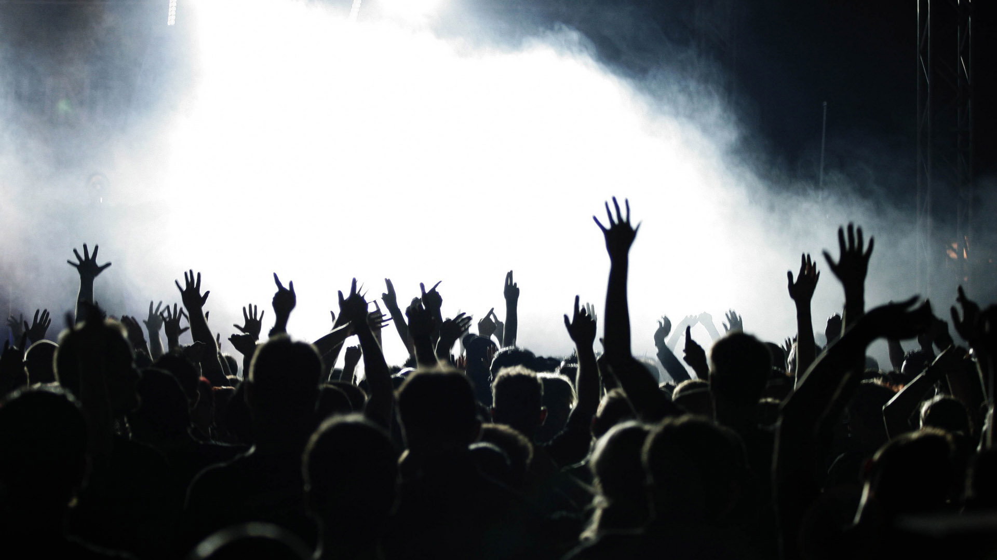
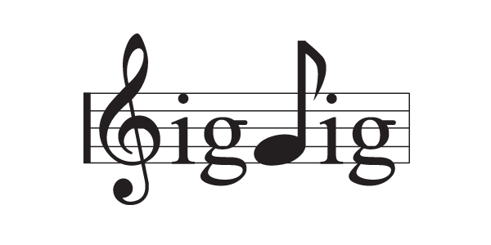
Team Dorsey
Andy Patrick, Jerry Poyntz, Bruno Fernandes

Slide 2

CONCEPT
An interactive concert search app that allows the user to:
• Search for concerts in their area
• Check out related artists and see if they have any upcoming shows
• Discover new artists by listening to sound clips
• Search the area of the concert venue for bars, restaurants and transportation

Slide 3
MOTIVATION
We thought of this idea after discovering some of our mutual interests…
Music and Beer!
We wanted to make an app that encompassed those interests and was different from the typical ticket sites by adding additional features.

Slide 4
DESIGN PROCESS
• We made a simple drawing of what the site would look like and expanded on that initial idea as we went along
• Picked a few API’s that stood out and made sense for us to put the app together, and started the pseudocode
• We split different tasks to get it started and put all the pieces together

Slide 5
TECHNOLOGIES
• HTML / CSS / JAVASCRIPT
jQuery, Ajax, Bootstrap, Modernizr, CSS Animations, Firebase
• SeatGeek API
• Spotify API
• Google Maps API

Slide 6
DEMO

Slide 7
FUTURE DEVELOPMENT
• Add other ticket API’s (Stubhub,
Ticketmaster, etc.) so users can compare
and get the best price available for seats.
• Add more search parameters and expand
the radius of the search to include
other states
• Add link to Uber or other transportation

Slide 8
QUESTIONS?

