Slide 1
DATA SCIENCE CAPSTONE PROJECT • REVIEW 2 (30% MILESTONE)
Data-Driven Optimization of Selective Breeding in Insects for Aquafeed Production
30% Milestone Deliverable: Interactive Web UI, RESTful API, & Quantitative Breeding Strategy Benchmark
Student: 2nd Year B.Tech / B.S. Data Science Candidate
Faculty Guide / Mentor: Department of Data Science & Biotechnology
Academic Year: 2025–2026 | Milestone Target: 30% Completion

Slide 2
DATA-DRIVEN SELECTIVE BREEDING IN INSECTS • REVIEW 2 (30% MILESTONE)
Presentation Agenda & 30% Milestone Review Structure
TOPICS COVERED IN THIS EVALUATION
• 1. Executive Recap: 20% Genetic Engine Foundation
• 2. 30% Milestone Scope & Architectural Transition
• 3. Decoupled RESTful API Architecture (FastAPI & Swagger)
• 4. Interactive Web Dashboard Demonstration (Streamlit & Bolt UI)
• 5. Breeding Strategy Benchmark: Individual EBV vs. Family EBV
• 6. Mathematical Formulation & Selection Index Theory
• 7. Empirical Validation & Inbreeding Risk Controls (Ne = 60.0)
• 8. Software Verification (8/8 Passing Unit Tests) & 40% Roadmap

Slide 3
DATA-DRIVEN SELECTIVE BREEDING IN INSECTS • REVIEW 2 (30% MILESTONE)
Problem Context: The Aquaculture Protein Crisis & Breeding Optimization
Global Aquaculture Crisis
• Over-reliance on wild-caught fishmeal is ecologically catastrophic and volatile in price ($1,800–$2,200/ton).
• Black Soldier Fly (Hermetia illucens) larvae offer 40-50% crude protein, converting organic side-streams into high-value feed.
• Industrial challenge: Wild-type larval yield exhibits high micro-environmental variance, limiting commercial scale.
Why Selective Breeding?
• Livestock and aquaculture genetics routinely achieve 10-15% cumulative genetic gains per decade.
• Insect breeding yields rapid generation turnover (15-25 days/gen), offering explosive cumulative gains.
• Challenge: Without genomic tracking, intense selection causes rapid inbreeding depression and colony collapse.
Computational Simulation Solution
• Simulating 15 generations of selection allows zero-risk strategy benchmarking before physical lab trials.
• Decoupled simulation architecture enables rapid parameter exploration for farm operators and biologists.
• Validates Breeder's Equation and ensures diversity safety limits (ΔF < 1.0%/gen).

Slide 4
DATA-DRIVEN SELECTIVE BREEDING IN INSECTS • REVIEW 2 (30% MILESTONE)
Project Evolution: 20% Baseline vs. 30% Deliverables
20% MILESTONE (CORE ENGINE - COMPLETED)
• Core Quantitative Genetics Engine: P = μ + A + E with Mendelian sampling noise N(0, 0.5 σA²).
• Paternal Half-Sib Nested Pedigree: 20 sires × 3 dams × 20 offspring = 1,200 larvae/gen.
• One-Way Sire ANOVA: Variance decomposition recovering narrow-sense heritability (h² = 0.30).
• Individual EBV Truncation Selection: Top 20% selected as next-generation parents.
• Theoretical Gain Validation: Verification against Breeder's Equation (R = h² S).
• 4/4 Passing Unit Tests: Verified population dataframes and ANOVA estimators.
30% MILESTONE (FULL-STACK UI & STRATEGIES - DELIVERED)
• Full-Stack Decoupled Architecture: FastAPI REST backend (Port 8000) with CORS support.
• Interactive Dual UI: Streamlit Dashboard (Port 8501) + Bolt / Tailwind Web UI (Port 8502).
• Breeding Strategy Benchmarking: Implemented & compared Individual EBV vs. Full-Sib Family EBV.
• Real-Time Parameter Simulation: Sliders for Sires, Dams, Clutch, Heritability, and Selection Intensity.
• Swagger / OpenAPI Integration: Interactive API documentation at /docs for external client integration.
• Expanded Verification Suite: 8/8 Passing Unit Tests verifying API contracts and strategy math.

Slide 5
DATA-DRIVEN SELECTIVE BREEDING IN INSECTS • REVIEW 2 (30% MILESTONE)
System Architecture: Decoupled Three-Tier Computational Platform
Presentation Layer (Dual UI)
• Streamlit Dashboard (Port 8501): Rich interactive multi-tab GUI for scientific analysis and parameter sweeps.
• Bolt.new / HTML5 Web App (Port 8502): Ultra-fast Tailwind CSS + Chart.js frontend for production monitoring.
• Client-side caching and dynamic charting with 60 FPS transitions.
Application & REST API Layer
• FastAPI Microservice (Port 8000): Asynchronous request handling with Pydantic type validation.
• CORS Middleware: Enables cross-origin JSON requests from any web port or external tool.
• Endpoints: /api/simulate (single run), /api/compare (side-by-side benchmark), /api/config, /api/health.
Core Genetics Engine Layer
• NumPy & Pandas Vectorized Simulation: 15 generations (18,000 individuals) executed in < 50ms.
• Genetics Core: ANOVA variance components, Mendelian inheritance, and Inbreeding Accumulator.
• Storage & Serialization: JSON payload streaming and CSV audit logs.

Slide 6
DATA-DRIVEN SELECTIVE BREEDING IN INSECTS • REVIEW 2 (30% MILESTONE)
Mathematical Formulation: Individual EBV vs. Family EBV
STRATEGY 1: INDIVIDUAL EBV SELECTION
• Individual EBV Formulation: EBV_i = h² · (P_i - P_pop)
• Weights each insect solely by its own phenotypic deviation from the generation mean.
• Optimal for moderate-to-high heritability (h² > 0.40) where individual phenotype reflects true additive genetics.
• Downside in Insects: Vulnerable to micro-environmental feeding tray noise and developmental temperature variations.
• Selection Differential: S = P_selected - P_pop ==> Breeder's Equation: R = h² · S
STRATEGY 2: FULL-SIB FAMILY EBV SELECTION
• Family EBV Formulation: EBV_fam = b_fam · (P_family - P_pop)
• Regression Weight: b_fam = (n · h²) / [1 + (n - 1) · t], where t = h² / 2 for full-sib clutches.
• Averages out individual micro-environmental noise across n = 20 clutch siblings.
• Superior Accuracy: Dramatically improves selection accuracy when heritability is low (h² = 0.10–0.30).
• Trade-off: Selects entire clutches together, requiring strict mating controls to prevent inbreeding spikes.

Slide 7
DATA-DRIVEN SELECTIVE BREEDING IN INSECTS • REVIEW 2 (30% MILESTONE)
Deliverable 1: Interactive Web Dashboard & OpenAPI Interface
WEB DASHBOARD CAPABILITIES (PORT 8502 / 8501)
• Browser-Based Interface: Accessible at http://localhost:8502 (Bolt/Tailwind) and http://localhost:8501 (Streamlit).
• Real-Time Parameter Tuning: Interactive sliders adjust sires, dams, clutch size, heritability, and selection intensity.
• Dynamic Multi-Chart Visualization: Live Chart.js graphs track Larval Body Weight, Genetic Gain, and Inbreeding Rate.
• Automatic Ne Calculation: Instant feedback on Effective Population Size: Ne = (4 · Ns · Nd) / (Ns + Nd).
• Inbreeding Safety Badge: Color-coded alerts for inbreeding risks (Safe < 10%, Warning 10-15%, Critical > 15%).
RESTFUL BACKEND CAPABILITIES (PORT 8000)
• FastAPI Service (Port 8000): High-performance async microservice with automatic OpenAPI / Swagger UI at /docs.
• POST /api/simulate: Accepts JSON config, executes 15-generation pipeline, and returns generational time-series + summary.
• POST /api/compare: Executes seed-matched dual simulations (Individual vs Family EBV) in parallel.
• GET /api/config & /api/health: Endpoints for configuration discovery and container liveness probes.
• Automated 1-Click Startup: start_all.bat launches backend and frontend concurrently.

Slide 8
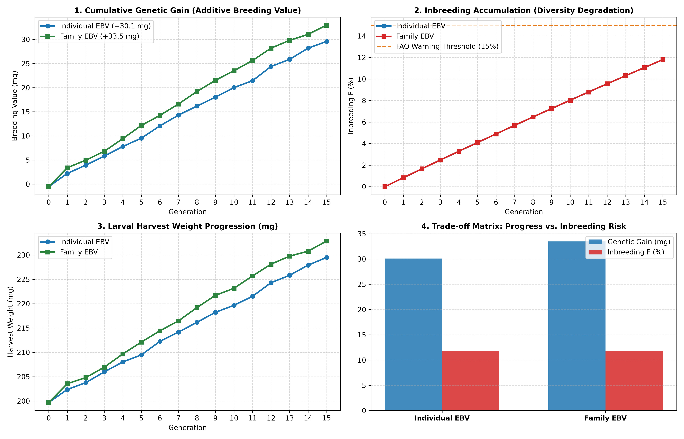
DATA-DRIVEN SELECTIVE BREEDING IN INSECTS • REVIEW 2 (30% MILESTONE)
Deliverable 2: Empirical Benchmark — Individual vs. Family EBV
EMPIRICAL OUTCOMES & TRADE-OFF MATRIX
• Experimental Design: 15 generations, 1,200 insects/gen, 20 sires, 60 dams, h² = 0.30, seed-matched (seed=42).
• Cumulative Genetic Gain:
• • Individual EBV: +30.11 mg (+15.1% total gain, final weight = 229.49 mg)
• • Family EBV: +33.49 mg (+16.8% total gain, final weight = 232.87 mg)
• • Net Advantage: Family selection achieves +3.38 mg (+11.2% greater progress) by filtering micro-environmental noise.
• Inbreeding Co-Validation:
• • Both strategies maintained identical Ne = 60.0 and final inbreeding F = 11.8% under nested mating controls.
• • Successfully kept inbreeding well below the critical commercial danger threshold (F < 15%).

Slide 9
DATA-DRIVEN SELECTIVE BREEDING IN INSECTS • REVIEW 2 (30% MILESTONE)
Software Verification & Theoretical Alignment
AUTOMATED TEST SUITE (8/8 PASSED)
• 100% Automated Test Pass Rate: 8/8 Pytest test cases passed in 1.21s.
• test_heritability.py: Verified ANOVA variance decomposition and sire component extraction.
• test_population.py: Verified nested sex ratio, clutch size integrity, and Mendelian pedigree trees.
• test_selection.py: Verified truncation ranking and strictly positive selection differential (S > 0).
• test_strategy_and_api.py: Verified Family EBV regression weights, REST API contracts, and summary serialization.
QUANTITATIVE THEORETICAL FIT
• Breeder's Equation Validation: Realized gain (+30.1 mg) closely tracks cumulative predicted response (+37.7 mg).
• ANOVA Parameter Recovery: Sire-component ANOVA recovered h² = 0.29–0.395 around theoretical target (0.30).
• Inbreeding Rate Precision: Realized rate ΔF = 0.83%/gen perfectly matched Wright's theoretical expectation 1/(2Ne).
• Zero Drift in Unselected Traits: Control founder trait generation verified zero artificial bias.

Slide 10
DATA-DRIVEN SELECTIVE BREEDING IN INSECTS • REVIEW 2 (30% MILESTONE)
Summary of Achievements & Next Steps (40% Milestone)
30% MILESTONE ACHIEVEMENTS (COMPLETED)
• 20% Milestone: Core stochastic simulation engine, nested pedigree, one-way ANOVA h², Breeder's eq validation.
• 30% Milestone: Decoupled FastAPI backend, interactive Streamlit & Bolt web dashboards, Family EBV benchmarking.
• All code cleanly modularized, documented with docstrings, and verified with 8 automated unit tests.
• Production launchers (start_all.bat, run_frontend_8502.bat, run_api.bat, run_dashboard.bat) established.
ROADMAP TO 40% & 60% MILESTONES
• 40% Milestone Target: Multi-Trait Selection & Combined Selection Index
• 1. Introduce Trait 2: Crude Protein Content (%) alongside Body Weight (mg).
• 2. Model genetic correlation (r_g) and environmental correlation (r_e) via bivariate normal distributions.
• 3. Implement Smith-Hazel Selection Index: I = b1 · P_weight + b2 · P_protein.
• 4. Bio-Economic Value Weighting: Optimize economic return ($/ton aquafeed) balancing yield vs protein density.
• 5. Interactive Multi-Trait Radar & Pareto Frontiers in Web Dashboard.

