Slide 1
End-to-End Data Engineering Solution for HR Analytics
​​A Databricks-based historical HR data pipeline with interactive web-based analytics dashboard​
Group Members:
Bruno do Nascimento Beserra | 300392300
Jay Clark Bermudez | 300380540
Matheus Filipe Figueiredo | 300389657
CSIS 4495 - 50
Applied Research Project

Slide 3
What was the problem?
Problem: Loss of Historical HR Data
HR SaaS (e.g., Dayforce) focus on daily operations, not history
Records overwritten/removed when employees change or leave
Manual CSV exports - not a structured historical store
Hard to answer long-term workforce questions (turnover, promotion, salary trends)
Notes:
Many organizations use HR SaaS platforms such as Dayforce for payroll, scheduling, and employee records.
These systems are very good for daily operations, but they are not designed to preserve detailed historical data. When employees change departments or leave, older records are often overwritten or deleted.
Teams usually export CSV files into BI tools, but those are manual snapshots and not a structured historical store. Because of this, it becomes hard to answer long term questions about turnover, promotion patterns, and salary progression.

Slide 4
Project Goal & Objectives
Goal:
Design and implement an end-to-end data engineering solution that preserves and enables analysis of historical HR data for workforce planning and decision-making.
Objectives:
Simulate 7 years of monthly HR snapshots from a Kaggle dataset
Build a Databricks-based pipeline with Bronze, Silver, and Gold layers
Apply Slowly Changing Dimensions Type 2 + Kimball dimensional model
Develop a Dash web application on top of the Gold layer
Show reusability via Power BI and CSV-based analysis
Notes:
Our goal is to design and implement an end-to-end solution that preserves historical HR data and supports workforce analytics.
To achieve this, we simulate seven years of monthly HR snapshots using a Kaggle dataset. These snapshots are processed by a Databricks-based pipeline with Bronze, Silver, and Gold layers. In the Gold layer, we apply Slowly Changing Dimensions Type 2 and a Kimball-style dimensional model to track employee history.
On top of the Gold tables, we built a Dash web application for interactive analysis, and we also show that the same curated data can power Power BI and CSV-based analysis using a single, consistent data model.

Slide 5
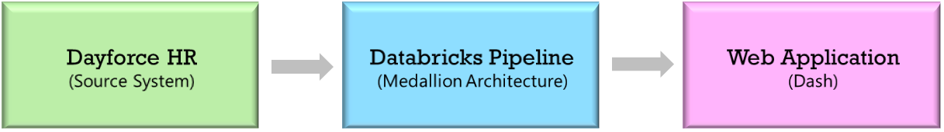
Overall System Architecture

Slide 6
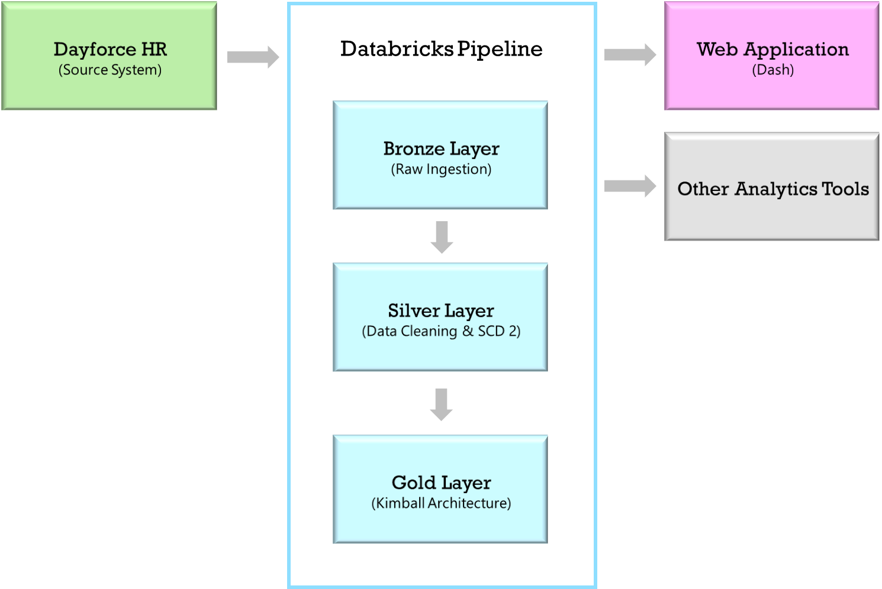
Databricks Pipeline

Slide 7
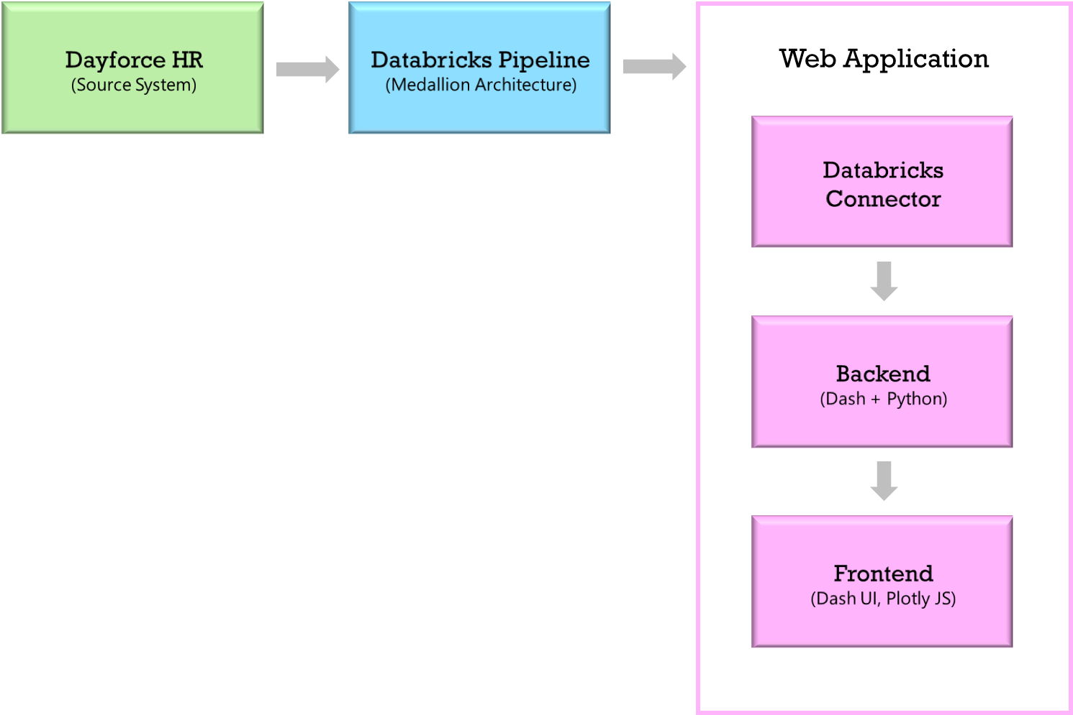
Web Application

Slide 8
Technologies Used
Data Engineering
  Databricks
  Medallion Architecture
  Slowly Changing Dimension
  Kimball Architecture
Visualizations
  Microsoft PowerBI
  Salesforce Tableau
  Dash Web Application

Slide 9
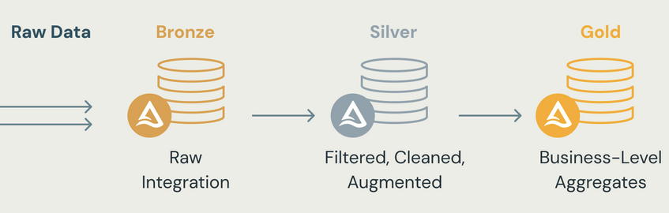
Technologies Impact
Medallion Architecture
  Splits the data into three quality layers (Bronze, Silver, Gold)
  Enables incremental ETL
  Can recreate your tables from raw data at any time
  ACID transactions, time travel

Slide 10
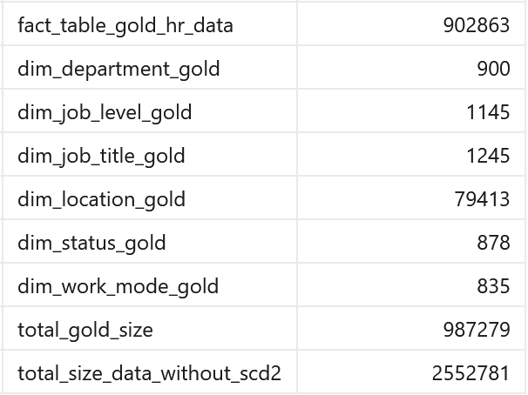
Technologies Impact
Slowly Changing Dimension
  There are 3 most common types of SCD Techniques
  Type 2, which was used for this project, focus on retaining all changing in data that happens in the dataset
  It’s useful for support time-based analysis
  Saves storage space
61.3% Size Reduction

Slide 11
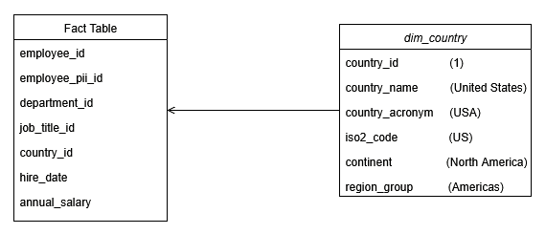
Technologies Impact
Kimball Architecture
  Based on Star Schema
  Composed of Dimension and Fact Tables
  Saves space and reduce redundancy in data

Slide 12
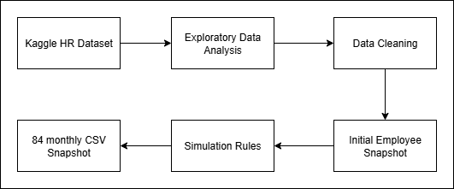
Dataset Creation & Future Simulation
EDA: Basic Information, Missing Values, Dtypes, and Statistics of data.
Data Cleaning: Column Renaming, Schema enforcement
Simulation Rules: Leaving Reasons, raise percentages, milestones percentages, monthly hiring rate, promotions milestones
Notes:
This figure shows the full workflow we used to create the dataset for our project.
We start from a Kaggle HR dataset that contains information on about two million employees. First, we perform exploratory data analysis to understand the structure and quality of the data, including data types, missing values, distributions, and obvious outliers.
Based on that, we run a data cleaning step. We remove columns that are not relevant for our objectives, correct unrealistic salary values, and standardize important fields such as dates and numeric variables.
From the cleaned dataset, we create an initial employee snapshot by sampling around five thousand employees to represent a mid-sized company. We also derive a job level attribute from years of experience and check that the distribution of employees across job levels looks realistic.
Next, we define simulation rules that control how the company evolves over time. These include hiring rates, exit probabilities, promotion patterns, department changes, and typical salary increase percentages.
Finally, we apply these rules month by month to generate eighty-four monthly snapshots, which represent seven years of company history. Each snapshot is saved as a CSV file in a year and month folder structure, such as data/2023/05/file.csv. These CSVs are what our data engineering pipeline ingests into the Bronze layer in Databricks.

Slide 13
Bronze & Silver Layers
Bronze - Raw Landing Zone
Fetches new files from source.
Detects new CSVs and appends rows to a Bronze Delta table
Adds ingestion timestamp; preserves original structure
Silver - Cleaning SCD Type 2
Reads only new Bronze records based on latest ingestion timestamp
Standardizes column names, schemas & data types
Fixes missing values, duplicates, inconsistent IDs
Implements Slowly Changing Dimensions Type 2
Notes:
In the Bronze layer, we treat the CSV snapshots as raw data. The Bronze notebook scans the year and month folders, finds any new CSV files, and appends their records into a Bronze Delta table. We add an ingestion timestamp and preserve the original structure so we can always trace back to the source export.
The Silver layer is responsible for cleaning and historical tracking. It reads only new records from Bronze, standardizes column names and data types, and addresses data quality issues such as missing values and duplicates.
This is also where we implement Slowly Changing Dimensions Type 2. When an employee’s department, job title, location, or employment status changes, we create a new version of the record, close the previous one with a valid-to date, and keep a flag indicating which version is current. This allows us to reconstruct the workforce at any point in time.

Slide 14
Gold Layer & Pipeline Automation
Gold – Dimensional model
Dimensions: department, job title, location, job level, status, work mode
Fact: employee history with salary, experience, performance, hire date
Includes SCD2 fields (is_current, valid_from, valid_to)
Pipeline Automation:
Databricks Job runs:
  Bronze → Silver → Gold
Can be scheduled to refresh automatically when new snapshots arrive
Notes:
The Gold layer organizes the historized data from Silver into a dimensional model.
We have dimension tables for departments, job titles, locations, job levels, status, and work mode, and a central fact table that links to these dimensions and stores measures like salary, experience, performance ratings, and key dates. It also includes SCD Type 2 fields for current and historical versions.
The Databricks Job that we just ran automates the sequence Bronze → Silver → Gold. It can be scheduled so that whenever new monthly snapshots are dropped into storage, the pipeline updates the Gold tables that our dashboards and BI tools use

Slide 15
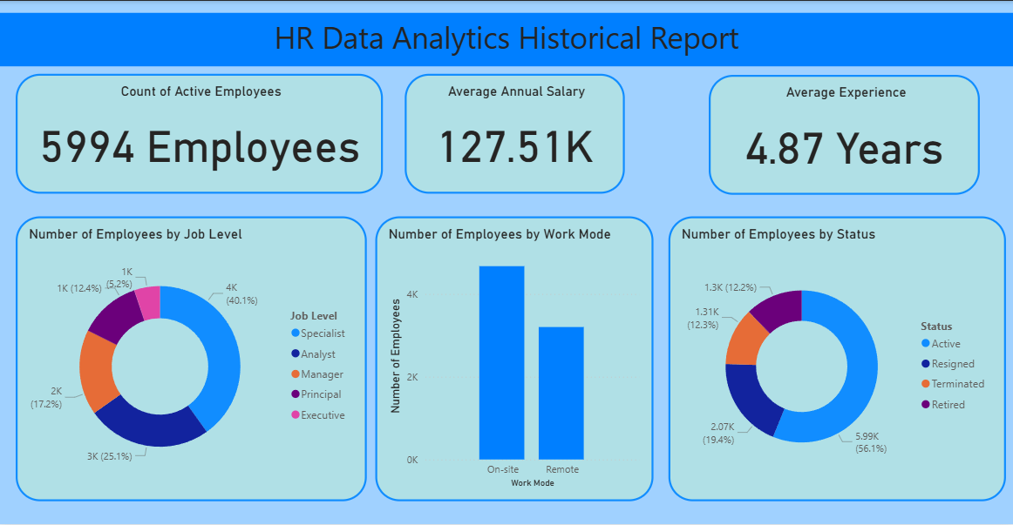
PowerBI

Slide 16
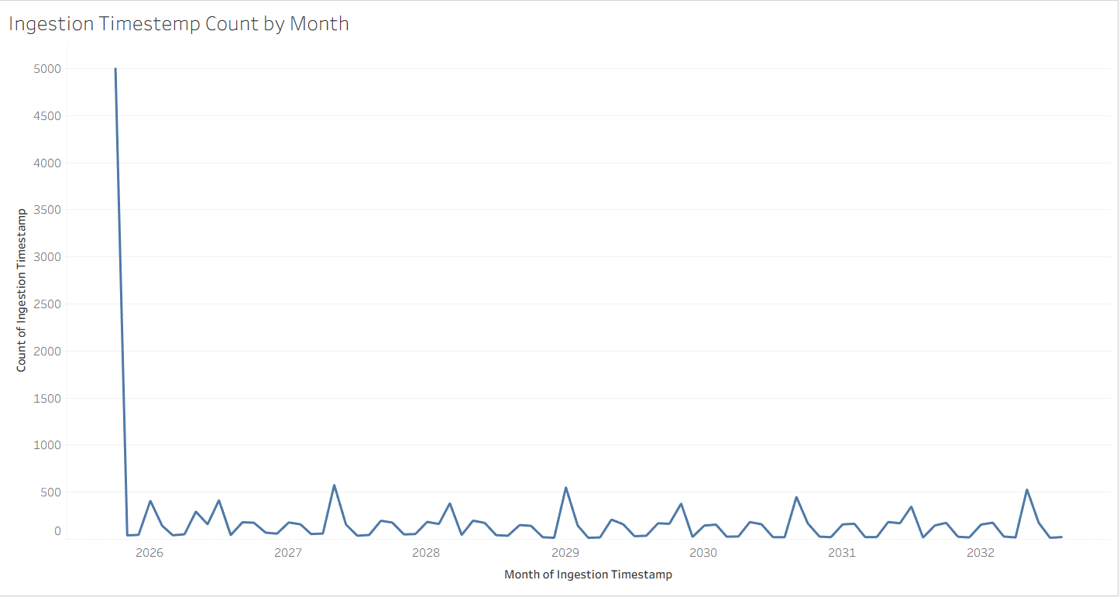
Tableau

Slide 17
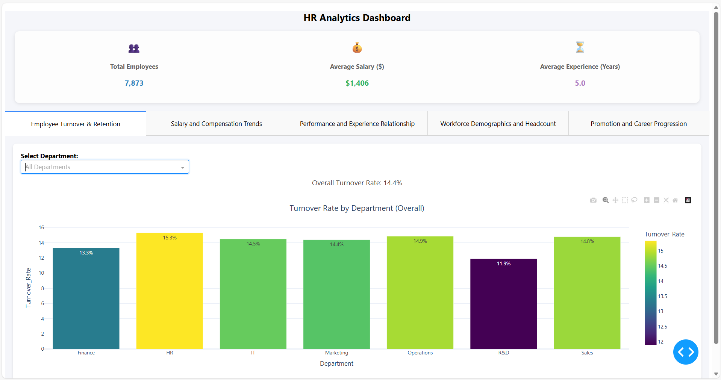
Dash Web Application

Slide 18
Live Demo

Slide 19
Lessons Learned & Future Work
Lessons Learned
Even simulated data requires real data cleaning and validation
Medallion Architecture helped separate ingestion, cleaning, and analytics
SCD Type 2 and a Kimball model enabled historical analysis, not just current snapshots
Choosing Dash kept the focus on analytics and data modeling, instead of heavy web infrastructure
Future Work
Connect pipeline to real HR data with proper privacy and governance
Add scheduling, monitoring, and alerts for Databricks Jobs
Implement anonymization and role-based dashboards
Build predictive models (e.g., attrition risk, promotion likelihood)
Deploy Dash to a cloud environment, using the Gold layer as a single source of truth
Notes:
We learned that even though our dataset was simulated, we still had to treat it like real data. Cleaning, validating, and simulating realistic behavior took significant effort.
The Medallion Architecture helped us separate concerns between raw ingestion, cleaning and historization, and analytics ready structures. SCD Type 2 and a Kimball model made it possible to answer historical questions, not just see the current state of the workforce.
For future work, this solution could be connected to real HR data, scheduled and monitored more robustly, secured with anonymization and role-based access, and extended with predictive models. The Dash app could also be deployed in the cloud while continuing to use the Gold layer as the single source of truth.

Slide 20
Conclusion
Built an end-to-end HR data engineering solution
Simulated 7 years of workforce history from a Kaggle dataset
Implemented a Databricks Medallion pipeline with SCD2 and a Gold dimensional model
Developed a Dash HR analytics dashboard plus optional Power BI and CSV exports
Provides a foundation for a production-ready HR analytics platform
Notes:
In summary, our project designed and implemented an end-to-end HR data engineering solution.
We simulated seven years of workforce history from a Kaggle dataset, processed it through a Databricks Medallion pipeline with SCD Type 2 and a dimensional model in the Gold layer, and developed a Dash dashboard and complementary BI options on top of that data.
Together, these components demonstrate how an organization can preserve historical HR records and turn them into a reusable, analytics ready foundation for workforce planning.
Thank you for listening. We are happy to answer any questions.

Slide 21
Questions?

Slide 22
Jay Clark Bermudez
Matheus Filipe Figueiredo
Bruno do Nascimento Beserra

