Slide 1
Case Study 2: IT salaries
Author: Biasotti, Bruno
Date: 2/Jul/2022

Slide 2
Table of Contents
Objective
Analysis, Cleaning process and Insights:
1) General Insights
2) Specific Insights for Developer
3) Specific Insights for Data Analyst
4) Anomalies
Conclusions and Next Steps
Appendix

Slide 3
Objective
The IT sectors grow every year and a lot of new candidates are willing start a career in any of these professions
This analysis aims to give general salary insights to newcomers
Then I do a more in-depth analysis in my preferred roles: Developer and Data Analyst

Slide 4
Analysis
Gather general insights for all IT roles for Full-Time, Part-Time and Freelance contracts
Gather specific insights for Developer and Data Analyst roles

Slide 5
Data Cleaning Process

Slide 6
Cleaning data
The Dataset used was provided by a survey realized by a group called ‘sysarmy’ in .csv format
315 data points (from a total of 4818) were removed through the cleaning process. This includes responses which did not have a numeric value in the ‘salary’ column and unrealistic values (~6.54%)
For the specific insights, 35 rows where ignored (from a total of 1897). This includes responses of ‘half years’ (For example: 1.5) (~1.85%)

Slide 7
General insights

Slide 8
General insights
Statistics considered are mean, mode, max and min
Some anomalies has been found. This will be detailed later
We will detail here the top 5 of Full-Time Contracts. All the graphs can be found annexed in the github repository for further analysis

Slide 9
Full-Time contracts: Top 5
Average | Mode | Max | Min
VP | Manager | Developer | Scrum Master
Manager | VP | Sysadmin | Middleware
Architect | Recruiter | Tech Leader | DBA
Tech Leader | Architect | VP | Sales
Product Manager | Project Manager | Architect | Infosec

Slide 10
Developer insights

Slide 11
Developer insights
Mean: 210.345 ARS
Mode: 150.000 ARS
Max: 3.225.000 ARS
Min: 11.500 ARS

Slide 12
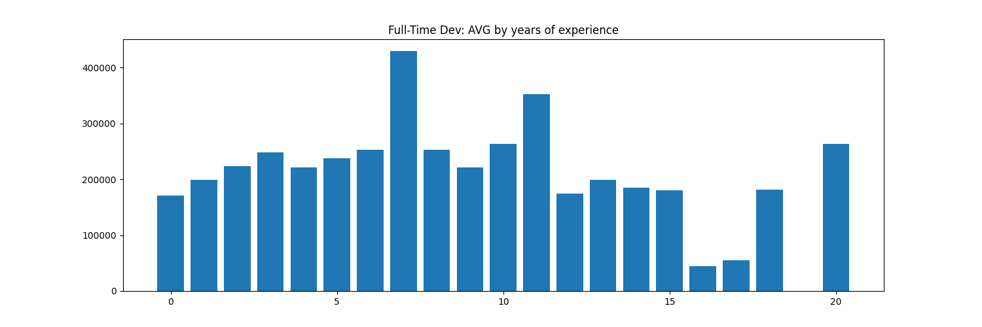
Developer Insights

Slide 13
Data Analyst insights

Slide 14
Data Analyst insights
Mean: 170.147 ARS
Mode: 100.000 ARS
Max: 800.000 ARS
Min: 43.000 ARS

Slide 15
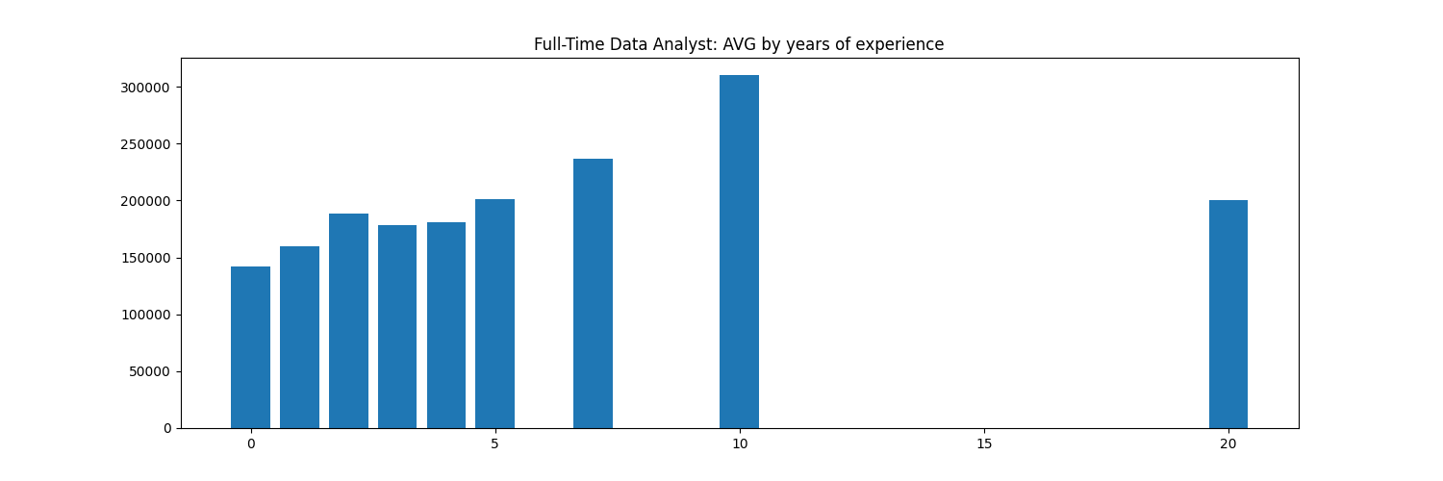
Data Analyst insights

Slide 16
Anomalies

Slide 17
Anomalies
Developer: Years 7 and 11 show a much higher average than the rest, but it is not a problem of the amount of data used (Numbers of data entries are found in the pdf annexed)
Developer: For years 17 and 18, only one data entry was considered. The low value probable represents a bad data entry from the survey
Data Analyst: Year 10 has a bigger growth than expected. There are only two data entries, so it may be the cause

Slide 18
Conclusions

Slide 19
Conclusions
If based on salary only, it can be considered that Developers is more profitable than Data Analyst
Data Analyst is a relatively new job, so there is no data available for higher years of experience
For a entirely new person, is better to follow their personal likings, as there is no ‘huge’ difference between roles

Slide 20
Next Steps
Gather more data and investigate further these anomalies
Specific insights for all roles
Include company size, rating, and happiness and work environment scores to complement the analysis

Slide 21
Questions

