Slide 1
Case Study 2: ICT salaries
Author: Biasotti, Bruno
Date: 11/Oct/2022

Slide 2
Table of Contents
Objective
Analysis, Cleaning and Insights:
Conclusions and process Next Steps

Slide 3
Objective
The IT sectors grow every year and a lot of new candidates are willing start a career in any of these professions
This analysis aims to give general insights into the ICT sector

Slide 4
Data Cleaning Process

Slide 5
Cleaning data
The Dataset used was provided by a survey realized by a group called ‘sysarmy’ in .csv format
1187 rows from a total of 5163 were removed in the cleaning process. This represents 23% of the dataset
The cleaning process documents what rows were removed for further analysis

Slide 6
General insights

Slide 7
General insights
Median is the statistical value calculated
Some anomalies has been found. This will be detailed later

Slide 8
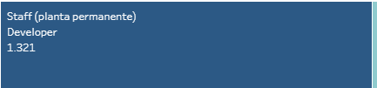
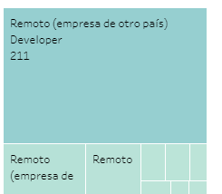
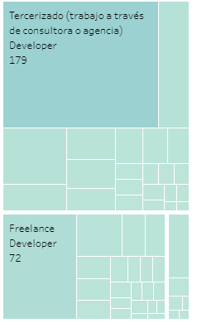

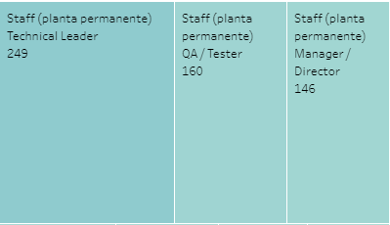
Job and contract type treemap

Slide 9
Treemap Insights
Developer is the most popular choice, regardless of contract type
SysAdmin/DevOps/SE is the second most popular choice for Full-Time contracts and Freelance
QA/Tester is the second most popular choice for Remote (company outside the country) and Outsource

Slide 10
Salary per experience and job type
Interactive graph can be found in Tableau
User can filter their desired profession and job experience

Slide 11
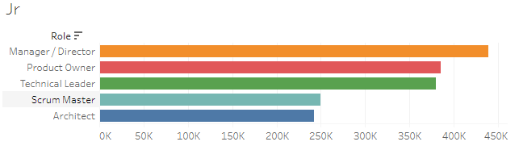
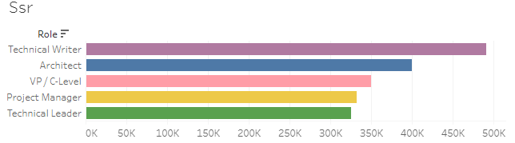
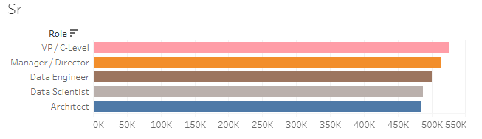
Best-paid professions

Slide 12
Anomalies

Slide 13
Anomalies
Some SSr’s earn less than their Jr counterparts.
Ssr Technical Writer have a higher median than expected
What could be the reason behind these inaccuracies? It can be because there are not enough data points, or because there is still incorrect data within the IQR range

Slide 14
Conclusions

Slide 15
Conclusions
Developer is the most popular profession in the ICT sector in Argentina, followed by SRE and QA/Tester
The differences in salary per job type are not considerable enough. If a new person wishes to enter the ICT labor market, they should seek opportunities based on their personal likes

Slide 16
Next Steps
Gather more data and investigate further these anomalies
Specific insights for a desired job type
New tabs can be created with an analysis of the demography: Age, highest degree, etc. This would imply a new step in the data-cleaning process

Slide 17
Questions

Slide 18
Thank you
Contact email: elbiazzo025@gmail.com

