Slide 1
Case Study 1:
Cyclistic Members
Author: Biasotti, Bruno
Date: 9/Jun/2022

Slide 2
Table of Contents
Objective
Analysis, Data and Insights
Conclusions and Next Steps
Appendix

Slide 3
Objective
There are two types of riders using Cyclistic. Casual Member and Annual Members. Annual Members are more profitable
The reason of the analysis is to gain insights on difference between both types and to design a market strategy to get Casual Member into an Annual membership

Slide 4
Analysis
How do both types of riders differ?
We will look into two main categories:
  Average travel time per day
  Which days are more frequent

Slide 5
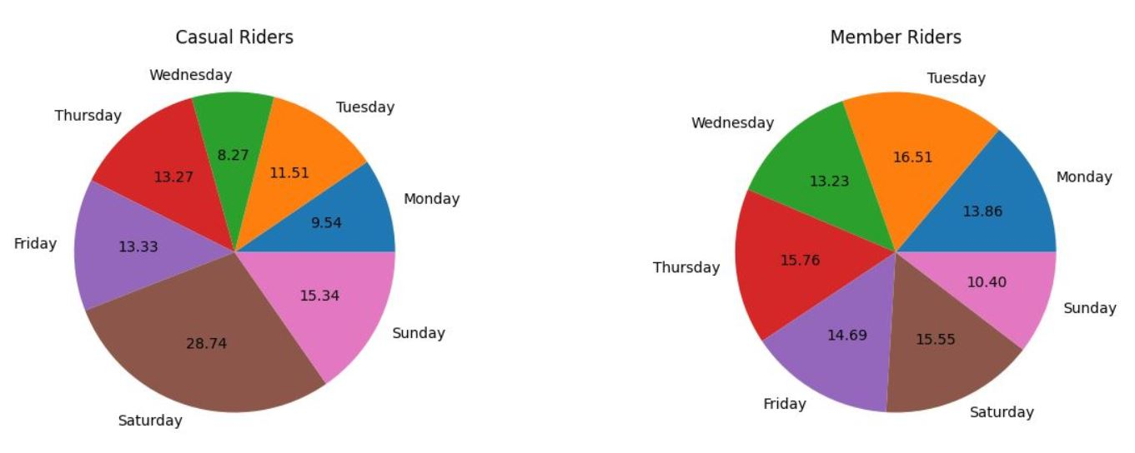
Occurrence of Days

Slide 6
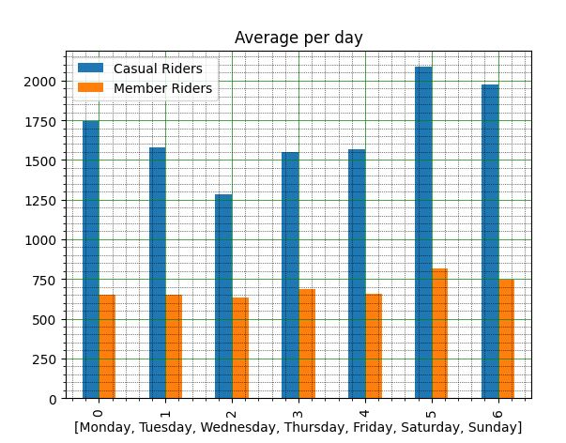
Average travel time per day in Seconds
Casual Members ride for longer times than Member riders
The Longer Times in Casual Member are Saturday and Sunday. While Annual Members are equitative among all days

Slide 7
Conclusions
Casual Riders use the service for longer travels on weekends, probably more as a recreation activity
Member Riders prefer to do day-to-day activities, which explains a constant distribution among all days, but also a shorter travel time

Slide 8
Next Steps
Draw a heat map about the travels of both types of riders
Survey disponibility and usage of Bicycles during peak times
Inquiry Casual Members about locations and preferences

Slide 9
Questions

Slide 10
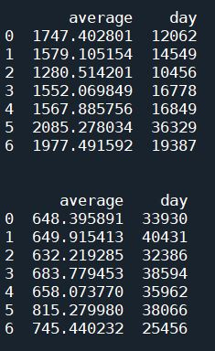
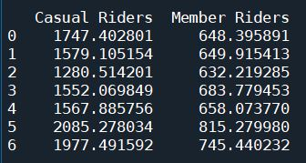
Appendix
Data Tables: Total Seconds and Occurrence of Days

