Slide 1
STM8S Training

Slide 2
Agenda
STM8 Basics & Portifolio
Available Peripherals
Getting Started with the Software and Firmware
Compiler and IDE
Library
Tec. Characteristics
Hands-On

Slide 3
STM8S Training
STM8 Basics & Portifolio

Slide 4
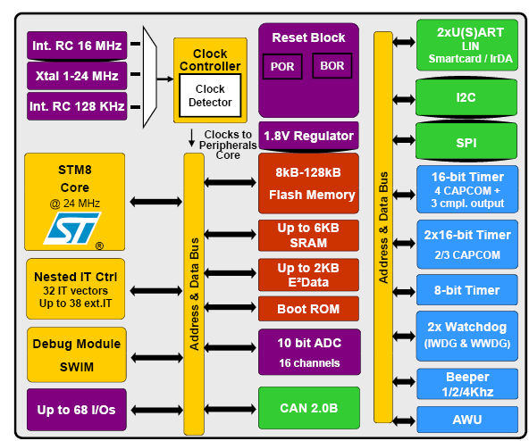
Internal block Diagram

Slide 5
Highlights
24MHz Fcpu
2.95 to 5.5V
-40 a +125°C
10K cycles under Flash and 300K under E2PROM
4kBytes to 128kBytes, 20 up to 80 pins
5 different Low Power Modes
IrDA
SWIM programming interface

Slide 6
STM8S Training
Getting Started

Slide 7
Where can I find the library and SW?
The library is available here
The STVD (our IDE!) is available here
The compiler is a 3rd part and has no limitation and it’s free!!
http://cosmicsoftware.com/download_stm8_free.php
STSW-STM8069 | STM8S/A Standard peripheral library
STVD | ST Visual develop IDE for developing ST7 and STM8 applications

Slide 8
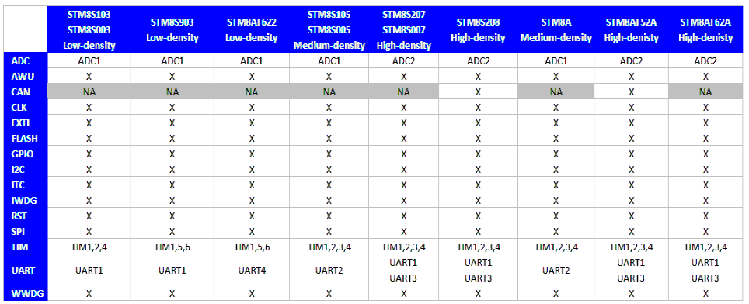
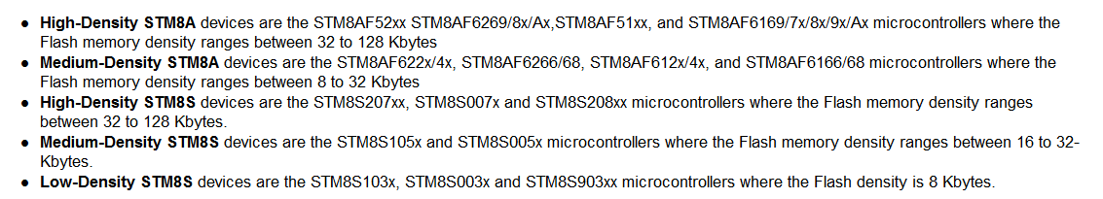
Library’s Supported Features

Slide 9
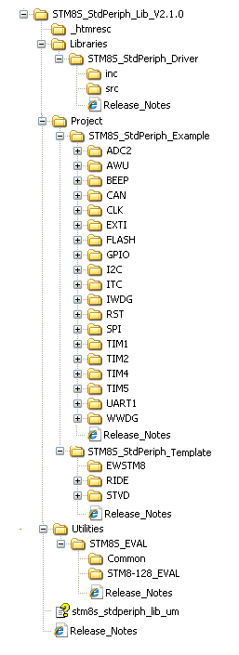
File Structure

Slide 10
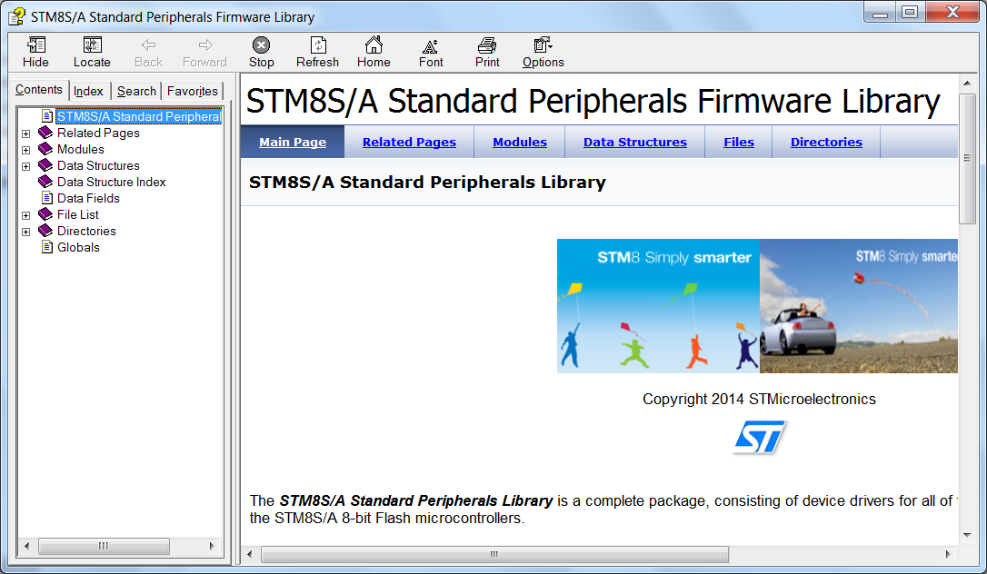
Library’s Help/User Manual

Slide 11
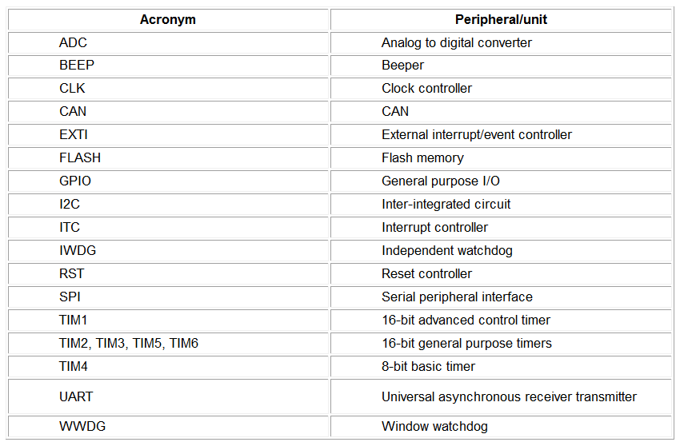
Conventions 1/3 ☺

Slide 12
Conventions 2/3 ☺
The library uses the following naming patern:
PPP refers to any peripheral acronym, for example TIM2 and TIM3
System and source/header file names are preceded by the prefix ‘stm8s_’.
Names of peripheral functions are preceded by the corresponding peripheral acronym in upper case followed by an underscore, for example SPI_SendData.
Functions used to initialize the PPP peripheral according to parameters specified in the header file are named PPP_Init, for example TIM2_Init
Functions used to reset the PPP peripheral registers to their default values are named PPP_DeInit, for example TIM2_DeInit
Functions used to enable or disable the specified PPP peripheral are named PPP_Cmd, for example SPI_Cmd
Functions used to enable or disable an interrupt source of the specified PPP peripheral are named PPP_ITConfig, for example SPI_ITConfig
Functions used to check whether the specified PPP flag is set or reset are named PPP_GetFlagStatus, for example I2C_GetFlagStatus
Functions used to clear a PPP flag are named PPP_ClearFlag, for example I2C_ClearFlag
Functions used to check whether the specified PPP interrupt has occurred or not are named PPP_GetITStatus, for example TIM2_GetITStatus
Functions used to clear a PPP interrupt pending bit are named PPP_ClearITPendingBit, for example TIM2_ClearITPendingBit

Slide 13
Conventions 3/3 ☺
Variable types:
#define __I volatile const /*!< defines 'read only' permissions */
#define __O volatile /*!< defines 'write only' permissions */
#define __IO volatile /*!< defines 'read / write' permissions */
/*!< Signed integer types */
typedef signed char int8_t;
typedef signed short int16_t;
typedef signed long int32_t;
/*!< Unsigned integer types */
typedef unsigned char uint8_t;
typedef unsigned short uint16_t;
typedef unsigned long uint32_t;
/*!< STM8 Standard Peripheral Library old types (maintained for legacy purpose) */
typedef int32_t s32;
typedef int16_t s16;
typedef int8_t s8;
typedef uint32_t u32;
typedef uint16_t u16;
typedef uint8_t u8;
typedef enum {FALSE = 0, TRUE = !FALSE} bool;
typedef enum {RESET = 0, SET = !RESET} FlagStatus, ITStatus, BitStatus, BitAction;
typedef enum {DISABLE = 0, ENABLE = !DISABLE} FunctionalState;

Slide 14
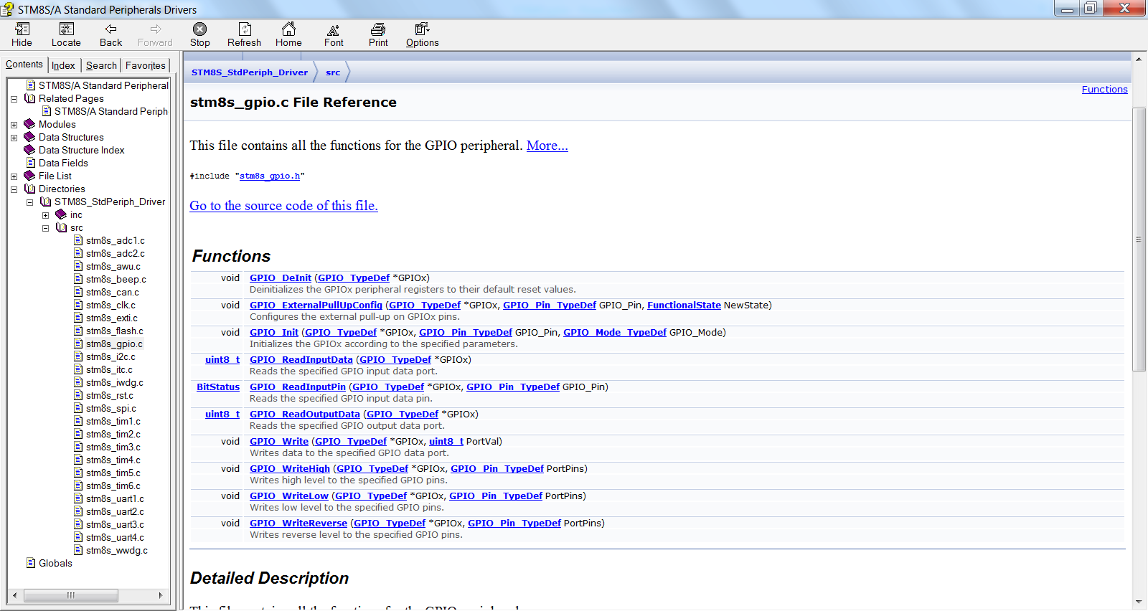
How to find the available functions

Slide 15
How to get more info?

Slide 16
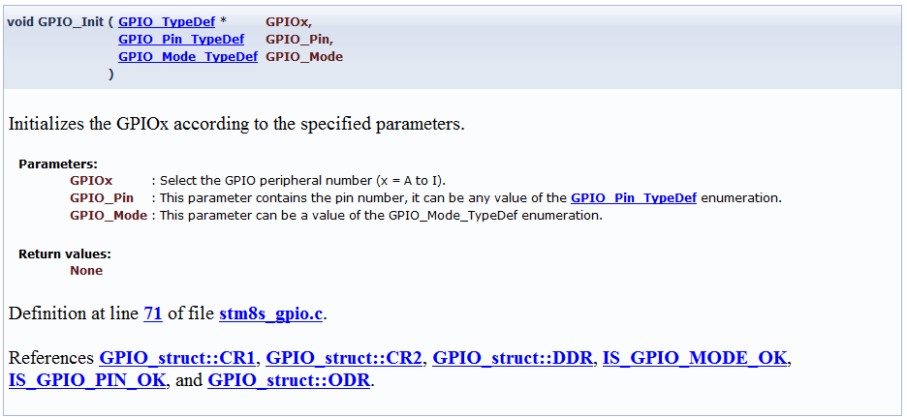
How to get more info?

Slide 17
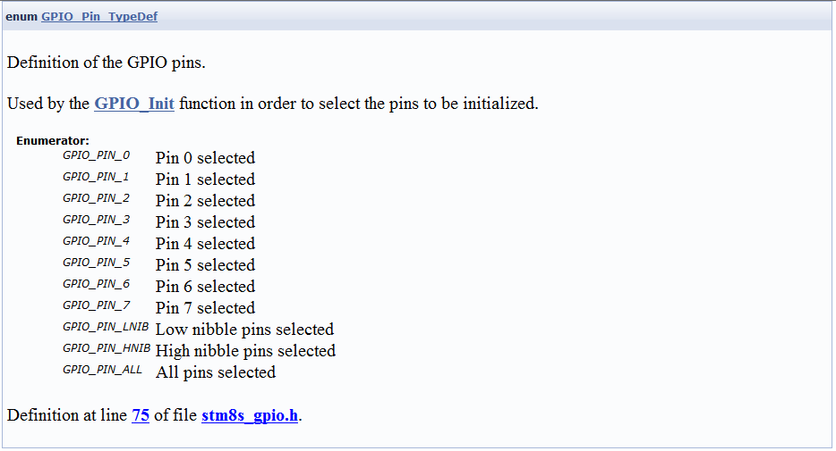
How to know the available defines?

Slide 18
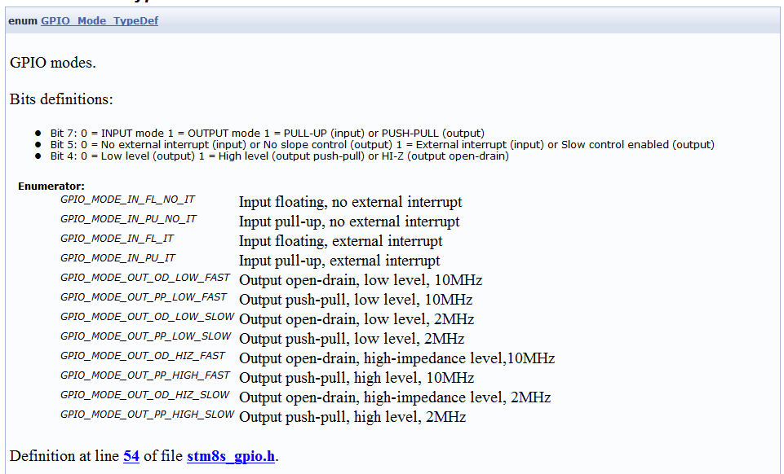
How to know the available defines?

Slide 19
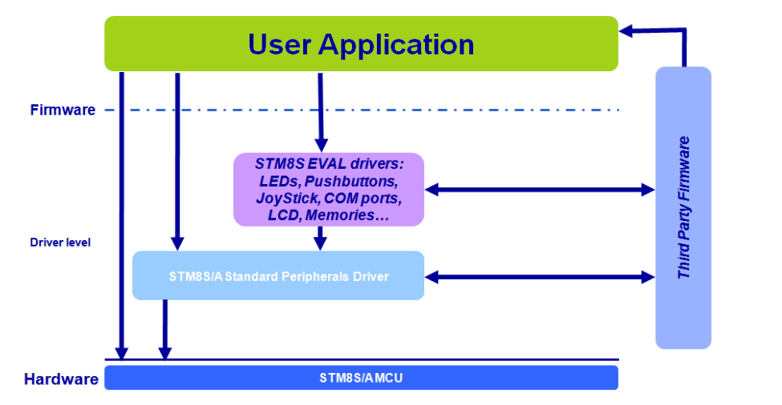
Library’s Architecture

Slide 20
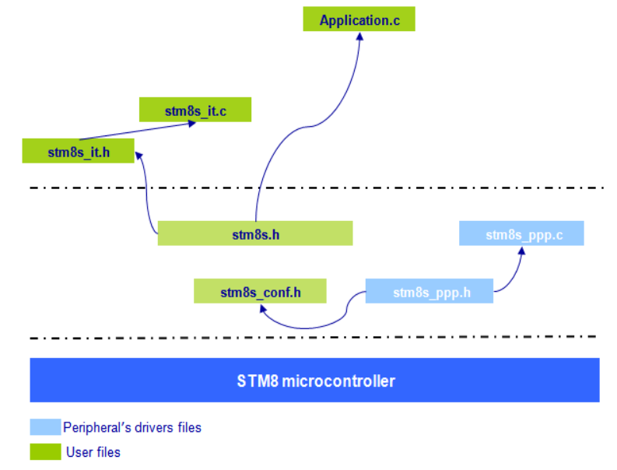
Library’s Architecture in files

Slide 21
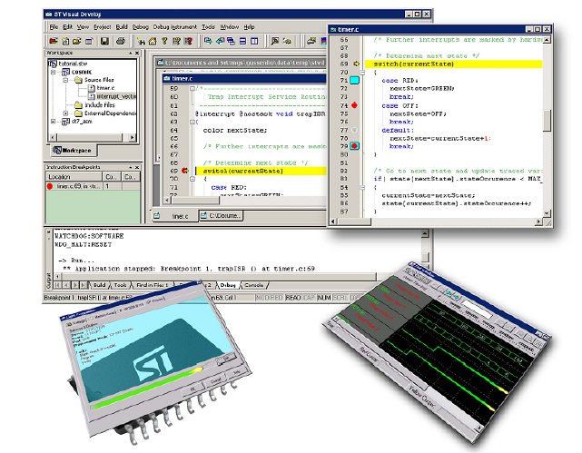
Getting Started from scratch!

Slide 22
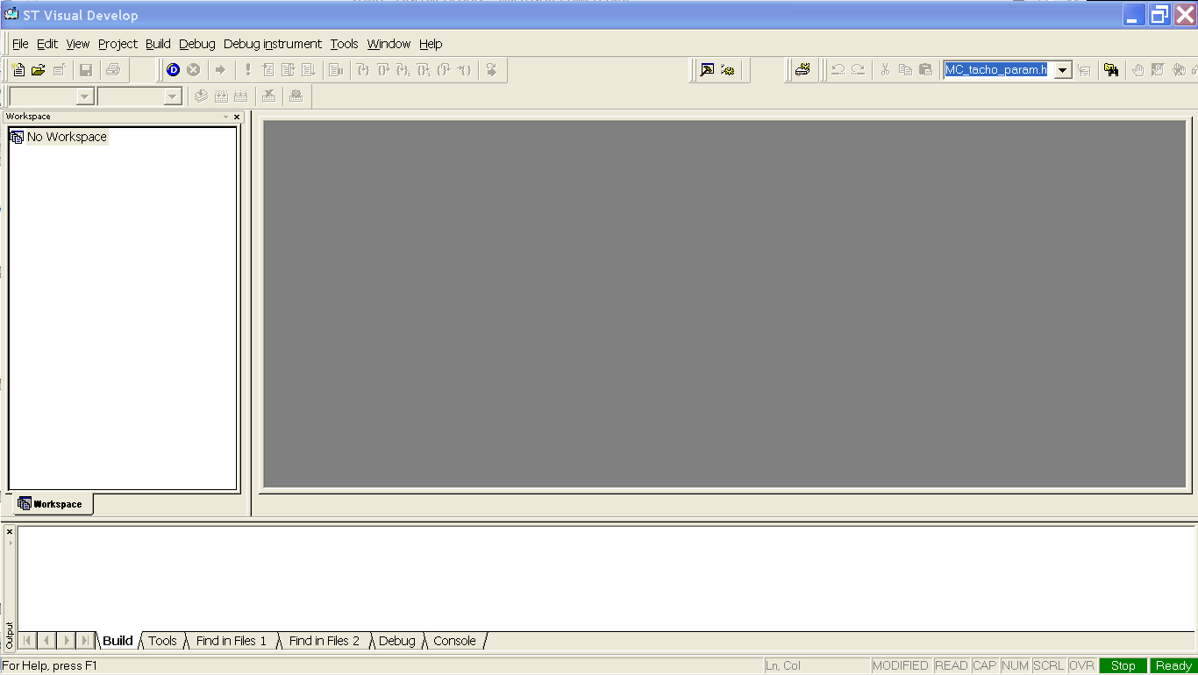
Open the STVD

Slide 23
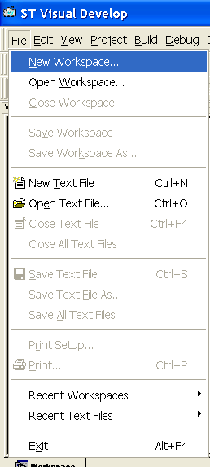
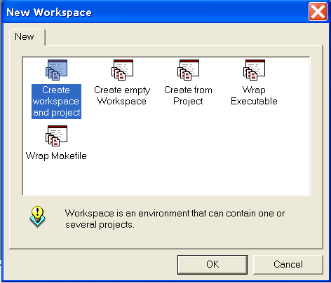
Choose to create a New Workspace
And then, to create workspace and project

Slide 24
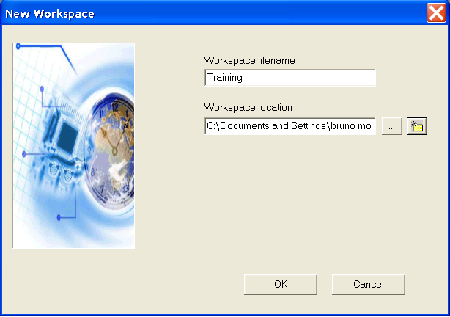
Name the workspace and set it’s location

Slide 25
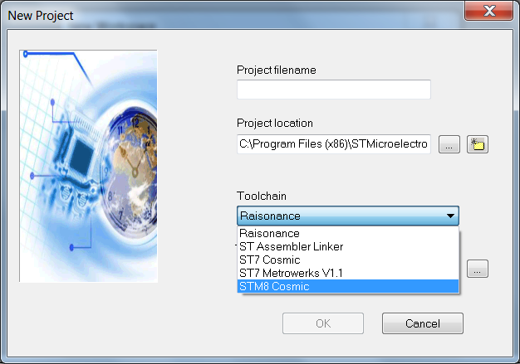
Select the proper Toolchain

Slide 26
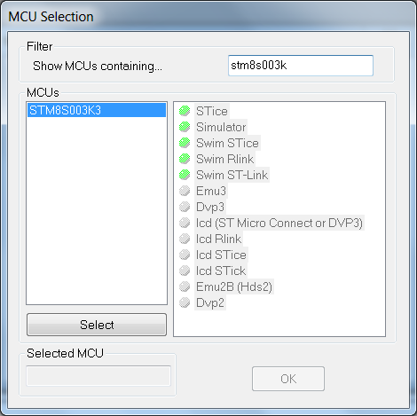
Select the STM8S003K3

Slide 27
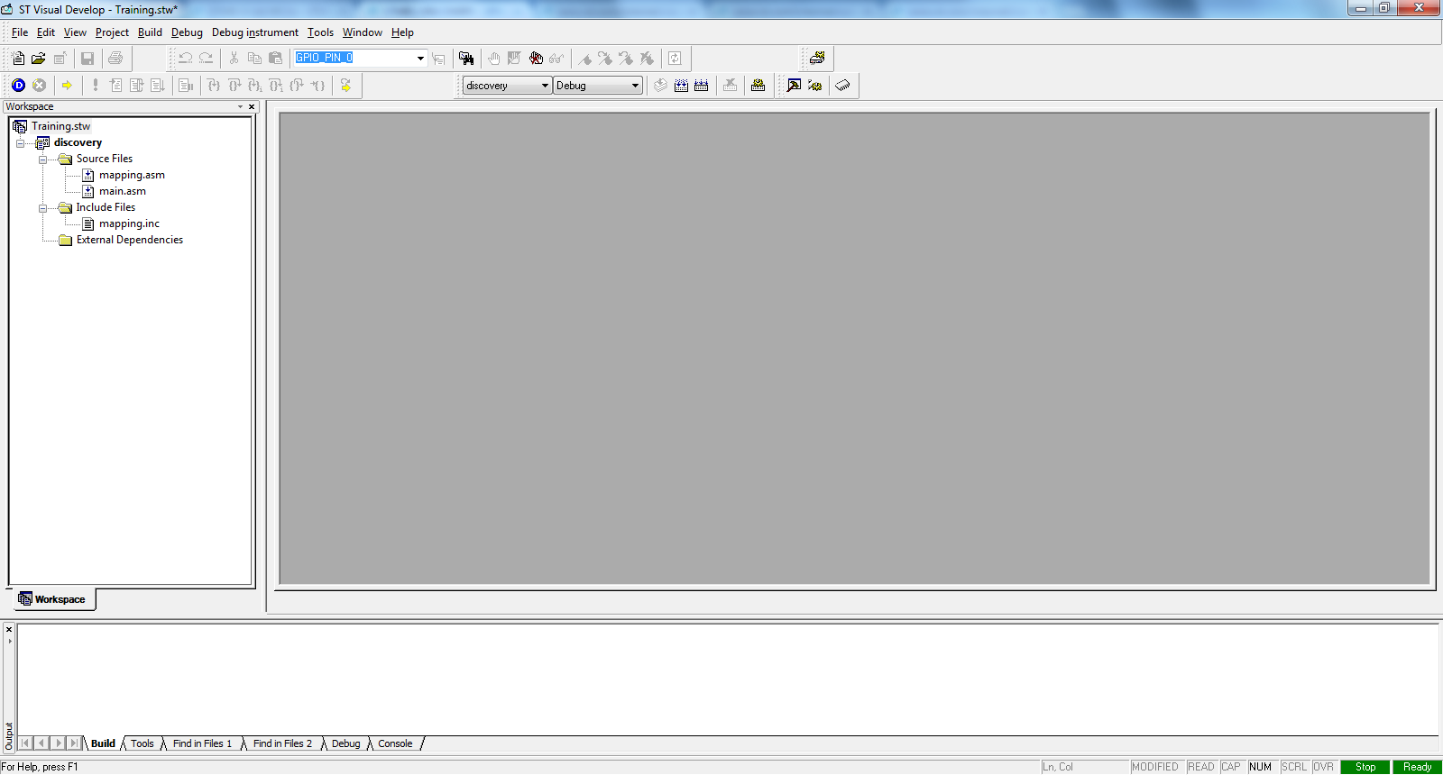
Your workspace should look like this

Slide 28
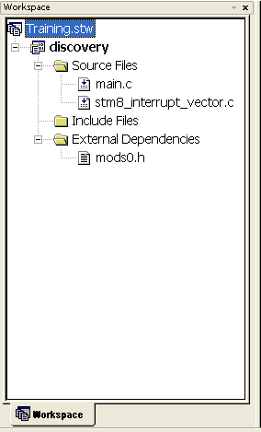
Giving a closer look

Slide 29
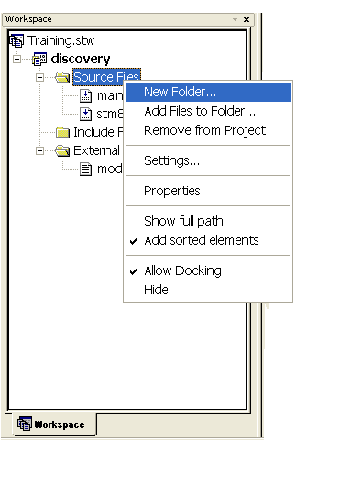
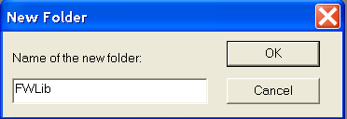
Now, let’s add the library

Slide 30
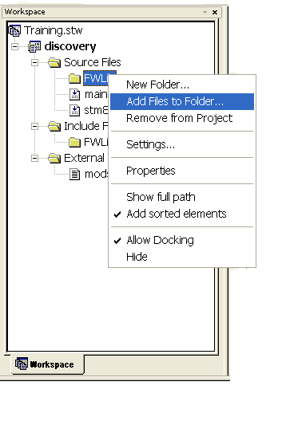
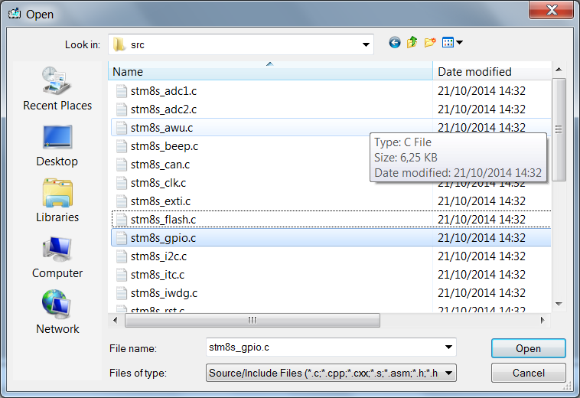
Now, let’s add the library

Slide 31
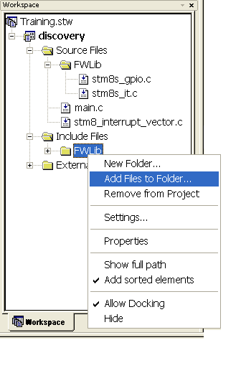
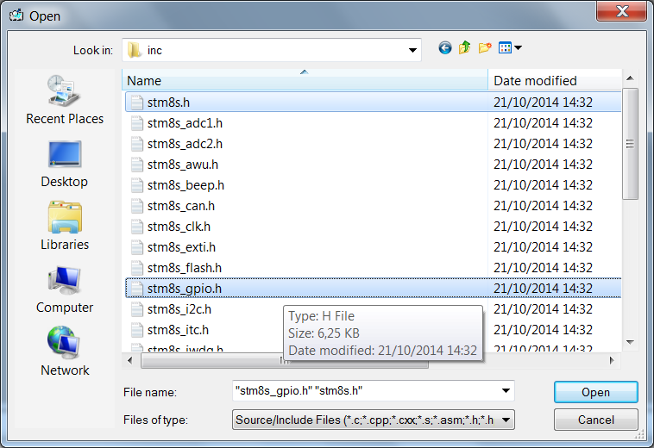
Now, let’s add the library

Slide 32
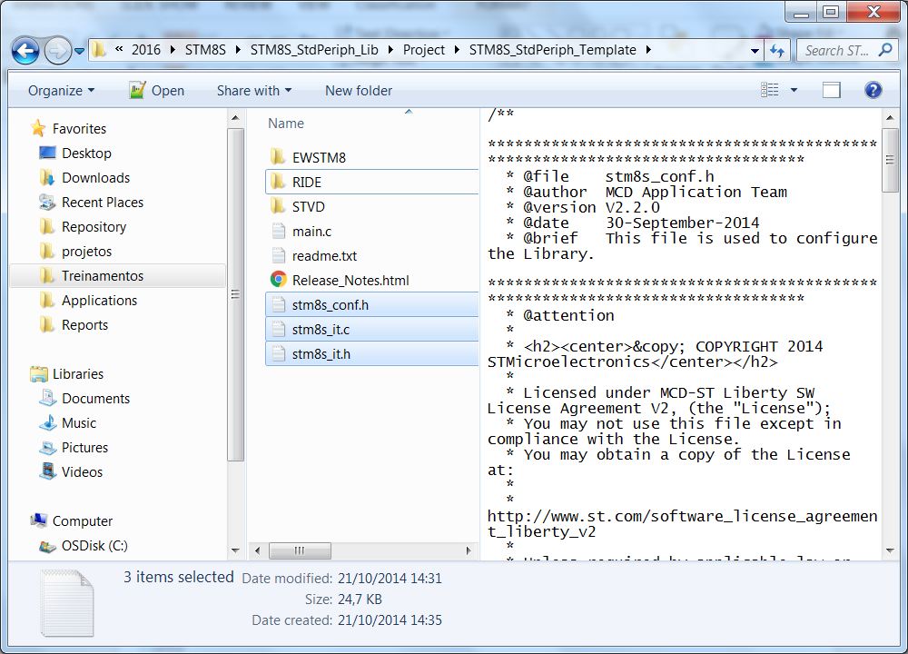
Now, let’s add the library
Once the basic files are imported, we need to add the files responsibles to manage the interrupt vector
Copy the 3 highlighted files to our project folder, these files are available under the unzip library folder: STM8S_StdPeriph_Lib\Project\STM8S_StdPeriph_Template

Slide 33
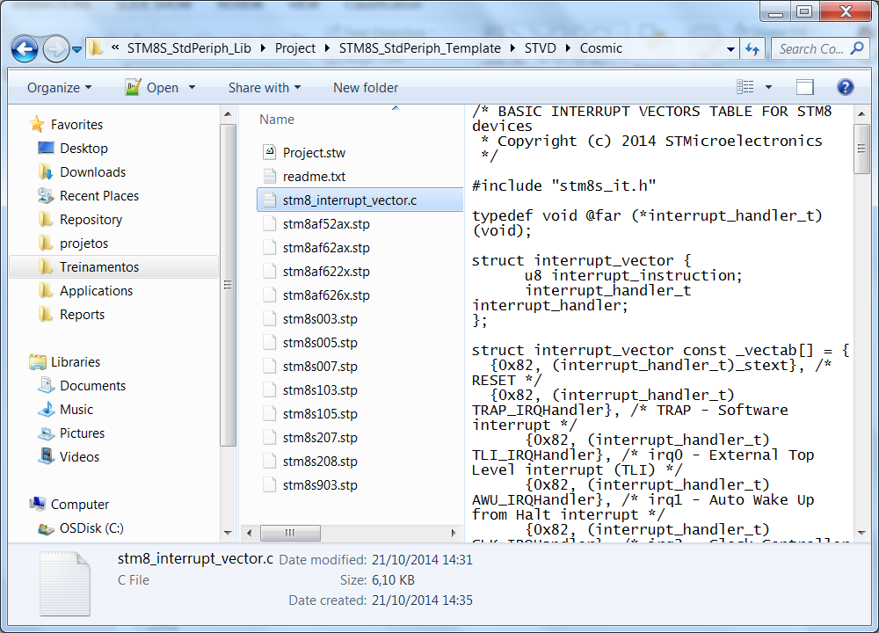
Now, let’s add the library
Since the interrupt vector file that is automatically generated is not asserted with the library’s names, we need to replace the file
Copy the highlighted file to our project folder, this file is available under the unzip library folder: STM8S_StdPeriph_Lib\Project\STM8S_StdPeriph_Template\STVD\Cosmic

Slide 34
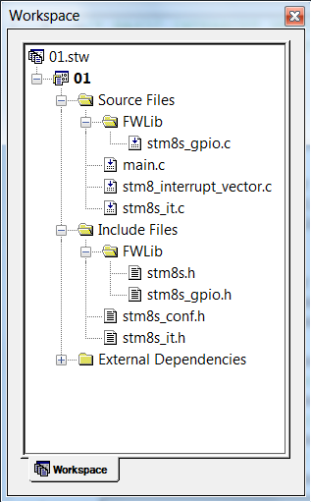
Now, let’s add the library
With all the preparations done, we just need to add the following files within our project:
stm8s_it.c
stm8s_it.h
stm8s_conf.h
The final result should be like this:

Slide 35
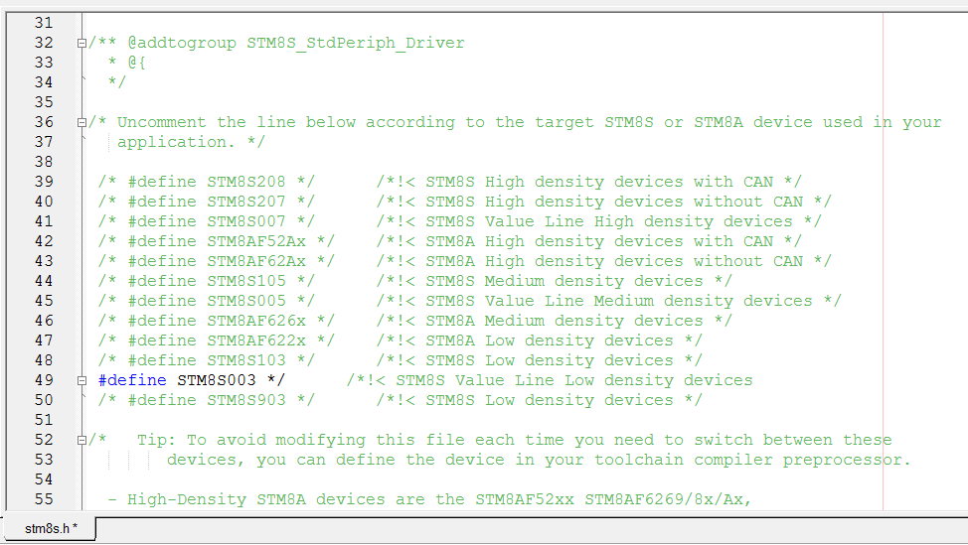
Configuring the library – stm8s.h

Slide 36
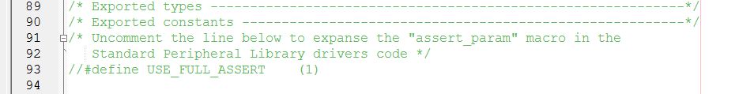
Configuring the library – stm8s_conf.h
The Standard Peripherals Library implements run-time failure detection by checking the input values of all library functions. The run-time checking is achieved by using an assert_param macro. This macro is used in all library functions which have at least an input parameter. It allows the user to check that the input value lies within the defined parameter values
For the purpouse of this training, we won’t use this feature, so it’s mandatory to comment the assert define:

Slide 37
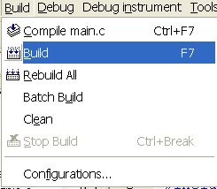
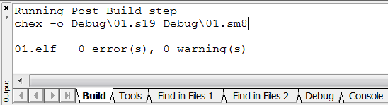
Compile the project (F7 as short key)
Once all is done, just compile and get the so desired 0 erros and 0 warnings

Slide 38
STM8S Training
Tec. Char.

Slide 39
Programming interface - General Info
SWIM (Single Wire Interface Module):
Direct access to all memory content and RAM
The overall information is transmitted at a 145bytes/ms rate
We do have a simple Stand Alone programmer based on the STM8S discovery kit

Slide 40
Interrupt – General Info
3 software priorities
32 interrupt vectors already with hardware priorities
Trap and reset interrupts
27 external interrupts, distributed in 6 different vectors

Slide 41
Flash and EEPROM for the 003
This micro has 8Kb of flash
128B de EEPROM
It doesn’t have the feature Read while Write. Any micro with 16KB or more has this this feature

Slide 42
Clock
Startup clock: After the reset, the system clock is automatically set to the minimum: 2MHz (HSI/8)
CSS: this feature can be enabled to verify any issues under the HSE and automatically change back to HSI, avoiding any unexpected stop

Slide 43
STM8S Training
Hands-On

Slide 44
Hands On
GPIO
ADC
TIM4
UART

Slide 45
Hands On
GPIO
ADC
TIM4
UART

Slide 46
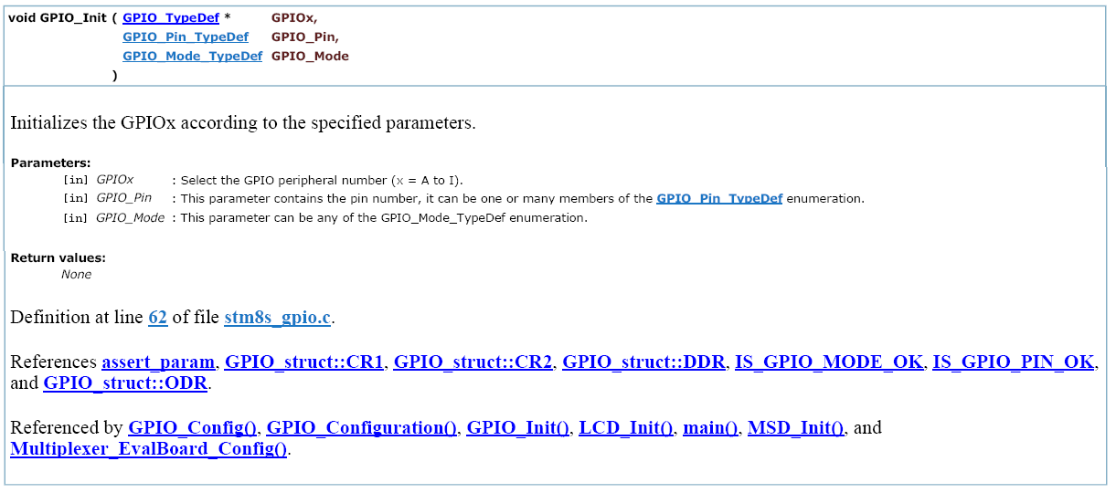
Library

Slide 47
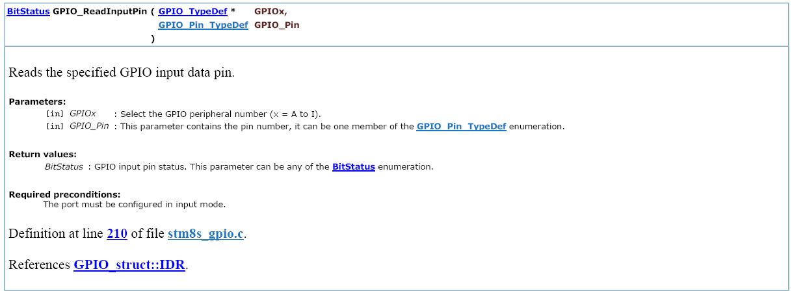
Library

Slide 48
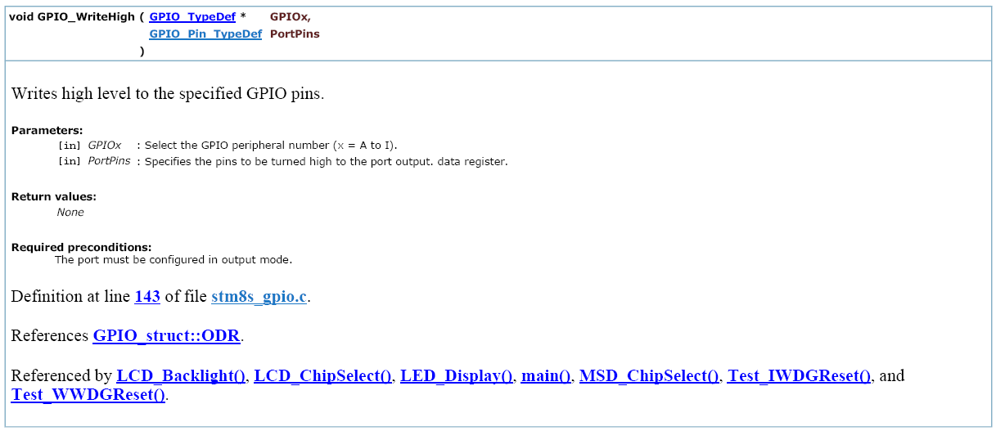
Library

Slide 49
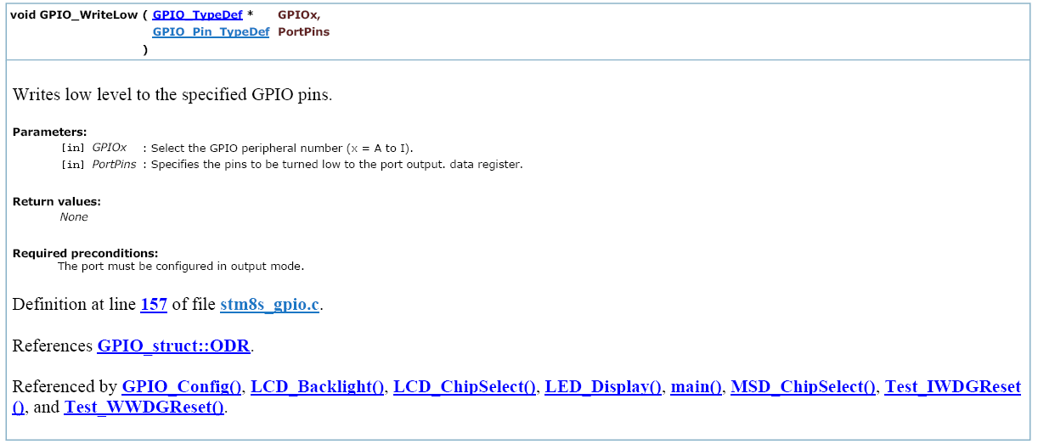
Library

Slide 50
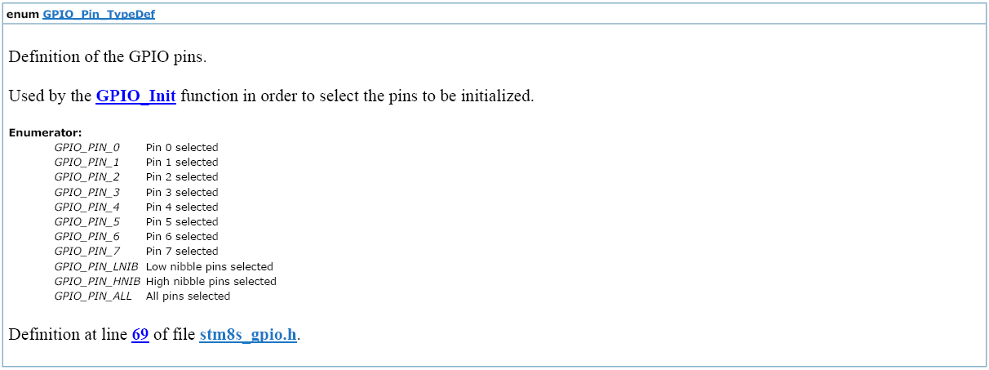
Library

Slide 51
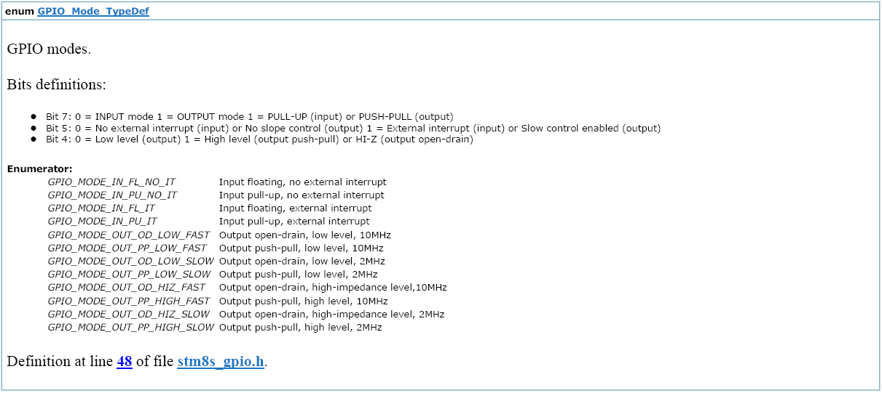
Library

Slide 52
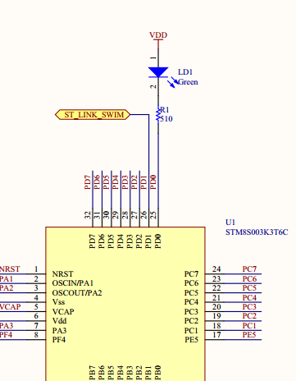
GPIO
Turn on and off a simple LED
#include "stm8s.h"
void Delay(u16 nCount)
{
/* Decrement nCount value */
while (nCount != 0)
{
nCount--;
}
}
main()
{
GPIO_Init(GPIOD,GPIO_PIN_0,GPIO_MODE_OUT_PP_HIGH_SLOW);
while (1)
{
GPIO_WriteLow(GPIOD,GPIO_PIN_0);
Delay(9000);
GPIO_WriteHigh(GPIOD,GPIO_PIN_0);
Delay(9000);
}
}

Slide 53
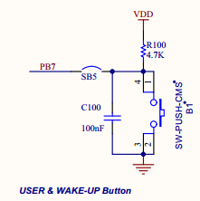
GPIO
Blink a simple LED, depending on the key status
#include "stm8s.h"
void Delay(u16 nCount)
{
/* Decrement nCount value */
while (nCount != 0)
{
nCount--;
}
}
main()
{
GPIO_Init(GPIOD,GPIO_PIN_0,GPIO_MODE_OUT_PP_HIGH_SLOW);
GPIO_Init(GPIOB,GPIO_PIN_7,GPIO_MODE_IN_PU_NO_IT);
while (1)
{
if(GPIO_ReadInputPin(GPIOB,GPIO_PIN_7) == RESET)
{
GPIO_WriteLow(GPIOD,GPIO_PIN_0);
}
else
{
GPIO_WriteHigh(GPIOD,GPIO_PIN_0);
}
Delay(9000);
}
}

Slide 54
GPIO
Blink a simple LED, depending on the key status, using external interrupt
To accomplish this task, we’ll need to add the stm8s_exti.c/h in the project
main.c
stm8s_it.c
#include "stm8s.h"
main()
{
GPIO_Init(GPIOD,GPIO_PIN_0,GPIO_MODE_OUT_PP_HIGH_SLOW);
GPIO_Init(GPIOB,GPIO_PIN_7,GPIO_MODE_IN_PU_IT);
EXTI_SetExtIntSensitivity(EXTI_PORT_GPIOB,EXTI_SENSITIVITY_FALL_ONLY);
enableInterrupts();
while (1)
{
}
}
INTERRUPT_HANDLER(EXTI_PORTB_IRQHandler, 4)
{
/* In order to detect unexpected events during development,
it is recommended to set a breakpoint on the following instruction.
*/
GPIO_WriteReverse(GPIOD,GPIO_PIN_0);
}

Slide 55
Hands On
GPIO
ADC
TIM4
UART

Slide 56
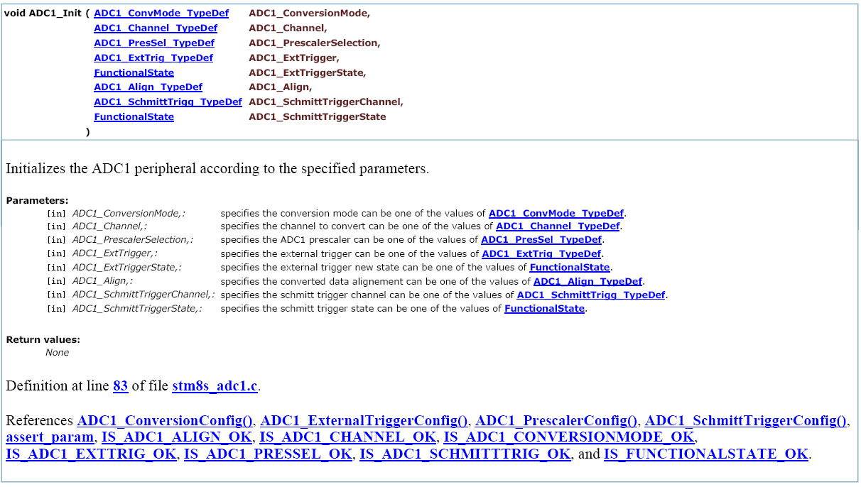
Library

Slide 57
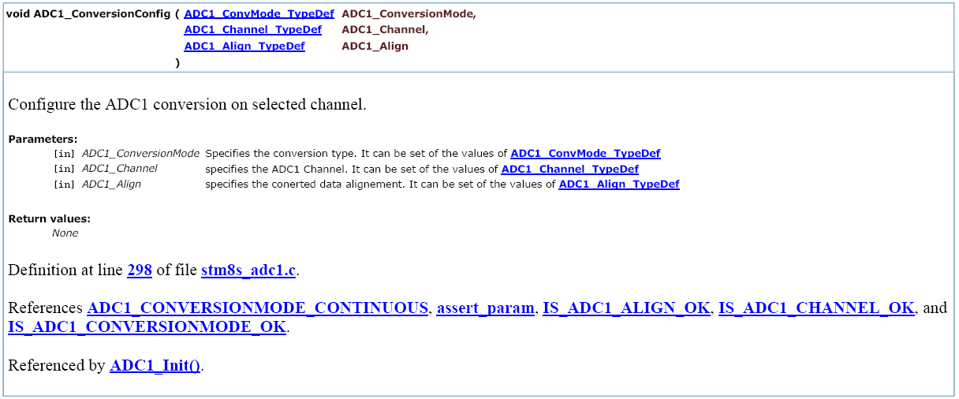
Library

Slide 58
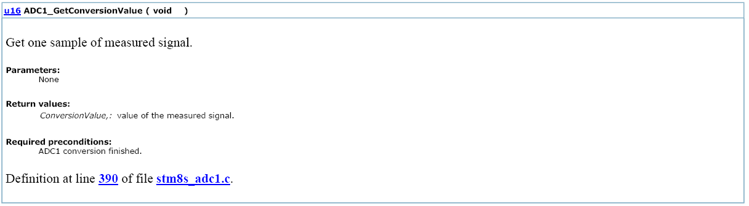
Library

Slide 59
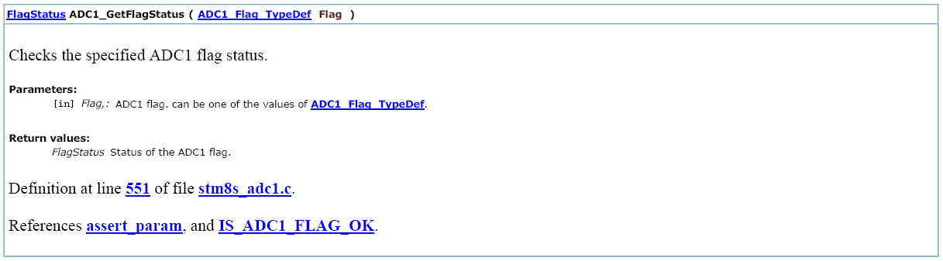
Library

Slide 60
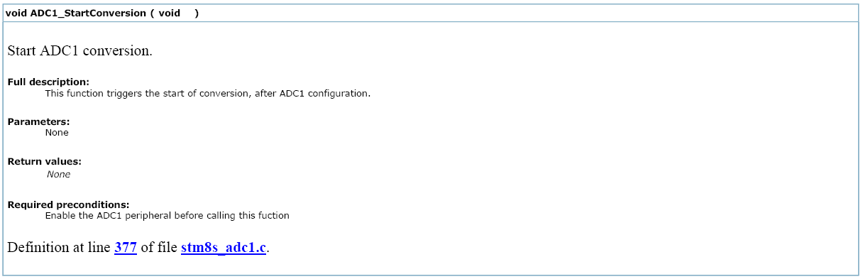
Library

Slide 61
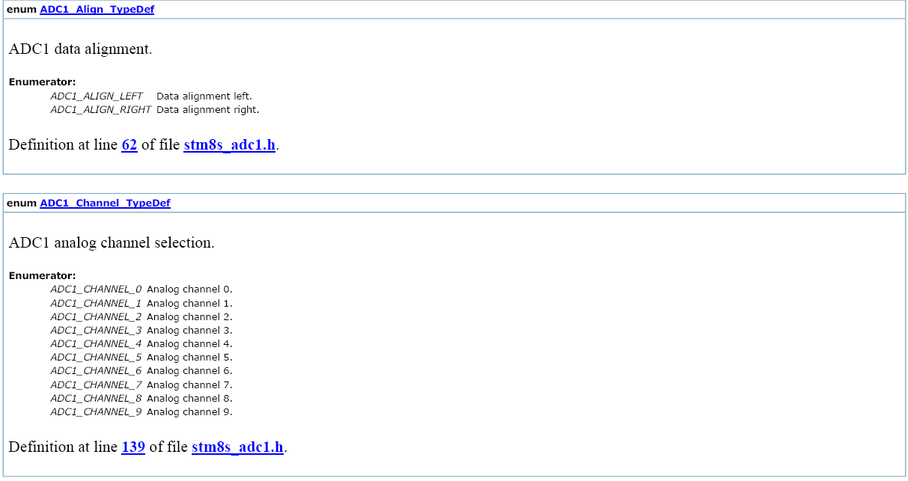
Library

Slide 62
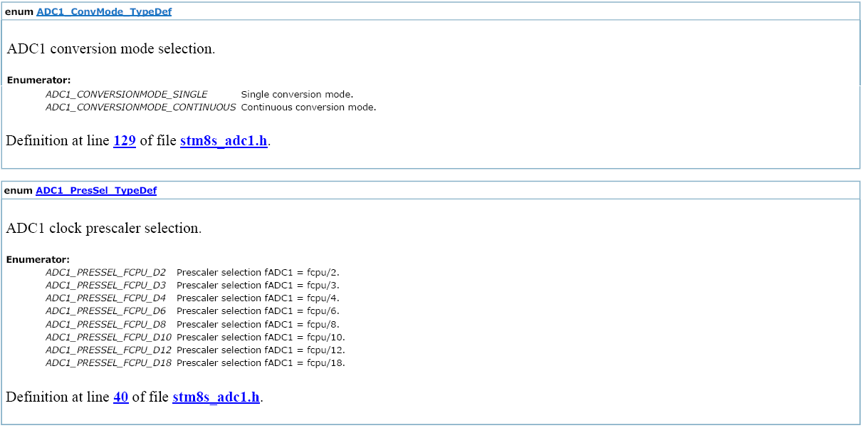
Library

Slide 63
ADC
Let’s monitor the ADC value!
To accomplish this task, we’ll need to add the stm8s_adc1.c/h in the project
main.c
To monitor de ADC_Value variable, select it under debug and use the quick watch feature, once enable, right-click in the green area and change it to Read/Write On Fly, the screen selection will turn yellow
#include "stm8s.h"
u16 ADC_Value;
main()
{
GPIO_Init(GPIOB,GPIO_PIN_0,GPIO_MODE_IN_FL_NO_IT );
ADC1_Init(ADC1_CONVERSIONMODE_CONTINUOUS,ADC1_CHANNEL_0,ADC1_PRESSEL_FCPU_D2,
ADC1_EXTTRIG_TIM,DISABLE,ADC1_ALIGN_RIGHT,ADC1_SCHMITTTRIG_CHANNEL0,DISABLE);
ADC1_Cmd(ENABLE);
ADC1_StartConversion();
while (1)
{
if(ADC1_GetFlagStatus(ADC1_FLAG_EOC))
{
ADC_Value = ADC1_GetConversionValue();
}
}
}

Slide 64
Hands On
GPIO
ADC
TIM4
UART

Slide 65
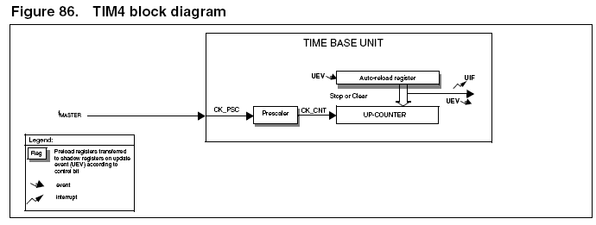
Diagrama em bloco

Slide 66

Library

Slide 67

Library

Slide 68

Library

Slide 69

Library

Slide 70

Library

Slide 71

Library

Slide 72
TIM4
Let’s configure the TIM4 to have a 1KHz frequency and blink our LED every second, using interrupt!
To accomplish this task, we’ll need to add the stm8s_tim4.c/h in the project
main.c
stm8s_it.c
#include "stm8s.h"
main()
{
GPIO_Init(GPIOD,GPIO_PIN_0,GPIO_MODE_OUT_PP_HIGH_SLOW);
TIM4_TimeBaseInit(TIM4_PRESCALER_16,124);
TIM4_ITConfig(TIM4_IT_UPDATE,ENABLE );
TIM4_Cmd(ENABLE);
enableInterrupts();
while (1) {
}
}
INTERRUPT_HANDLER(TIM4_UPD_OVF_IRQHandler, 23){
static u16 Counter = 0;
TIM4_ClearITPendingBit(TIM4_IT_UPDATE);
if(Counter >= 999){
GPIO_WriteReverse(GPIOD,GPIO_PIN_0);
Counter = 0;
}
else{
Counter++;
}
}

Slide 73
Hands On
GPIO
ADC
TIM4
UART

Slide 74

Library

Slide 75

Library

Slide 76

Library

Slide 77
UART
Let’s Configure UART to enter in loopback mode and receive what we send! Receive using interrupt

Slide 78
UART
#include "stm8s.h"
main()
{
GPIO_Init(GPIOD,GPIO_PIN_0,GPIO_MODE_OUT_PP_HIGH_SLOW);
GPIO_Init(GPIOD,GPIO_PIN_5,GPIO_MODE_OUT_PP_LOW_FAST);
GPIO_Init(GPIOD,GPIO_PIN_6,GPIO_MODE_IN_PU_NO_IT);
UART1_Init(9600, UART1_WORDLENGTH_8D,
UART1_STOPBITS_1, UART1_PARITY_NO,
UART1_SYNCMODE_CLOCK_DISABLE, UART1_MODE_TXRX_ENABLE);
UART1_ITConfig(UART1_IT_RXNE_OR,ENABLE);
UART1_Cmd(ENABLE);
enableInterrupts();
UART1_SendData8('a');
while(UART1_GetFlagStatus(UART1_IT_TC) == RESET);
Delay(1000);
UART1_SendData8('b');
while(UART1_GetFlagStatus(UART1_IT_TC) == RESET);
Delay(1000);
UART1_SendData8('c');
while(UART1_GetFlagStatus(UART1_IT_TC) == RESET);
Delay(1000);
while (1) {
}
}

Slide 79
UART
INTERRUPT_HANDLER(UART1_RX_IRQHandler, 18)
{
static char i = 0;
recebe[i] = UART1_ReceiveData8();
UART1_ClearITPendingBit(UART1_IT_RXNE);
i++;
}

Slide 80

Thank You

