Slide 1
Environmental layout

Slide 2
Strategy
ADVANCE : move forward while avoiding obstacles, prioritize displacement toward the center of the map along y-axis
CORNER : avoid obstacles when near the border of the map, force displacement towards the y-axis center
GOAL : search for the landing pad in the landing zone
GOALMISSED : Dijkstra’s route to explore the last part of the landing zone if the landing pad was not found during the GOAL state
RETURN : Dijkstra’s route to return to the take-off pad in the starting zone
FINDSTART : when around the take-off pad, search for it
LANDING : locate the border of the take-off / landing pad and land on its center

Slide 3
Result

Slide 4
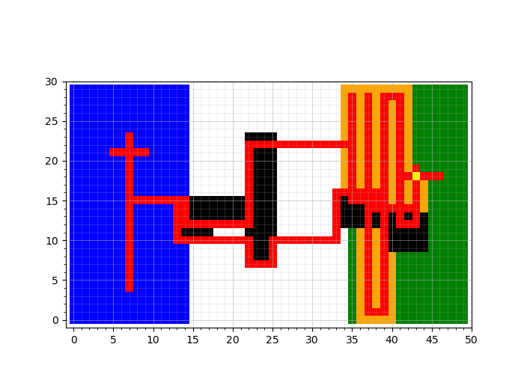
Mapping
Blue : starting zone
Green : landing zone
Red : path of the drone
Black : obstacles
Yellow : landing pad
Orange : searched area

