Slide 1
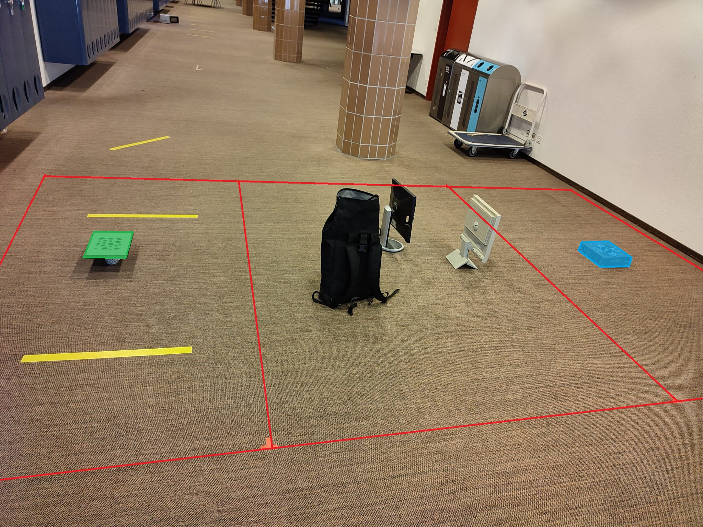
Environmental layout

Slide 2
Strategy
ADVANCE : move forward while avoiding obstacles, prioritize displacement toward the center of the map along y-axis
CORNER : avoid obstacles when near the border of the map, force displacement towards the y-axis center
GOAL : search for the landing pad in the landing zone
GOALMISSED : Dijkstra’s route to explore the last part of the landing zone if the landing pad was not found during the GOAL state
RETURN : Dijkstra’s route to return to the take-off pad in the starting zone
FINDSTART : when around the take-off pad, search for it
LANDING : locate the border of the take-off / landing pad and land on its center

Slide 3
Result
The multi-ranger doesn’t always detect the obstacles when they are the side on the drone
Our algorithm to land shows some problems when detecting the border of the landing pad
A lot of experiments were ruined by unexpected behavior from the drone
The project switches from simple, not too computationally heavy algorithm (advance, goal, …) to more complex one if necessary (goalmissed, return, …)

Slide 4
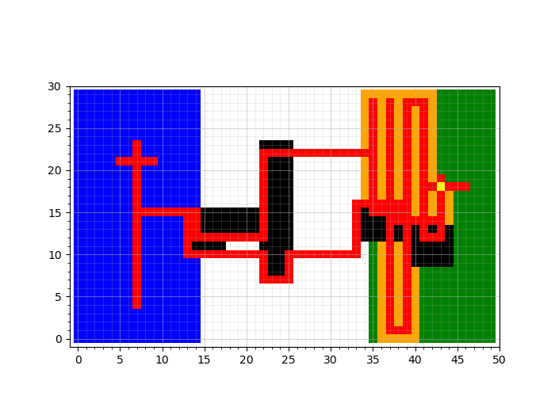
Mapping
Blue : starting zone
Green : landing zone
Red : path of the drone
Black : obstacles
Yellow : landing pad
Orange : searched area

