Slide 1
composite
Design patterns
Guilherme Amaral 113207
Danilo Silva 113384
Tomás Santos 112981

Slide 2
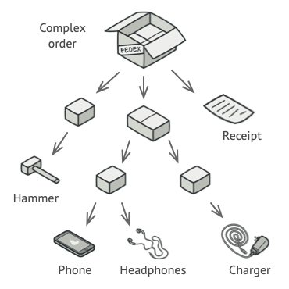

PROBLEMA REAL 1

Slide 3
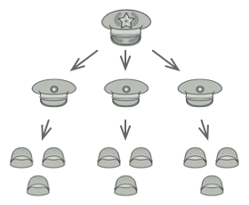

PROBLEMA REAL 11

Slide 4
ALGUM PADRÃO CONHECIDO?

Slide 5
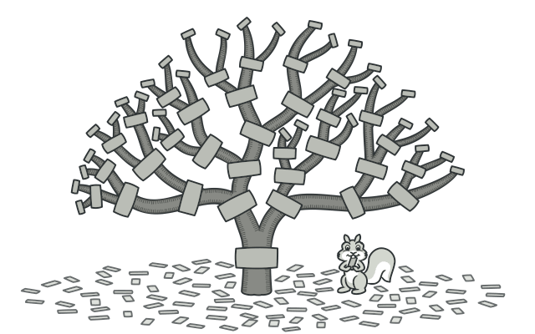
ÁRVORE
Composite is a structural design pattern that lets you compose objects into tree structures and then work with these structures as if they were individual objects.

Slide 6
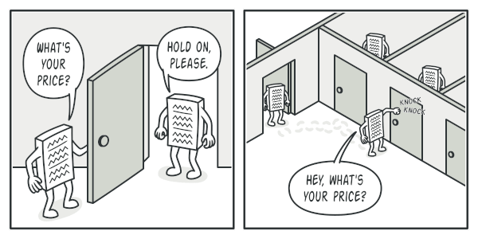
SOLUÇÃO
RECURSIVIDADE

Slide 7
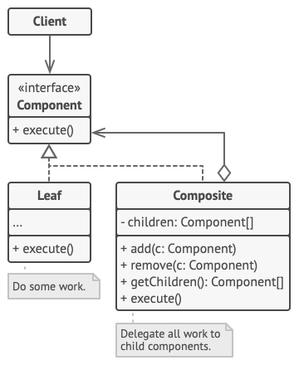
ESTRUTURA

Slide 8
VANTAGENS DESVANTAGENS
You can work with complex tree structures more conveniently: use polymorphism and recursion to your advantage.
It might be difficult to provide a common interface for classes whose functionality differs too much. In certain scenarios, you’d need to overgeneralize the component interface, making it harder to comprehend.
Open/Closed Principle. You can introduce new element types into the app without breaking the existing code, which now works with the object tree.

Slide 9
EXEMPLO PRÁTICO

