Slide 1
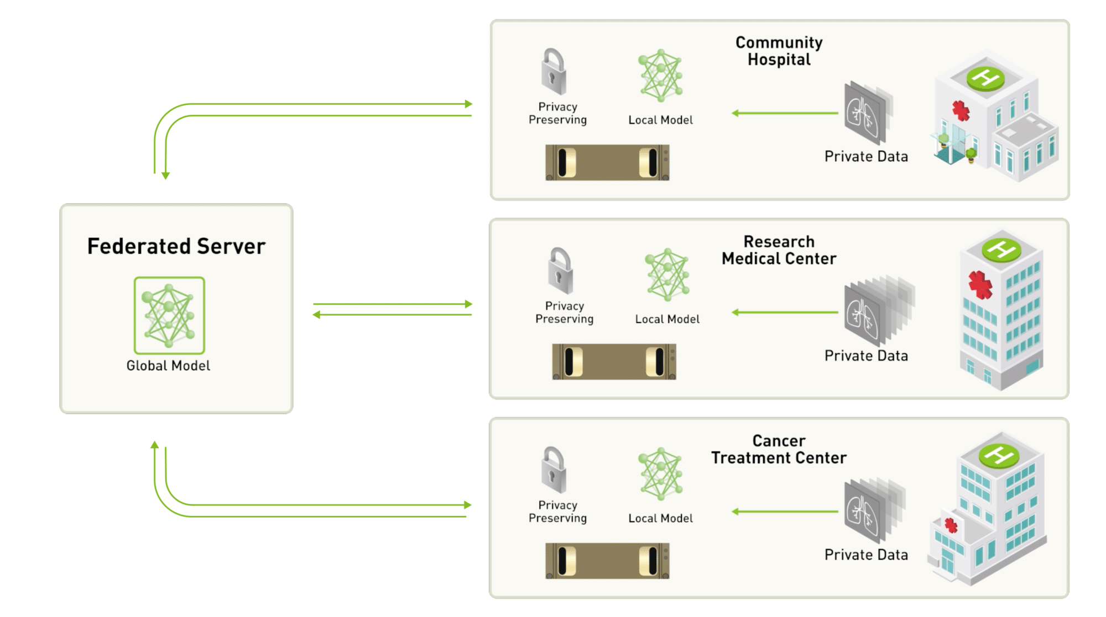
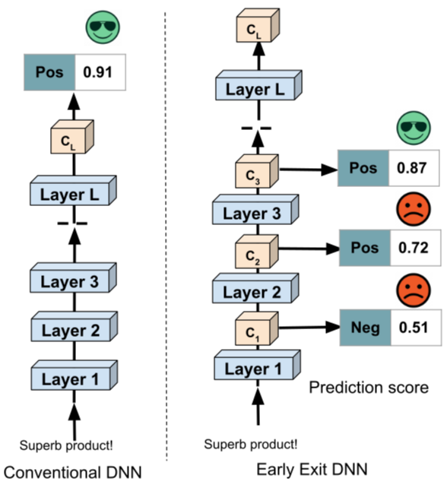
Basis Concepts
Federated Learning
Dynamic Neural Networks (Early-Exits) (Split Learning)
Work Novelty
Incorporation of these concepts in a real-world testbed considering the impact of EE DNNs in the FL workflow
Target and Potential Applications
RLC – Protocol Error Detection
RRC - Predict Network Conditions
RRC – Resource Allocation Optimization
MAC – Shared Network Access Management
Available Tools/Platforms in IT
srsRAN
Different Edge Devices
Images Source: https://blogs.nvidia.com/blog/what-is-federated-learning/
https://www.themoonlight.io/en/review/a-survey-of-early-exit-deep-neural-networks-in-nlp
Notes:
Potential Target Network Applications
RLC – Protocol Error Detection
RRC - Predict Network Conditions
RRC – Resource Allocation Optimization
MAC – Shared Network Access Management

