Slide 1
Cellular Engineering: computational modeling of biophysical processes
Brian Castle
Department of Biomedical Engineering
University of Minnesota
Email: cast0189@umn.edu

Slide 2
Goals for Module 6:
Introduce some of the basic physical and chemical processes that underlie cellular behaviors
Give examples of how to approach modeling these intracellular processes
Demonstrate how predictive models can be integrated with experiments to gain new insights
Inspire you to further explore these concepts and computational modeling of cellular processes!

Slide 3
We have entered the post-genomic era, giving us the molecular parts list. We now need to build predictive models for cell behavior, so that we can design more effective therapies.

Slide 4
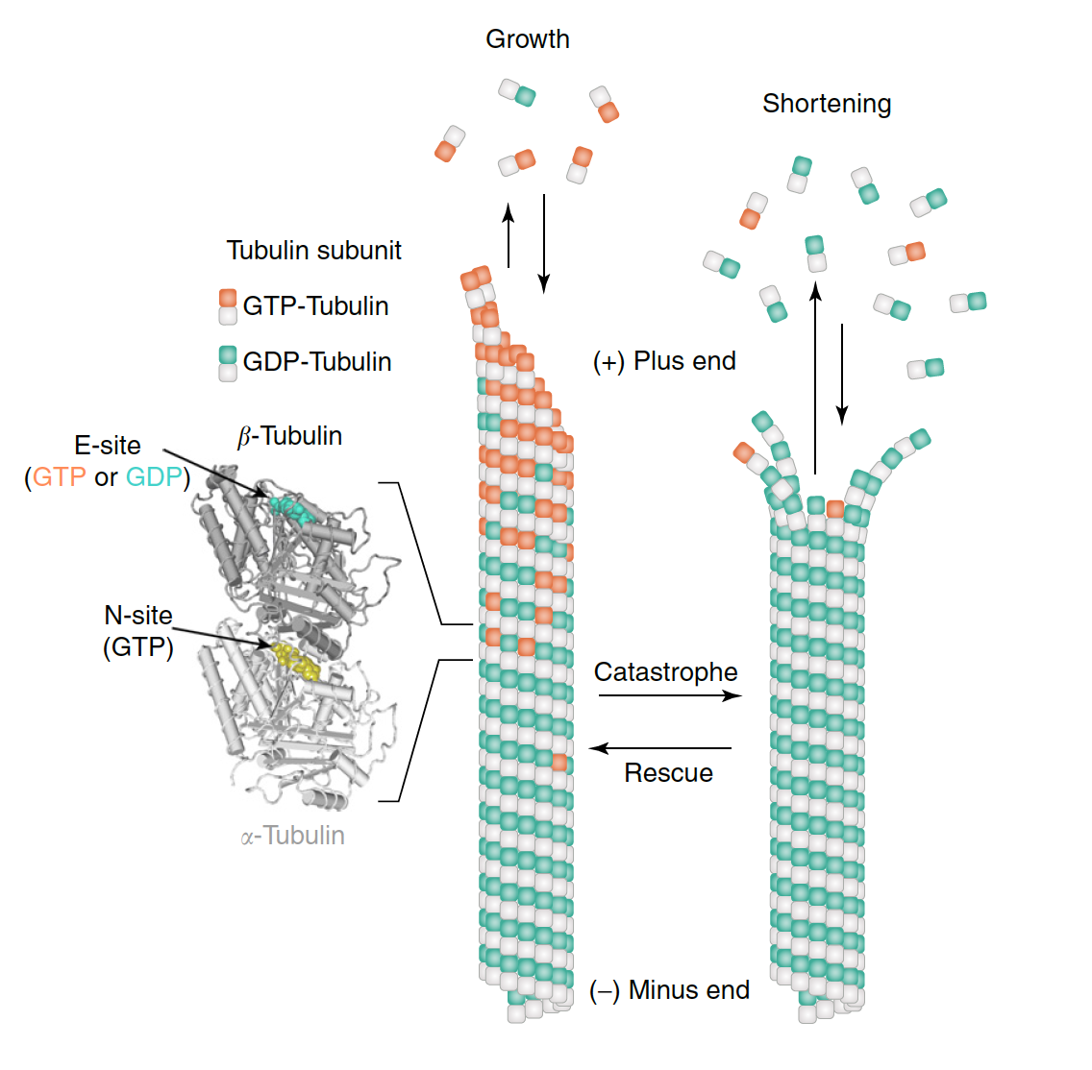
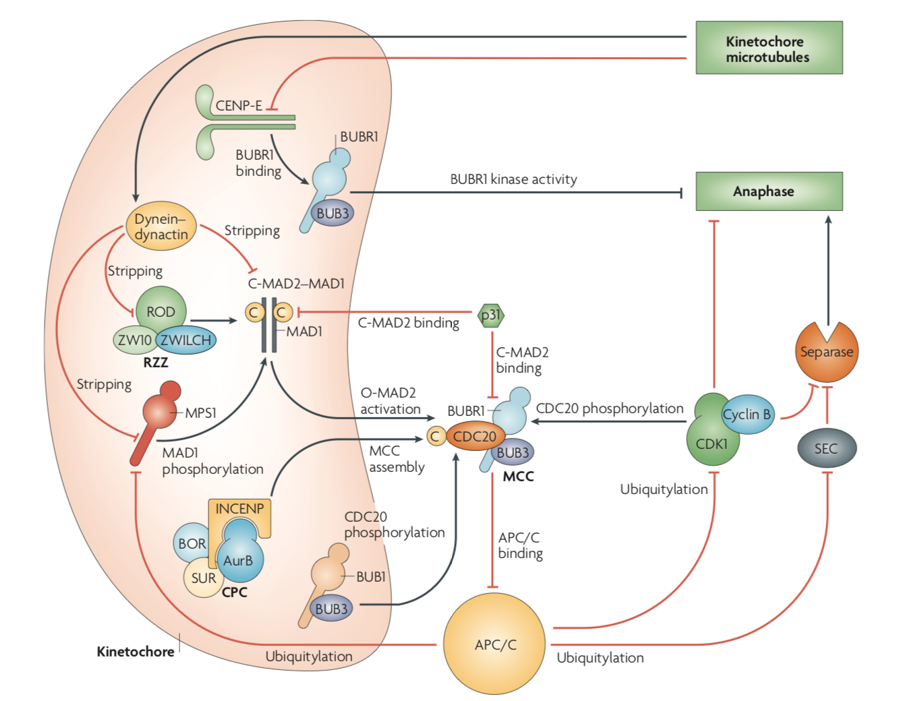
What can we model?
Biopolymer assembly dynamics
Spindle assembly checkpoint (SAC) signaling pathway
Where there’s an arrow, there’s a way…
Musacchio and Salmon, Nat. Rev. Mol. Cell Biol., 2007
Castle and Odde, Ency. of Cell Biol., 2016

Slide 5
Models must be based in physical and chemical principles
Essential Cellular Processes
Stuff inside cells has to move around…
Thermal energy and diffusion
Things interact with each other and implement forces…
Mechanical forces and energy potentials
Interactions produce some signal…
Chemical reactions and kinetics

Slide 6
Let’s do a quick thought experiment…
Notes:
Have the students visualize what it’s like to be inside of a cell. Ask about the experience afterwards.
Build in complexity (chaos)
-Room with thousands of bouncy balls bouncing all over, hitting them from all sides
-Each subsequent collision causes them to move in the opposite direction
-Then add another person that they are trying to interact with
-Can only interact within arms length
-Then blindfold them

Slide 7
Diffusion
Proteins and cells are subject to thermal forces, which are the result of collisions with water and other molecules in the surrounding fluid. As a result they are said to have thermal energy
Thermal energy → in units of k_{B}T,
where k_{B} is Boltzmann’s constant and T is temperature
Forces due to these collisions are randomly directed, and the resulting motion is characterized by frequent changes in direction, called diffusion
here D is the diffusion coefficient and γ is the drag coefficient
fluid viscosity
For a sphere,
Radius of the sphere

Slide 8
Diffusion as a Random Walk
Diffusion is a form of random motion that is characterized by frequent, abrupt changes in direction
Diffusion in the absence of force can be approximated by a random walk
p = 0.5
p = 0.5
−2δ
−δ
0
+δ
+2δ
1D Random Walk

Slide 9
Diffusion as a Random Walk
p = 0.5
p = 0.5
p = 0.5
p = 0.5
p = 0.5
p = 0.5
x₂
x₁
−2δ
−δ
0
+δ
+2δ

Slide 10
Let’s simulate it…
Notes:
Simulate diffusion using coin flips

Slide 11
Diffusion as a Random Walk
How far is the molecule or protein expected to go in time?
Mean-squared displacement (MSD)
If we say
then the number of steps in time t is given by
and therefore
Diffusion coefficient
(from Fick’s Law)
then we have

Slide 12
Diffusion as a Random Walk
What if we expand in to multiple dimensions?
In 2-dimensions
+δ
In 3-dimensions
r
therefore we have that
−δ
+δ
−δ
dimensionality

Slide 13
Diffusion in an Energy Potential
A molecule always tends towards its lowest energy state (whether it is folding conformations or binding interactions)
The chemical forces that drive biological processes have energies on the order of thermal energy (k_{B}T), meaning diffusive (random) motions are quite large comparatively, causing molecules to not always be at the lowest energy state
Boltzmann’s law states that if a particle or system is in thermal equilibrium, then the probability of being in state i that has energy U_{i} is given by
where
and

Slide 14
Diffusion in an Energy Potential
Where would you expect to find more molecules?
Boltzmann’s Law
U₂
U₃
Energy (U)
U₁
p₁ > p₃ > p₂
Reaction coordinate (distance)

Slide 15
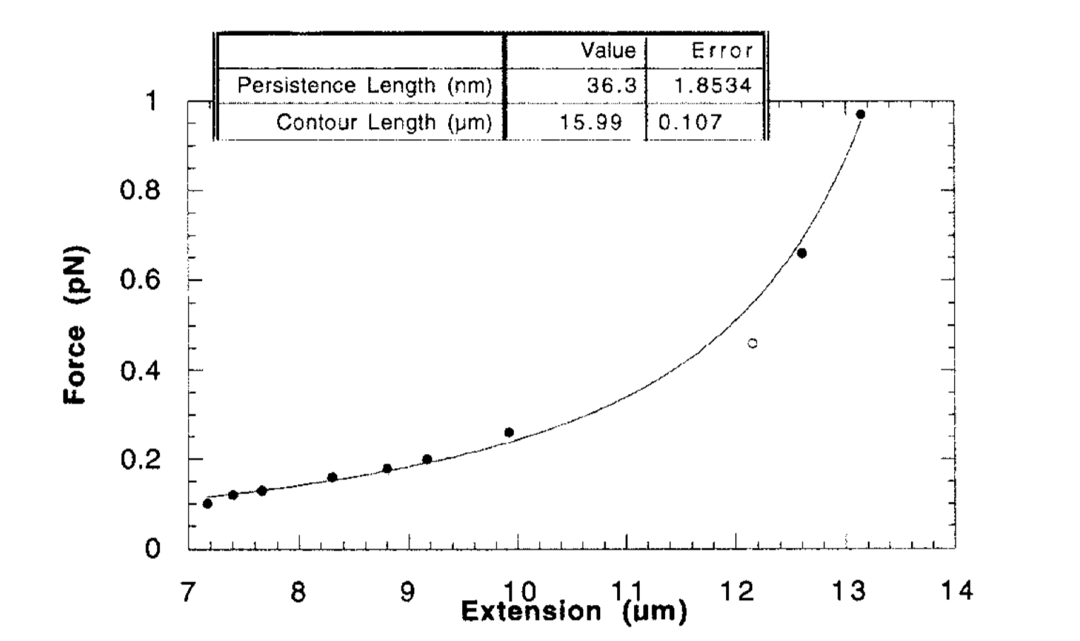
Macromolecules and Proteins as a Simple Spring
For small extensions, the force-extension relationship of macromolecules and proteins is reasonably approximated by a spring
Stretching DNA with magnetic tweezers
Simple Spring
Hooke’s Law
Linear relationship under low load
extension
Force
Spring constant
Haber and Wirtz, Rev. Sci. Instr., 2000

Slide 16
Macromolecules and Proteins as a Simple Spring
For small extensions, the force-extension relationship of macromolecules and proteins is reasonably approximated by a spring
Simple Spring
Hooke’s Law
Energy (U)
extension
Force
Spring constant
Extension (x)

Slide 17
Bimolecular Reactions
In addition to mechanical and thermal forces, proteins are also subject to chemical forces, which arise from the formation of intermolecular bonds
A very important chemical reaction in cell biology is the bimolecular reaction, in which two molecules come together to react or form a complex. A simple case is
Here A and B reversibly associate to form the complex AB.
Second-order, association rate constant or on-rate (units of M⁻¹s⁻¹)
First-order, dissociation rate constant or off-rate (units of s⁻¹)

Slide 18
Bimolecular Reactions
Dissociation constant
[B]_{tot}
Equilibrium constant
Let’s say
½
Bound ([AB]_{eq})
then
Langmuir isotherm
and
K_{D}
Free ([A]_{eq})

Slide 19
Reversible Reaction Kinetics
Often we want to know how the concentration of each component changes in time. For species A, it is lost in time due to the forward reaction (binding to B) and created by the reverse reaction (unbinding of AB)
[A] lost by the forward reaction
[A] created by the reverse reaction

Slide 20
Reversible Reaction Kinetics
Let’s say we add a small pulse of A at the beginning of the reaction, and want to know the timescale of A converting to AB through the forward reaction.
[A]₀
Binding time are exponentially distributed, meaning it can be described by a Poisson process!
[A](t)
We can solve to get
time, t

Slide 21
Enzyme Kinetics
Enzymes act as biological catalysts, increasing the rate of a chemical reaction by lowering the activation energy between states
An enzymatic reaction can be thought of as special case of the bimolecular reaction. Here we can think of A being the enzyme (E) and B the substrate (S), while AB is the intermediate that breaks down into the enzyme plus the product (P) such that
Substrate (S)
Product (P)
Enzyme (E)
or

Slide 22
Enzyme Kinetics
or more simply
where
This is known as the Michaelis-Menten equation. Here K_{M} is the Michaelis-Menten constant and k₂ is the maximum catalysis rate per enzyme

Slide 23
Models must be based in physical and chemical principles
Essential Cellular Processes
Stuff inside cells has to move around…
Thermal energy and diffusion
Things interact with each other and implement forces…
Mechanical forces and energy potentials
Interactions produce some signal…
Chemical reactions and kinetics

Slide 24
For Thursday…
Brief introduction to MATLAB and the MATLAB Live environment
Make sure you have access to MATLAB ahead of time! An instructional can be found on the Synapse page
Examples of how to approach simulating the processes discussed today
Introduction to the Module Activity

