Slide 1
Predictive modeling for cancer prognosis

Slide 2
Gene expression data
mRNA Samples
sample1 sample2 sample3 sample4 sample5 …
1 0.46 0.30 0.80 1.51 0.90 ...
2 -0.10 0.49 0.24 0.06 0.46 ...
3 0.15 0.74 0.04 0.10 0.20 ...
4 -0.45 -1.03 -0.79 -0.56 -0.32 ...
5 -0.06 1.06 1.35 1.09 -1.09 ...
Gene
gene-expression level or ratio for gene i in mRNA sample j
Notes:
3

Slide 3
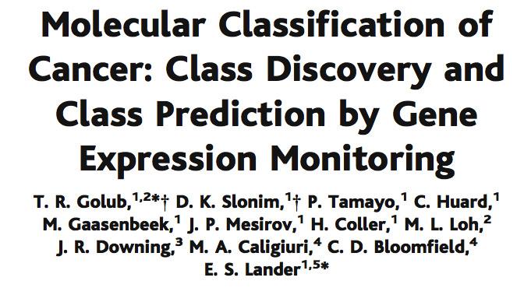
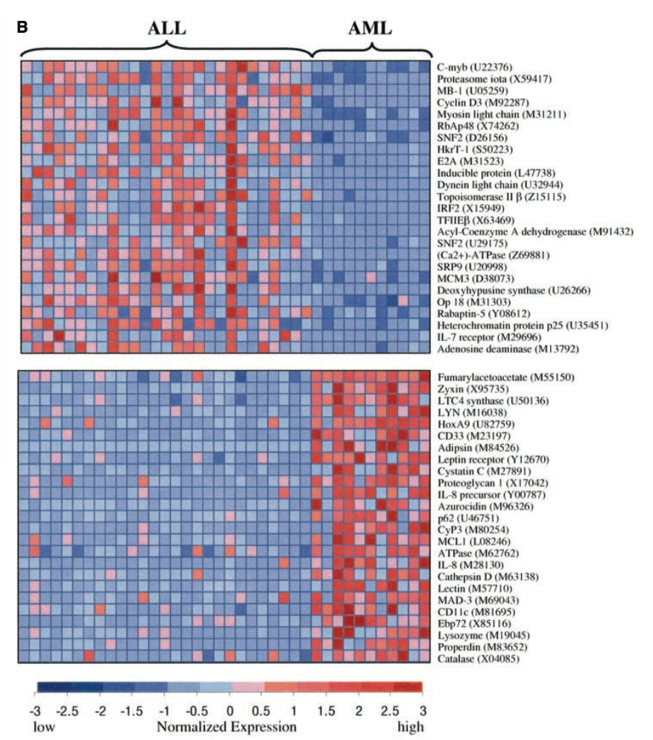
Golub, et al., Science 286:531-537 (1999).

Slide 4
Differential (supervised) expression analysis
Two (or more) classes of sample
Unpaired or paired
Perhaps defined from a clustering analysis
Continuous variable
Survival outcome (censored data)
What genes are significantly different between classes
Or correlated with a variable
Or associated with outcome

Slide 5
Basic Data Analysis
Differential expression analysis (what differs between 2 or more sample types)
Fold change (relative increase or decrease in intensity for each gene)
T-test type statistics
P-values, multiple hypothesis testing, false discovery rates
Clustering samples and/or genes by similar patterns across the dataset

Slide 6
What does difference mean?
The mean difference
is the same for all
three cases
medium
variability
high
variability
low
variability

Slide 7
The “p-value”
p-value = P(Type I Error) = P(Reject H0 | H0 is true)
This is also called the “statistical significance.”
It represents an acceptable probability of making a mistake (i.e. false positive)!
A p-value of 0.05 or less customarily treated as an “acceptable” error level (this is rather arbitrary)
Also important to consider type II error (false negative)
Don’t be a p-value slave or p-hacker!
https://med.stanford.edu/news/all-news/2016/03/misleading-p-values-showing-up-more-often-in-journals.html
http://www.nature.com/articles/nmeth.4120

Slide 8
H0 is the null hypothesis e.g. that there is no difference between two groups

Slide 9
Multiple hypothesis testing
Testing 1000’s of genes at once
Normal p-value not sufficient
Many results will be false positives
Modifications that account for this:
False discovery rate
Number of positive results that are likely to be wrong

Slide 10
Why Multiple Testing Matters
Genomics = Lots of Data = Lots of Hypothesis Tests
A typical gene expression expression might result in performing 20,000 separate hypothesis tests.
If we use a standard p-value cut-off of 0.05, we would expect 1000 genes to be deemed “significant” by chance.

Slide 11
Identifying Differential Expression
Compare treatment to the control
The fold approach
The t-test (unpaired or paired)
Variations of the t-test
SAM: significance analysis of microarrays
Compare several treatments
ANOVA: analysis of variance
MAANOVA: http://www.jax.org/staff/churchill/labsite/software/anova/index.html

Slide 12
Fold Change
Measure ratios of gene expression levels.
Ratio = T_{i}/C_{i}. Ratio of measured treatment intensity to control intensity for the i^{th} gene
The log₂ ratio treats up and down regulated genes equally
e.g. when looking for genes with more than 2 fold variation in expression

Slide 13
The Fold Approach
In northern blot analysis, a 2-fold change can be seen with bare eyes
Thus biologists tend to use 2-fold as the threshold of differential expression
If x1 and x2 are in log2 space:
Difference in mean(x₁, x₂) > 1
Difference in mean(x₁, x₂) < -1

Slide 14
Two-fold up-regulation
Problems with this approach:
Only identifies most changed genes.
Also identifies noise and highly variable genes.
Ratio is unstable when the denominator is small.
No estimate of significance of the results

Slide 15
Ratios are unstable
Initial measurements:
30/60 = 0.5
500/1000 = 0.5
Add random noise (+15 numerator and -15 denominator):
45/45 = 1.0
515/985 = 0.52

Slide 16
What does difference mean?
a statistical difference is a function of the difference between means relative to the variability
a small difference between means with large variability could be due to chance
like a signal-to-noise ratio
Which one shows
the greatest
difference?
low
variability

Slide 17
So we estimate
signal
difference between group means
=
noise
variability of groups
_
_
X_{T} - X_{C}
=
_
_
SE(X_{T} - X_{C})
=
t-value
low
variability

Slide 18
The Student’s t-test
We make use of the T-distribution distribution in the two-sample Students t-test.
This test is used to test whether two samples come from distributions with the same means.
The samples are assumed to come from Gaussian (normal) distributions.
The two samples must have similar dispersions

Slide 19
Student’s t-distribution
is mound shaped
is symmetrical about zero
is more widely dispersed than the standard normal distribution
it’s actual shape is dependent on the sample size
different t distributions are identified by their degrees of freedom (df), where df = n-1

Slide 20
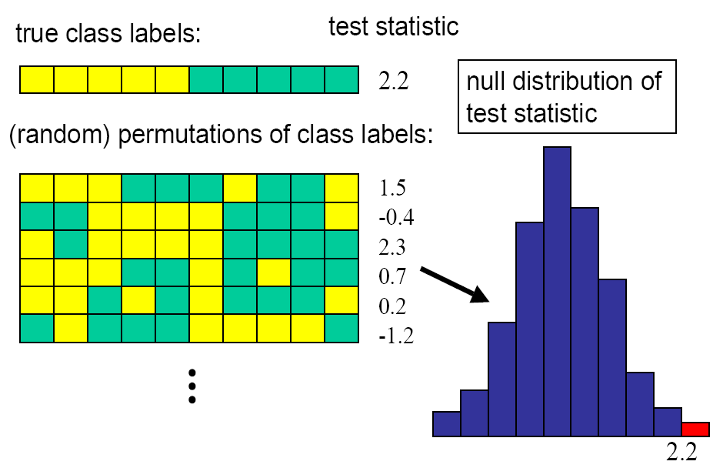
Permutation test

Slide 21
Significance analysis of microarrays
“Significance analysis of microarrays applied to the ionizing radiation response” Tusher, Tibshirani, Chu PNAS 2001
T-test combined with permutation testing to generate false discovery rate
Convenient Excel and R packages:
https://statweb.stanford.edu/~tibs/software.html
(or through Bioconductor)

Slide 22
Significance analysis of microarrays applied to the ionizing radiation response
Lymphoblastoid cell lines grown with (n=4) or without irradiation
Small sample size! Generally need more
6800 genes
Old technology
Test statistic for each gene

Slide 23
SAM procedure
Rank genes by d(i)
Do the same after permuting sample labels -> dE(i)
In this case there are only 36 balanced permutations
Generally want thousands (need more than you think)
Identify genes for which d(i) is greater than expected by some amount Δ
At a specified threshold Δ, the false discovery rate is # of genes in the permutations that appear significant
Choose Δ according to the FDR you want
Omitting s0 -> higher FDRs…

Slide 24
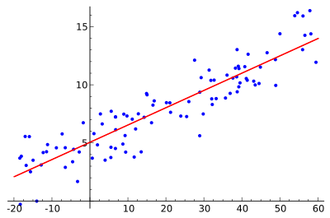
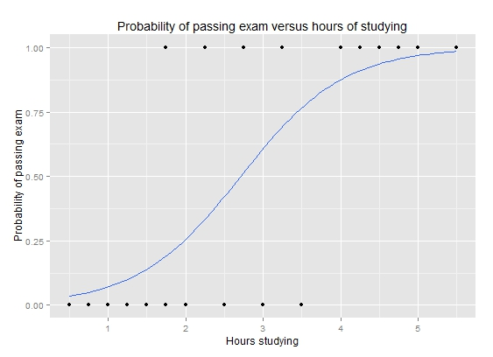
Regression
Linear (simple or multiple)
Logistic regression (also called logit)
Failure time (survival)
Meta-analysis
Nonlinear regression
Feature selection
Sparse regression
https://en.wikipedia.org/wiki/Regression_analysis

Slide 25
Linear regression
Y_{i} = β0 + β₁x₁ + β₂x₂ + …. + ε
Minimize objective function (sum of squares)
Linear refers to the coefficients - the regression could be a function of e.g. square of independent variables

Slide 26
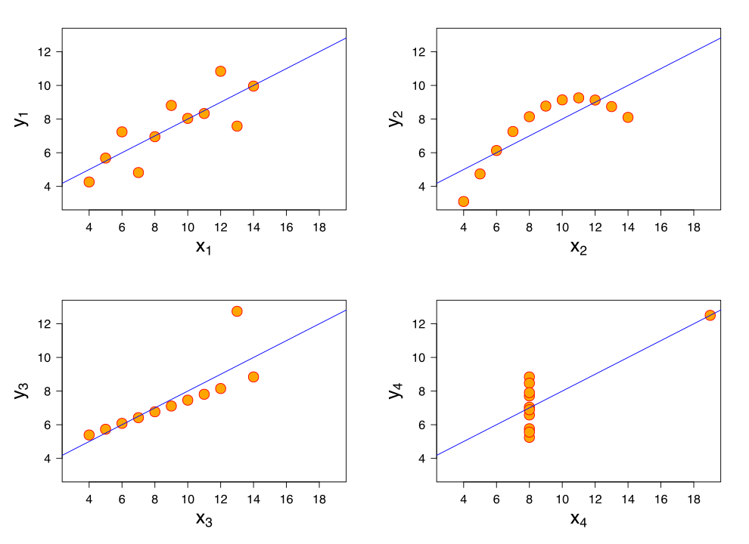
Pitfall of linear regression
Same regression line fit to all of these
(but different goodness of fit – plot of residuals)
Anscombe quartet

Slide 27
Linear modeling in R
lm !
Two vectors x,y
lm(x ~ y)
Two variables in a data frame
lm(var1 ~ var2, data=dataframe)
Residuals = deviation of predicted from observed
Leverage = ability of an observation to move the regression line

Slide 28
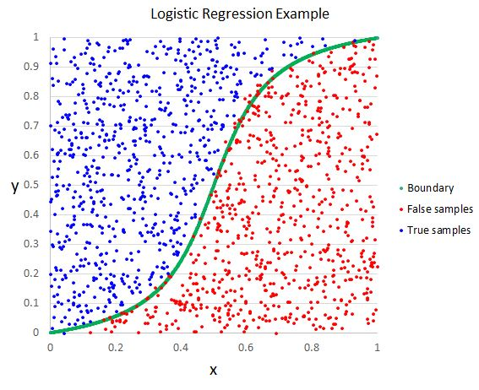
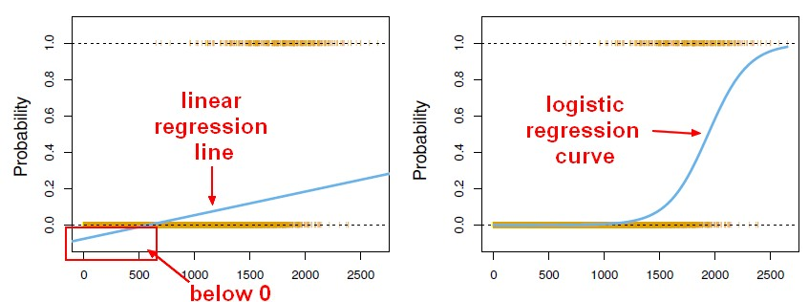
Logistic regression
Continuous independent variables
Discrete dependent variable

Slide 29
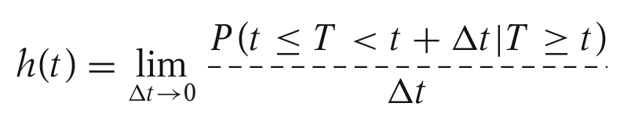
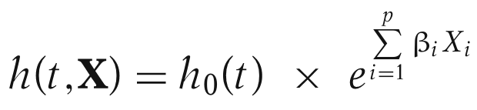
Survival (Cox) regression
Time to event (death, relapse, metastasis…)
Censored – patients drop out of followup
Variable | Patient1 | Patient2 | Patient3 | Patient4 | Patient5 | Patient6 | Patient7 | …
Time | 12 | 3 | 27 | 8 | 35 | 14 | 22 | …
Status | 1 | 1 | 0 | 1 | 0 | 0 | 1 | …
Gene1 | 1.45 | 0.15 | 1.48 | -0.59 | -1.88 | -0.83 | -0.26 | …
Gene2 | 0.94 | -0.35 | 1.23 | 2.66 | -0.23 | 2.09 | -0.13 | …
Gene3 | 0.91 | -0.32 | 0.91 | -0.82 | -0.35 | 0.86 | 0.32 | …
…
X_{i} = expression of gene i at sample collection

Slide 30
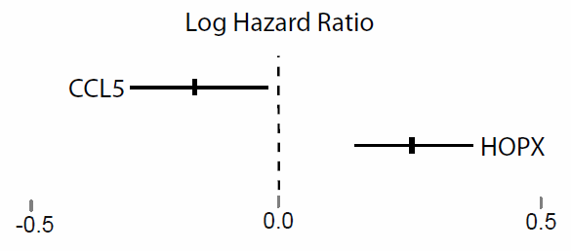
Expression ~ survival
Convenient to use the log-hazard
Z=-2.2
p=0.02
Z=+4.5
p=4e-6

Slide 31
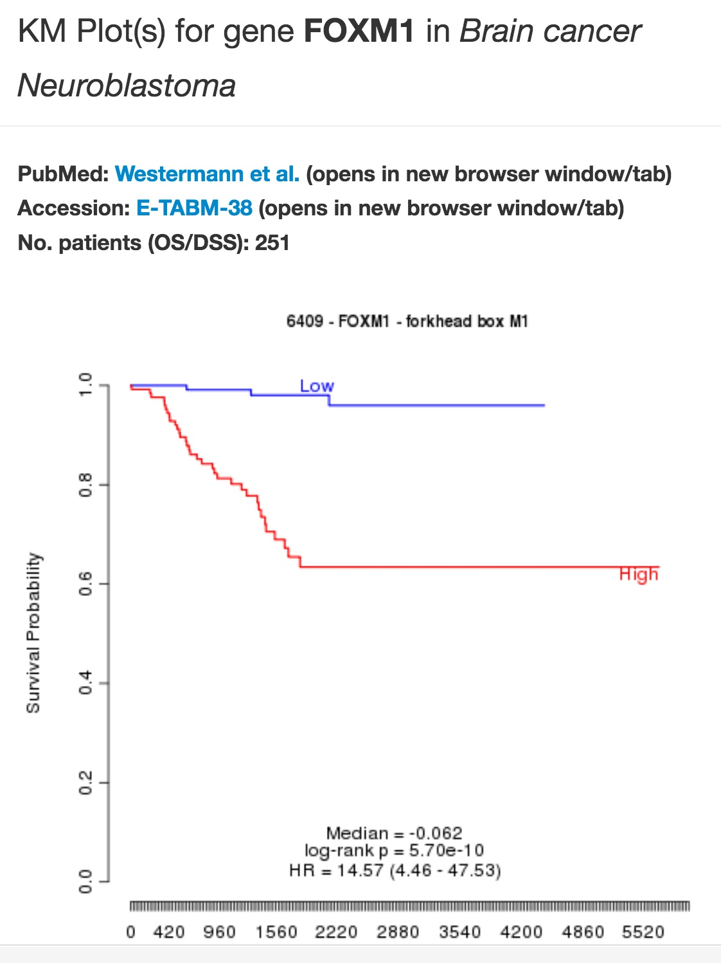
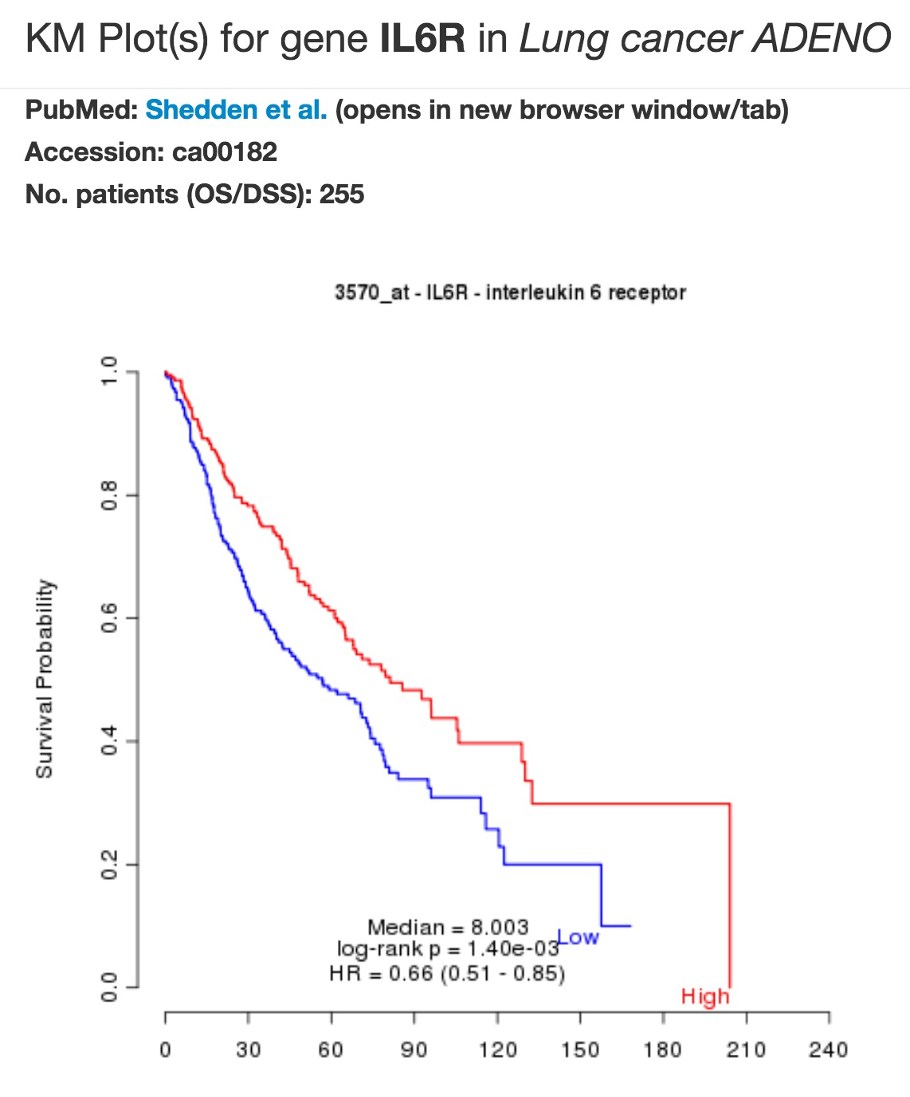
Survival (Cox) regression
Often evaluated with Kaplan-Meier analysis
http://precog.stanford.edu

Slide 32
Feature selection
Situation:
Simple outcome (class, treatment response, survival…0
1000s of potential predictors
Do not want all of them in model:
Overfitting
Uninterpretable
Sparse regression
Find a subset of predictors
Lasso & elastic net are common approaches

Slide 33
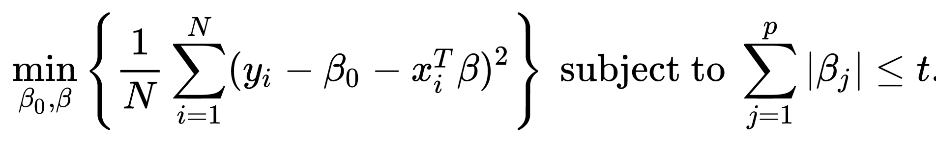
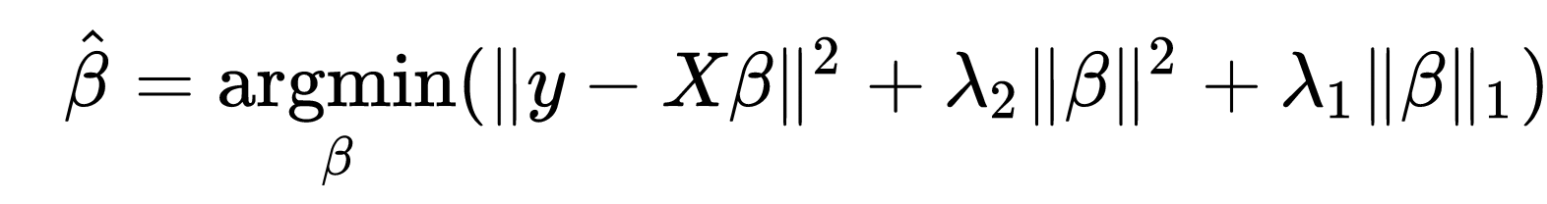
Lasso/elastic net
LASSO (least absolute shrinkage and selection operator)
Idea behind both is that the regression is subject to constraints on coefficients (“budget”)

Slide 34
glmnet
Implements Lasso and elastic net for various models including
Continuous outcome
Logistic
Survival
Surv(Time, Status)
Similar format to samr, lm etc
Uses nfold-internal cross validation to determine the penalization parameters

Slide 35
Internal cross-validation
Want to avoid over-fitting
Split the training data into pieces (e.g. 10)
Learn model on 90% of data and test it on left-out 10%
Repeat, leaving out each 10%
Take parameters which minimize the average error on left-out part
Run cross-validation multiple times
Refit model with selected variables

Slide 36
Thursday exercise
Predict groups (long term vs short term survivors) from cancer data
Estimate survival function
Plot survival curves (Kaplan-Meier)
Please go back and look at some of the genes that came up in Module 1

